Slide 1
Additive Manufacturing. Rolling mills.

Slide 2
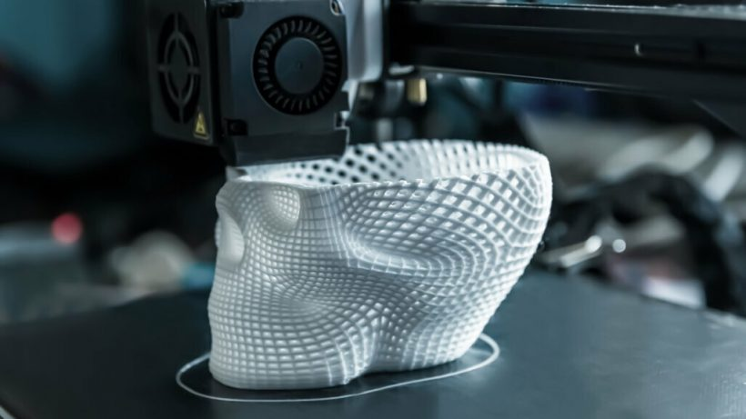

AM Rolling mills.

Slide 3
DOWNLOAD AND INSTALL THE LAMINATOR.
https://ultimaker.com/es/software/ultimaker-cura/

Slide 4

EXERCISE
One piece for exercise.

Slide 5




#LCAMP_EU
info@lcamp.eu
www.lcamp.eu
@LCAMP_EU
LCAMP
Learner Centric Advanced Manufacturing Platform for CoVEs

