Slide 1
Additive Manufacturing. Design fundamentals.

Slide 2
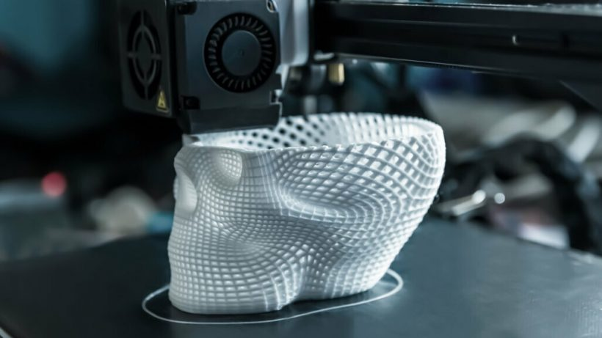

AM Design Fundamentals.

Slide 3
TINKERCAD TUTORIALS
https://www.youtube.com/watch?v=csvBRWfgf1I&authuser=0
https://www.youtube.com/watch?v=GbV8kufjvYA&authuser=0
https://www.youtube.com/watch?v=TuT0fOBQ1Q4&authuser=0
https://www.youtube.com/watch?v=wHm18FoTkvA&authuser=0
https://www.youtube.com/watch?v=1vduAADTmFA&authuser=0
https://www.youtube.com/watch?v=-NrbYUrgtLw&authuser=0

Slide 4
EXERCISE
Design a keychain with Inkscape and Tinkercad.
You can use the RESOURCES folder.

Slide 5




#LCAMP_EU
info@lcamp.eu
www.lcamp.eu
@LCAMP_EU
LCAMP Learner Centric Advanced Manufacturing Platform for CoVEs

