Slide 1
Additive Manufacturing. First exercise.

Slide 2
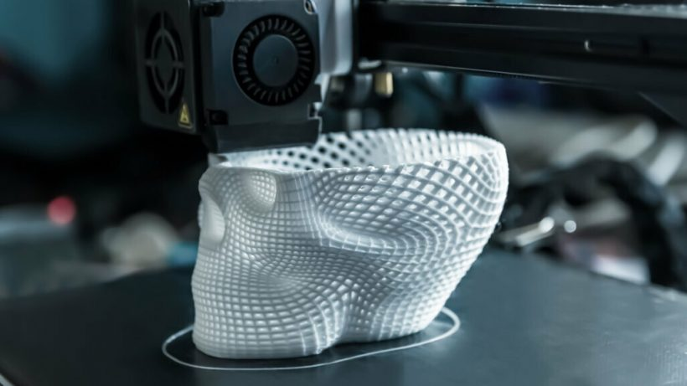

AM First exercise

Slide 3


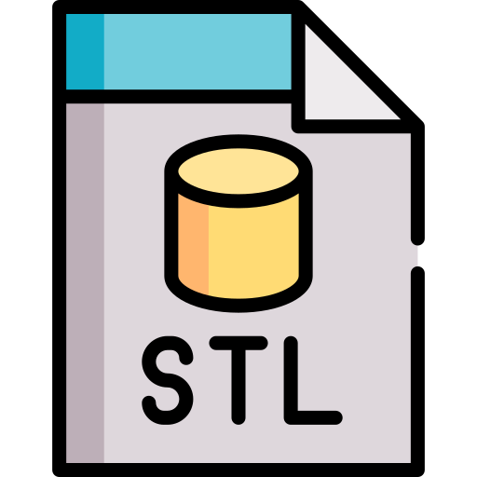

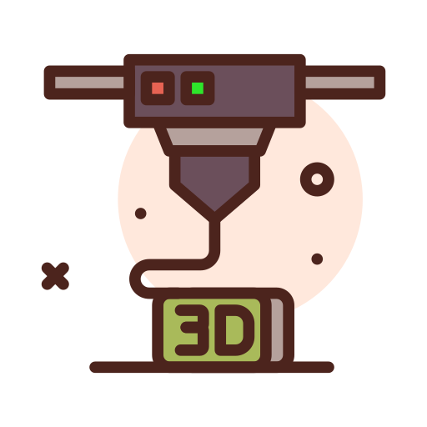
WHAT DO I NEED TO PRINT AN OBJECT?

Slide 4
WHAT FILE DO WE NEED TO PRINT?

Slide 5
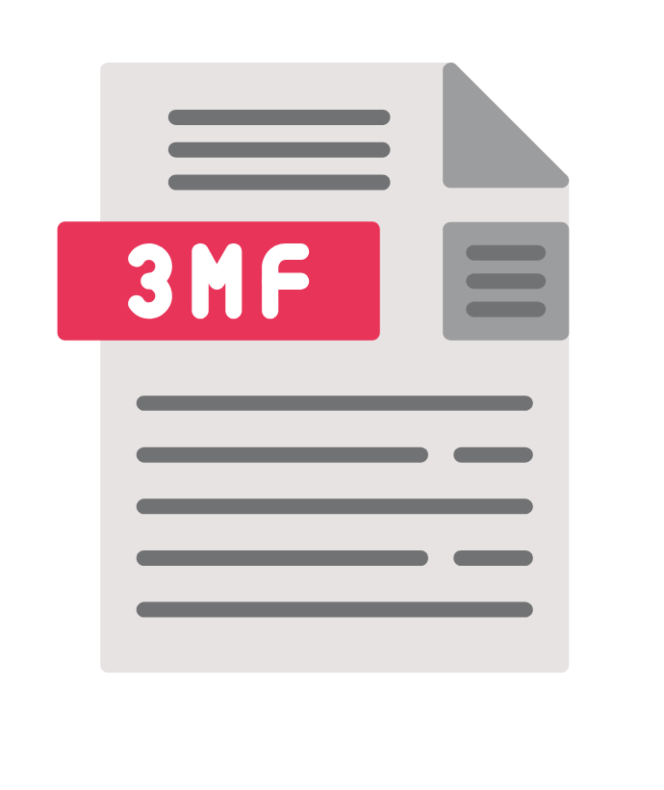
TWO MAIN TYPES OF ARCHIVES

Slide 6
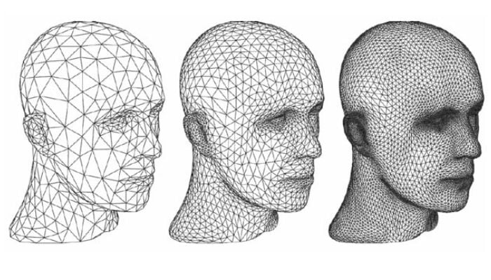
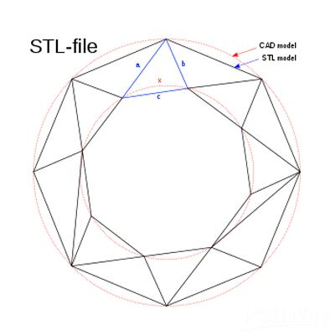
STL - Most used format - 1987
Information in the form of a triangle
Does not provide information on color, material, texture, or units of measurement
It is common for files to be damaged and need to be repaired

Slide 7
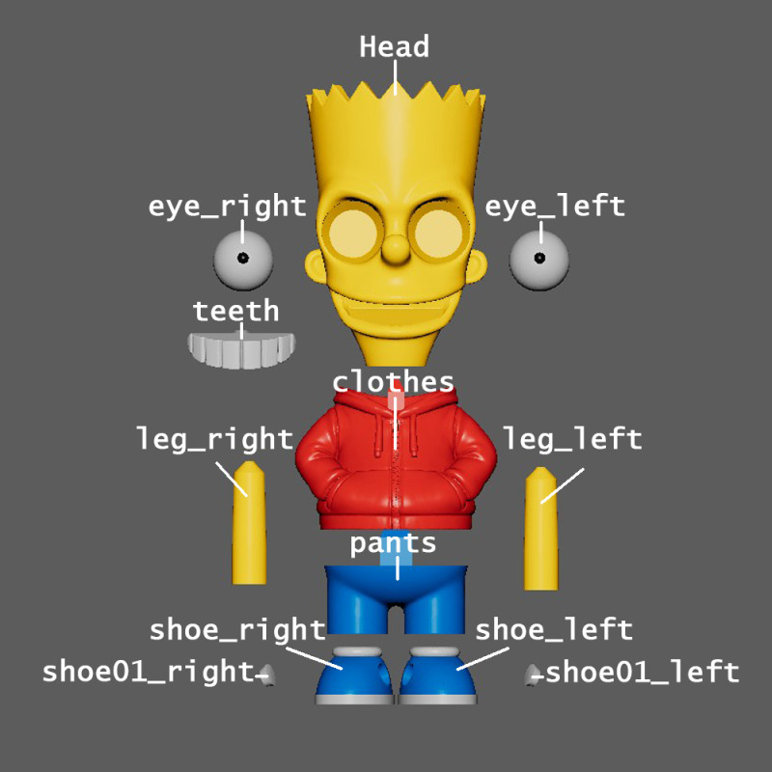
3MF - New format 2015
More optimized model geometry.
Provides information about color, material, texture, or measurement units.
Can contain multiple objects
It is common for files to be corrupted and need to be repaired.

Slide 8
HOW CAN WE GET THE ARCHIVES?

Slide 9

MAKER CULTURE

Slide 10




INTERNET GALLERIES

Slide 11
Find a 3D model by browsing the following links.
1. Thingiverse --> https://www.thingiverse.com/ 2. Printables--> https://www.printables.com/?lang=es 3. Cults --> https://cults3d.com/es 4. Maker World --> https://makerworld.com/es

Slide 12




#LCAMP_EU
info@lcamp.eu
www.lcamp.eu
@LCAMP_EU
LCAMP Learner Centric Advanced Manufacturing Platform for CoVEs

