Slide 1
Additive Manufacturing. General overview.

Slide 2
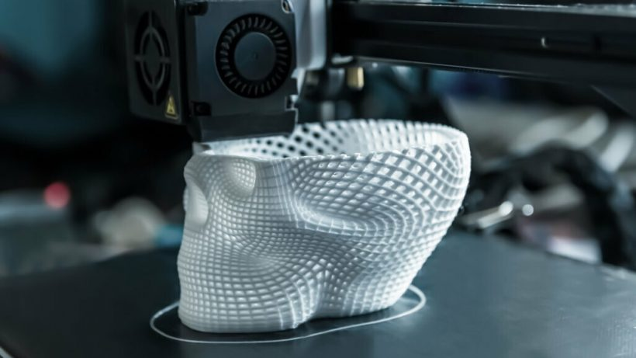
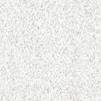
Additive Manufactiring. Overview

Slide 3

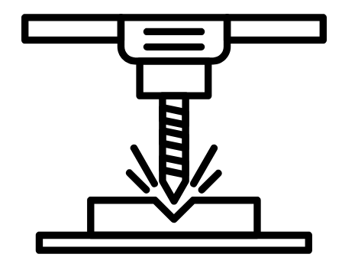
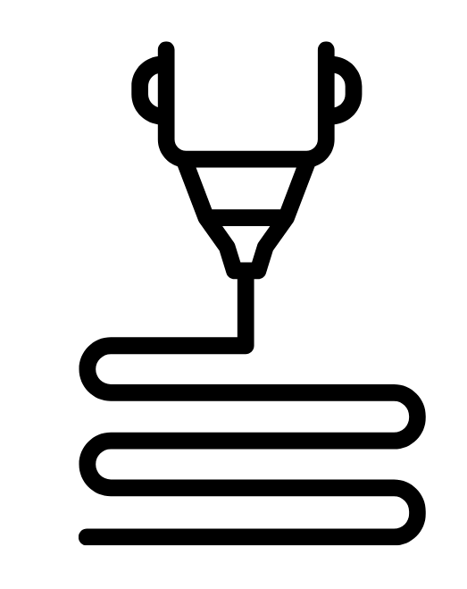
MANUFACTURING METHODS
Formative Manufacturing
Manufacturing Remover
Additive Manufacturing

Slide 4
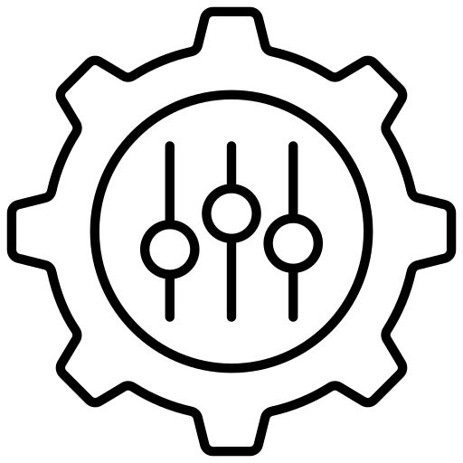

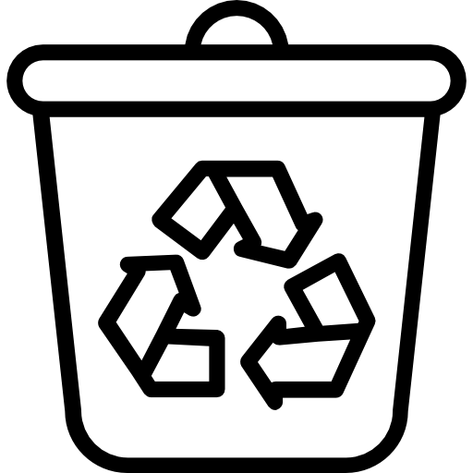
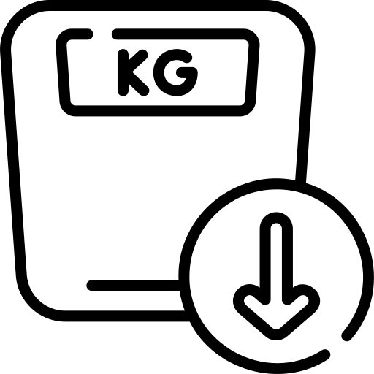
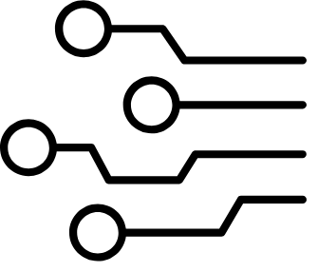
ADVANTAGES OF ADDITIVE MANUFACTURING
Personalization
Design freedom - speed
Waste Reduction
Optimized Parts
Digitization
Notes:
Hemen garrantzitsuena da ahaldundu egiten duela ze behin diseinatuta zuzenean gai gera inprimatzeko ikasketa kurba moztu egin da. PDF-WORD-Inprimir.

Slide 5
ADVANTAGES OF ADDITIVE MANUFACTURING - DIGITALIZATION
Digital storage, reducing logistics costs.
Very fast from design to manufacturing
Possibility of making changes to the manufactured product at the time

Slide 6
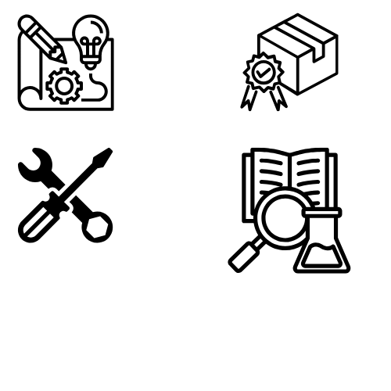
ADDITIVE MANUFACTURING APPLICATIONS
Final product 31.7%
Functional prototyping
24.6%
Education and Research
11.6%
Tools and molds
17%
Notes:
Adibideak eraman.

Slide 7
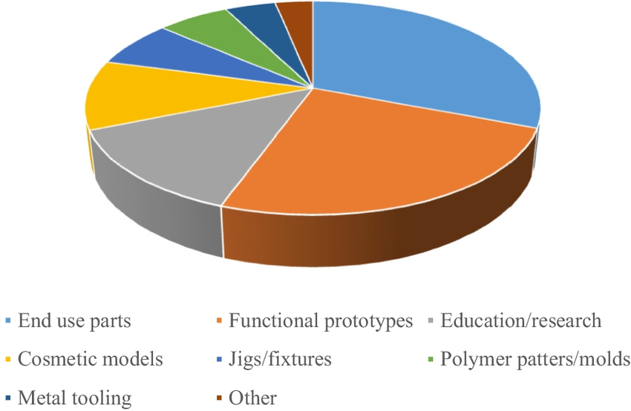
ADDITIVE MANUFACTURING APPLICATIONS 2020
Notes:
Hau da 2020 koa baina 2025koaren oso antzekoa da.

Slide 8


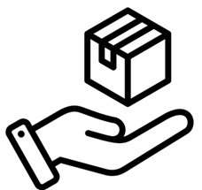
ADDITIVE MANUFACTURING TODAY – MAIN SECTORS
Automobile industry
Aeronautics
Education
Consumer Products
Healthcare

Slide 9
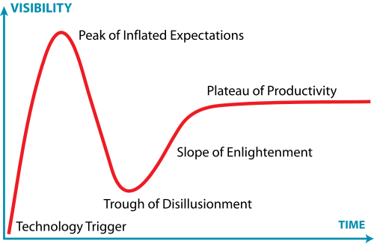
Additive Manufacturing Today – Hype cycle
Notes:
Teknologia eztanda, Neurriz gaineko itxaropen gailurra, Desilusioaren sakonunea, Argitzearen malda, Produktibitatearen goi-ordokia

Slide 10
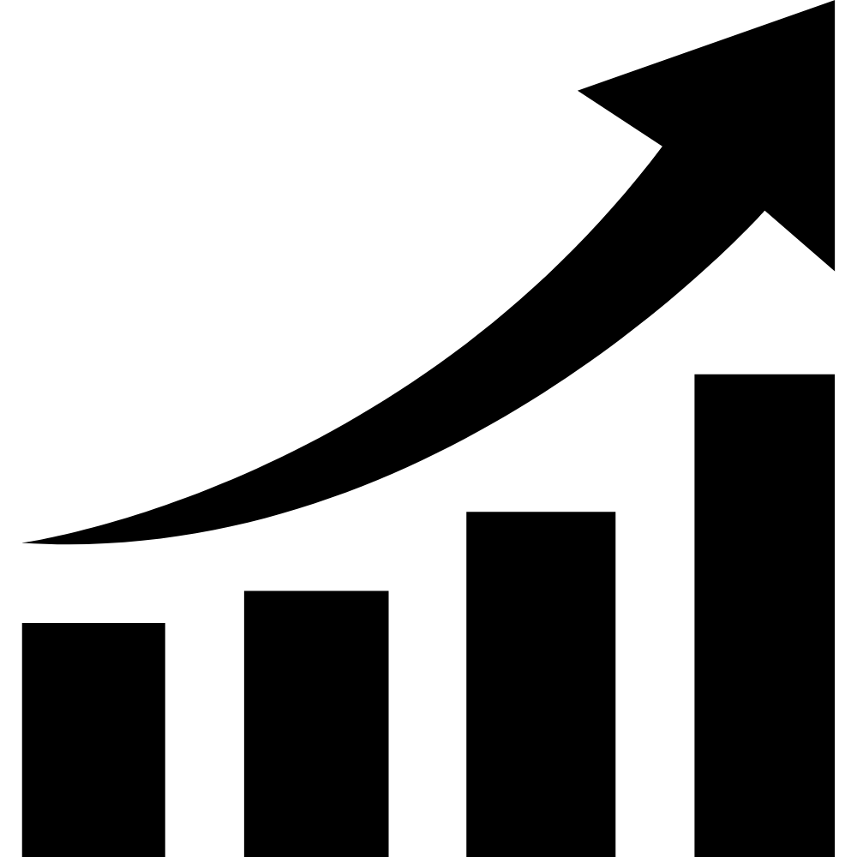
Additive Manufacturing Today – Growth
The industry has been experiencing significant growth since its launch.
Generalized double-digit growth in recent years.
It is entering a stabilization process from the initial boom.

Slide 11
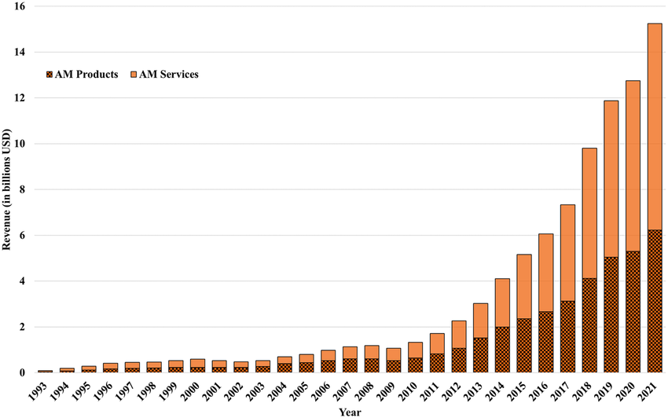
Additive Manufacturing Today – Growth
5% increase in products
A significant 11% drop in global growth compared to recent years.

Slide 12
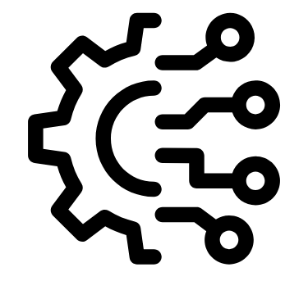
Additive Manufacturing Technologies
Notes:
MJF (Multi Jet Fusion)

Slide 13
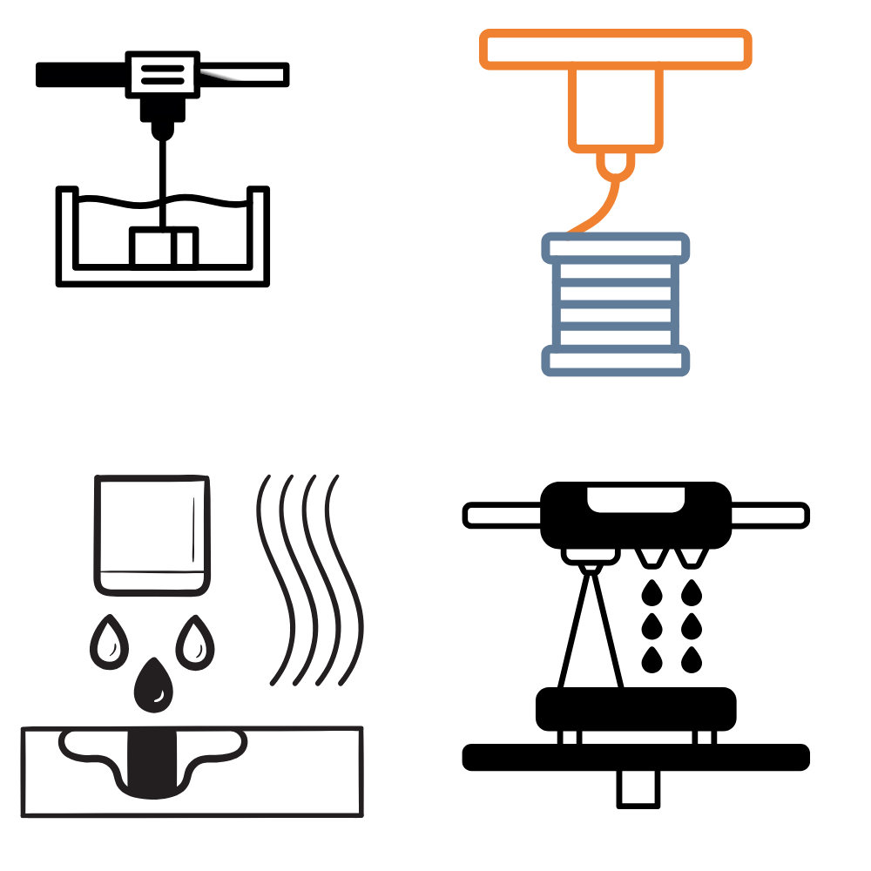
Additive Manufacturing Technologies
FDM (Fused Deposition Modeling)
The semi-liquid material is fed through an extruder.
Wide range of materials, mostly thermoplastic bases.
It is the most accessible both in terms of cost and development.
In most cases, supports will be required.

Slide 14
Additive Manufacturing Technologies
SLA (Stereo Litography Apparatus)
A resin is selectively hardened by light.
Wide range of photopolymerizable materials.
High level of accuracy and accessibility are improving.
In most cases, supports will be required.

Slide 15
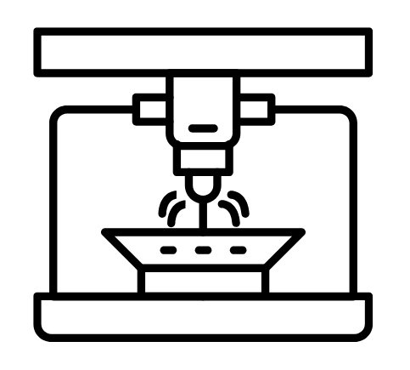
Additive Manufacturing Technologies
MJF (Multi Jet Fusion) –
SLS (Selective Laser Sintering)
It selectively fuses plastic powder.
Only certain thermoplastics.
High level of precision and good mechanical properties.
No support is needed.

Slide 16
Additive Manufacturing Technologies
MJ (Material Jetting)
The object material is added dropwise and hardens.
Wide range of photopolymerizable materials.
By mixing the drops as desired, we can achieve realistic finishes.
In most cases, supports will be required.
Notes:
MJF (Multi Jet Fusion)

Slide 17
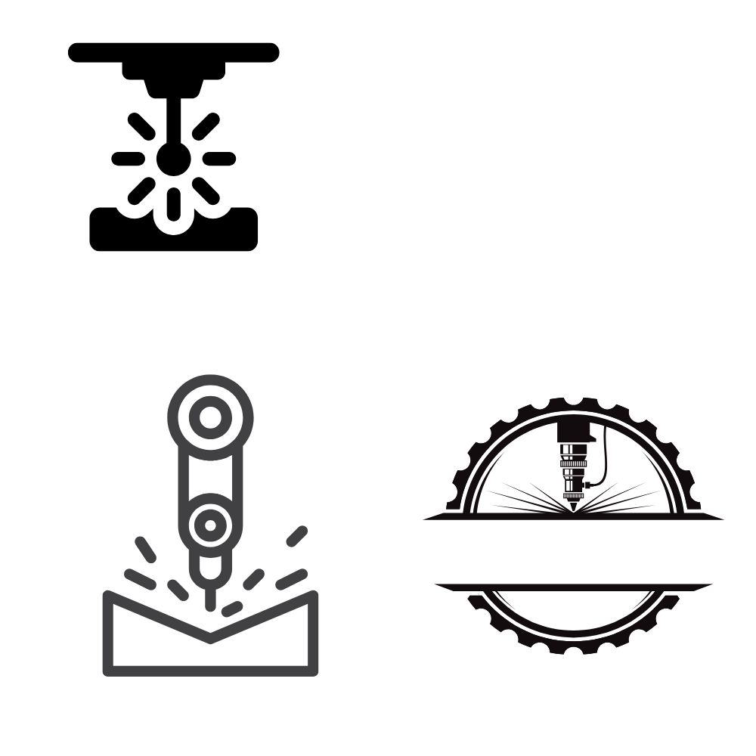
Additive Manufacturing Technologies
SLM (Selective Laser Melting)
The metal powder is selectively melted by a laser.
Wide choice of materials.
Complex geometries, new design options, high precision.
Post processing will be required.
Notes:
MJF (Multi Jet Fusion)

Slide 18
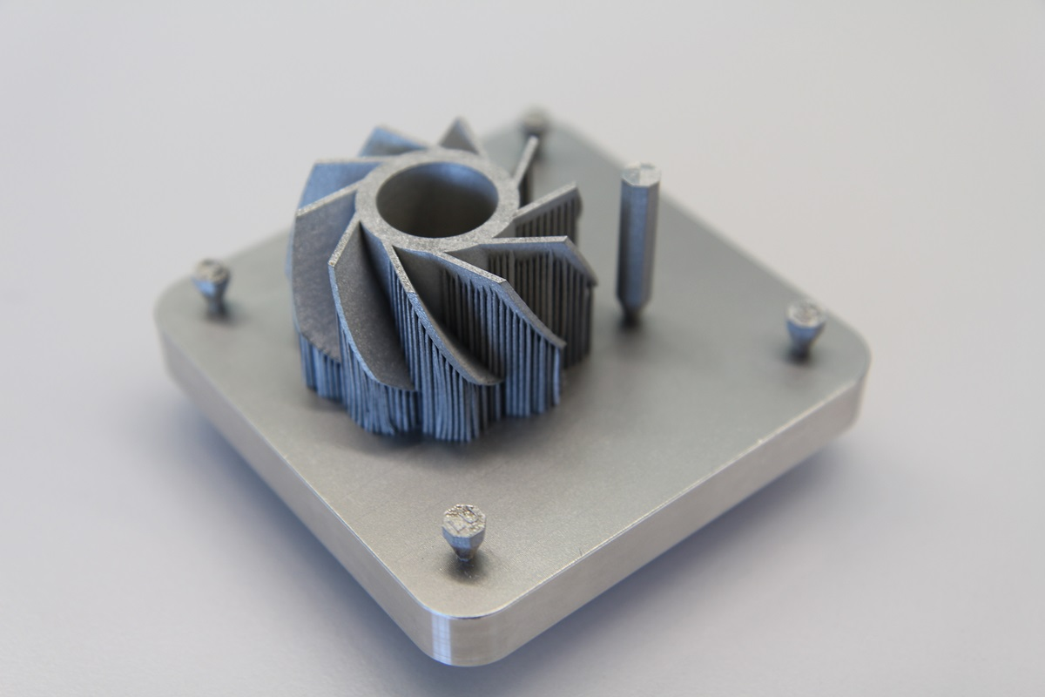
Additive Manufacturing Technologies
Notes:
MJF (Multi Jet Fusion)

Slide 19
Additive Manufacturing Technologies
DED (Direct Energy Deposition)
Energy and Material contribution are provided at the same place and time.
Any metal that can be welded.
Possibility of making medium and large parts and geometries, high contribution rates.
Post processing will be required.
Notes:
MJF (Multi Jet Fusion)

Slide 20
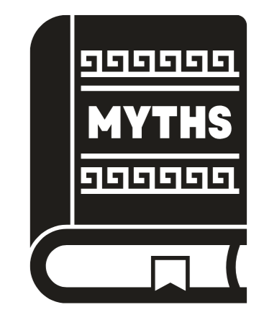
Additive Manufacturing Myths
Notes:
MJF (Multi Jet Fusion)

Slide 21
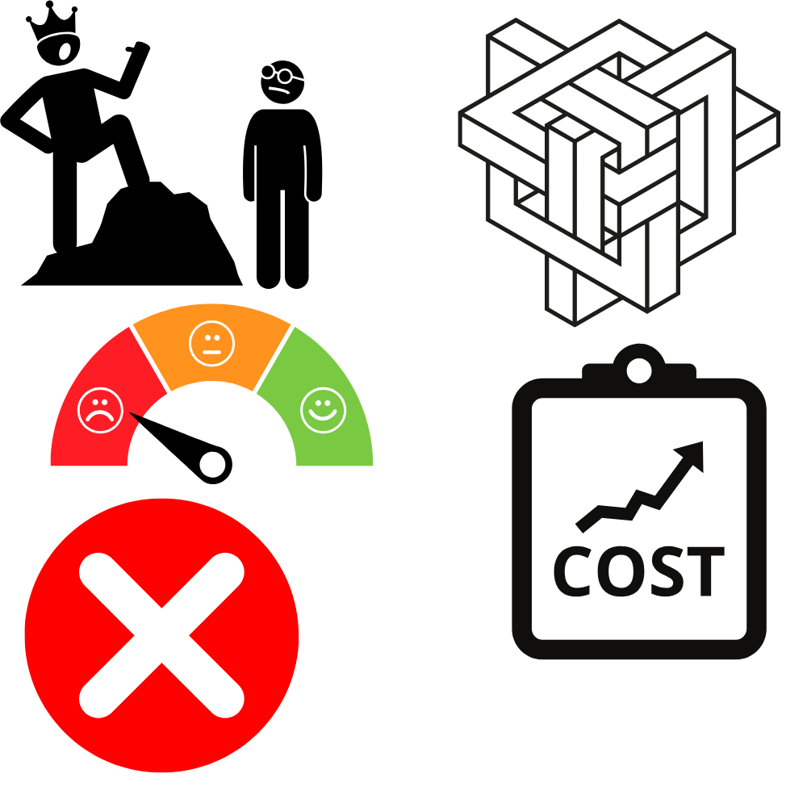
Additive Manufacturing Myths
“Additive Manufacturing will replace conventional methods”

Slide 22

Additive Manufacturing Myths
“Additive Manufacturing will replace conventional methods”
Different technologies can be integrated.
They can also be used indirectly.
In some cases, other methods are more appropriate.

Slide 23
Additive Manufacturing Myths
“Any geometry can be printed”

Slide 24
Additive Manufacturing Myths
“Any geometry can be printed”
Each type of technology has its own limitations.
Generally, we will need to use supports.

Slide 25
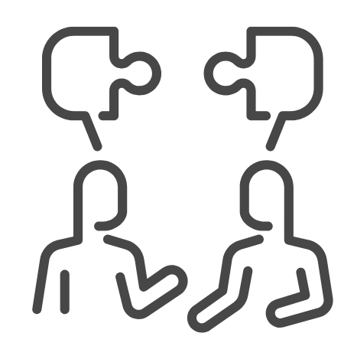
Additive Manufacturing Myths
“Additive manufacturing technologies are very similar and there are few materials available”

Slide 26
Additive Manufacturing Myths
“Additive manufacturing technologies are very similar and there are few materials available”
There are very different technologies with different characteristics.
We have a wide range of materials depending on the technology.

Slide 27
Additive Manufacturing Myths
“It has worse quality.”

Slide 28
Additive Manufacturing Myths
“It has worse quality.”
As with other methods, we will have different characteristics, finishes and tolerances, depending on the machine and technology.

Slide 29
Additive Manufacturing Myths
“Additive manufacturing is more expensive”

Slide 30
Additive Manufacturing Myths
“Additive manufacturing is more expensive”
In low-run manufacturing and highly complex parts, it may be more economically appropriate.

Slide 31


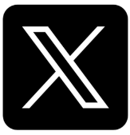

#LCAMP_EU
info@lcamp.eu
www.lcamp.eu
@LCAMP_EU
LCAMP Learner Centric Advanced Manufacturing Platform for CoVEs

