Slide 1
Additive manufacturing. Introduction

Slide 2
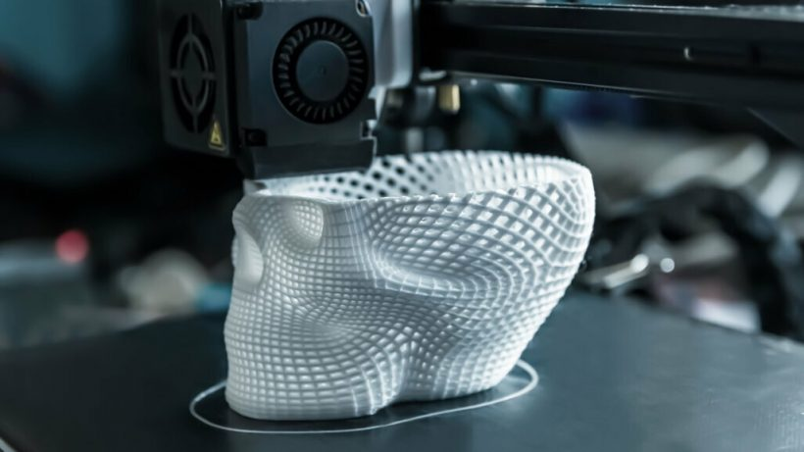

Introduction

Slide 3


Slide 4
WHAT DO I NEED TO PRINT A BOOK?

Slide 5




WHAT DO I NEED TO PRINT A BOOK?

Slide 6

WHAT DO I NEED TO PRINT A BOOK?

Slide 7
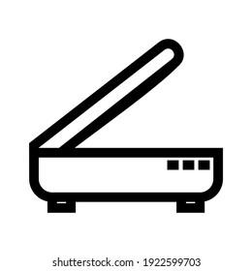

WHAT DO I NEED TO PRINT A BOOK?

Slide 8
SO, WHAT DO I NEED TO PRINT AN OBJECT?

Slide 9


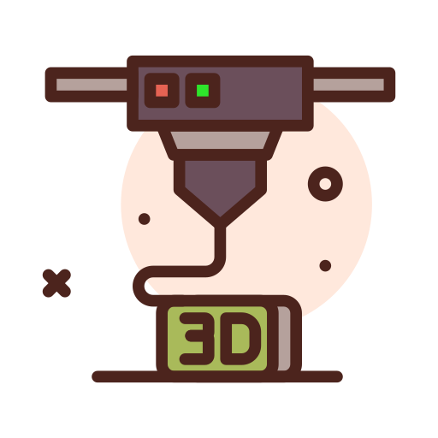
WHAT DO I NEED TO PRINT AN OBJECT?

Slide 10
WHAT DO I NEED TO PRINT AN OBJECT?

Slide 11


WHAT DO I NEED TO PRINT AN OBJECT?

Slide 12
WHAT HAS ADDITIVE MANUFACTURING HELPED WITH?

Slide 13
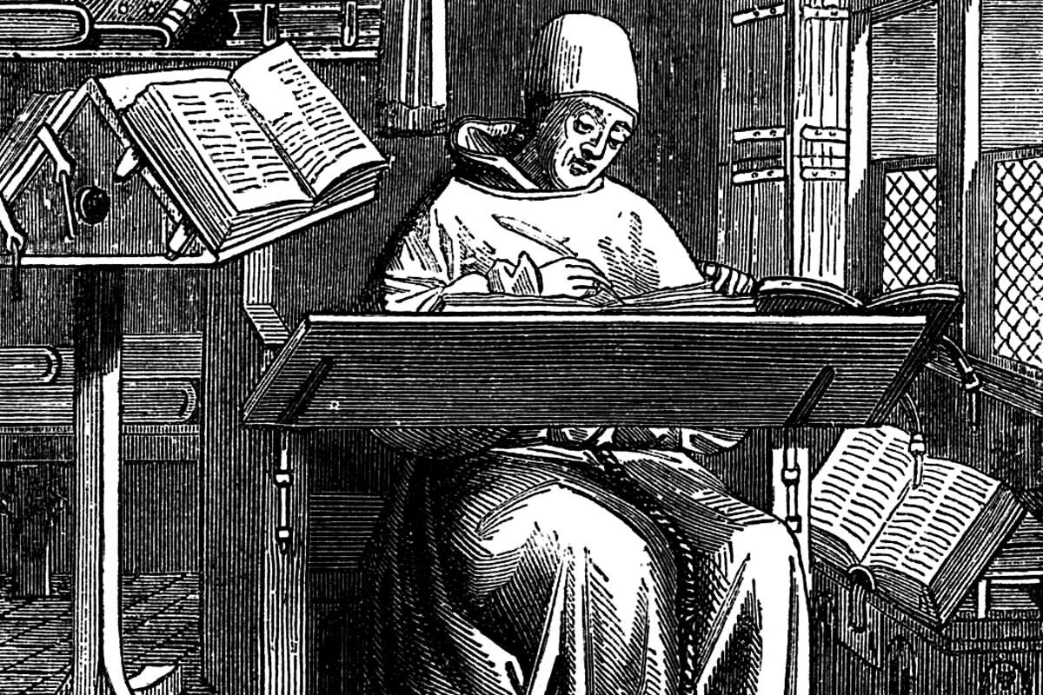
There was a time when writing required a lot of work...

Slide 14
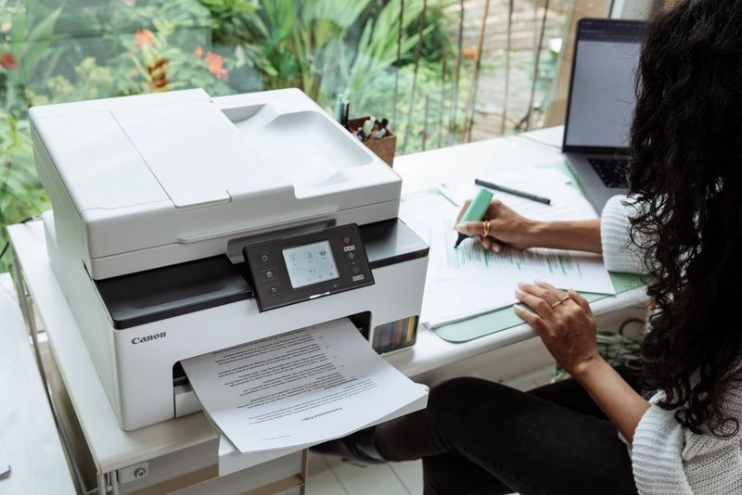
Nowadays we can copy or create writings very easily.

Slide 15
PRINTERS HAVE HELPED WITH THIS PART

Slide 16
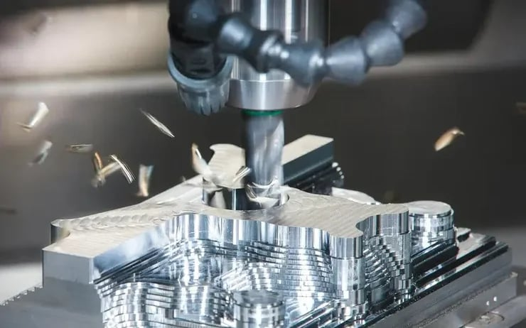

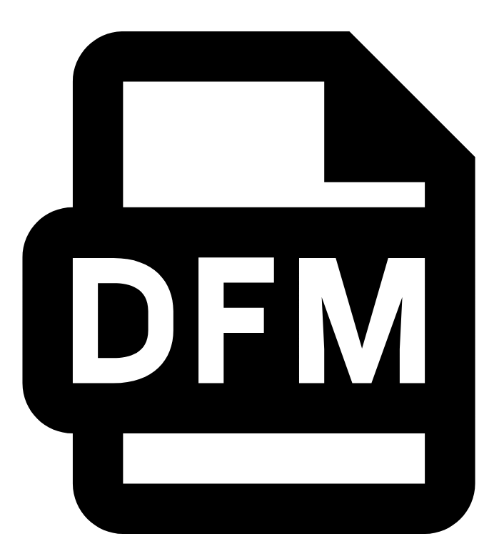

WHAT IS NEEDED TO CREATE AN OBJECT?
Notes:
Ideia bat izan, Cad bat osatu, Design for manufacturing, planificacion de la produccion, evaluación de costes, acuerdos con suministradores, puesta en marcha

Slide 17
WHAT IS NEEDED TO CREATE AN OBJECT?

Slide 18
WHAT ARE WE GOING TO TRY TO DO?

Slide 19
WHAT WILL WE DO?
Day 1:
Introduction to Additive Manufacturing
Used Formats
Open Galleries
Day 2:
Basic Design
Incscape
Tinkercad
Day 3:
Lamination Software
Classification

Slide 20




#LCAMP_EU
info@lcamp.eu
www.lcamp.eu
@LCAMP_EU
LCAMP Learner Centric Advanced Manufacturing Platform for CoVEs

