Slide 1
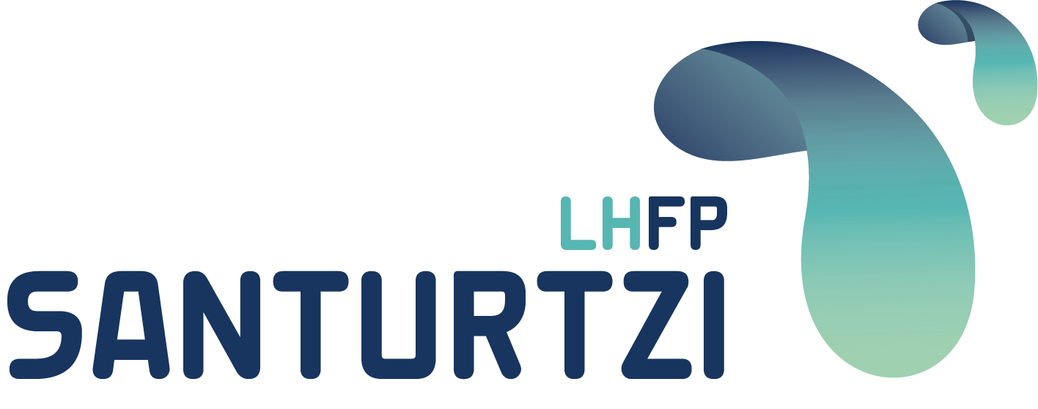
UD1: BASIC KNOWLEDGE OF 3D PRINTING

Slide 2
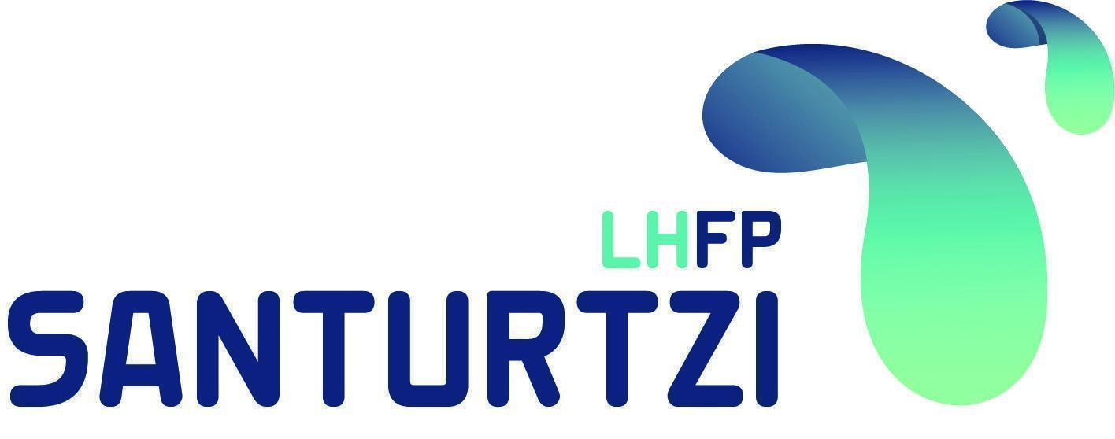
UD1: BASIC KNOWLEDGE
SUMMARY OF CONTENTS
1.1 WHAT IS ADDITIVE MANUFACTURING?
1.2 TECHNOLOGIES
1.3 PROCESS

Slide 3
UD1: BASIC KNOWLEDGE
1.1 WHAT IS ADDITIVE MANUFACTURING?
Additive manufacturing, better known as 3D printing, is a production process that allows physical objects to be created from a digital design.
Although there are different technologies and materials, they all follow the same principle: transforming a digital model into a three-dimensional object by adding material layer by layer.
Additive manufacturing is a set of manufacturing methods, each with its own characteristics. However, they all share three fundamental aspects:
They are based on the addition of material to build objects, superimposing layers of material successively and using a digital 3D model as a reference for manufacturing.

Slide 4




UD1: BASIC KNOWLEDGE
1.1 WHAT IS ADDITIVE MANUFACTURING?
It is a production process.
It allows physical objects to be created from a digital design
It is called Additive Manufacturing to differentiate it from traditional methods such as machining or molding.
It is based on the addition of material to build 3D objects.

Slide 5
UD1: BASIC KNOWLEDGE
1.2 TECHNOLOGIES
There are various 3D printing technologies, each with unique characteristics that make them more suitable for different applications.
These technologies vary according to:
  The material used.
  Printing accuracy.
  The size of the parts to be printed.
  Printing speed.

Slide 6
UD1: BASIC KNOWLEDGE
1.2 TECHNOLOGIES
FDM/FFF
Fused deposition modeling
SLS
Selective Laser Sintering
SLA
Stereolithography
SLM
Selective Laser Melting
DLP
Digital Light Processing
MATERIAL JETTING
Polyjet,Multijet

Slide 7
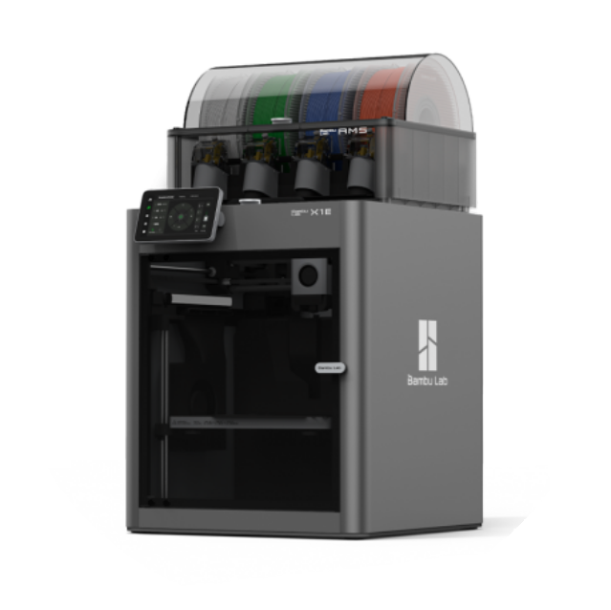
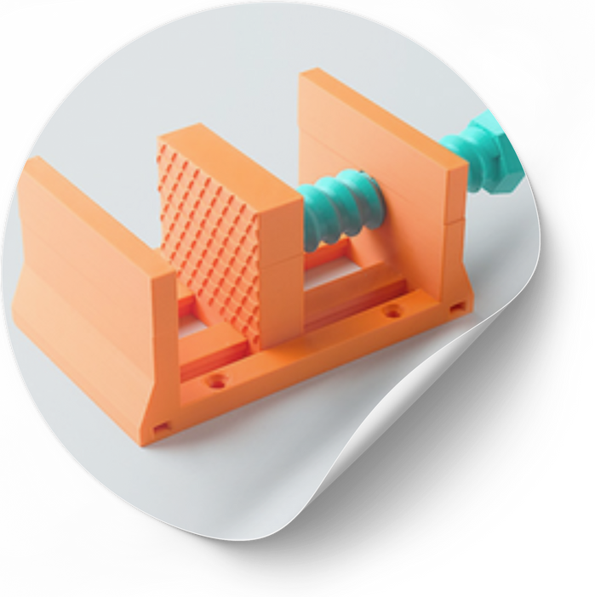
UD1: BASIC KNOWLEDGE
1.2 TECHNOLOGIES
FDF-FUSED DEPOSITION MODELING
How it works: Deposits thermoplastic material in layers from a filament.
Materials: PLA, ABS, PETG, TPU, among others.
Advantages: Economical, easy to use, versatile.
Disadvantages: Lower precision and surface finish compared to other technologies.
Applications: Rapid prototyping, education and hobbies, industrial and architectural parts.
.

Slide 8
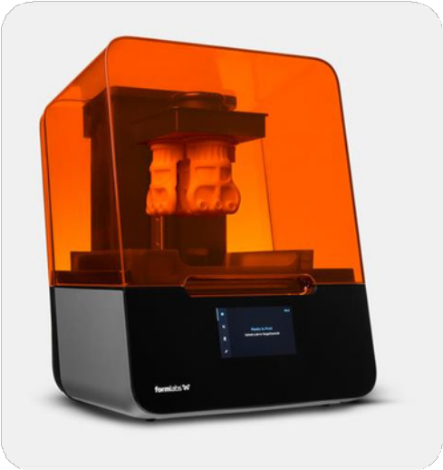
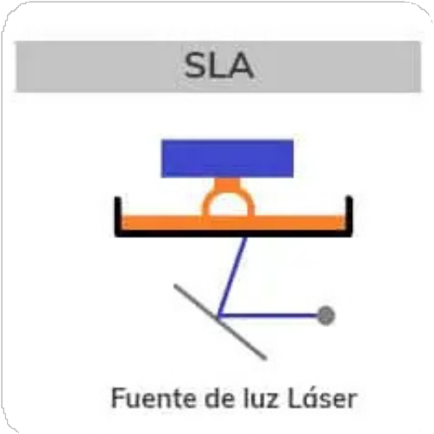
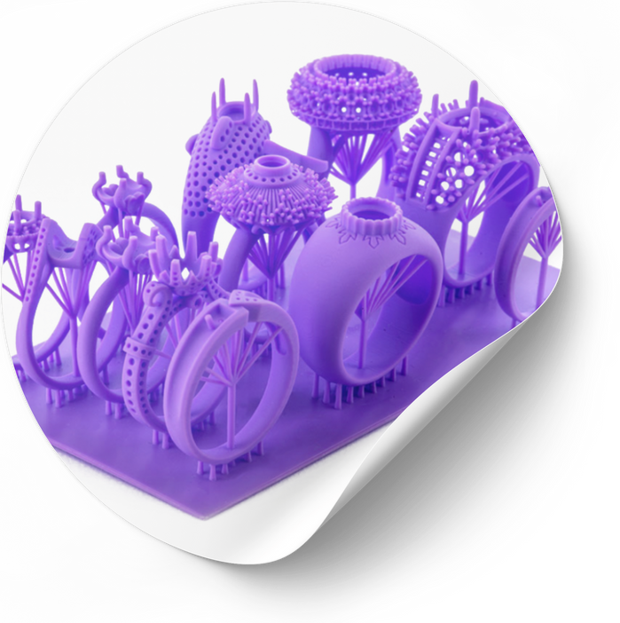
UD1: BASIC KNOWLEDGE
1.2 TECHNOLOGIES
SLA-STEREOLITHOGRAPHY
How it works: Uses a UV laser to solidify liquid photosensitive resin in layers.
Materials: Photosensitive resins.
Advantages: High precision, excellent surface finish.
Disadvantages: More expensive, fragile, and requires post-processing (washing and curing).
Applications: Parts with a high level of detail and geometric complexity.

Slide 9
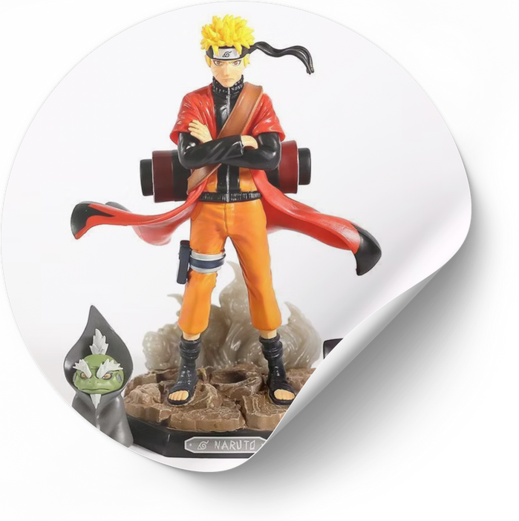
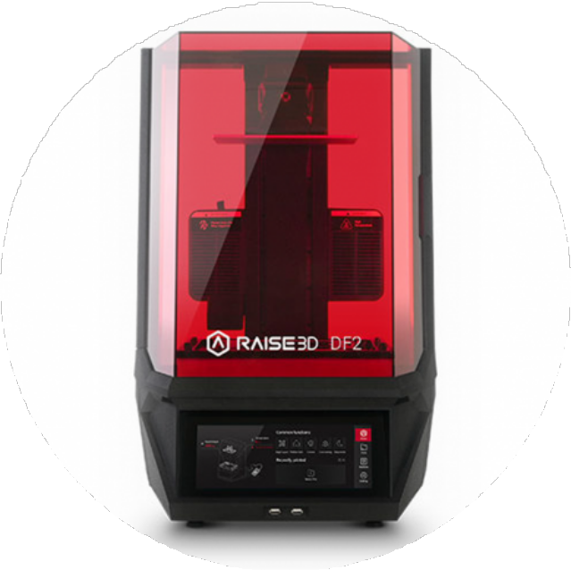
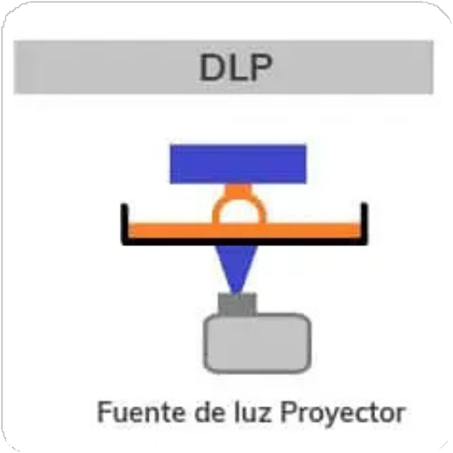
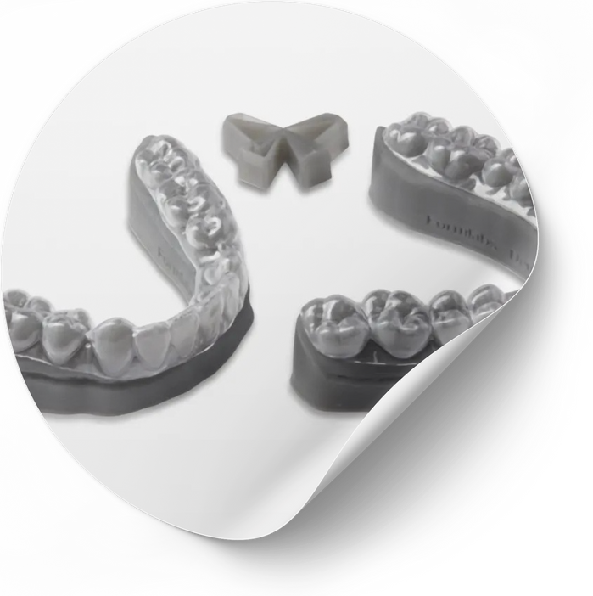
UD1: BASIC KNOWLEDGE
1.2 TECHNOLOGIES
DLP-DIGITAL LIGHT PROCESSING
How it works: Uses a digital light processor (DLP) to solidify liquid photosensitive resin layer by layer.
Materials: Photosensitive resins.
Advantages: High printing speed, good precision, and fine details.
Disadvantages: May exhibit some pixelation in the layers, requires post-processing (washing and curing).
Applications: Jewelry and dentistry. Model making and miniatures. Detailed prototypes.
.

Slide 10
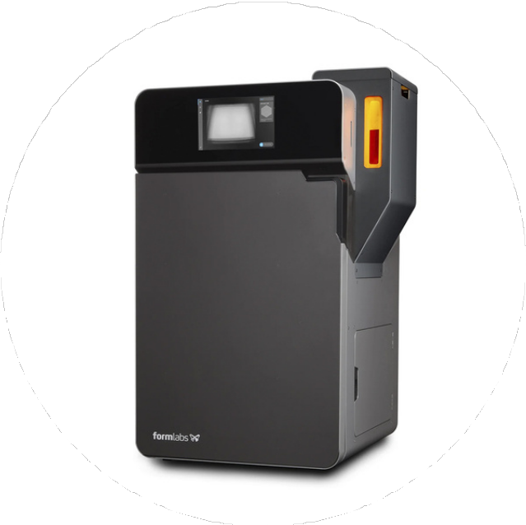
UD1: BASIC KNOWLEDGE
1.2 TECHNOLOGIES
SLS-SELECTIVE LASER SINTERING
How it works: A laser sinteresizes powdered material in successive layers.
Materials: Nylon, TPU, metal and ceramic powders.
Advantages: No supports required, strong and functional parts, complex geometries.
Disadvantages: High cost and more complex equipment.
Applications: Automotive and aerospace industries. Footwear and fashion. Functional mechanical parts.

Slide 11
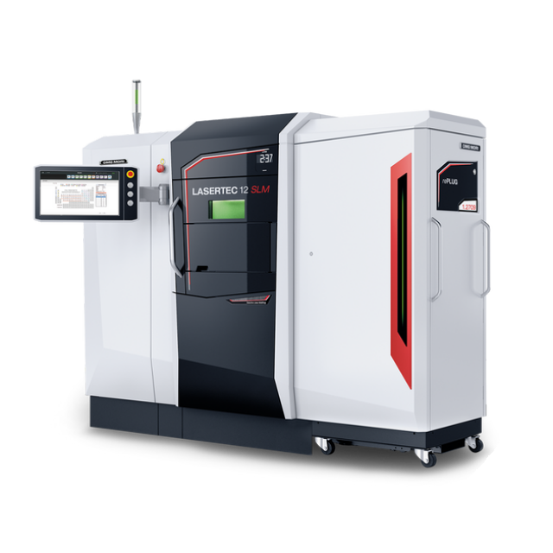
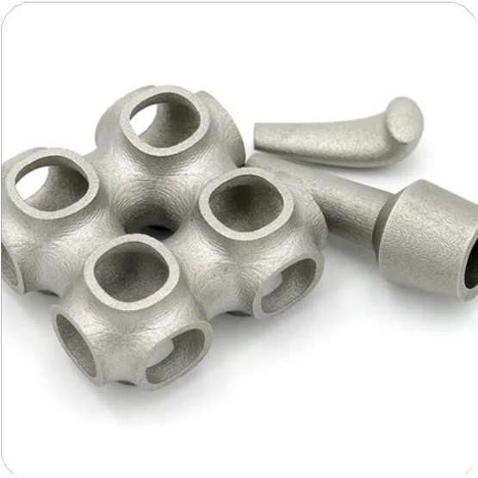
UD1: BASIC KNOWLEDGE
1.2 TECHNOLOGIES
SLM-SELECTIVE LASER MELTING
How it works: A laser melts metal powder layer by layer to create three-dimensional parts.
Materials: Metal powders such as stainless steel, titanium, aluminum, among others.
Advantages: Production of dense and resistant parts, optimized structures, no assembly required, capacity for complex and customized surface designs.
Disadvantages: High cost of equipment and materials, relatively long production time.
Applications: Aerospace and medical industries. Customized implants. High-precision tools.
.

Slide 12
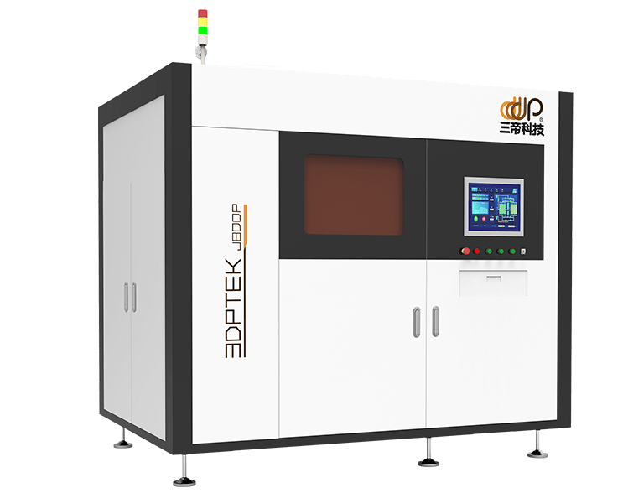
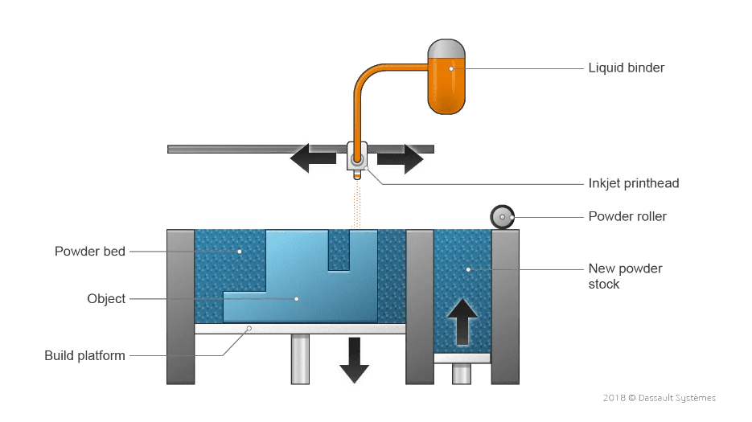
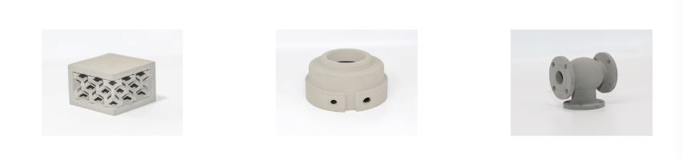
UD1: BASIC KNOWLEDGE
1.2 TECHNOLOGIES
BINDER JETTING
How it works: It uses a binding agent to join powder particles layer by layer, instead of using heat or lasers.
Materials: It is compatible with a wide variety of materials, including metals, ceramics, and sand.
Advantages: Its main advantage is the ability to print large parts with high precision and a variety of materials.
Disadvantages: requires post-processing, inferior mechanical properties
Applications: Color architectural models. Sand casting molds. Art and decoration.

Slide 13
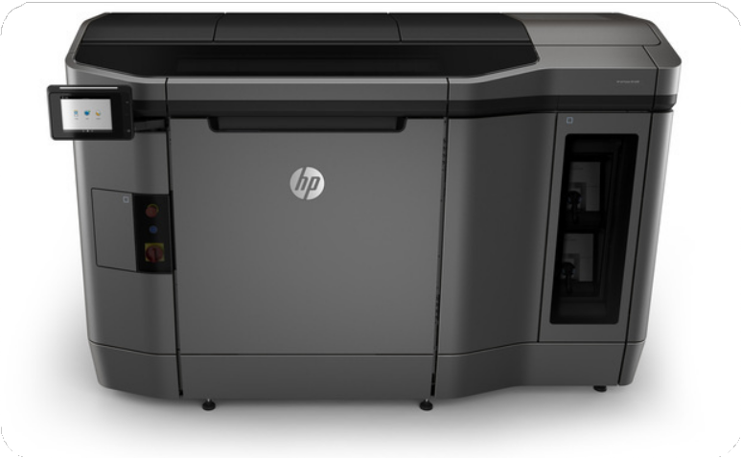
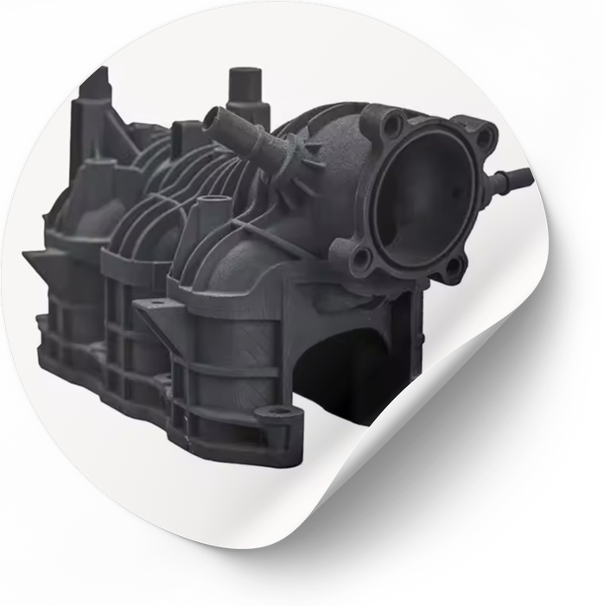
UD1: BASIC KNOWLEDGE
1.2 TECHNOLOGIES
MATERIAL JETTING
How it works: Uses a UV laser to solidify liquid photosensitive resin in layers.
Materials: Photosensitive resins.
Advantages: High precision, excellent surface finish.
Disadvantages: More expensive and requires post-processing (washing and curing).
Applications: Functional mechanical parts. Anatomical models. Industrial design.

Slide 14
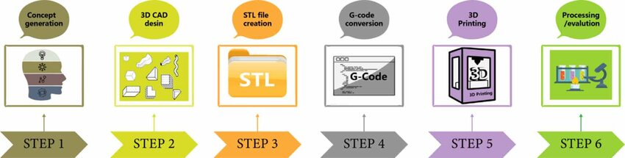
UD1: BASIC KNOWLEDGE
1.3 3D PRINTING PROCESS

Slide 15
:
THANK YOU!!
www.fpsanturtzilh.eus
Mikel Iturraspe Eguia
miturraspee@fpsanturtzilh.eus
Notes:
The alliance will establish an Open Innovation Community to promote applied research and development projects, mainly between Centres of Vocational Excellence and Small and Medium Enterprises. To achieve this cooperation, the role of Vocational Education and Training in Advanced Manufacturing Research and Development activities and its contribution to Regional Smart Specialisation Strategies will be clarified.

