Slide 1

UD4: FDM PRINTING ELEMENTS.

Slide 2
UD4: FDM PRINTING ELEMENTS
SUMMARY OF CONTENTS
4.1 STL FORMAT
4.2 SLICERS
4.3 PRINTING PROJECTS
4.4 PRINTING PARAMETERS
4.5 PARAMETERS COMPARISON TABLE

Slide 3
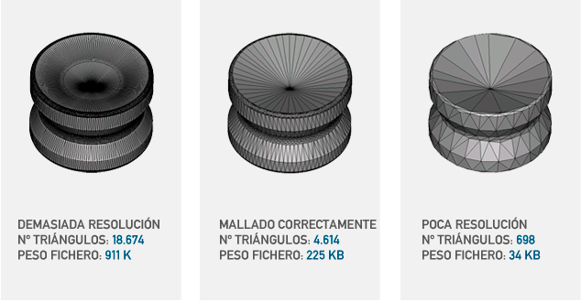

UD4: FDM PRINTING ELEMENTS
4.1 STL FORMAT
The STL format is the most common standard for 3D printing files. It represents the object's geometry using a mesh of triangles, without color, texture, or physical property information.
Main features:
Simplicity: Contains only information about the model surface.
Accuracy: Depends on the number of triangles in the mesh.
File size: The larger the STL file, the greater the number of triangles that will make up the surface of the model.
Fans
They are used to cool the hotend and the printed part, improving the quality of the layers and preventing overheating.

Slide 4
UD4: FDM PRINTING ELEMENTS
4.2 SLICERS
A slicer works by analyzing the 3D model and "slicing" it into horizontal layers. For each of these layers, the program generates detailed instructions that indicate:
Nozzle Path: The slicer calculates the precise path the extruder nozzle must follow to draw each layer of the model, defining outer and inner contours and fill patterns.
Travel speed: Determines the speed at which the nozzle will move, differentiating between printing movements (when it extrudes material) and empty movements (when it moves without extruding).
Material Extrusion: Defines the exact amount of filament to be extruded in each section, adjusting to the printing speed and layer thickness.
Print Temperature: Sets the optimal extruder temperature based on the material used, as well as the temperature of the bed and hot chamber to ensure proper adhesion of the first layer.
Fans
They are used to cool the hotend and the printed part, improving the quality of the layers and preventing overheating.

Slide 5
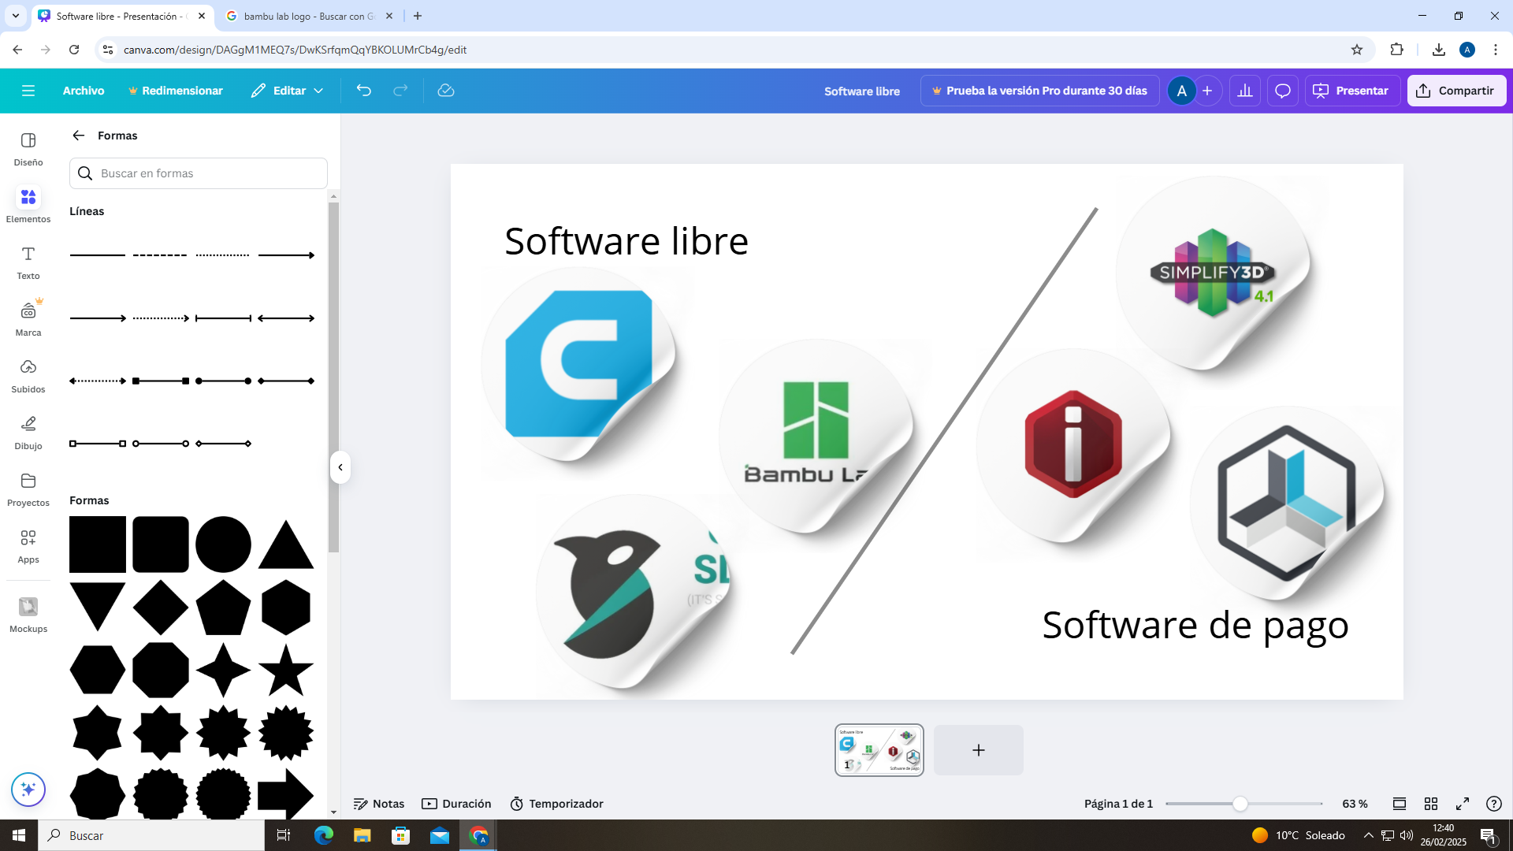
UD4: FDM PRINTING ELEMENTS
4.2 SLICERS
There are different slicer options, both free and paid:
Free software: A free slicer is software available at no cost. These programs are typically compatible with a wide variety of printers and materials.
Examples: Cura, Orca, BambuLab, PrusaSlicer, SuperSlicer…
Paid software: These often include more precise customization options, improved printing efficiency, and optimization of final part quality.
Examples: Simplify3D, IdeaMaker Pro, Repetier-Host Pro…
Fans
They are used to cool the hotend and the printed part, improving the quality of the layers and preventing overheating.

Slide 6
UD4: FDM PRINTING ELEMENTS
4.3 PRINTING PROJECT
Before printing, it is essential to create a project within the slicer that includes the basic data of the additive manufacturing environment.
The project brings together information from:
STL File
Printer parameters: Nozzle diameter, bed type....
Slicer printing parameters
Type of material
Printer Profile: This is a file that informs the Slicer about the printer's inherent characteristics, such as the relationship between motor steps and carriage travel, maximum print volume, etc.
Fans
They are used to cool the hotend and the printed part, improving the quality of the layers and preventing overheating.

Slide 7
UD4: FDM PRINTING ELEMENTS
4.4 SLICER PRINTING PARAMETERS
Temperatures (Hotend and bed)
Layer height
Number of upper and lower covers
Number of sidewall loops
Filling: Type and density
Supports
Bed adhesion (Raft/skirt/wing)
Print speed
Retraction
Flow
Seam alignment
Print time
Fans

Slide 8
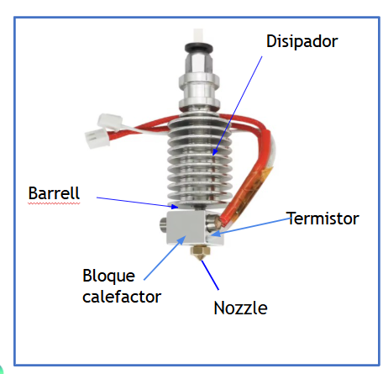
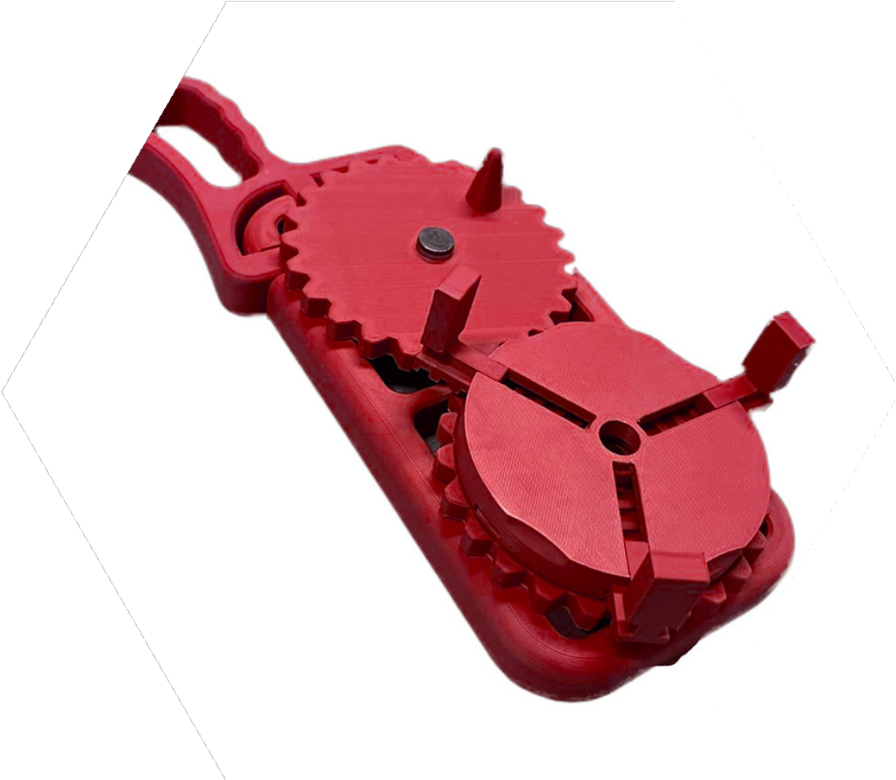
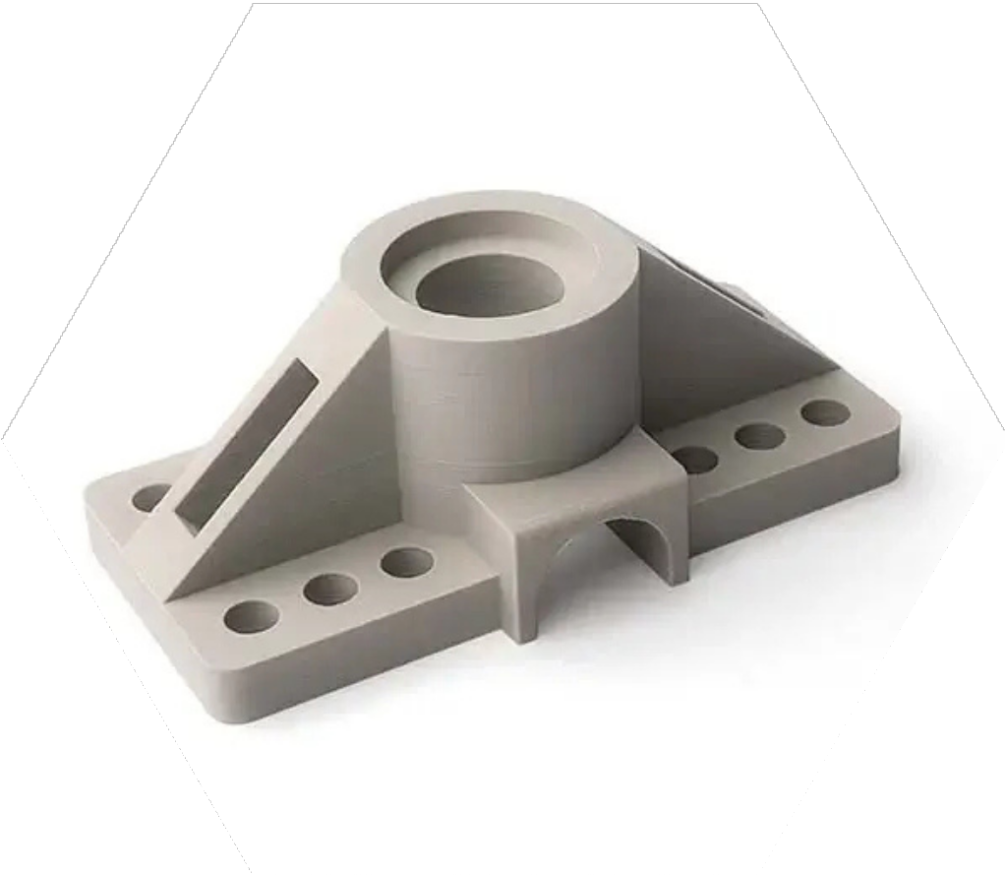
UD4: FDM PRINTING ELEMENTS
4.4 SLICER PRINTING PARAMETERS
4.4.1 TEMPERATURES
HOTEND: Specifies the temperature to which the nozzle should heat up to melt the material and deposit it on the bed. Each material has an ideal melting temperature.
IMPORTANT: When inserting new material into the printer, check whether the previous material used in the print has a higher melting temperature than the current one to avoid blockages in the component.
Not:
PLA
Tº Hotend : 120º-220º
Bed temperature: 0º-55º
ABS
Tº Hotend : 230º-260º
Bed temperature: 60º-100º
Fans
They are used to cool the hotend and the printed part, improving the quality of the layers and preventing overheating.

Slide 9
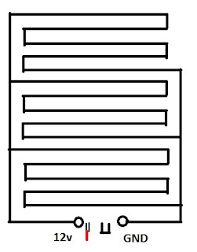
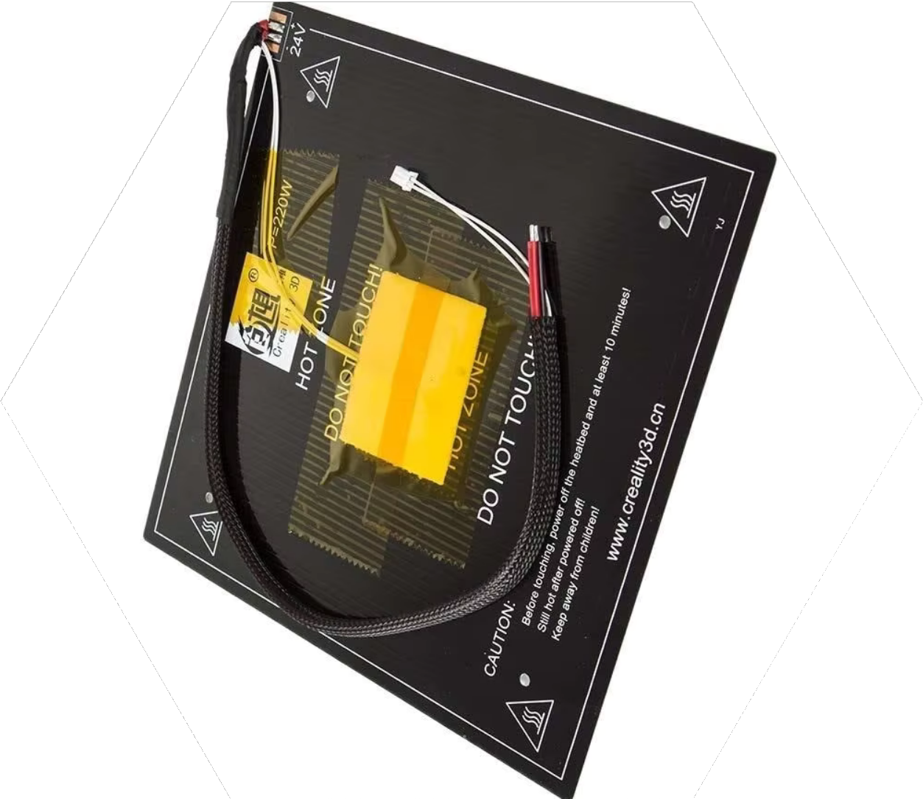
UD4: FDM PRINTING ELEMENTS
4.4 SLICER PRINTING PARAMETERS
4.4.1 TEMPERATURES
HEATED BED: It is the platform on which the molten material is deposited.
Helps improve the adhesion of the material to the surface during printing and prevent deformations
CHAMBER: Controlled temperature within the printing space. This is crucial to prevent warping and improve adhesion between layers. Maintaining a constant temperature in the chamber improves the stability and quality of the final part.
Thermal resistance
Temperature sensor
Fans
They are used to cool the hotend and the printed part, improving the quality of the layers and preventing overheating.

Slide 10
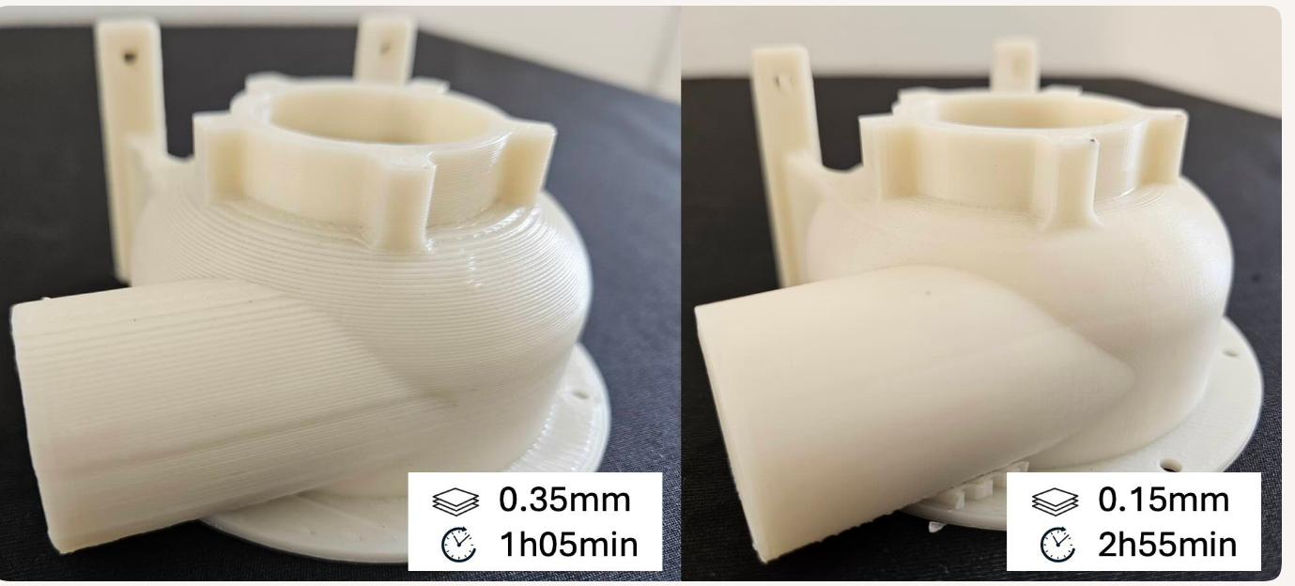
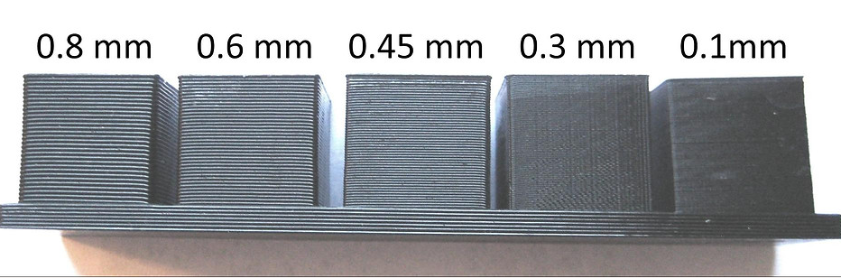
UD4: FDM PRINTING ELEMENTS
4.4 SLICER PRINTING PARAMETERS
4.4.2 LAYER HEIGHT
Layer Height: In additive manufacturing, layer height is the thickness of each individual layer that the printer deposits during the 3D printing process. It directly affects: surface quality, print time, and model resolution.
The lower the layer height, the more detailed the object will be, but it will also take longer to print.
Typical values:
Standard 0.2 mm
Detail 0.1 mm
Fans
They are used to cool the hotend and the printed part, improving the quality of the layers and preventing overheating.

Slide 11
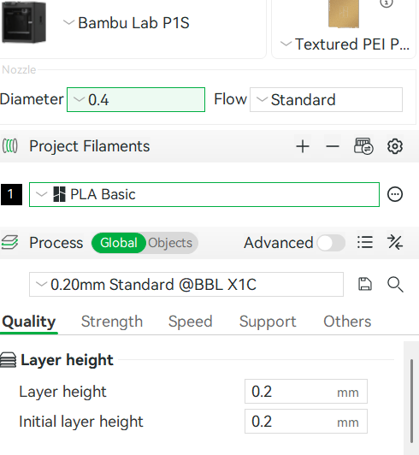

Unit 4: FDM Printing Elements.
4.4 SLICER PRINTING
4.4.2 LAYER HEIGHT
Layer height in Bambu studio: In the variable layer height section, which allows you to dynamically adjust the layer height in different areas of the model to balance quality and speed.
Variable layer height in Bambu Studio: This article explains how to use this feature, the recommended ranges based on nozzle diameter (e.g., 0.08–0.28 mm for a 0.4 mm nozzle), and how to optimize printing for curved or sloping surfaces.
Attached is a link to the “Bamboo Wiki”:
https://wiki.bambulab.com/en/software/bambu-studio/adaptive-layer-height
Fans
They are used to cool the hotend and the printed part, improving layer quality and preventing overheating.

Slide 12
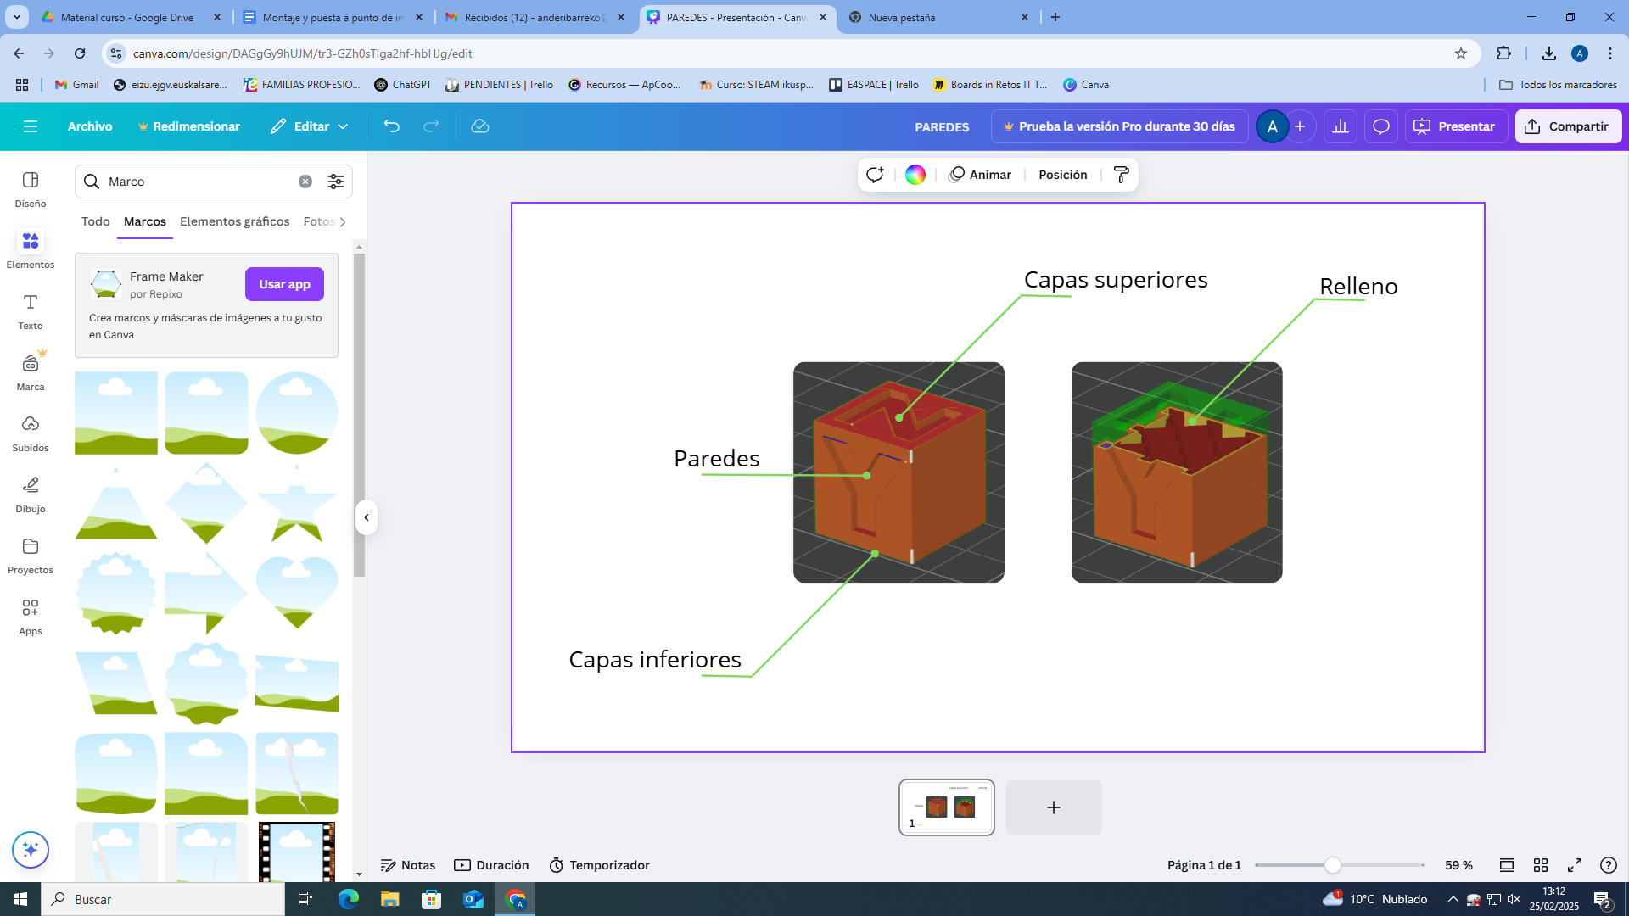
Unit 4: FDM Printing Elements
4.4 SLICER PRINTING PARAMETERS
4.4.3 NUMBER OF UPPER AND LOWER LAYERS
Upper layers
Number of layers: Influences the strength and surface finish of the piece.
Typically, 2 to 4 outer layers are used, depending on the desired layer thickness and strength.
For greater strength > 4 layers
"Top Layers": These influence the play or rigidity of the upper layers and prevent buckling and deformation due to gravity in the event of insufficient support.
“Bottom Layers”: Having more layers makes it easier and allows the layers to be “flattened” so that it allows for greater adhesion to the bed
Stuffed
Lower Layers
Fans
They are used to cool the hotend and the printed part, improving layer quality and preventing overheating.

Slide 13
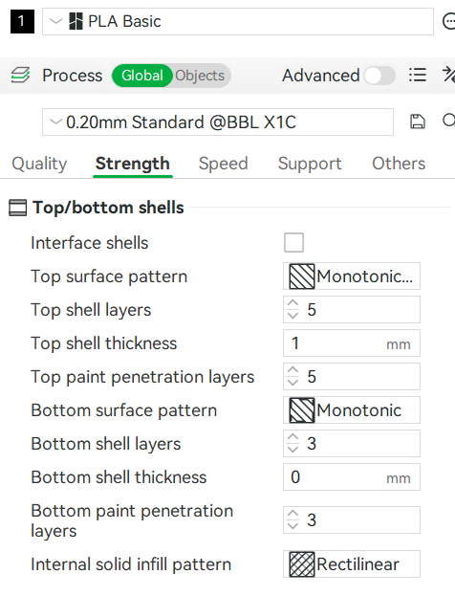
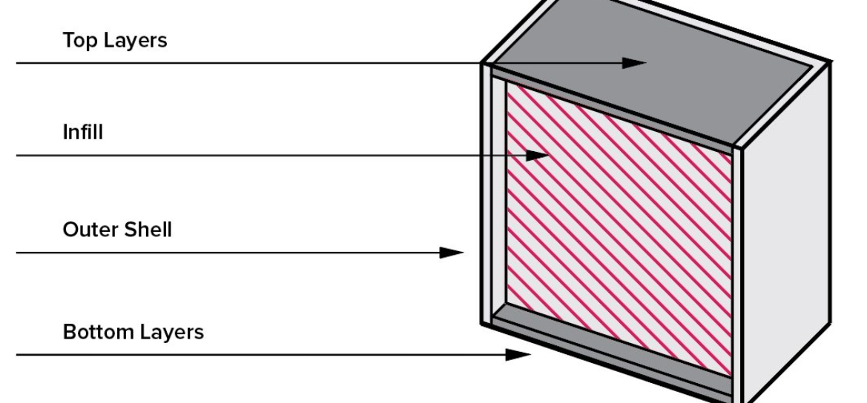
Unit 4: FDM Printing Elements
4.4 SLICER PRINTING PARAMETERS
4.4.3 NUMBER OF UPPER AND LOWER LAYERS
Number of layers in Bamboo Studio:
Capas superiores”Top shell Layers”:
Capas inferiores“Bottom shell Layers” :
I've attached the link to the "Bamboo wiki"
Fans
They are used to cool the hotend and the printed part, improving layer quality and preventing overheating.

Slide 14
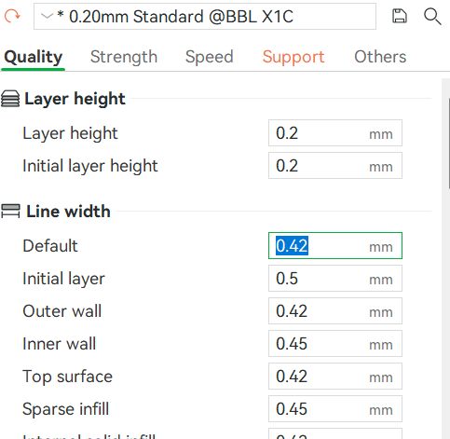
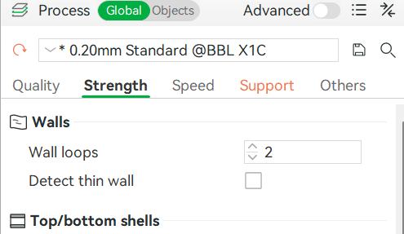
Unit 4: FDM Printing Elements
4.4 SLICER PRINTING PARAMETERS
4.4.4 SIDE WALL LOOPS
This would be the number of layers in the walls of the piece to be printed.
It is found in two different parameters of the bamboo studio, “Outer walls” and “Wall loops”.
Fans
They are used to cool the hotend and the printed part, improving layer quality and preventing overheating.

Slide 15
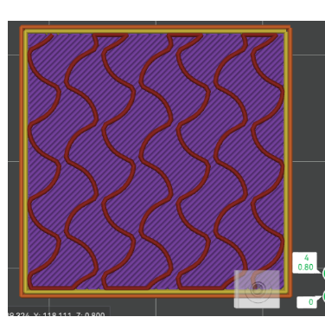
Unit 4: FDM Printing Elements
4.4 SLICER PRINTING PARAMETERS
4.4.5 FILL.TYPE AND DENSITY.
CUBE
In additive manufacturing (such as 3D printing), material infill refers to the internal structure that is generated within a printed object.
It is not completely solid, but is formed with geometric patterns (such as grids, honeycomb or lines) to save material, reduce printing time and maintain good mechanical strength.
Higher density = more strength, but also more weight and time.
Typical values
Normal use 15-20%
Structural part >30%
GIROIDE

Slide 16
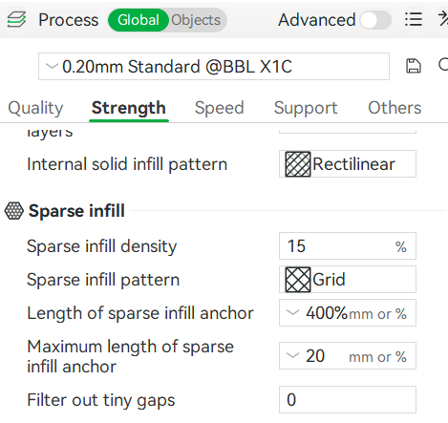
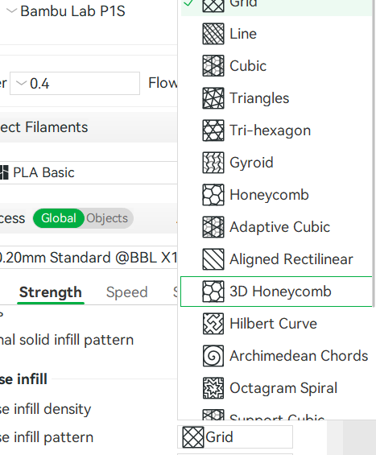
Unit 4: FDM Printing Elements
4.4 SLICER PRINTING PARAMETERS
4.4.5 FILL.TYPE AND DENSITY.
At Bambú Studio, you can adjust the type of filling, its density and pattern according to the model's needs.
I've attached the link to the "Bamboo wiki"
https://wiki.bambulab.com/en/software/bambu-studio/fill-patterns

Slide 17
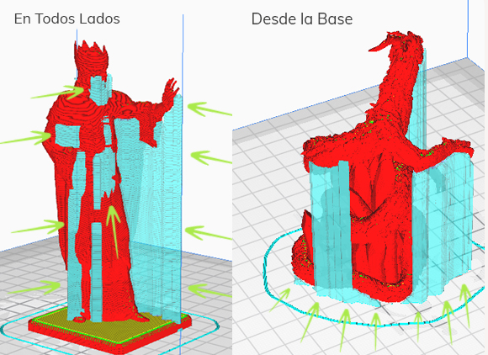
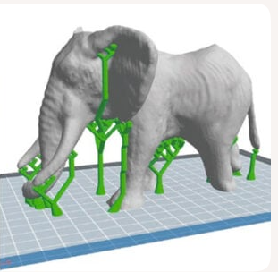
Unit 4: FDM Printing Elements
4.4 SLICER PRINTING PARAMETERS
4.4.6 SUPPORTS.TYPES.
Definition: In additive printing, a support is an auxiliary structure that is automatically generated to hold parts of the model that protrude or have sharp angles.
Its function is to prevent deformations during printing, especially in overhangs or bridges, where the molten material would not have a base on which to settle.
The type and density of supports vary depending on the geometry of the part and the material.
Fans
They are used to cool the hotend and the printed part, improving layer quality and preventing overheating.

Slide 18
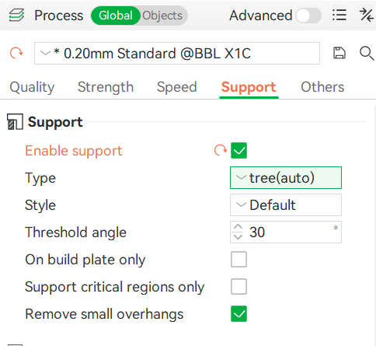
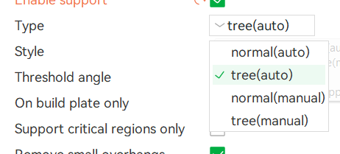
Unit 4: FDM Printing Elements
4.4 SLICER PRINTING PARAMETERS
4.4.6 SUPPORTS.TYPES.
In Bambu Studio you can configure:
Type of support (automatic, manual, contact)
with the base, etc.).
Cantilever angle from which the supports are generated.
Pattern/Type of support to facilitate its removal
I've attached the link to the "Bambu wiki" (SUPPORT)
https://wiki.bambulab.com/en/software/bambu-studio/support
Fans
They are used to cool the hotend and the printed part, improving layer quality and preventing overheating.

Slide 19
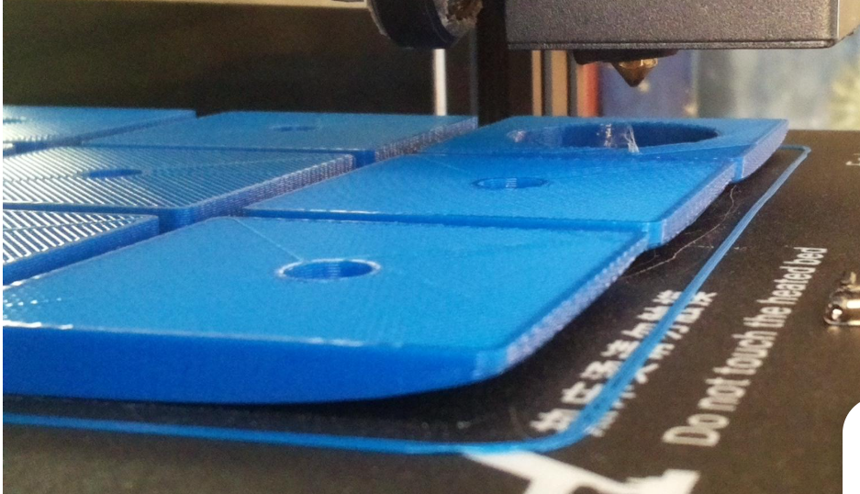
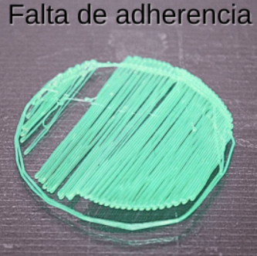
Unit 4: FDM Printing Elements
4.4 SLICER PRINTING PARAMETERS
4.4.7 BED ADHESION
Definition: In additive printing, especially in technologies like FDM (Fused Deposition Modeling), bed adhesion refers to how well the first layer of material adheres to the print bed.
This stage is crucial: if the base of the piece is not properly secured from the beginning, everything printed on top of it can:
Commute,
To deform
Even fail completely.

Slide 20
Unit 4: FDM Printing Elements
4.4 SLICER PRINTING PARAMETERS
4.4.7 BED ADHESION
Some key factors that influence good adherence:
Bed leveling: Ensure the bed is level and at the correct distance from the nozzle.
z-offset of nozzle tip to bed.
Bed temperature: Some materials such as ABS or PETG require a heated bed to improve adhesion.
Preheating the bed before leveling improves adhesion and can prevent lacquers.
Bed surface: Glass, PEI, BuildTak or adhesive tapes modify adhesion depending on the material.
Speed ​​and height of the first layer: A slower initial layer with adjusted height improves adhesion.

Slide 21
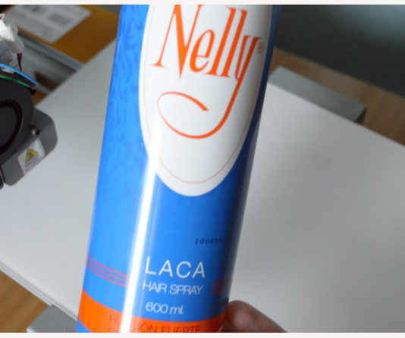
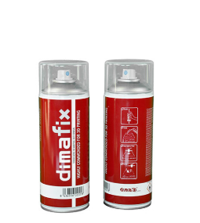
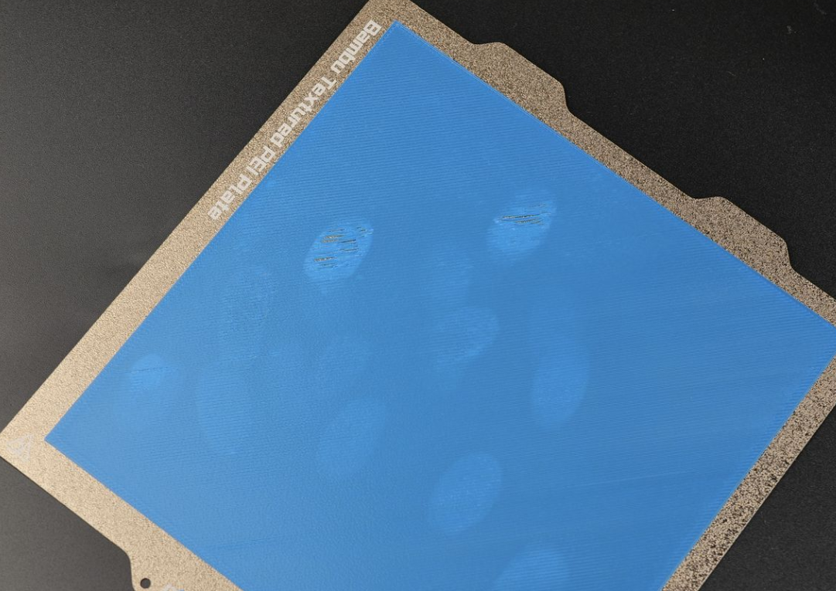
Unit 4: FDM Printing Elements
4.4 SLICER PRINTING PARAMETERS
4.4.7 BED ADHESION
Some key factors that influence good adherence:
Use of lacquers and glue sticks: To improve adhesion in 3D printing with ABS and PLA:
PLA: Classic Nelly lacquer. A popular homemade option. Silicone- and oil-free, it works well with PLA on heated beds. Inexpensive and easy to find.
ABS: Dimafix. Excellent for ABS. Its adhesion is activated by heat (from 65°C) and released upon cooling. Ideal for large parts and preventing warping.
Important notes to improve adherence in daily life:
Clean the bed with water or isopropyl alcohol after each use
Do not touch the surface of the bed with your fingers (Marks)

Slide 22
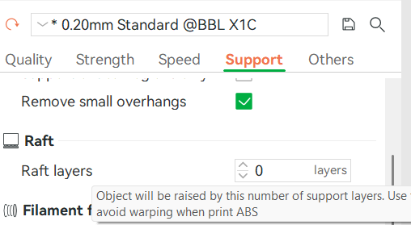
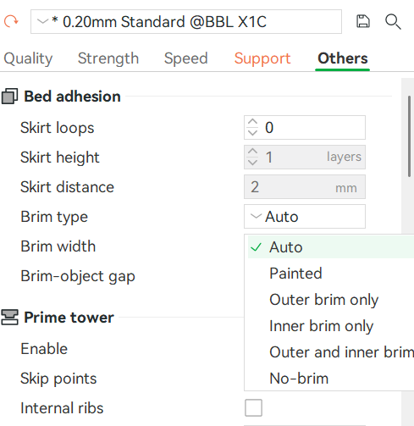
Unit 4: FDM Printing Elements
4.4 SLICER PRINTING PARAMETERS
4.4.7 BED ADHESION
In Bambu Studio you can configure:
Raft: Thick base to improve grip on small pieces
Skirt: Line around the part for priming the extruder:
Brim: An additional edge that increases the contact area to prevent warping
I have attached the link to the “Bambu wiki” (“Troubleshooting bed adhesion issues”)
https://wiki.bambulab.com/en/general/textured-PEI-plate-not-working-as-expected

Slide 23
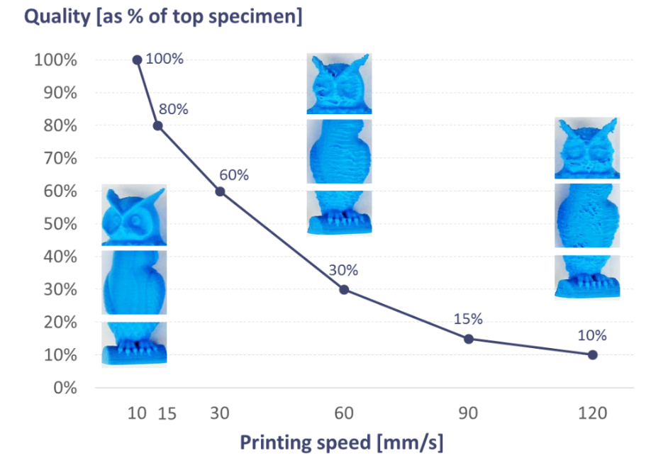
Unit 4: FDM Printing Elements
4.4 SLICER PRINTING PARAMETERS
4.4.8 PRINT SPEED
Definition: Defines the speed at which the printer moves while depositing the material. It affects printing time.
If the speed is too high, the quality of the part can be compromised (if the parameters are not adjusted), as well as resulting in poorer layer adhesion.
If it is reduced, accuracy improves.
Typical values
General: 40-60 mm/s
Fine details: 20-30 mm/s
Fast movement: Up to 150 mm/s

Slide 24
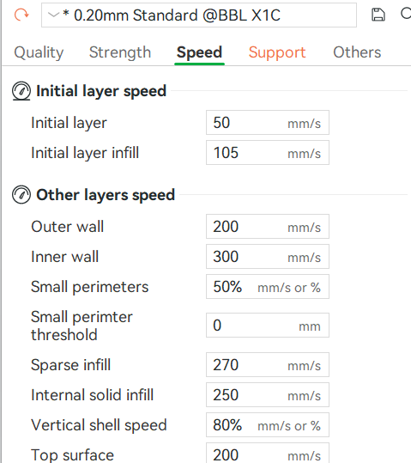
Unit 4: FDM Printing Elements
4.4 SLICER PRINTING PARAMETERS
4.4.8 PRINT SPEED
Work tips:
The first layers are always slower
Faster filling
Slower walls
In Bambu Studio, you can configure the printing speed of the different layers:
The initials for improved adhesion (Slow)
The rest
Adjunto el enlace al “Bambu wiki”( High-speed and quality)
https://wiki.bambulab.com/en/software/bambu-studio/high-speed-print-at-quality

Slide 25
Unit 4: FDM Printing Elements
4.4 SLICER PRINTING PARAMETERS
4.4.9 Retraction
Retraction is the movement of the filament backward during non-extrusion movements to prevent unwanted stringing. In Bambu Studio, you can adjust:
Retraction distance: depends on the type of extruder.
Retraction speed: affects how quickly the filament retracts.
Retraction when changing layers and only during travel movements
This value depends largely on the type of extruder and the printing material.
Extruder type:
Bowden (direct): Requires more retraction
Direct: Requires less retraction
Material
Rigid materials: Requires less shrinkage
Elastic materials: Needs more shrinkage

Slide 26
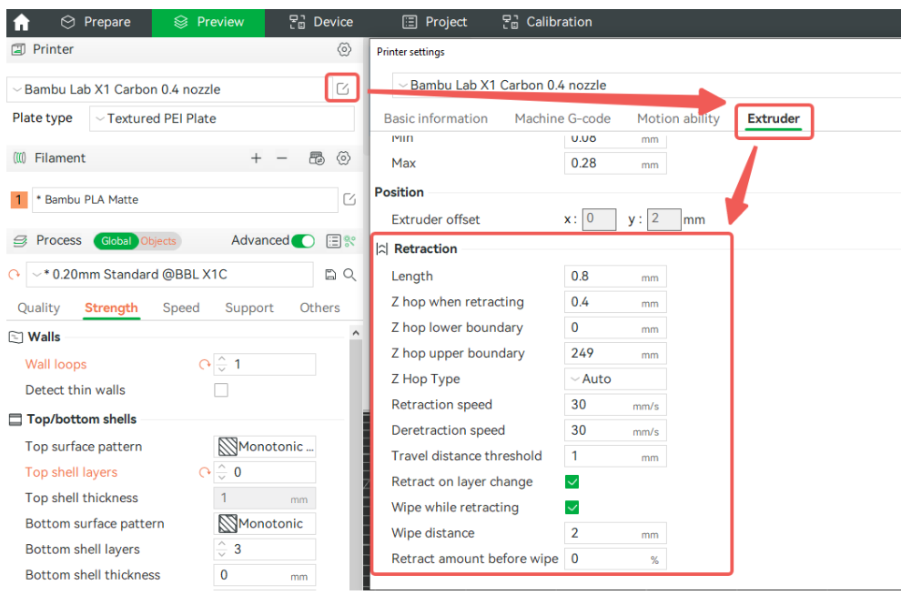
Unit 4: FDM Printing Elements
4.4 SLICER PRINTING PARAMETERS
4.4.9 Retraction
In Bambu Studio, you can configure the extrusion retraction according to the attached image.
.
Attached is the link to the “Bambu wiki” (Retraction)
https://wiki.bambulab.com/en/software/bambu-studio/parameter/retraction

Slide 27
Unit 4: FDM Printing Elements
4.4 SLICER PRINTING PARAMETERS
4.4.10 FLUJO ( FLOW RATE)
Definition: It is the extrusion flow of the filament through the hotend.
This parameter is crucial for obtaining parts with precise dimensions and good surface quality.
Flow Rate (or flow multiplier) is the percentage of material the printer attempts to extrude relative to what the slicer calculates. By default, it's usually set to 100%, but it can be adjusted for calibration.
Extrusion width vs. nozzle diameter If the line width produced by the printer does not match the expected value, it may indicate flow problems: under-extrusion (too little) or over-extrusion (too much material).
Fans

Slide 28
Unit 4: FDM Printing Elements
4.4 SLICER PRINTING PARAMETERS
4.4.10 FLUJO ( FLOW RATE)
Factors that affect flow:
Temperatura del hotend
Print speed
Filament type and quality
Extruder alignment and cleaning
Flow calibration: A calibration cube is usually printed without infill and without lids, to measure the wall thickness with a caliper and thus adjust the flow rate until it matches the expected value.
A poorly adjusted flow can cause problems such as inconsistent layers, poor adhesion between layers, or incorrect dimensions.
Fans

Slide 29
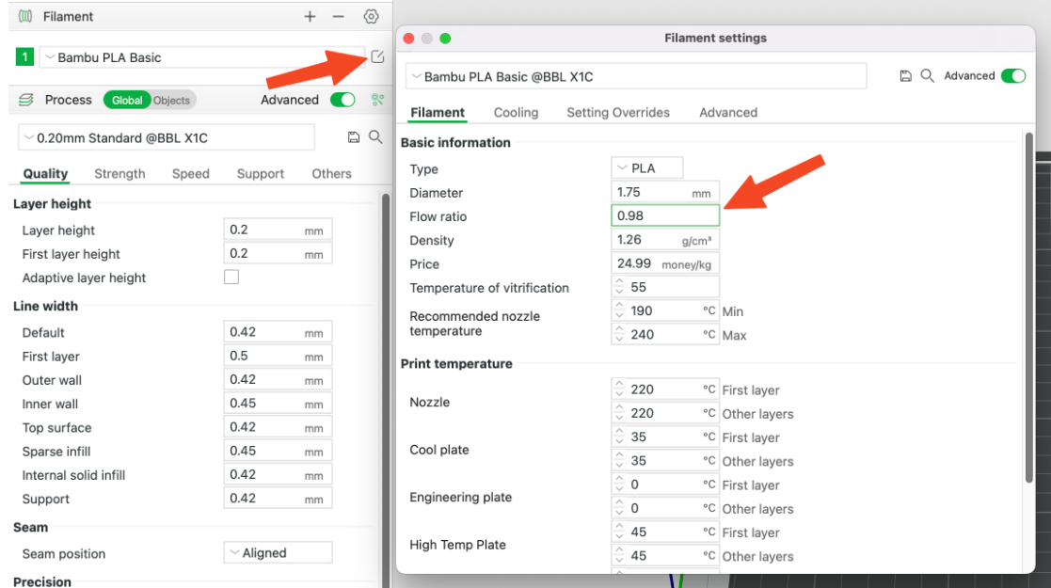
Unit 4: FDM Printing Elements
4.4 SLICER PRINTING PARAMETERS
4.4.10 FLUJO ( FLOW RATE)
In Bambu Studio you can configure the flow manually or calibrate it.
.
Attached is the link to the “Bambu wiki” (FLOW RATE tuning)
https://wiki.bambulab.com/en/x1/manual/manual-flow-rate-tuning
Attached is the link to the “Bambu wiki” (FLOW RATE calibration)
https://wiki.bambulab.com/en/software/bambu-studio/calibration_flow_rate
Fans

Slide 30
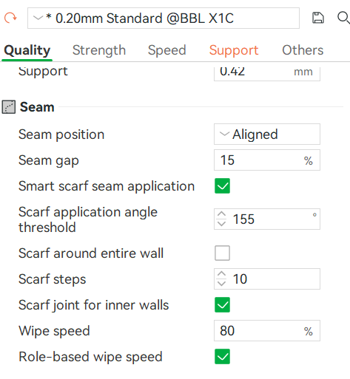
Unit 4: FDM Printing Elements
4.4 SLICER PRINTING PARAMETERS
4.4.11 SEAM ALIGNMENT
Definition: In FDM 3D printing, "Seam Alignment" refers to the location where the printer starts and ends each layer.
This start/end point creates a small vertical mark visible on the surface of the model, known as a z-seam or seam.
In Bambu Studio, you can easily configure:
Adjunto enlace de “Bambu wiki” (seam setting).
https://wiki.bambulab.com/en/software/bambu-studio/Seam

Slide 31
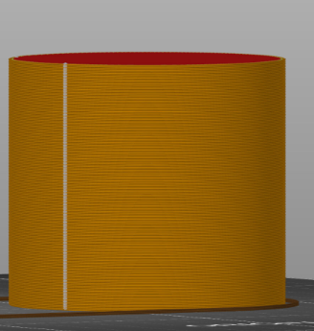
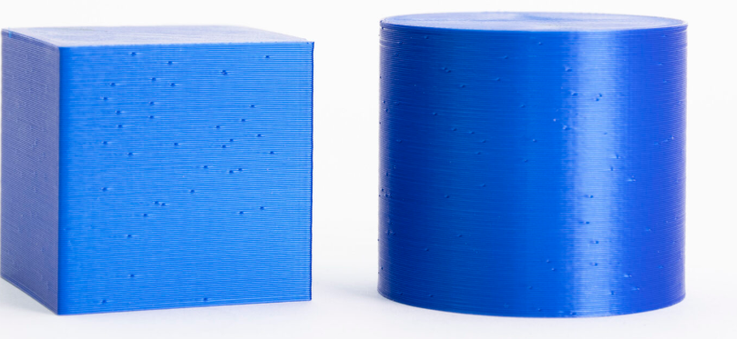
Unit 4: FDM Printing Profiles
4.4 SLICER PRINTING PARAMETERS
4.4.11 SEAM ALIGNMENT
Slicers like Bambu Studio, Cura, or PrusaSlicer allow you to control how and where these seams are placed. Here are the most common options:
Aligned: All layers start at the same point, creating a visible vertical line. This is useful if you want the seam to be in a specific area, such as the back of the garment.
Random: The starting point changes in each layer, dispersing the seam and making it less visible, although it may generate an uneven texture.

Slide 32
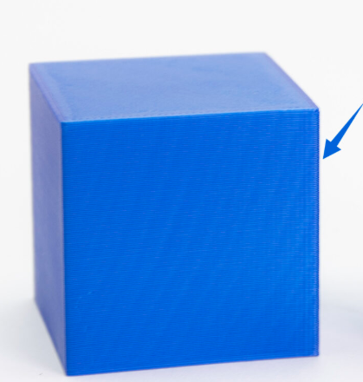
Unit 4: FDM Printing Profiles
4.4 SLICER PRINTING PARAMETERS
4.4.11 SEAM ALIGNMENT
Nearest: The slicer chooses the point closest to the previous one to minimize unnecessary movements, which can improve efficiency but not always aesthetics.
If your garment has sharp corners, this will make the seam effectively invisible.
User-defined: Some slicers allow you to manually select the seam location
Attached is a link to the QIDI guide on stitching, which explains the concept very well and how it affects the final appearance of the model.
https://qidi3d.com/es/blogs/guides/how-to-optimize-model-seams-in-qidi-studio
Fans
They are used to cool the hotend and the printed part, improving layer quality and preventing overheating.

Slide 33
Unit 4: FDM Printing Profiles
4.6 SUMMARY TABLE OF PARAMETERS
TEMPERATURE Crucial for the correct extrusion and adhesion of the mat to the bed PLA: Extruder: 190-220 ºC / Bed: 60º ABS: Extruder: 230-250 ºC / Bed: 100º | BED HEIGHT. Defines the vertical resolution of the print and the printing time. Standard values ​​0.2 mm Detail values ​​0.1 mm
Number of outer layers that form the wall of the piece, affecting its strength and finish Standard: 2-4 walls Greater strength >4 walls | FILLER Determines the internal structure of the part, resistance and printing time Normal use: 15-20% Structural parts > 3%
SUPPORTS Temporary structures to prevent the collapse of cantilevered parts or bridges Angle 45-60º Density: Determines ease of removal | BED ADHESION Ensures the first layer adheres correctly to the print surface to prevent warping. RAFT/SKIRT/BRIM
PRINTING SPEED Affects printing time and surface quality. General :40-60 mm/s Fines: 20-30 mm/s | RETRACTION Moves the filament away from the nozzle to prevent stringing and dripping when the extruder moves. Distance: 1-6 mm Speed: 25-60 mm/s
FLOW RATE controls the amount of material extruded. An incorrect value can cause underextrusion or overextrusion. Typical value: 95-100% | SEAM ALIGNEMENT In FDM 3D printing, "Seam Alignment" refers to the location where the printer starts and ends each layer.
Fans
They are used to cool the hotend and the printed part, improving layer quality and preventing overheating.

Slide 34
Unit 4: FDM Printing Profiles
PRACTICAL EXERCISE
Students must locate all the above parameters in the CURA and prepare an explanatory document like the one indicated in the "seam alignment example".
Print the files from the exercises folder, testing different parameters and minimizing printing times while maximizing quality. Analyze and explain the errors in each piece and their possible solutions. Example:
Calibration cube: number of top, bottom and side wall layers
Branch: Layer height
Mechanical part: Types of supports
Dragon: Raft/Skirt/Wing
…..
Attached is a “Visual Guide to Solving 3D Printing Problems” https://bitfab.io/es/blog/problemas-impresion-3d

Slide 35
:
THANK YOU!
www.fpsanturtzilh.eus
Mikel Iturraspe Eguia
miturraspee@fpsanturtzilh.eus
Notes:
The alliance will establish an Open Innovation Community to promote applied research and development projects, mainly between Centres of Vocational Excellence and Small and Medium Enterprises. To achieve this cooperation, the role of Vocational Education and Training in Advanced Manufacturing Research and Development activities and its contribution to Regional Smart Specialisation Strategies will be clarified.

