Slide 1

Unit 3: Components of FDM 3D Printer.

Slide 2
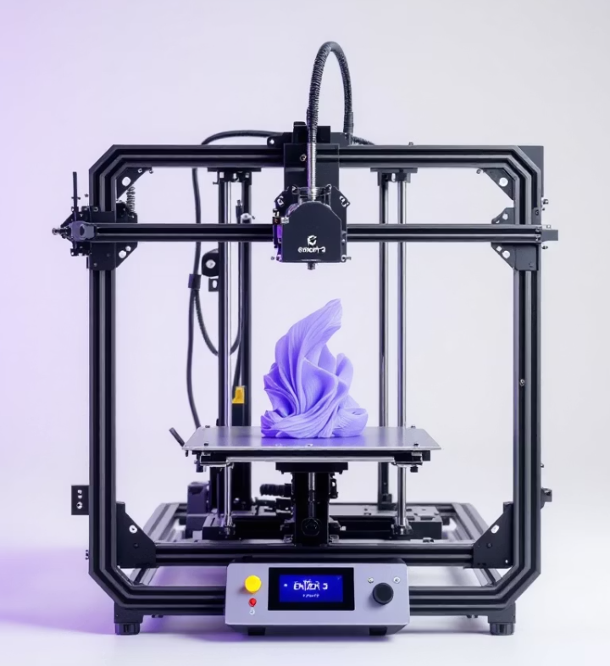
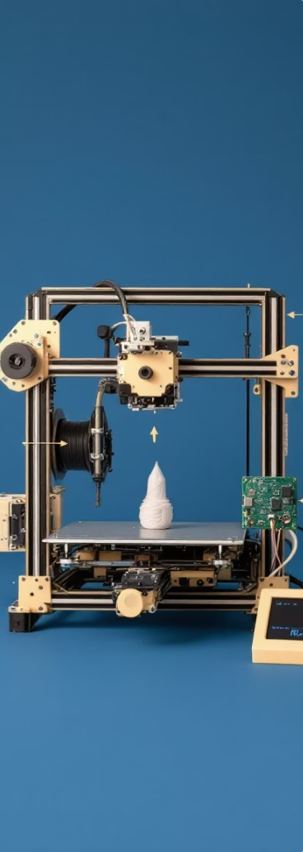

Unit 3: Components of an FDM 3D Printer.
3.1 PARTS OF AN FDM 3D PRINTER.GENERAL
Frame and structure: Provides the stability and rigidity needed for precise movements and a consistent impression
Movement system: Stepper motors, belts and shafts that allow precise movement in X, Y and Z.
Extrusion system: Composed of the feed motor, hotend, and nozzle. It melts and deposits the filament with precision.
Heated bed: The surface where the part is built. It maintains initial adhesion and prevents warping during printing.
Electronics and firmware: Controller board, screen, sensors and software that manage and coordinate the entire printing process
Layer fans: These are used to cool the hotend and the printed part, improving layer quality and preventing overheating.
Fans
They are used to cool the hotend and the printed part, improving layer quality and preventing overheating.

Slide 3
Unit 3: Components of an FDM 3D Printer.
3.2 MECHANICAL PARTS OF AN FDM 3D PRINTER.
3.3.1 STRUCTURE AND BASE
3.3.2 MOVEMENT SYSTEM
3.3.2 BELTS AND MOTORS

Slide 4
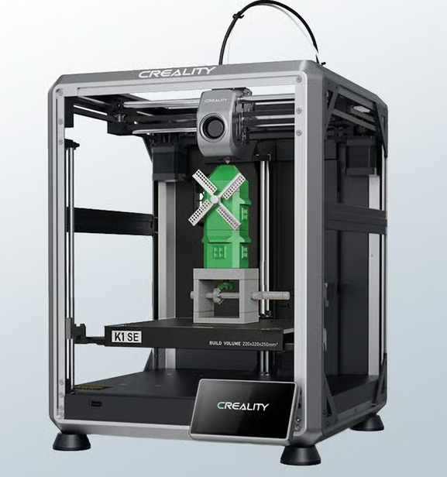
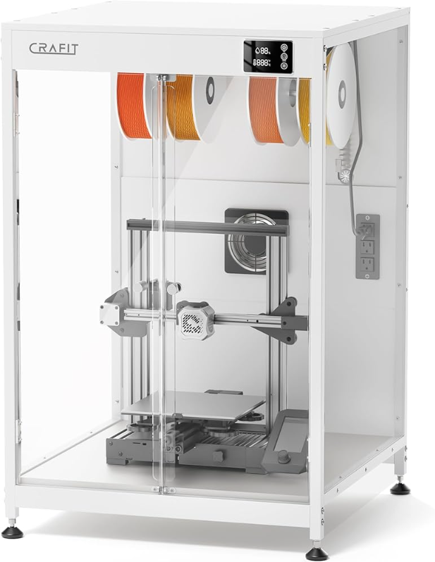
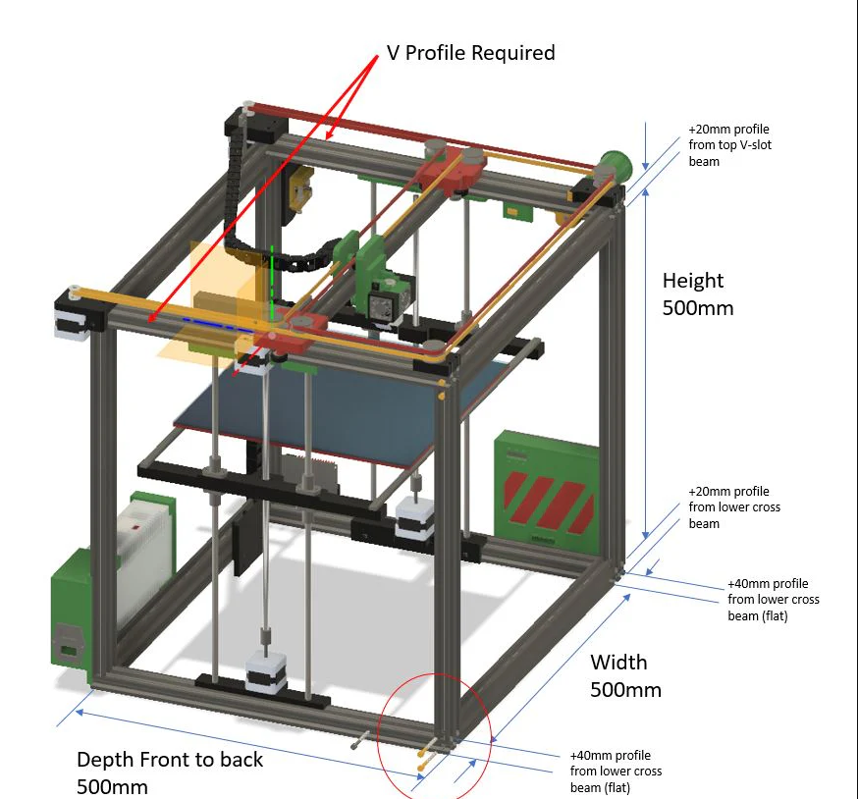
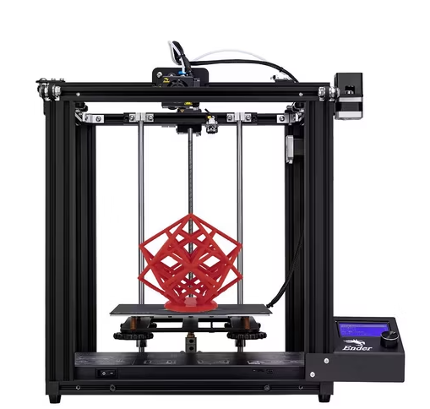
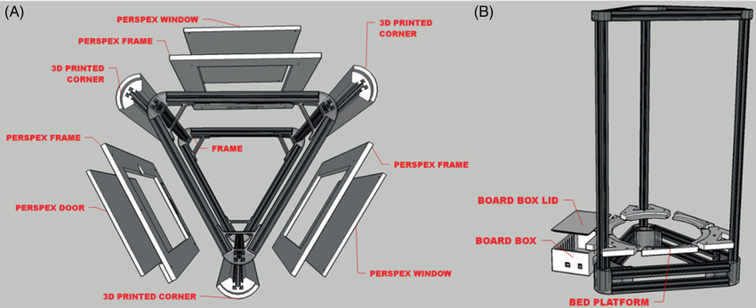
Unit 3: Components of an FDM 3D Printer.
3.2 MECHANICAL PARTS OF AN FDM 3D PRINTER.
3.2.1 STRUCTURE AND BASE
Frame: The printer's skeleton, key to stability and precision.
Constructed of aluminum or steel.
Types: Cartesian, Delta, CoreXY
Types of Structure:
Open: Lightweight, economical, easy to maintain. Sensitive to ambient temperature, more noise/odor.
Enclosed: Stable temperature, greater precision (ABS), reduced noise/odors. More expensive, limited access
Fans
They are used to cool the hotend and the printed part, improving layer quality and preventing overheating.

Slide 5
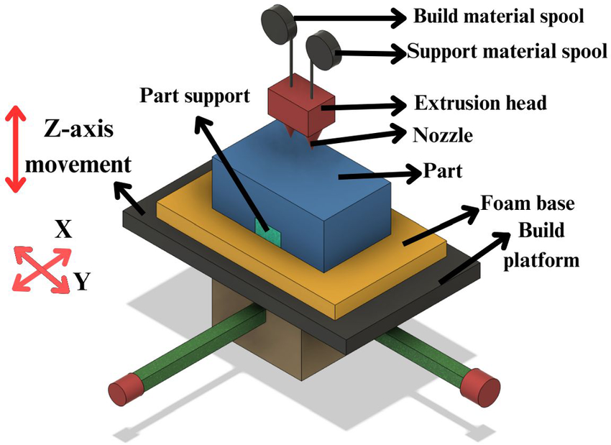
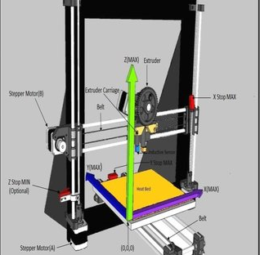
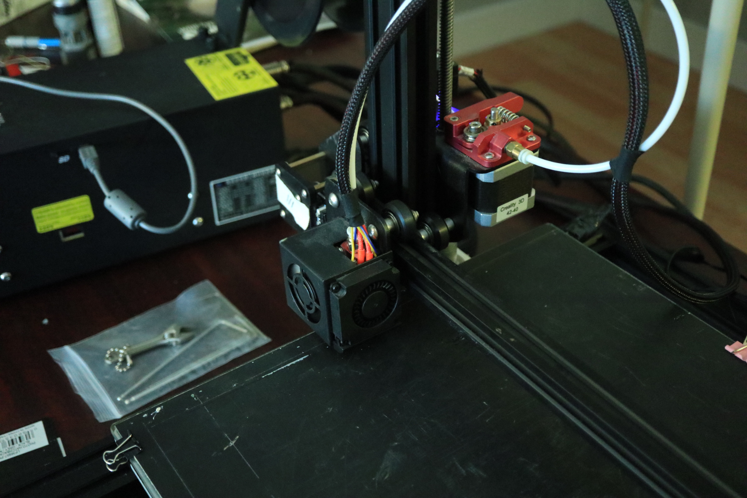
Unit 3: Components of an FDM 3D Printer.
3.2 MECHANICAL PARTS OF AN FDM 3D PRINTER
3.2.2 MOVEMENT SYSTEM
X, Y, Z axes:
They define the head movement (X and Y) and the height (Z).
Crucial for dimensional accuracy.
Linear Guides:
Bars or rails that ensure smooth and precise movements.
They can be smooth rods with bearings, aluminum profiles, or industrial linear rails.
Fans
They are used to cool the hotend and the printed part, improving layer quality and preventing overheating.

Slide 6
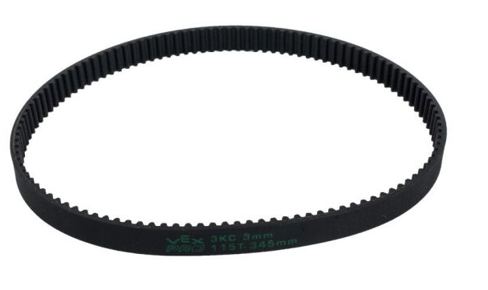
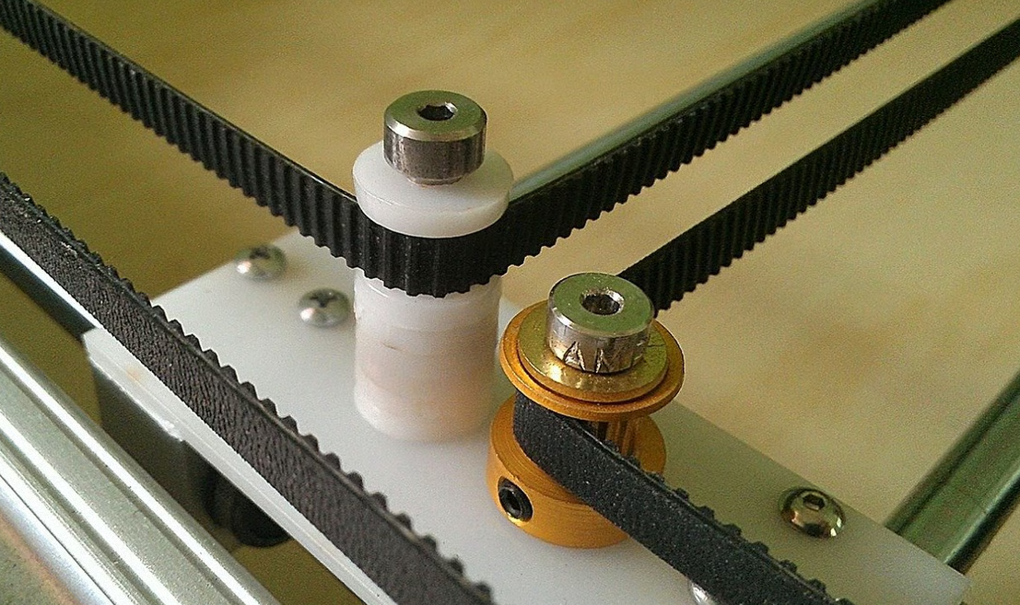
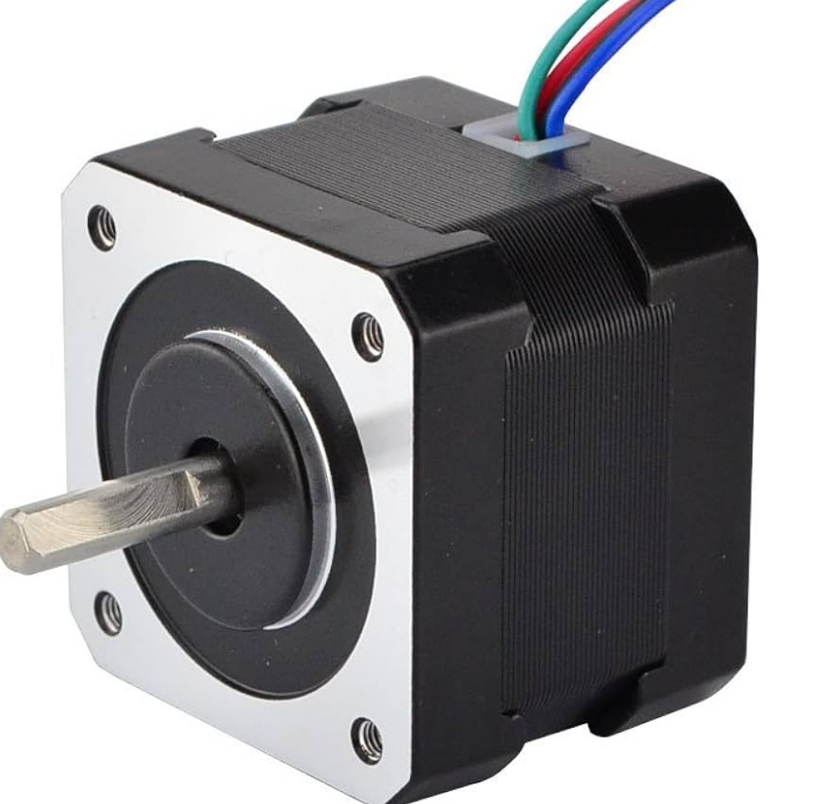
Unit 3: Components of an FDM 3D Printer.
3.2 MECHANICAL PARTS OF AN FDM 3D PRINTER
3.2.2 BELTS AND MOTORS
Straps:
Transmission of motion from the motors to the X and Y axes.
Materials: fiberglass reinforced rubber or steel.
Correct voltage is essential to avoid errors.
Stepper Motors:
They control the movement of each axis with great precision.
They divide their turns into small steps, allowing for precise positioning.
Commonly NEMA 17
Fans
They are used to cool the hotend and the printed part, improving layer quality and preventing overheating.

Slide 7
Unit 3: Components of an FDM 3D Printer.
3.3 HEATED PARTS AND EXTRUSION SYSTEM
3.4.1 HEATED BED
3.4.2 HOTEND
3.4.3 EXTRUSOR
3.4.4 LAYER FAN

Slide 8
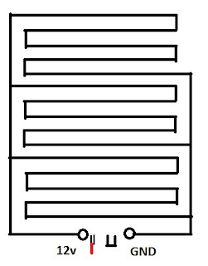
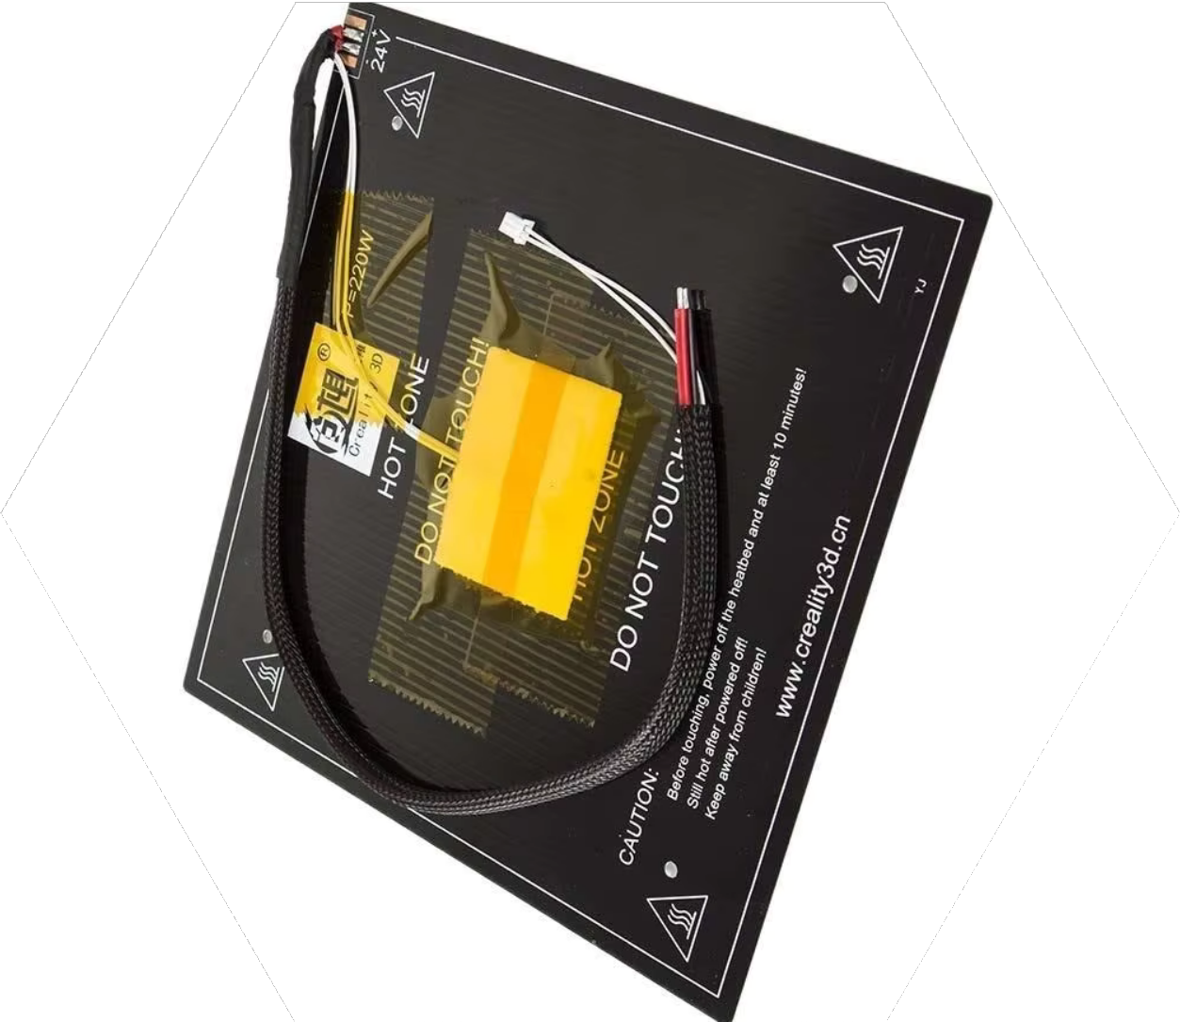
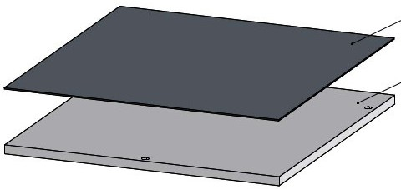
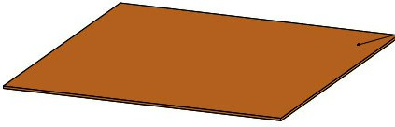
Unit 3: Components of an FDM 3D Printer.
3.3 HEATED PARTS AND EXTRUSION SYSTEM
3.3.1 HEATED BED
It is the platform on which the molten material is deposited. Between 30 and 100ºC.
It is composed of 3 key elements:
printing surface
Heat transmitting layer
Heated layer
Thermal resistance
Print surface
Heat transmitting layer
Temperature sensor
Heated layer

Slide 9
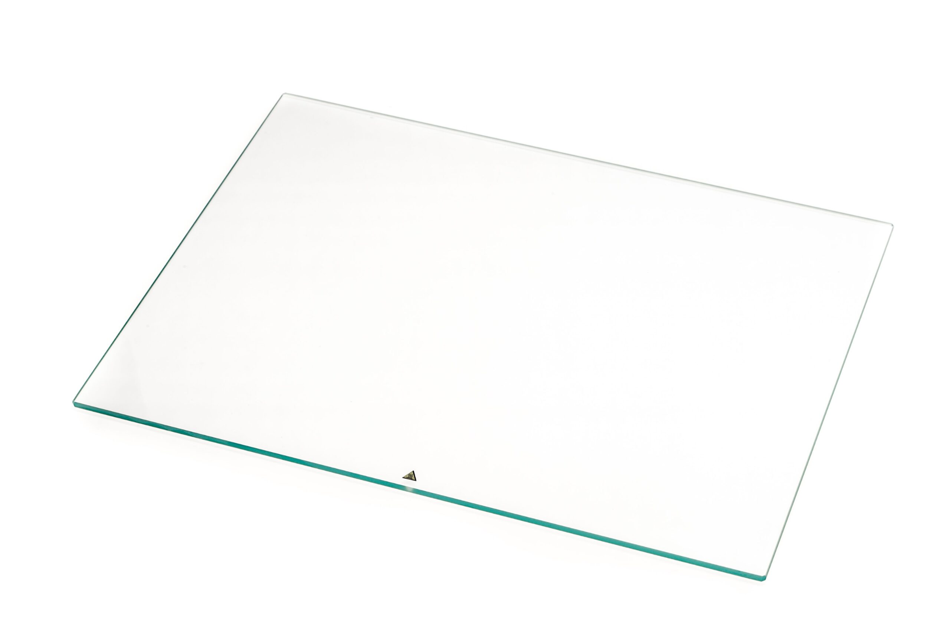
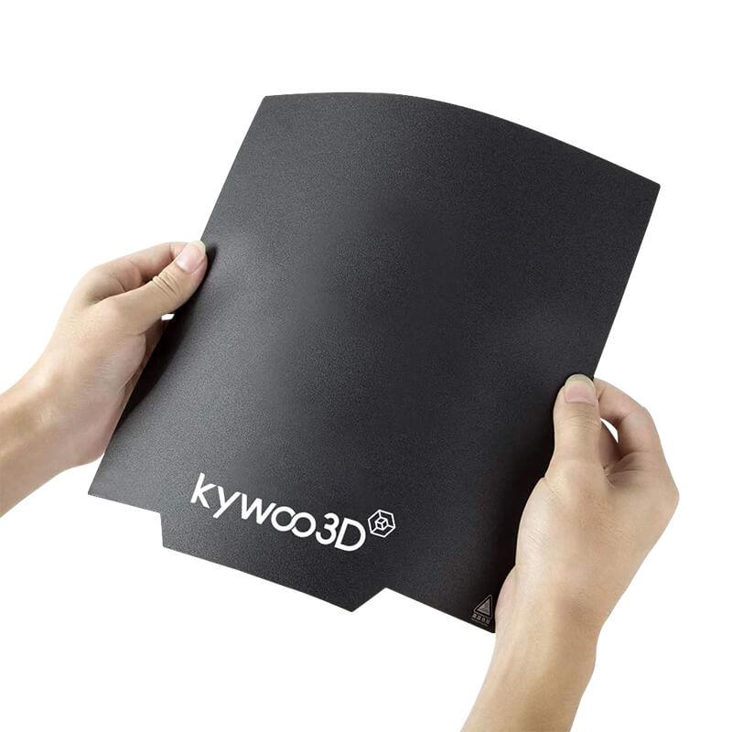
Unit 3: Components of an FDM 3D Printer.
3.3 HEATED PARTS AND EXTRUSION SYSTEM
3.3.1.1 PRINTING SURFACE
glass
It is placed on the heated bed and is the direct medium where the filament adheres.
Improved material adhesion: Helps the material adhere better during the first layers of printing.
The choice of surface material is crucial for the adhesion and ease of removal of the model once finished.
Reduction of deformations: Reduces the possibility of “warping” (corner lifting)
Special surfaces (PEI): Improved adhesion without the need for additional adhesives. Easy removal from the object. Durable.
Magnetic

Slide 10
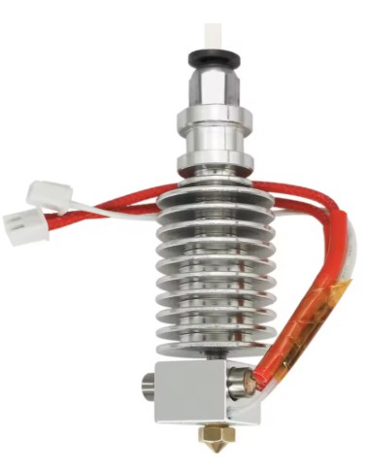
Unit 3: Components of an FDM 3D Printer.
3.3 HEATED PARTS AND EXTRUSION SYSTEM
3.3.2 HOT END
The hotend is the heart of extrusion, where the filament is melted.
Key Components:
Barrel (Guide Tube): Guides the filament, prevents premature heating.
Heat sink: Prevents heat from rising through the barrel and causing jams.
Heating Block: Heats the filament to the melting point.
Thermistor: Temperature sensor for precise control.
Nozzle: It is the final part of the hotend through which the molten filament is extruded.
Heatsink
Barrell
Thermistor
heating block
Nozzle

Slide 11
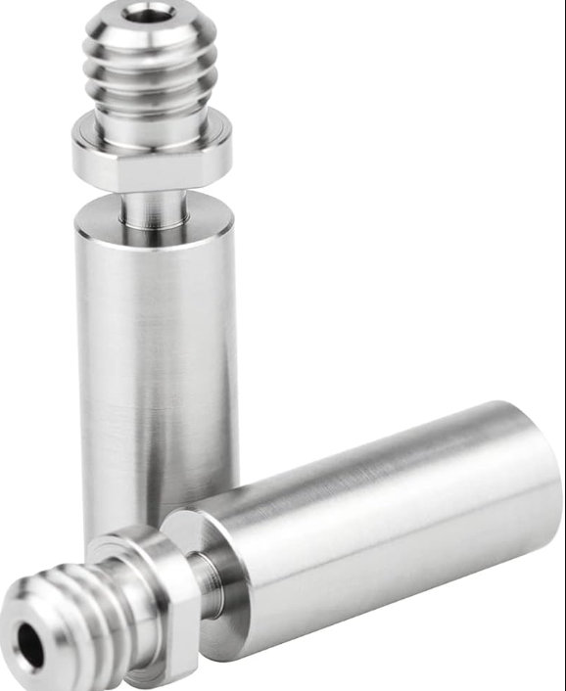
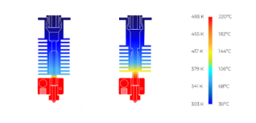
Unit 3: Components of an FDM 3D Printer.
3.3 HEATED PARTS AND EXTRUSION SYSTEM
3.3.2.1 BARRELL
A metal tube that carries the filament from the extruder to the nozzle.
Its main function is to ensure that the material does not heat up prematurely and remains cool at the top to prevent jams. The molten filament is extruded.
Mainly

Slide 12
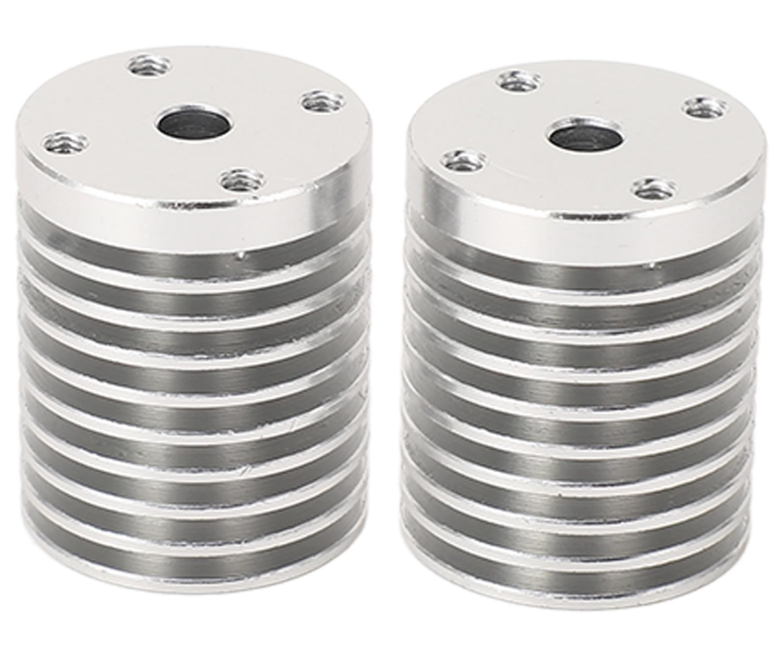
Unit 3: Components of an FDM 3D Printer.
3.3 HEATED PARTS AND EXTRUSION SYSTEM
3.3.2.2 HEAT SINK
A piece with metal fins (usually aluminum) that is responsible for dissipating the heat generated in the heating block.
It prevents this heat from rising through the barrel and causing premature filament jams.
A good heatsink is vital for smooth extrusion.

Slide 13
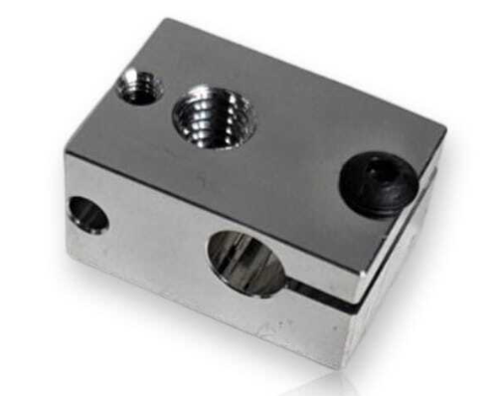
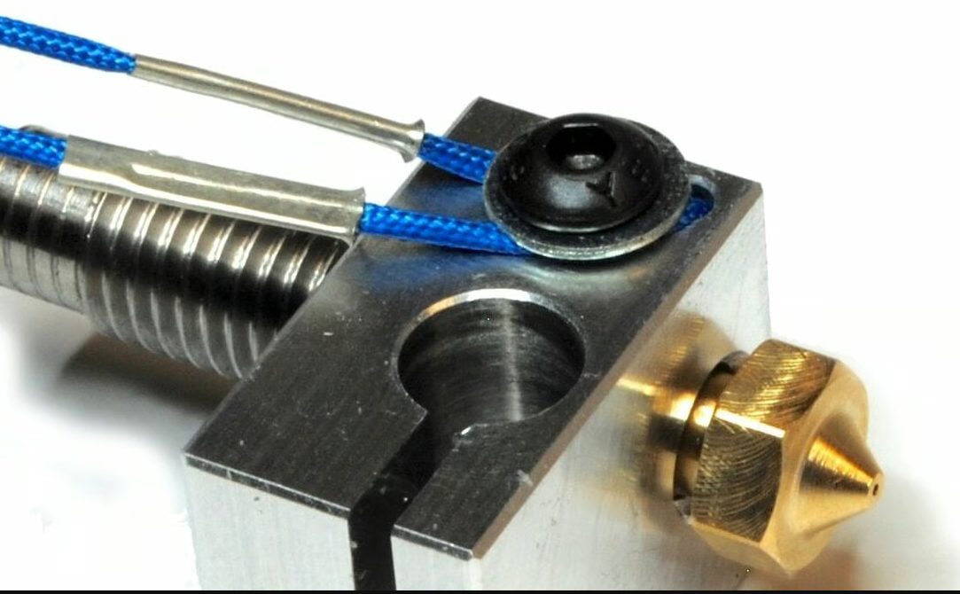
Unit 3: Components of an FDM 3D Printer.
3.3 HEATED PARTS AND EXTRUSION SYSTEM
3.3.2.3/4 HEATING BLOCK
Barrel
Heating block: It is a metal block (usually aluminum) where the heating cartridge and thermistor are inserted.
Its function is to heat the filament to its melting point uniformly, allowing it to be deposited smoothly and in a controlled manner on the printing surface.
Thermistor: A small temperature sensor that is inserted into the heater block.
It accurately measures the heat in the block and allows the printer to adjust and maintain the desired temperature consistently, which is critical for uniform extrusion.
Temperature probe
(Thermistor)
Resistance cartridge

Slide 14
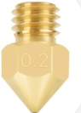

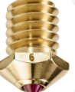
Unit 3: Components of an FDM 3D Printer.
3.3 HEATED PARTS AND EXTRUSION SYSTEM
3.3.2.5 NOZZLE (NOZZLES)
It is the final part of the hotend through which the molten filament is extruded.
Materials:
Brass: Common for PLA, ABS, PETG. Good conductor, economical, wears down with abrasive filaments.
Hardened steel: For abrasive filaments (carbon fiber, metallic). High wear resistance
Ruby/Diamond Point:
Extreme durability, superior quality, more expensive.

Slide 15
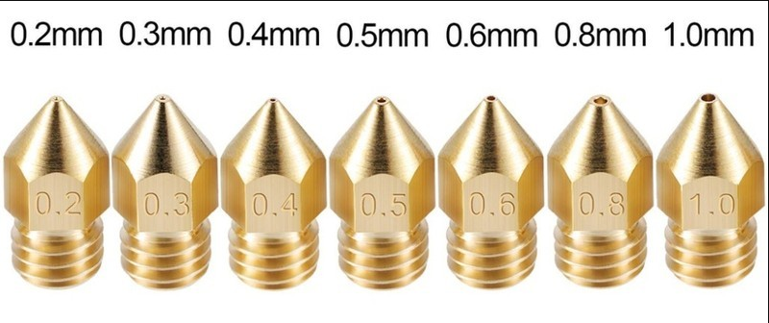
Unit 3: Components of an FDM 3D Printer.
3.3 HEATED PARTS AND EXTRUSION SYSTEM
3.3.2.6 NOZZLE (NOZZLES)
In addition, the nozzles come in different standard diameters:
0.2 mm: For high-resolution prints
precision and fine details, although with
a slower printing speed.
0.4 mm: The most common size, it offers a
balance between speed and detail.
0.6 mm and 0.8 mm: Used for fast prints and larger parts, sacrificing some resolution.

Slide 16
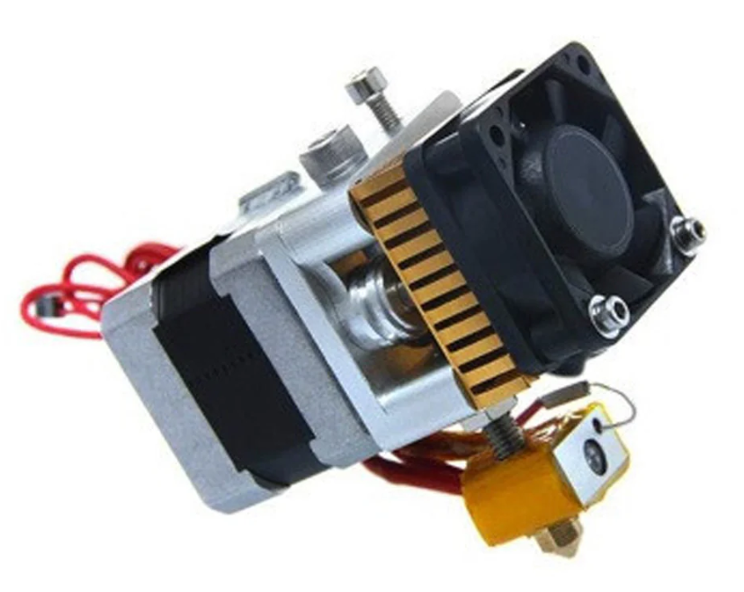
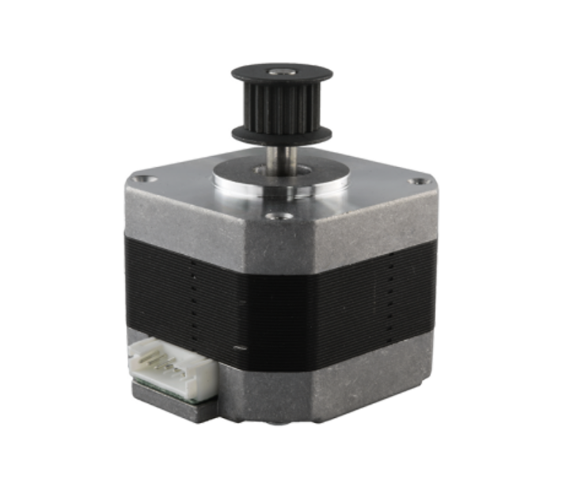
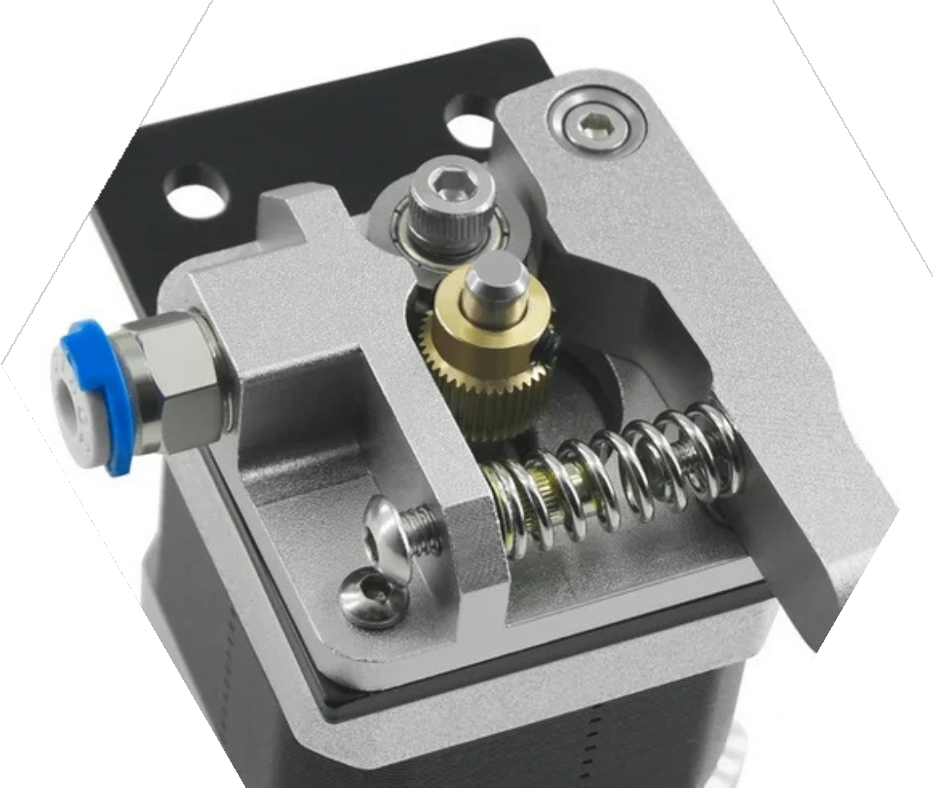
Unit 3: Components of an FDM 3D Printer.
3.3 HEATED PARTS AND EXTRUSION SYSTEM
3.3.3 EXTRUSION SYSTEM
Extrusor
Extruder: It is a motor directly responsible for pushing the plastic filament towards the hotend, where it will be melted.
It is usually a stepper motor, like those of the axes, but with a reduction system (gears) that allows it to apply the necessary force to move the filament in a constant and controlled manner.
Toothed Pulley (or Drive Gear): It is a small wheel with teeth that meshes firmly with the filament and continuously drives it towards the hotend.
Its design ensures a firm grip and constant movement of the material, preventing slippage and under-extrusion problems.
Stepper motor
Drive gear
Housing
Filament input
Pressure mechanism

Slide 17
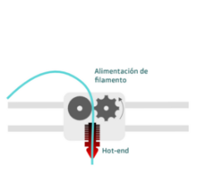
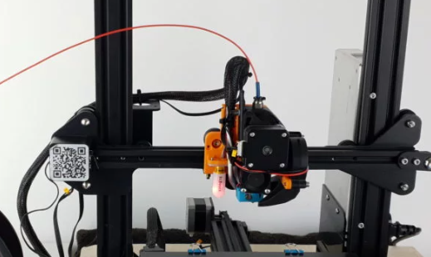
Unit 3: Components of an FDM 3D Printer.
3.3 HEATED PARTS AND EXTRUSION SYSTEM
3.3.3 EXTRUSION SYSTEM
Direct System: The motor is mounted directly on the hotend.
Advantages: It offers greater precision in filament retraction and extrusion.
Ideal for flexible filaments such as TPU, as the filament path is very short and direct.
Disadvantages: The greater weight on the printhead can limit printing speed and increase "ghosting" if not managed properly.
Filament feed
Hot-end

Slide 18
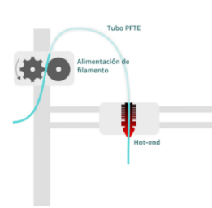
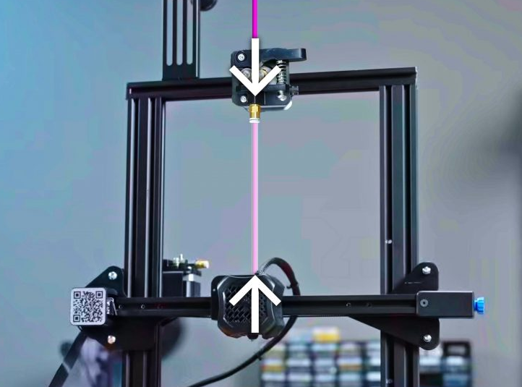
Unit 3: Components of an FDM 3D Printer.
3.3 HEATED PARTS AND EXTRUSION SYSTEM
3.3.3 EXTRUSION SYSTEM
PTFE tube
PTFE tube
Bowden or Direct Drive System: These two systems describe the configuration of the extruder and hotend, impacting the printer's performance.
Bowden system: The extrusion motor is separate from the hotend, and the filament travels through a flexible PTFE (Teflon) tube.
Advantages: It significantly reduces the weight on the print head, allowing faster movements, reducing inertia and also reducing ghosting.
Disadvantages: it may have more retraction delay and is less ideal for very flexible filaments.
Filament Feeding
Hot-end

Slide 19
Unit 3: Components of an FDM 3D Printer.
3.3 HEATED PARTS AND EXTRUSION SYSTEM
3.3.3 EXTRUSION SYSTEM
Direct System: The motor is mounted directly on the hotend.
Advantages: It offers greater precision in filament retraction and extrusion.
Ideal for flexible filaments such as TPU, as the filament path is very short and direct.
Disadvantages: The greater weight on the printhead can limit printing speed and increase "ghosting" if not managed properly.
Filament feed
Hot-end

Slide 20
Unit 3: Components of an FDM 3D Printer.
3.3 HEATED PARTS AND EXTRUSION SYSTEM
3.3.3 EXTRUSION SYSTEM
PTFE tube
PTFE tube
Bowden or Direct Drive System: These two systems describe the configuration of the extruder and hotend, impacting the printer's performance.
Bowden system: The extrusion motor is separate from the hotend, and the filament travels through a flexible PTFE (Teflon) tube.
Advantages: It significantly reduces the weight on the print head, allowing faster movements, reducing inertia and also reducing ghosting.
Disadvantages: it may have more retraction delay and is less ideal for very flexible filaments.
Filament Feeding
Hot-end

Slide 21
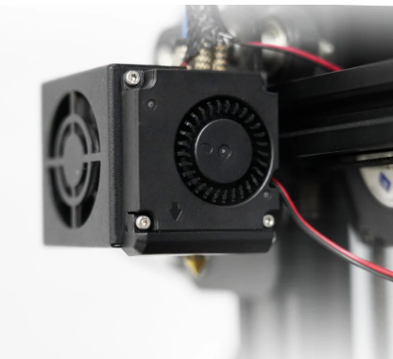
Unit 3: Components of an FDM 3D Printer.
3.3 HEATED PARTS AND EXTRUSION SYSTEM
3.3.4 LAYER FAN
Main function: The layer fan rapidly cools the freshly extruded filament, helping it solidify immediately. This improves print quality by preventing warping, unwanted stringing, and layer adhesion problems.
Location: It is usually mounted near the hotend, directing the airflow directly onto the nozzle or material deposition zone.
Adjustable speed: The fan speed can be controlled from the printing software. Materials like PLA require more ventilation, while others like ABS or PETG need less to avoid sudden contractions.

Slide 22
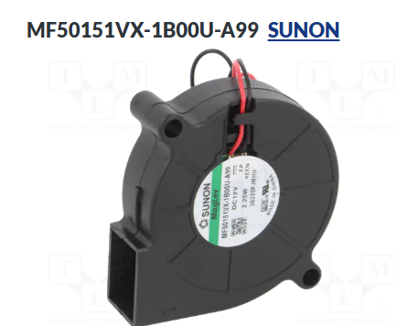
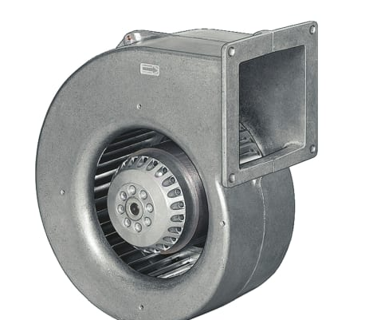
Unit 3: Components of an FDM 3D Printer.
3.3 HEATED PARTS AND EXTRUSION SYSTEM
3.3.4 LAYER FAN
Types of fans:
Radial (blowers): They are usually more efficient at directing air precisely in a concentrated flow.
Axial: Similar to computer fans, they move a large volume of air but with less directional pressure.
Importance in fine details: It is crucial when printing small parts, thin structures or bridges, as rapid cooling helps to maintain the shape and stability of these structures.

Slide 23
:
THANK YOU!
www.fpsanturtzilh.eus
Mikel Iturraspe Eguia
miturraspee@fpsanturtzilh.eus
Notes:
The alliance will establish an Open Innovation Community to promote applied research and development projects, mainly between Centres of Vocational Excellence and Small and Medium Enterprises. To achieve this cooperation, the role of Vocational Education and Training in Advanced Manufacturing Research and Development activities and its contribution to Regional Smart Specialisation Strategies will be clarified.

