Slide 1

Unit 2: FDM Technology and materials

Slide 2

Unit 2: FDM Technology
SUMMARY OF CONTENTS
2.1 OPERATION
2.1 OPERATION
2.2 DESIGN PREPARATION
2.3 FDM PRINTING PHASE
2.4 STRUCTURE
2.5 PRINTING MATERIALS AND PARTICULARITIES

Slide 3
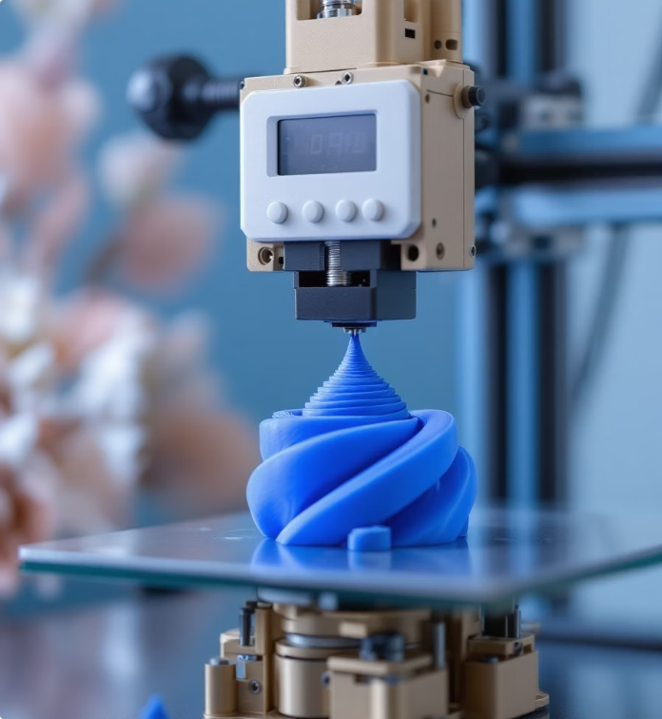
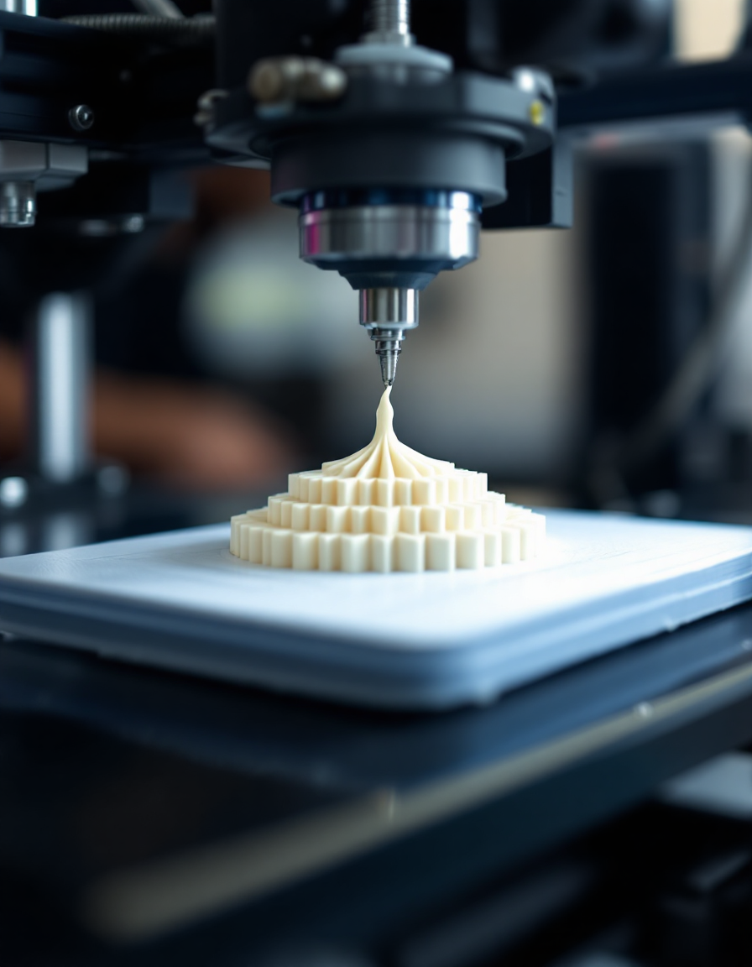
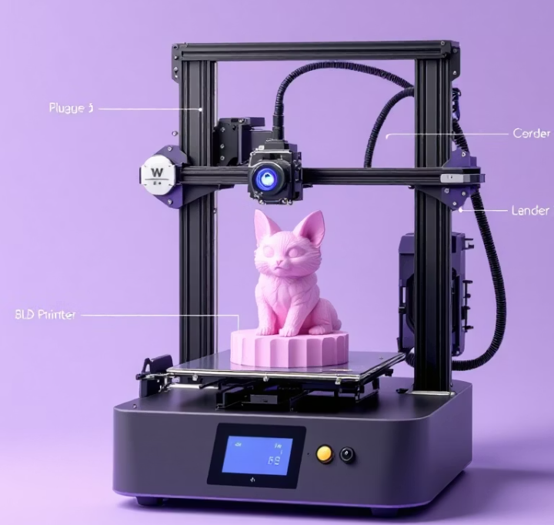
Unit 2: FDM Technology
2.1 OPERATION
FDM stands for Fused Deposition Modeling. It is an additive manufacturing process that builds objects layer by layer. It is a 3D printing method based on melting and extruding thermoplastic material to create 3D objects layer by layer.

Slide 4



Unit 2: FDM Technology
2.2 FDM DESIGN PREPARATION
3D model preparation: A digital model is designed and converted into printer instructions using slicing software.
Export the previous file to STL, a format compatible with the slicer.
Laminating software (BAMBU-CURA): Converts the STL file into printer instructions by configuring parameters and generating a GCODE file.
3D MODEL
STL
SLICER

Slide 5
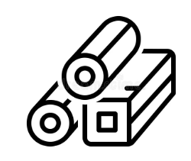

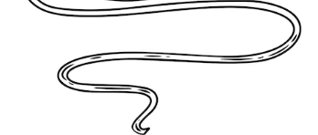
Unit 2: FDM Technology
2.3 FDM PRINTING PHASE.
Material: The extruder is correctly fed with thermoplastic materials (PLA…), after having properly cleaned said extruder of materials from previous prints.
Heating and extrusion: A filament of thermoplastic material (such as PLA, ABS or PETG) is heated in a nozzle until it reaches its melting point.
Material deposition: The nozzle moves over the printing base, extruding the molten material in successive layers according to the design.
.
MATERIAL
FUSION
DEPOSITION

Slide 6
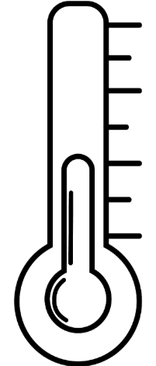
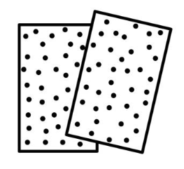
Unit 2: FDM Technology
2.3 PRINTING PHASE.
Cooling and solidification: As the material is deposited, it cools and hardens to form the object's structure.
Post-processing. Finishing the part: Once the printing is finished, the part may need post-processing, such as sanding or removing supports.
.
SOLIDIFICATION
POST-PROCESSING

Slide 7
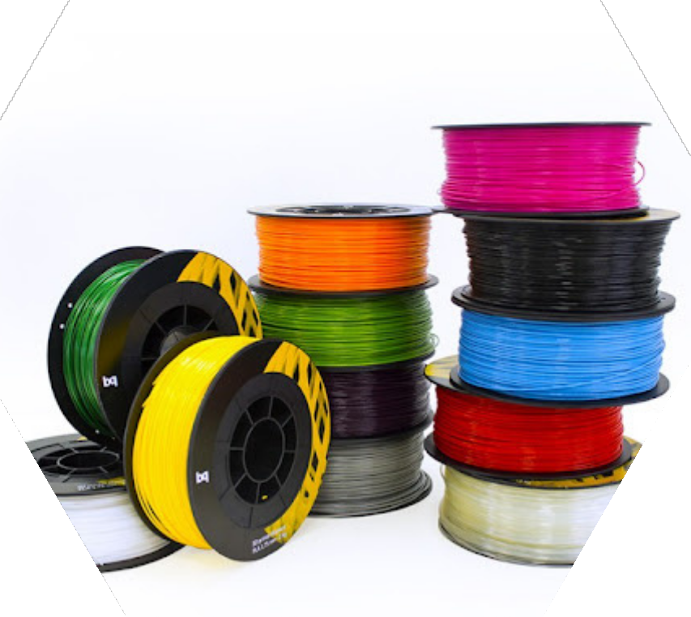
Unit 2: FDM Technology
2.4 MATERIALS AND PARTICULARITIES
Choosing the right materials for FDM printing is essential to ensuring the success of any project.
Each material possesses unique properties that influence the strength, flexibility, finish, and durability of the printed parts.
Understanding its characteristics allows for optimizing both the process of
printing as the performance of the final product

Slide 8
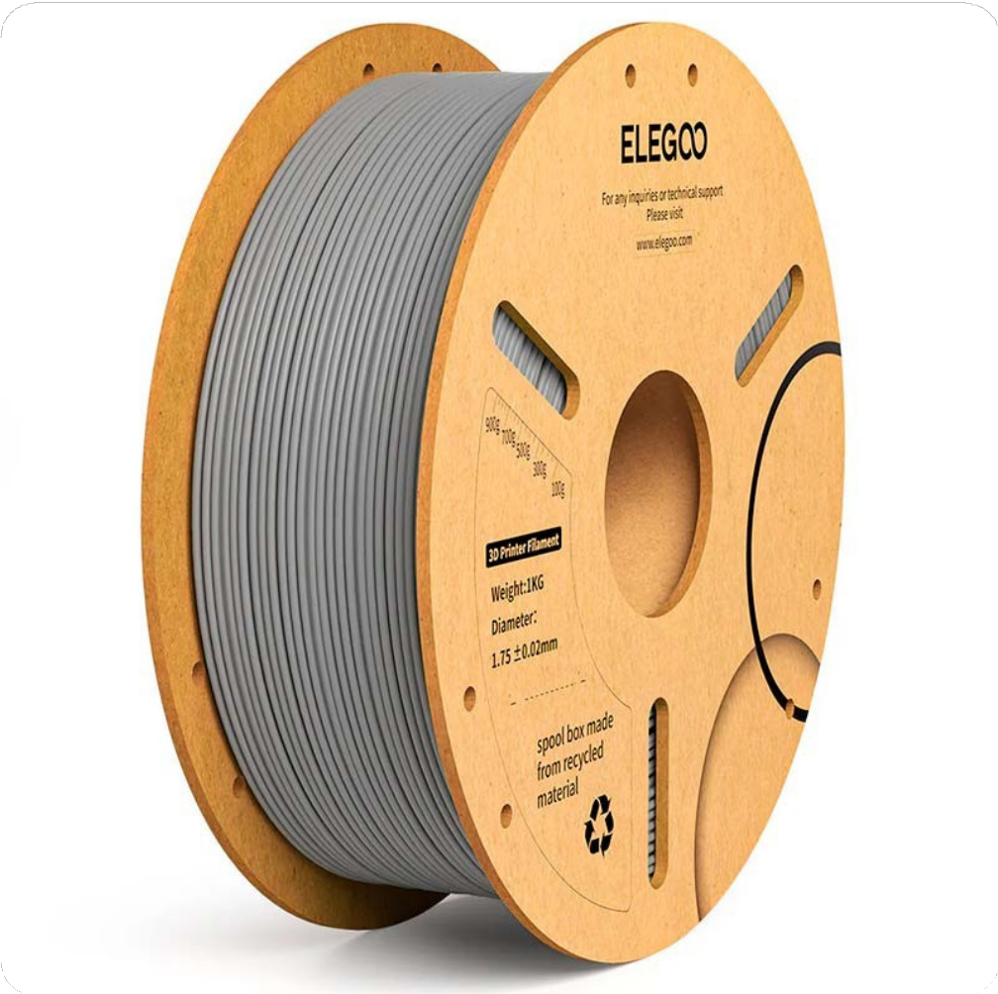
Unit 2: FDM Technology
2.4. MATERIALS AND PARTICULARITIES
2.4.1 CONSTRUCTION
COIL
FILAMENT
COIL:
The width and diameter vary depending on the material manufacturer.
MATERIAL:
Two diameters: 1.75 mm and 2.85 mm
Units of measurement: KG

Slide 9


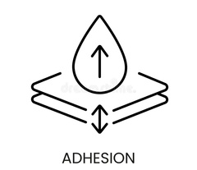

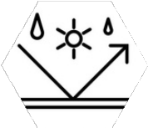

Unit 2: FDM Technology
2.4 MATERIALS AND PARTICULARITIES
2.4.2 PROPERTIES
Melting point and thermal resistance
Melting temperature: range of temperature required to extrude the filament
Thermal resistance: determines the ability of the part to maintain its shape and properties at high temperatures
Surface finishing and post-processing
Mechanical resistance.
Material's ability to withstand external forces
The texture and appearance of the piece
Flexibility and rigidity
Adhesion between layers
Good adhesion between layers ensures the cohesion and strength of the final piece
Flexibility allows a piece to bend without breaking, while rigidity ensures that it maintains its shape under pressure.
Durability and degradation
Material resistance to environmental factors such as humidity and UV rays

Slide 10
UD2: FDM TECHNOLOGY
2.4 MATERIALS AND SPECIAL FEATURES
2.4.3 MOST COMMON MATERIALS
PLA
PVA
ABS
TPU
PETG
NYLON
PC

Slide 11
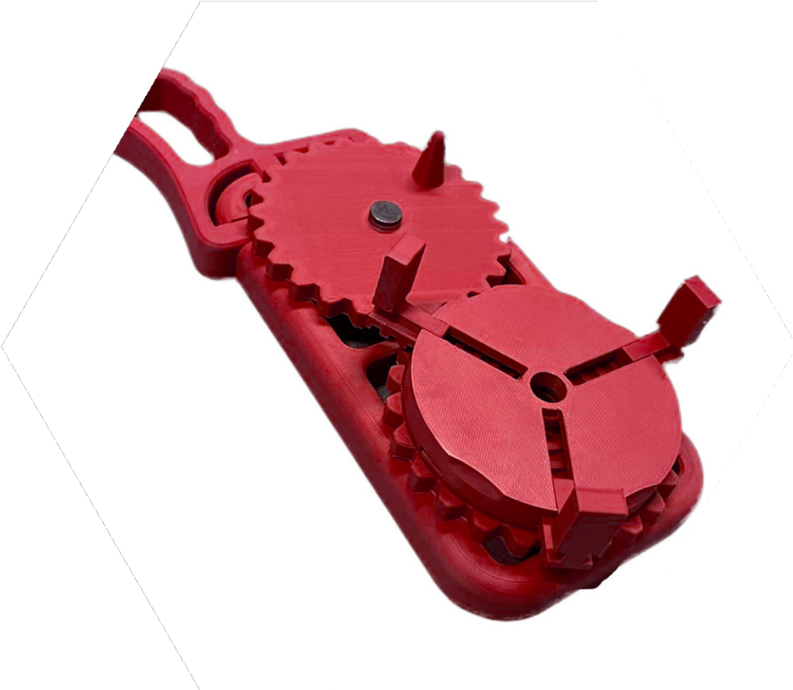
UD2: FDM TECHNOLOGY
2.4 MATERIALS AND SPECIAL FEATURES
2.4.3.1 PLA (Polylactic Acid)
Common applications
Prototypes (without excessive mechanical characteristics)
Decorative and visual parts..
.
Advantages over others:
Ease of use
Produced from vegetable starches.
BIODEGRADABLE.
Melts at low temperatures.
Key printing temperatures.
Hotend temperature: 120º-220º
Bed temperature: 0º-55º.
Disadvantages compared to others:
It is fragile.
It has low thermal resistance.

Slide 12
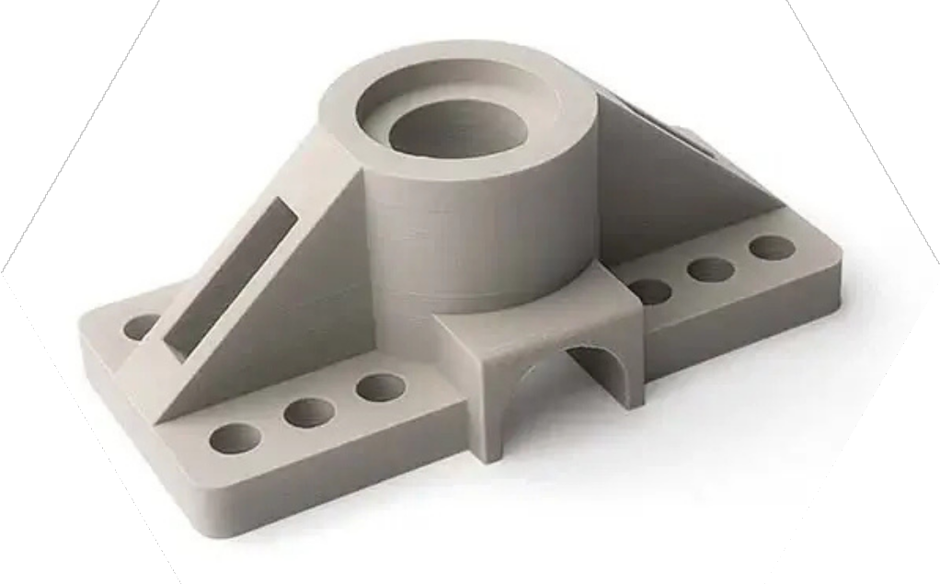
UD2: FDM TECHNOLOGY
2.4 MATERIALS AND SPECIAL FEATURES
2.4.3.1 ABS (Acrylonitrile Butadiene Styrene)
Advantages over others:
Resistant material
Withstands higher temperatures than PLA
Can be sanded and painted easily
Common applications
Functional parts
Housings
Mechanical components
Disadvantages over others:
Emits vapors during printing
Prone to warping
Prone to cracking
Key printing temperatures.
Hotend temperature: 230º-260º
Bed temperature: 60º-100º

Slide 13
Unit 2: FDM Technology
2.4 MATERIALS AND PARTICULARITIES
2.4.2 PROPERTIES
Melting point and thermal resistance
Melting temperature: range of temperature required to extrude the filament
Thermal resistance: determines the ability of the part to maintain its shape and properties at high temperatures
Surface finishing and post-processing
Mechanical resistance.
Material's ability to withstand external forces
The texture and appearance of the piece
Flexibility and rigidity
Adhesion between layers
Good adhesion between layers ensures the cohesion and strength of the final piece
Flexibility allows a piece to bend without breaking, while rigidity ensures that it maintains its shape under pressure.
Durability and degradation
Material resistance to environmental factors such as humidity and UV rays

Slide 14
UD2: FDM TECHNOLOGY
2.4 MATERIALS AND SPECIAL FEATURES
2.4.3 MOST COMMON MATERIALS
PLA
PVA
ABS
TPU
PETG
NYLON
PC

Slide 15
UD2: FDM TECHNOLOGY
2.4 MATERIALS AND SPECIAL FEATURES
2.4.3.1 PLA (Polylactic Acid)
Common applications
Prototypes (without excessive mechanical characteristics)
Decorative and visual parts..
.
Advantages over others:
Ease of use
Produced from vegetable starches.
BIODEGRADABLE.
Melts at low temperatures.
Key printing temperatures.
Hotend temperature: 120º-220º
Bed temperature: 0º-55º.
Disadvantages compared to others:
It is fragile.
It has low thermal resistance.

Slide 16
UD2: FDM TECHNOLOGY
2.4 MATERIALS AND SPECIAL FEATURES
2.4.3.1 ABS (Acrylonitrile Butadiene Styrene)
Advantages over others:
Resistant material
Withstands higher temperatures than PLA
Can be sanded and painted easily
Common applications
Functional parts
Housings
Mechanical components
Disadvantages over others:
Emits vapors during printing
Prone to warping
Prone to cracking
Key printing temperatures.
Hotend temperature: 230º-260º
Bed temperature: 60º-100º

Slide 17
UD2: FDM TECHNOLOGY
2.4 MATERIALS AND SPECIAL FEATURES
2.4.3.1 PLA vs ABS. PRINTING RECOMMENDATIONS.
ABS
Preheat the bed before leveling.
Perform proper bed leveling before each print.
Constant chamber temperature to prevent cracking.
Layer fan at 0° to prevent cracking.
If necessary, use DIMAFIX lacquer.
PLA
Perform proper bed leveling before each print.
Preheat the bed before leveling.
If necessary, use NELLY lacquer (may not be necessary if the above steps are performed correctly).

Slide 18
UD2: FDM TECHNOLOGY
2.4 MATERIALS AND PARTICULARITIES
2.4.3.1 PETG (Polyethylene Terephthalate Glycol).
Advantages compared to others:
Good mechanical resistance.
Good thermal resistance.
Impact resistant.
Common applications
Functional parts
Components exposed to
efforts
.
Disadvantages compared to others:
It may have stringing.
It needs fine-tuning of parameters.
.

Slide 19
UD2: FDM TECHNOLOGY
2.4 MATERIALS AND PARTICULARITIES
2.4.3.1 TPU (Thermoplastic Polyurethane).
Advantages compared to others:
Very flexible.
Wear resistant.
.
Common applications
Elastic pieces.
Protectors.
Together.
.
Disadvantages compared to others:
Difficult to print due to its elasticity.
.

Slide 20
UD2: FDM TECHNOLOGY
2.4 MATERIALS AND PARTICULARITIES
2.4.3.1 NYLON.
Advantages compared to others:
High mechanical resistance.
Flexible.
Durable.
.
Common applications
Mechanical parts subjected to friction.
.
Disadvantages compared to others:
It absorbs moisture easily.
Requires special storage.
.

Slide 21
UD2: FDM TECHNOLOGY
2.4 MATERIALS AND PARTICULARITIES
2.4.3.1 PC (POLYCARBONATE)
Advantages compared to others:
Very high thermal resistance
Very high mechanical resistance
.
Common applications
Parts subjected to high temperatures or stress
.
Disadvantages compared to others:
It requires high printing temperatures
Prone to deformation.
.

Slide 22
:
THANK YOU!
www.fpsanturtzilh.eus
Mikel Iturraspe Eguia
miturraspee@fpsanturtzilh.eus
Notes:
The alliance will establish an Open Innovation Community to promote applied research and development projects, mainly between Centres of Vocational Excellence and Small and Medium Enterprises. To achieve this cooperation, the role of Vocational Education and Training in Advanced Manufacturing Research and Development activities and its contribution to Regional Smart Specialisation Strategies will be clarified.

