Slide 1


Robotics- Health and Security

Slide 2

COURSE INTRODUCTION
The following course will cover the main topics of interest regarding occupational safety and health (OSH), and the technological innovation that is impacting OSH and will affect its management and operational development in the field.
The topics covered in different clips will be:
CLIP 1 - 2 – 3 OSH and Technology - Overview
CLIP 4 - 5 – 6 OSH and Collaborative Robotics
CLIP 7 - 8 - 9 OSH and Exoskeletons
CLIP 10 - 11 - 12 OSH and Digital Twins, Virtual Reality, and Proximity Sensing
CLIP 13– 14 – 15 – 16 Human factor and emerging risks

Slide 3
The value of the problem of OSH
Universal Declaration of Human Rights (1948)
Everyone has the right to work, to free choice of employment, to just and favourable conditions of work ... (Article 23)
Everyone has the right to work under just and favorable conditions.
This declaration emphasizes the importance of respecting and protecting individual wellbeing at work.
International Covenant on Economic, Social and Cultural Rights (1976)
The States Parties to the present Covenant recognize the right of everyone to the enjoyment of just and favourable conditions of work, which ensure, in particular: ... (b) Safe and healthy working conditions ... (Article 7)
Safe and healthy working conditions are highlighted as a key aspect of this right.
The States Parties recognize the right to just and favorable conditions of work.
Declaration on Fundamental Principles and Rights at Work (1998)
It explicitly recognizes the right of workers to a healthy and safe work environment.
This declaration expresses the commitment to uphold fundamental human values.

Slide 4
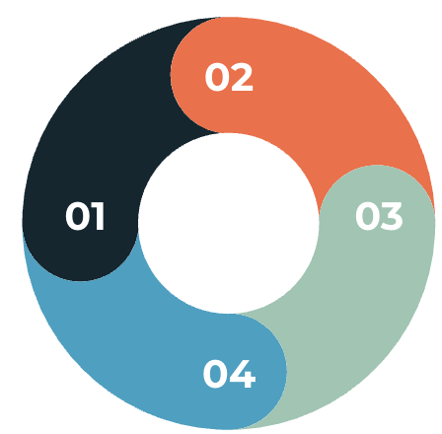
OSH social and economic relevance
Convincing people about the benefits
Safety measures as an inevitable aspect of work
Perceived hindrance to productivity
Positive change in workplaces: innovation as a driving force
Exploring the role of technology in improving safety
Enhancing productivity through safety measures

Slide 5
OSH social and economic relevance
Workplace Safety: A Global Concern
Some alarming data in Italy and the world…
2 workers die daily in Italy due to work-related incidents.
2.78 million work-related deaths worldwide reported by ILO.
$3.2 trillion lost annually due to work-related accidents, 4% world GDP.
EU reports over 3,000 fatal accidents yearly.
The sharing of knowledge is the key to pursuing positive changes.
Collaboration among international and national organizations crucial for improvement.

Slide 6
OSH social and economic relevance
Some other truly significant data points from the International Labour Organization…
Work-related illnesses are the leading cause of death among workers globally, with hazardous substances alone estimated to cause 651,279 deaths annually.
The construction sector exhibits a notably high rate of recorded accidents.
Both younger and older workers are particularly vulnerable demographics. As the population ages in developed countries, there is a growing need for tailored attention and specific protection measures for older workers.
The sharing of knowledge is the key to pursuing positive changes.
Collaboration among international and national organizations crucial for improvement.

Slide 7
National and international organizations
[Europe] Eu-OSHA, National Legislation:
https://osha.europa.eu/en/legislation/directives/the-osh-framework-directive/the-osh-framework-directive-introduction
[USA] Dept. Of Labour, State Plans:
https://www.dol.gov/general/topic/safety-health
[USA] NIOSH:
https://www.usa.gov/federal-agencies/national-institute-of-occupational-safety-and-health
[WORLD] ILO:
https://www.ilo.org/safework/countries/lang--en/index.htm

Slide 8
OSH definition
From the International Labour Organization…
Occupational Safety and Health (OSH) is a discipline aimed at:
Continuously promoting the highest level of physical, mental, and social well-being of workers;
Maintaining and improving workplace conditions to reduce or prevent the likelihood of worker injuries;
Protecting workers from risks that negatively impact their health over the years;
Promoting a work environment suitable for the physical and mental capacities of workers.

Slide 9
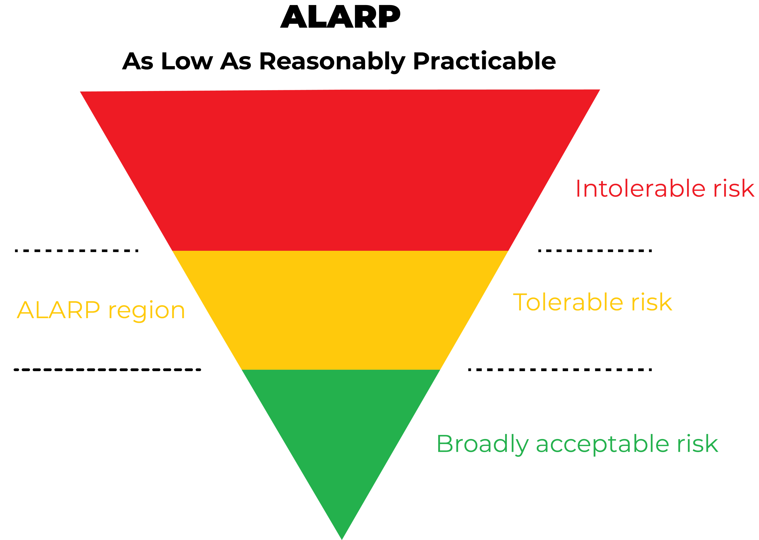
The goal of OSH management
Objective: Eliminate or minimize sources of risk.
Risk: Likelihood of negative outcomes for workers.
Source: Main cause of risk (e.g., inadequately protected equipment).
Approach: "Eliminate the source of risk" where feasible.
Realism: No activity is risk-free; some risks are unavoidable.
Pragmatic Approach: Aim for the lowest reasonably achievable risk level (ALARP). This concept allows us not to bankrupt companies and to be productive: otherwise, to avoid accidents, we would have to shut down all activities.
UNI ISO 45001:2018

