Slide 1

Programming ofAugmented Realityassistedassembly station -Architect
Translated from Basque to English - www.onlinedoctranslator.com

Slide 2
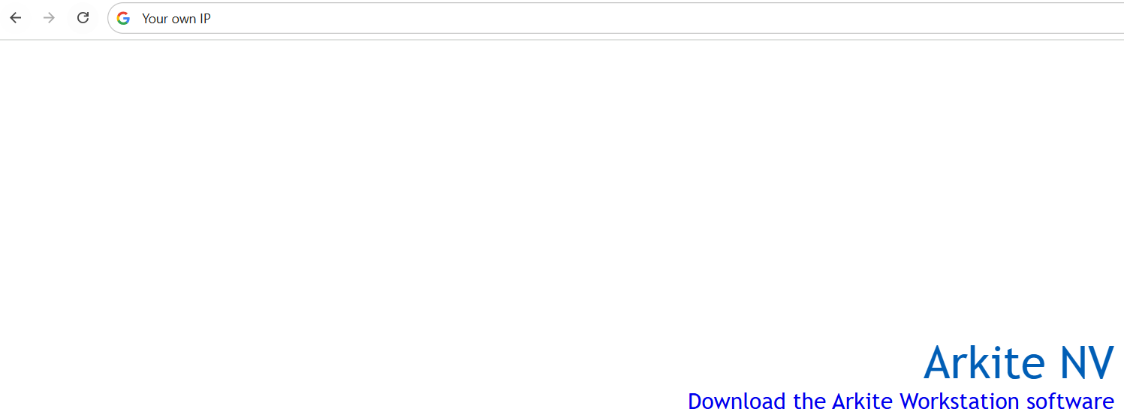
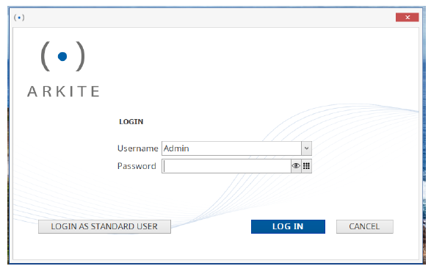
Installation and access
Installation
Access
When opening ARKITE, the following window will open.
Fill in the following details (Note: enter administrator details):
In the Username section: “own license username"
In the Password section: times “own license password"
#LCAMP_EU

Slide 3
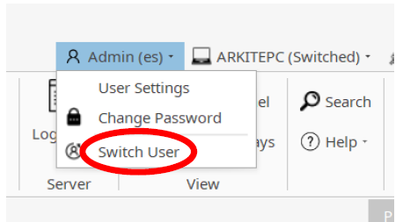
Installation and access
Access
Sometimes, when opening ARKITE, it takes us directly to the main screen as “Standard User”. In this case, to change the user, we will select “Switch User” in the place shown in the following image and perform the same sequence as in the previous step.
#LCAMP_EU

Slide 4
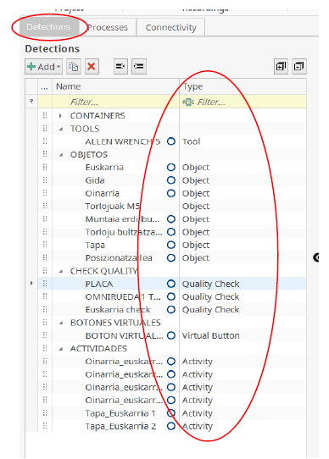
Program elements
Detections
Once we are on the main screen as an administrator, we will create all the elements that will participate in our assembly in the "Detections" section:
Container: Boxes used to store assembly material. Do not modify these, they have already been created and will remain the same throughout all assemblies (the material that will be placed in each box will change, and we will explain this later).
Tools: Tools that will be used during assembly.
Object: To create detections of all the parts we will assemble.
Quality check: The validation system that we will use to certify the edits made using the “Visio” camera.
Virtual Button: For workers to interact with the machine. The worker must press a button to perform something requested by the machine (start assembly verification, jump to the next step in the assembly, etc.).
Activity: The command we will use when we want to perform an operation over a period of time. For example, when tightening screws, gluing a piece, etc.
#LCAMP_EU

Slide 5
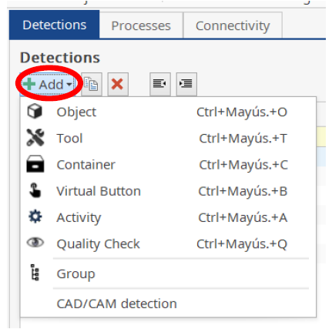
Program elements
Create detections
To create these detections we should click on the “ADD” button. Once we click on it, we will select and name the detection we want to create.
NOTE
This first part , until detections are calibrated, we will work from the computer. Even that, the machine should be should on.
#LCAMP_EU

Slide 6
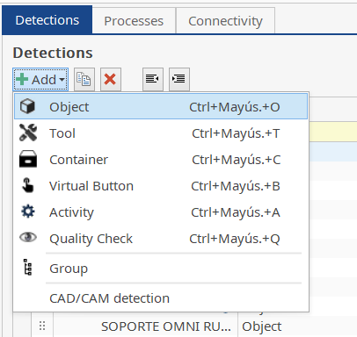
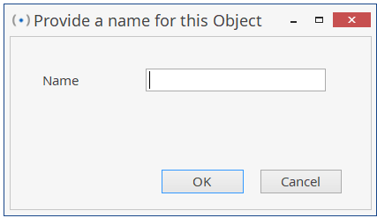
Program elements
Create an “Object”
Among the different options, we will create all the objects that participate in the first assembly. If an identical piece is located in more than one place, we will have to create that many detections, not just one. We will give each detection the name we want.
#LCAMP_EU

Slide 7
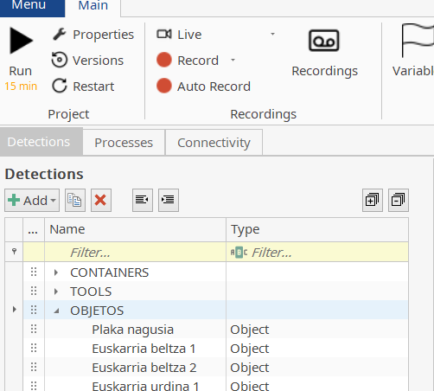
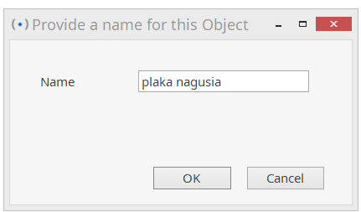

Program elements
Create “Object” - Example
1. Select the “Detections” tab and choose the “Objects” section to create the object itself.
2. Click the “+Add” button and select “object”.
3. Select the object name “Main plate” and click OK.
#LCAMP_EU

Slide 8
Program elements
Exercise
Create our in the project necessary which are objects.From Lcamp robot base taken for granted, robotthis chassis simplificationonewill do we have.Remember,link items(screws,etc..)no that they are object as considering.Create need which are objects:
MAIN BOARD
ARDUINO BASE
WHEEL SUPPORT 1
WHEEL SUPPORT 2
OMNI WHEEL SUPPORT 1
OMNI WHEEL SUPPORT 2
BATTERY SUPPORT
CURVED SENSOR BOX 1
CURVED SENSOR BOX 2
USB CONNECTOR SENSORBOX
4PIN CONNECTOR SENSORBOX
#LCAMP_EU

Slide 9
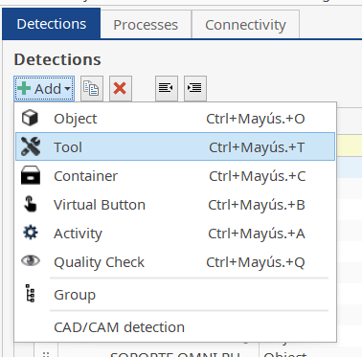
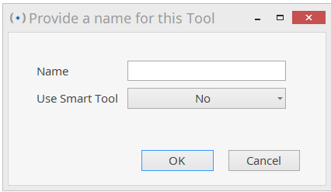
Program elements
Create a “Tool”
With this option we will create all the tools that we will have on our workbench to complete the assembly. Each tool will have its own detection and name.
#LCAMP_EU

Slide 10
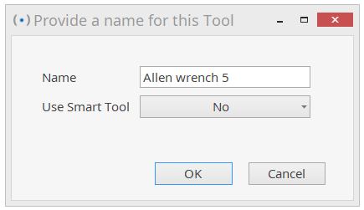
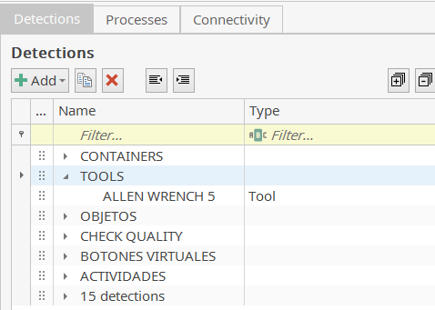
Program elements
Create a “Tool” - Example
1. Select the “Detections” tab and choose the “Tools” section to create the tool there.
2. Click the “+Add” button and select “Tool”.
3. Select the tool name “Allen wrench 5” and click OK.
#LCAMP_EU

Slide 11
Program elements
Exercise
Create the tools needed for our project. We only need one tool to assemble this simplified Lcamp robot. Tools needed to create:
Allen wrench 5
#LCAMP_EU

Slide 12
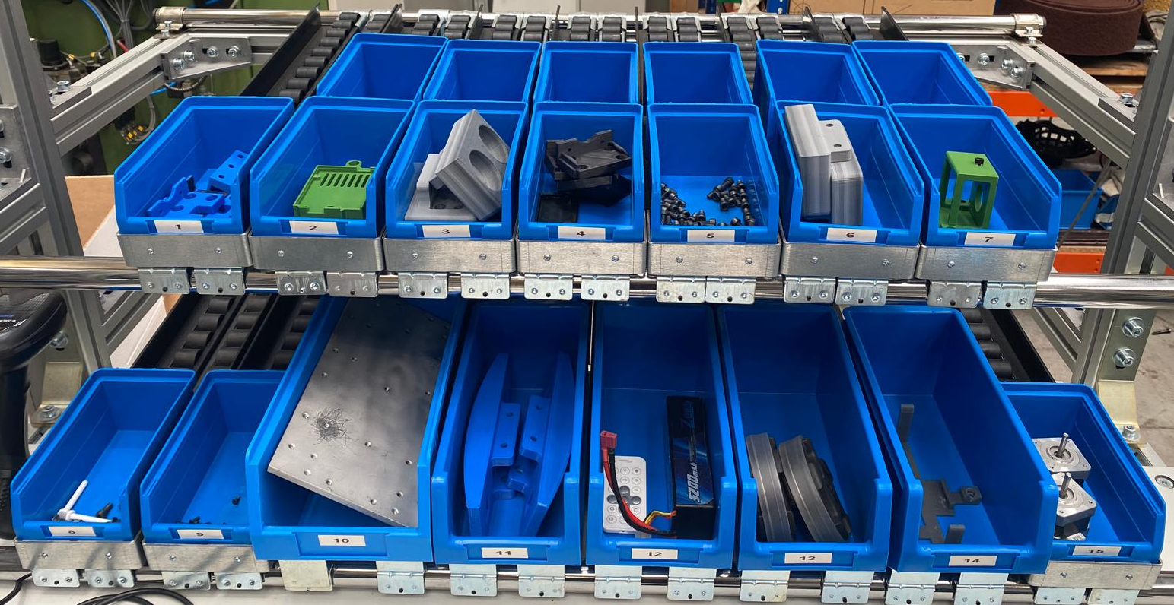
Program elements
Create a “Container”
This option defines the locations of the parts that will be in the assembly. In this case, following the template in this course, the “Containers” will be defined.
In the image below you can see the “Container” layout that we follow in this project.
To have a different layout, the “Containers” should be adjusted. On the one hand, adjust the number of “Containers”, using “Add+” if there are more and deleting them otherwise. On the other hand, if the box size or layout is different, adjust the detections that will be explained later.
Small box:
Medium box:
Big box:
#LCAMP_EU

Slide 13
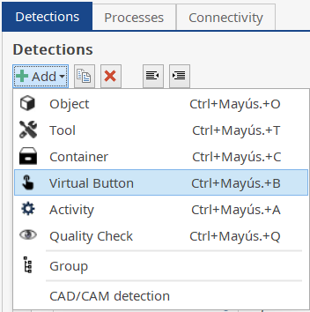
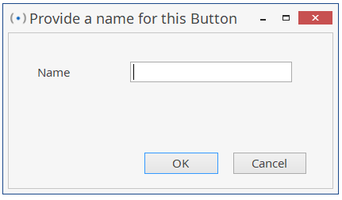
Program elements
Create a “virtual button”
It allows us to create a virtual button on the workbench so that the worker can manually validate a step or interact with the machine.
#LCAMP_EU

Slide 14
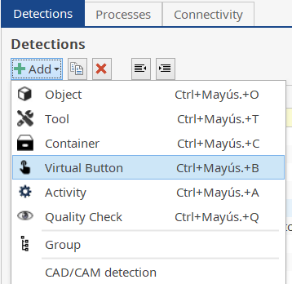
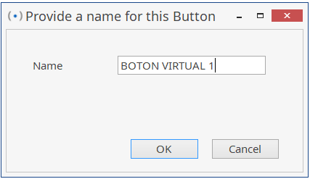
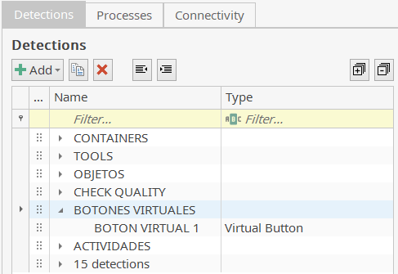
Program elements
Create a “Virtual Button” - Example
1. Select the “Detections” tab and choose the “Virtual button” section to create the virtual button there.
2. Click the “+Add” button and select “Virtual Button”.
3. Select the name of the virtual button “VIRTUAL BUTTON 1” and press OK.
#LCAMP_EU

Slide 15
Program elements
Exercise
Create the virtual buttons needed in our project. In this simplified Lcamp robot, when the assembly is complete, the worker will press the virtual button to perform all the verification of the robot (we will activate all the quality checks). Therefore, we will only create one virtual button:
VIRTUAL BUTTON 1
#LCAMP_EU

Slide 16
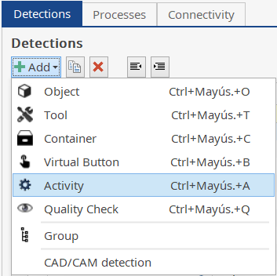
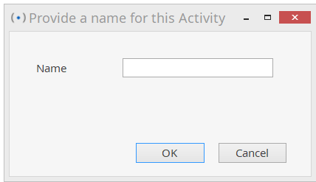
Program elements
Create an “Activity”
It allows us to create an activity (fastening a screw, gluing a part) that must be performed within a certain period of time during the assembly process. Each activity will have its own name, and for example, if the same screw must be fastened in more than one place, that many activities will need to be created.
#LCAMP_EU

Slide 17
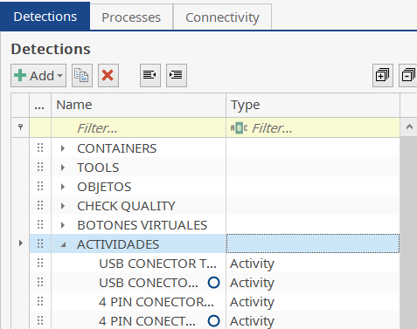
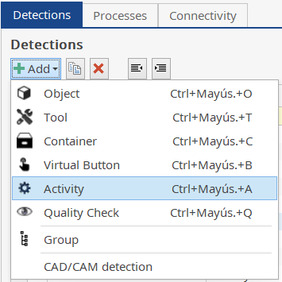
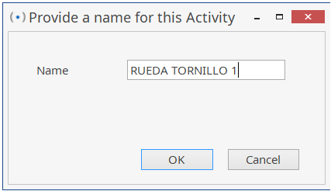

Program elements
Create an “Activity” - Example
1. Select the “Detections” tab and choose the “Activity” section to create activities there.
2. Click the “+Add” button and select “Activity”.
3. Select the name of the virtual button (for example “WHEEL SCREW 1”) and press OK.
#LCAMP_EU

Slide 18
Program elements
Exercise
Create the activities needed for our project. In this simplified Lcamp robot, we will need to create its own activity for each screw that needs to be connected in the assembly. Here are all the “Activities” that need to be created:
SUPPORT 1 OMNI WHEEL SCREW 1
SUPPORT 1 OMNI WHEEL SCREW 2
SUPPORT 1 WHEEL SCREW 1
SUPPORT 1 WHEEL SCREW 2
SUPPORT 2 WHEEL SCREW 1
SUPPORT 2 WHEEL SCREW 2
BATTERY SUPPORT SCREW 1
BATTERY SUPPORT SCREW 2
ARDUINO SUPPORT TOR 1
ARDUINO SUPPORT TOR 2
ARDUINO SUPPORT TOR 3
INSERT SCREW 1
INSERT SCREW 2
INSERT SCREW 3
INSERT SCREW 4
CURVED BOX 1 SCREW 1
CURVED BOX 1 SCREW 2
CURVED BOX 2 SCREW 1
CURVED BOX 2 SCREW 2
USB CONNECTOR SCREW 1
USB CONNECTOR SCREW 2
4 PIN CONNECTOR SCREW 1
4 PIN CONNECTOR SCREW 2
#LCAMP_EU

Slide 19
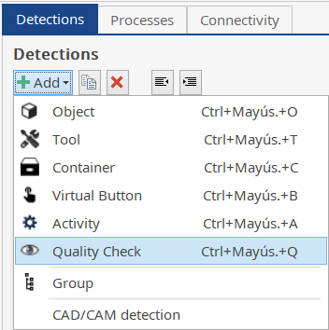

Program elements
Create a “Quality Check”
Detections generated during the assembly process to verify the assembly using a vision camera. It can be included at every step of the assembly, but it is not mandatory. The more verifications you include, the longer the assembly process will be.
#LCAMP_EU

Slide 20
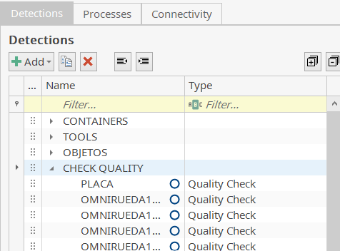

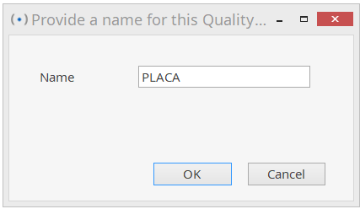

Program elements
Create a “Quality check” - Example
1. Select the “Detections” tab and choose the “Quality check” section to create the verifications there.
2. Click the “+Add” button and select “Quality check”.
3. Select the verification name (such as “PLACA”) and click OK.
#LCAMP_EU

Slide 21
Program elements
Exercise
Create the verifications required in our project. In this simplified robot from Lcamp, a verification has been added to almost every step of the assembly. Here are all the “Quality checks” that need to be created:
PLATE
OMNI1
OMNI2
SUPPORT1 DETECTION
SUPPORT2 DETECTION
ARDUINO
CRUVEDOR
CURVED BOX2 DETECTION
USB
4PIN
#LCAMP_EU

Slide 22
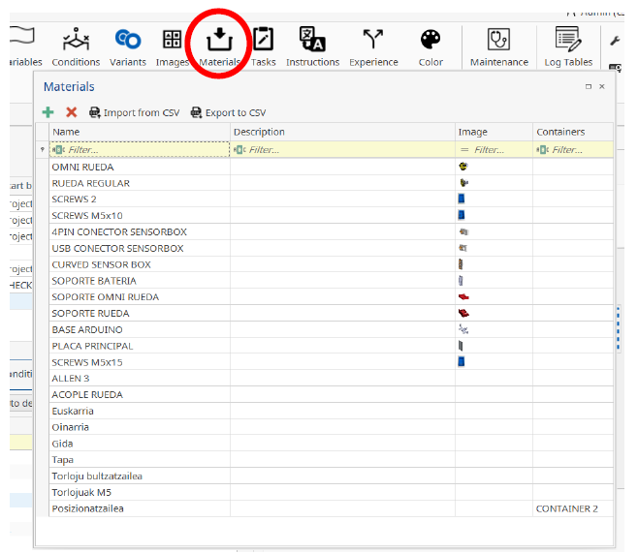
Program elements
Create materials
Along with these detections, the parts that will participate in the assembly process must be created in the “MATERIALS” section.
"MATERIALS" will be created to use in 2 different functions:
To sort parts into “CONTAINERS”.
To “PICK” from “CONTAINERS” and take the piece.
#LCAMP_EU

Slide 23
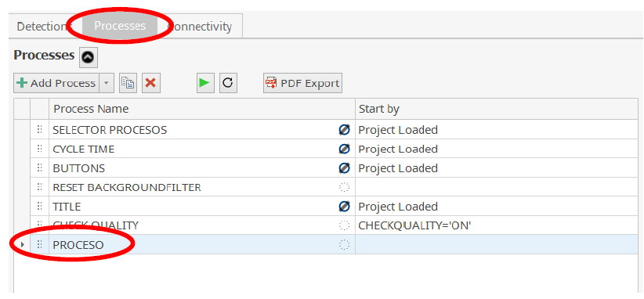
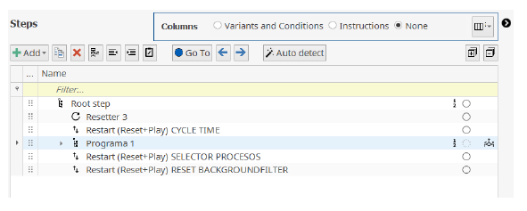
Program processes
Create processes
Once the detections and materials have been created, we will begin to complete the assembly process. To do this, we will enter the “PROCESSES” section. And within this section, the “PROCESSO” section created from previous projects (we will leave everything else as it is).
Within this section, the only thing we will need to modify will be “Program 1”. We will give it the name we want.
#LCAMP_EU

Slide 24
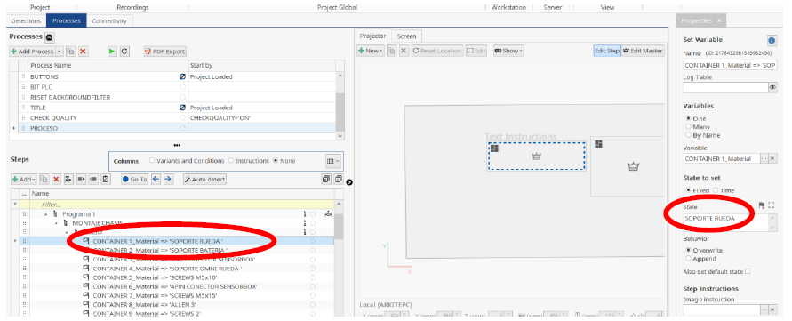
Program processes
Define materials in “Containers”
Within this program, the first change will be to define which pieces will be placed in each “CONTAINER”. To successfully complete this change, the name that will appear in the “State” window must be the same as the element that we created in the “Materials” section.
Note:The names that appear in “Materials” and “States” must be the same.
#LCAMP_EU

Slide 25
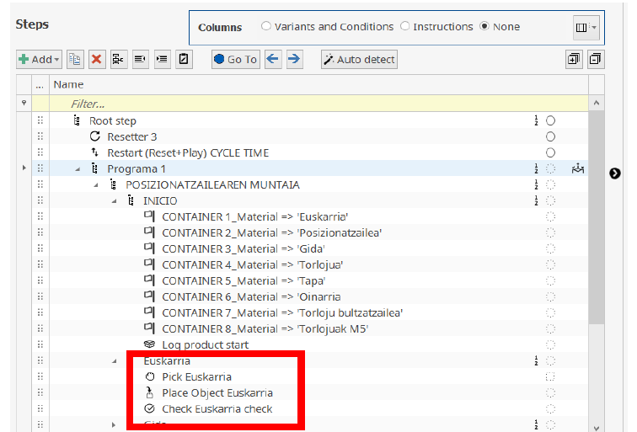
Program processes
Create a program
Next, we will start building the assembly sequence. We will mainly use 3 functions for this:
"Pick” -> To take the part from the container
"Place” -> To place the part in the corresponding assembly position.
"Check” -> To perform assembly verification using the vision camera.
#LCAMP_EU

Slide 26
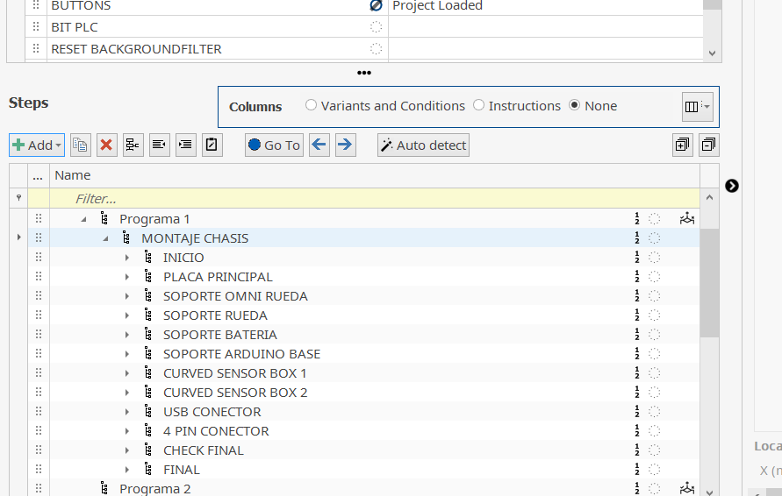
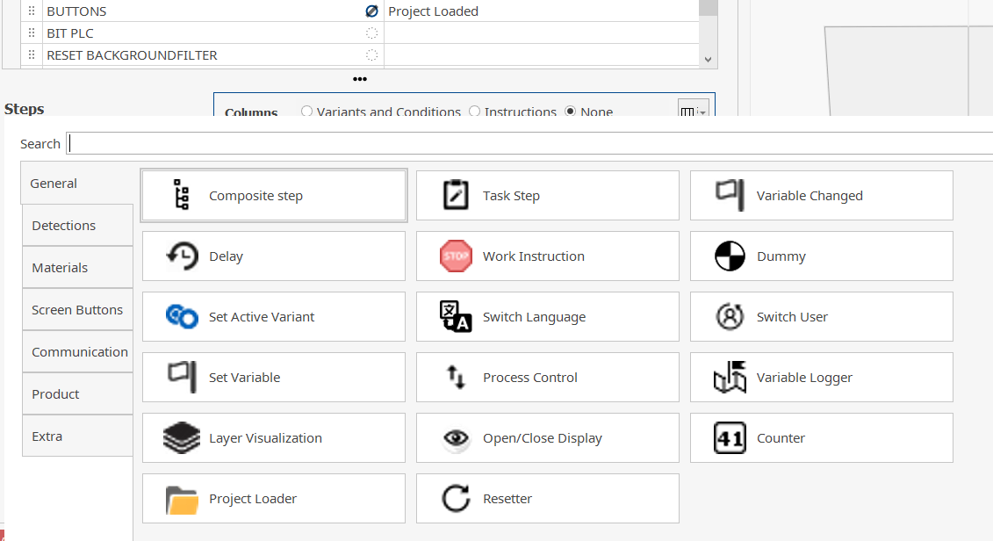
Program processes
Program create–Functions example
Next, we will begin to complete the assembly sequence. Inside "Assembly Chassis" click "+Add" button.
Next, insidev"General" click "Composite step".
#LCAMP_EU

Slide 27
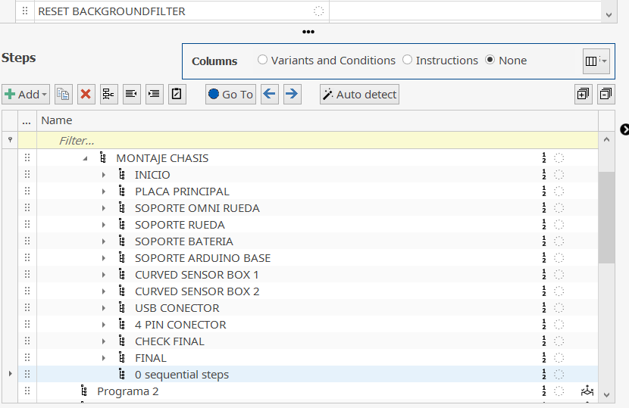
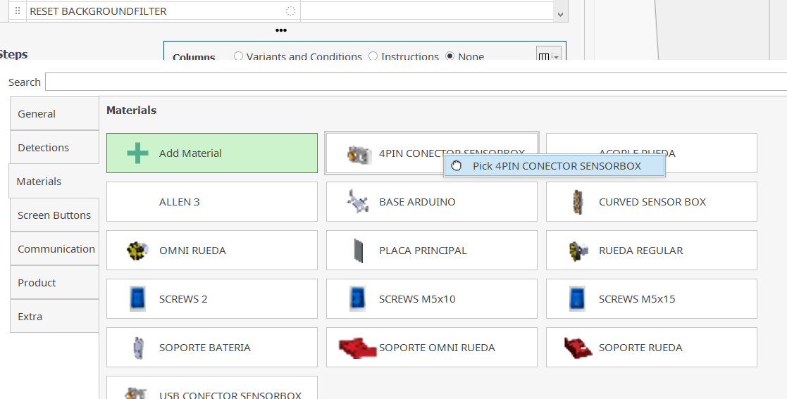
Program processes
Program create–Functions example
There click "+Add" button and inside "Materials", select the needed material (4pinconnector in our case) and click "Pick material", finishing this step.
Name the "sequential steps" that would be created. In our case we will name as "Training".
#LCAMP_EU

Slide 28
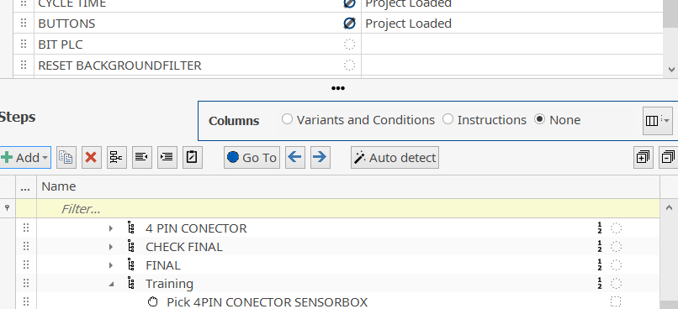
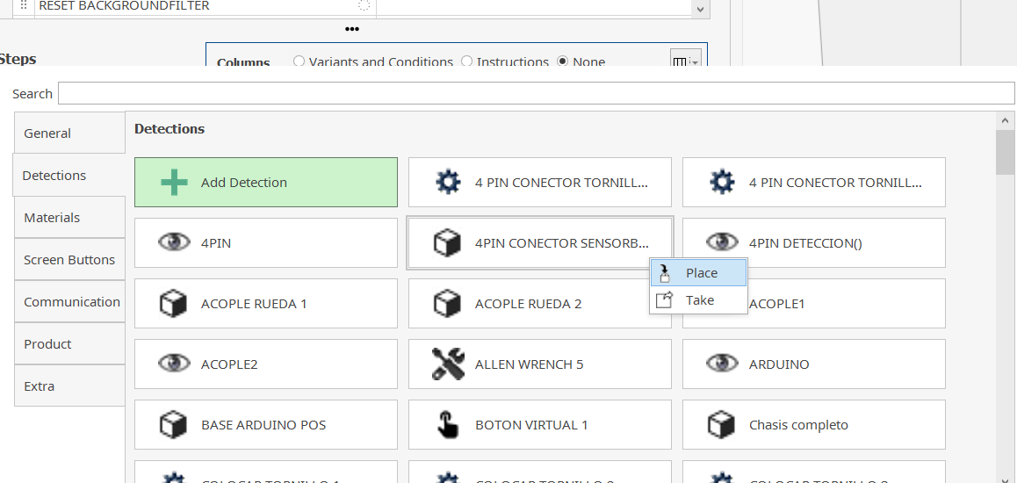
Program processes
Program create–Functions example
For this purpose again click "+Add" button, go to "Detections" part and when choosing the material with the same name (created before and the one that has a cube symbol) click "Place".
Once you create a "Pick" you should position it.
#LCAMP_EU

Slide 29
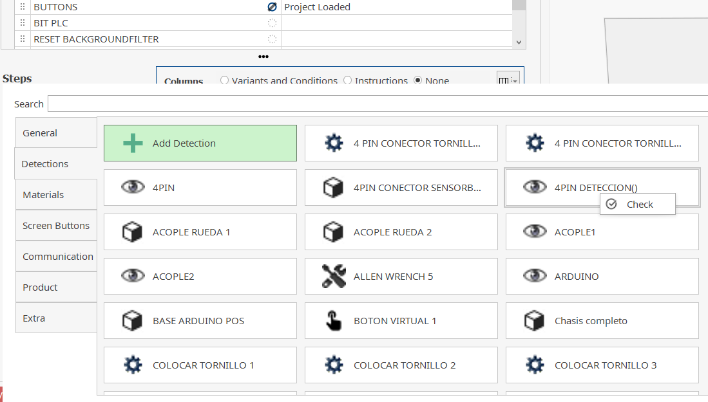
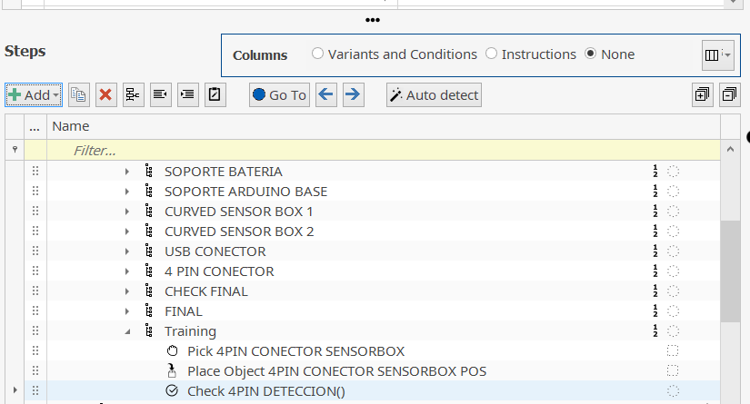
Program processes
Program create–Functions example
Finally, we can create a "Check" to make sure the piece is correctly positioned. Click the "+Add" button again, select the detection with the same name as the quality check (eye symbol) in "Detections" and select "Check".
The program for that part of the assembly would look like this.
#LCAMP_EU

Slide 30
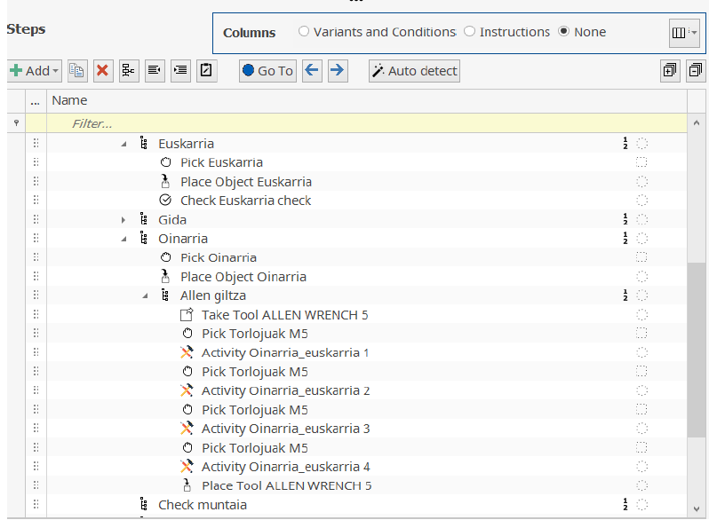
Program processes
Create a program
In addition to these 3 main functions, for example when it is necessary to fasten screws or glue a piece (an assembly activity that will be carried out over a period of time), we should include the “ACTIVITY” function. As an example, the process of fastening 4 screws in different positions in the following image:
#LCAMP_EU

Slide 31
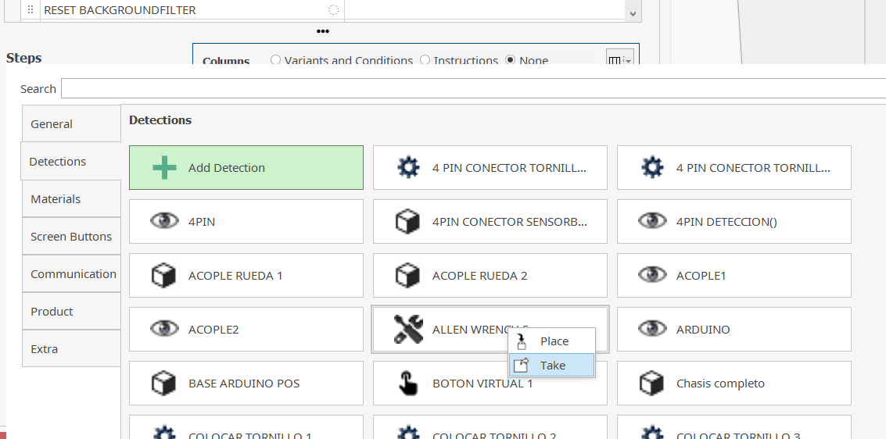
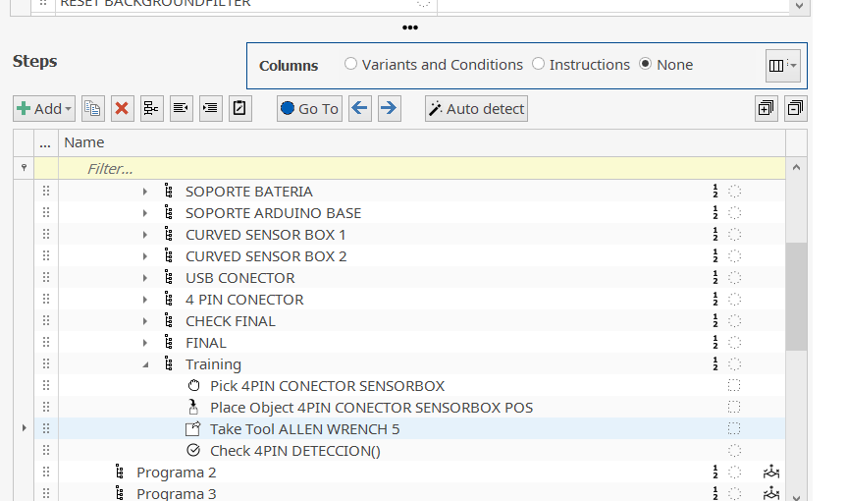
Program processes
Program create– Activityexample
In the previously created example, we will add some "Activities". To do this, we will first need to take the tool. Click the "+Add" button and select the Allen Wrench 5 in "Detections" and click "Take".
We will place this step before the "Check" step, as can be seen in the image.
#LCAMP_EU

Slide 32
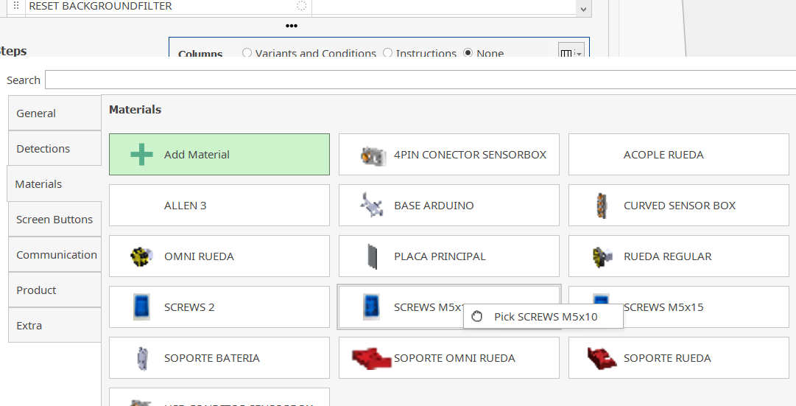
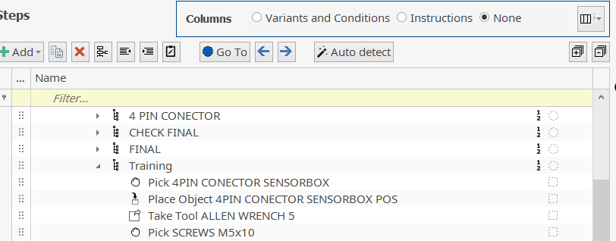
Program processes
Program creation– Activity example
Once you have the tool, you need to get the screw. To do this, click on "+Add" and under "Materials" click on "Screws M5x10" and click "Pick".
You should get the result shown in the image.
#LCAMP_EU

Slide 33
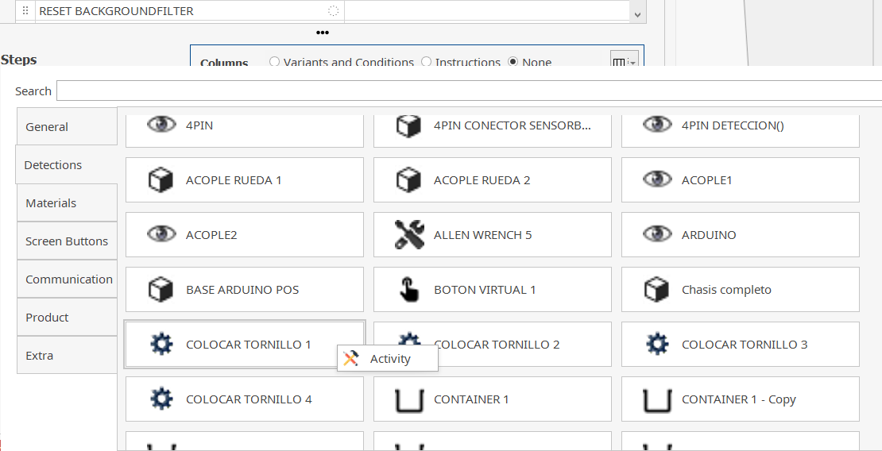
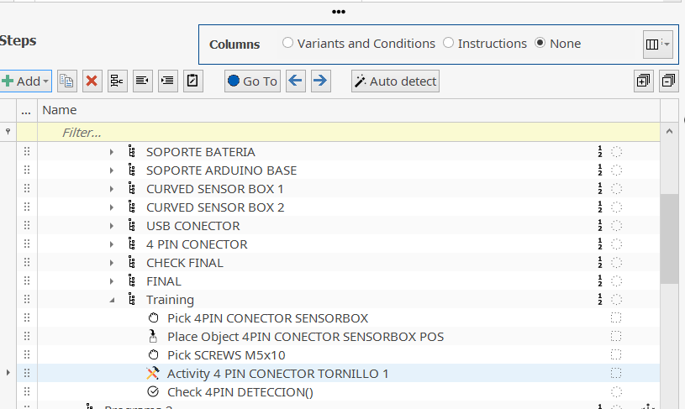
Program processes
Create a program– Activity example
Once you have the screw and the tool, it would be time to connect it. For this you need an "Activity". Click the "+Add" button, select the corresponding activity ("Place Screw 1") within "Detections" and click "Activity".
Emaitza finala ondorengoa izango zen.
#LCAMP_EU

Slide 34
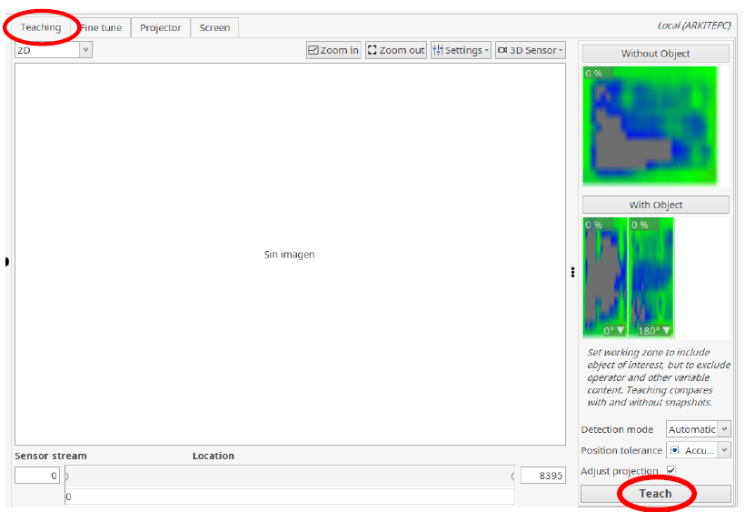
Program processes
Calibrate detections at the station
To detect the positioning of the elements included in the assembly, these detections must be adjusted in the “Detections” section. First, in the “Teaching” section, we will take photos of the element without and with it assembled and “Teach” it.
NOTE
From now on, we will carry out the following steps at the station, as the devices must be calibrated.
#LCAMP_EU

Slide 35
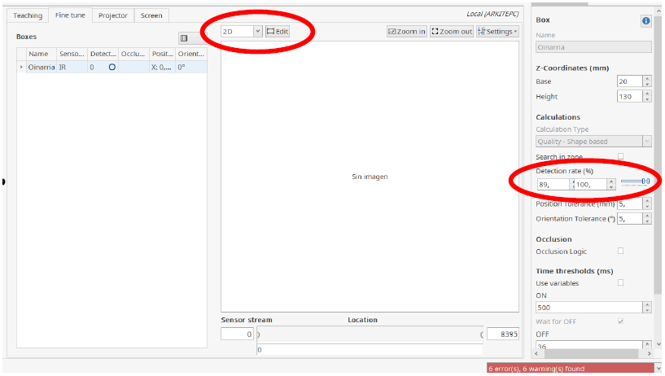
Program processes
Calibrate detections at the stationt
Next, in the “Fine tune” section, we will adapt the volume to be detected by the sensors to our part and adjust the “Detection rate” so that the detection is carried out correctly and we can proceed to the next step. We can visualize our work area in 2D or 3D to edit the volume.
#LCAMP_EU

Slide 36
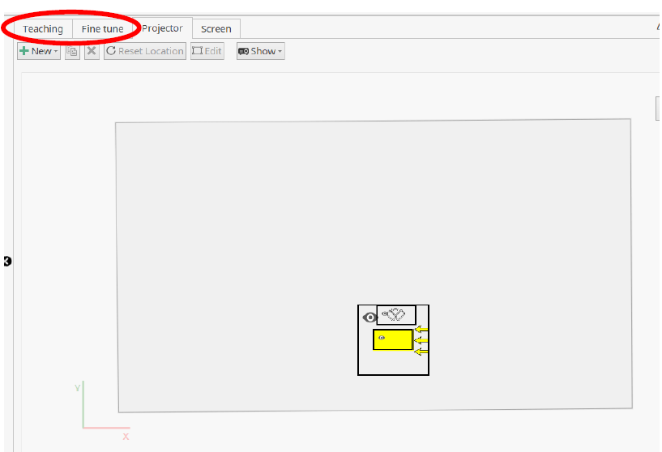
Program processes
Calibrate detections at the station
Once the volume and detection amplitude have been adjusted, we will define the images, videos or instructions that will be projected onto the screen and desk of the worker. We will define this in the “Projector” and “Screen” sections.
#LCAMP_EU

Slide 37

Program processes
Check
Once the detections of all the elements have been adjusted, the program will be finished, and all that remains is to simulate it to make sure that we have not made any mistakes and that the assembly sequence is carried out correctly. To do this, we will press the “Restart” button.
#LCAMP_EU

Slide 38
Program elements
Exercise
With the created "TooL", "Object", "Quality Check", "Virtual button", "Activity" and "Materials", complete the program for the complete assembly of the robot. Finally, to complete the complete assembly and pass the quality control, place a virtual button.
#LCAMP_EU

Slide 39




#LCAMP_EU
info@lcamp.eu
www.lcamp.eu
@LCAMP_EU
LCAMP Learner Centric Advanced Manufacturing Platform for CoVEs

