Slide 1

UD1. Machine FundamentalsLearning
Translated from Spanish to English - www.onlinedoctranslator.com

Slide 2
Index
1
4
The era of data
Main challenges of ML
The new data revolution
The value of the data
Insufficient amount of data
Non-representative data
Poor quality data
Irrelevant features
Overfitting (overfitting)
Under adjustment (underfitting)
2
MachineLearning
Data Science
What is the machine learning?
Why use ML
Application examples
5
Proveandvalidate
3
Guys systemsML
Test and validate
Adjustment of hyperparameters
Model selection
Data discrepancy
ML Solution
There's no free lunch theorem
Machine Learning Workflow
Supervised learning
Unsupervised learning
Learning semi-supervised
Learning self-supervised
Reinforcement learning
Batch learning
Online learning
Learning out of core
Instance-based learning
Model-based learning

Slide 3
The era of data
1.
The new data revolution
The value of the data

Slide 4
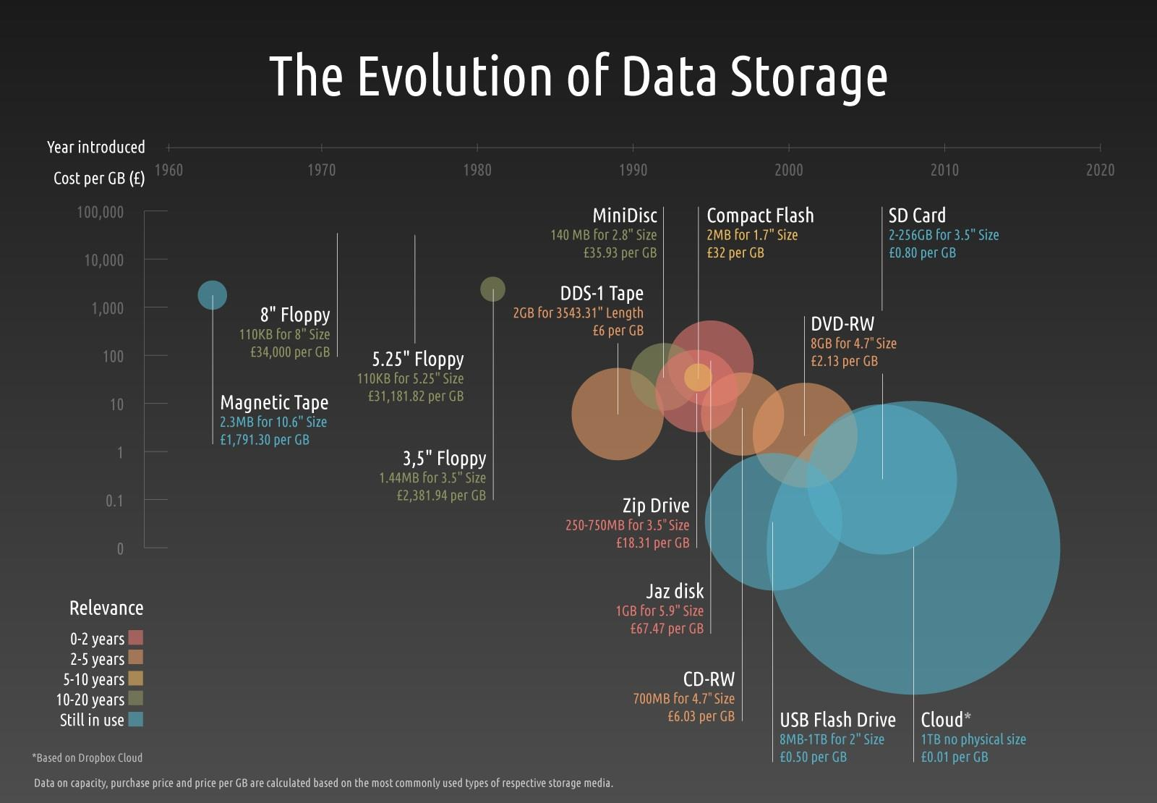
The new data revolution

Slide 5
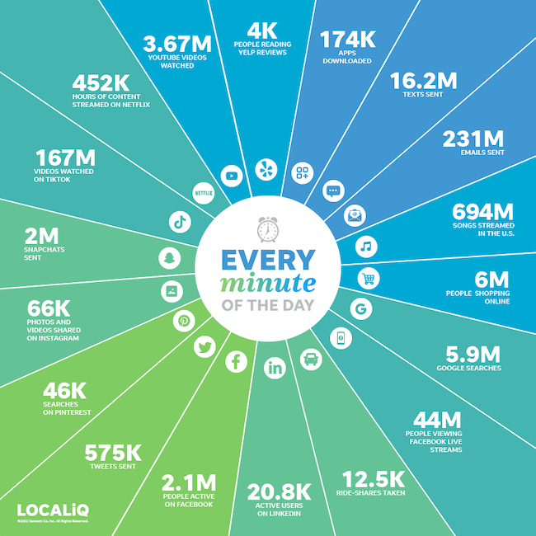
The new data revolution

Slide 6
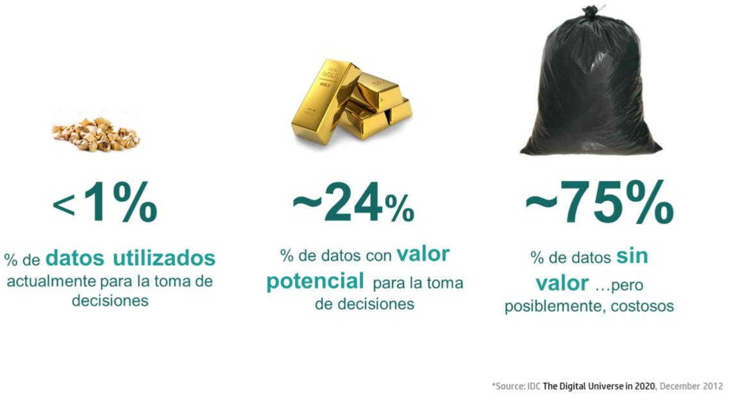
The value of the data

Slide 7
Value of data
Data in itself has no value.
The value is in the analysis what we do with them and how that data becomes information and in this way in knowledge.
The value lies in how organizations use that knowledge and transform it into a data-driven or information-centric enterprise that supports agile decision-making in their business.

Slide 8
Value of data
Data-driven algorithms reflect the underlying information contained in the data. That is, they model the data.
Only if we are sure that the data is truly representative of our process can we say that the algorithm models our process..
- Carlos Cernuda

Slide 9
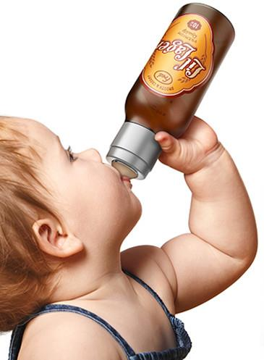
Value of data
A supermarket chain noticed that sales of both beer and diapers increased on game days.
Action => Joint offer beer + diapers
THANK YOU DATA SCIENCE!!!

Slide 10
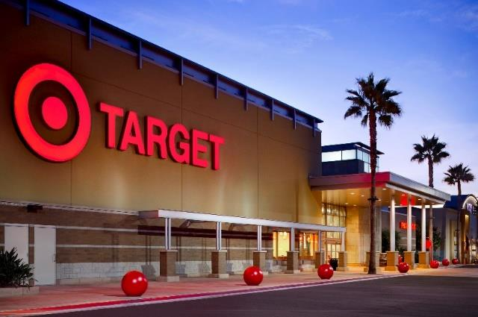
Value of data
The Target supermarket chain sends targeted advertising to its customers based on their purchases.
An outraged father filed a complaint because Target was encouraging his teenage daughter to have sex and become pregnant by sending her advertisements for childcare products and baby furniture.
Months later, she had to apologize when her daughter could no longer hide her pregnancy.
THANK YOU DATA SCIENCE???

Slide 11
2. MachineLearning
Data Science
What is the machine learning?
Why use ML
Application examples

Slide 12
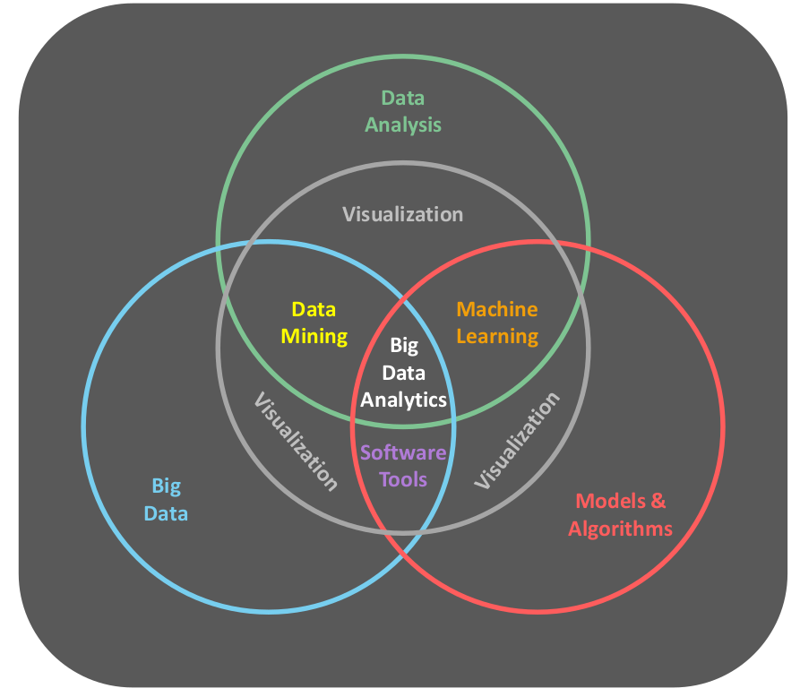
Data science

Slide 13
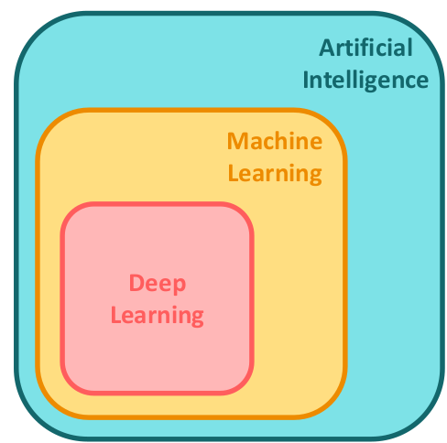
Machine Learning
Machine Learning (ML) is the field of study that gives computers the ability to learn without being explicitly programmed. - Arthur Samuel (1959)

Slide 14

What is the machinelearning?
It is the science of programming computers to learn from data.
Field of study that gives computers the ability to learn without being explicitly programmed.
A computer program learns from experience E, with respect to a task T and a performance measure R. If its performance at time T(time), as measured by P(Performance over time), improves with experience E.

Slide 15
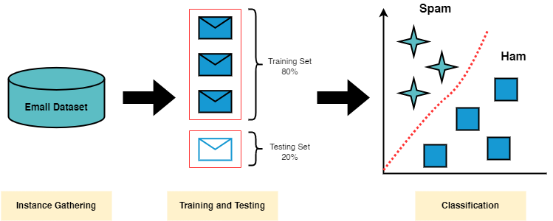
What is the machinelearning? Example
SPAM Filter:
90: It's not a self-aware robot. But it's technically ML.
Application that receives examples of spam emails (marked by users) and examples of regular emails (jam). Learn how to flag spam.
Training set:examples that the system uses to learn.
Training or sample instance:each training example.
Model:part of the ML system that learns and makes predictions.
Task T is to mark spam for new emails, experience E is the training data, performance measure R (accuracy) is the proportion of correctly classified emails.

Slide 16
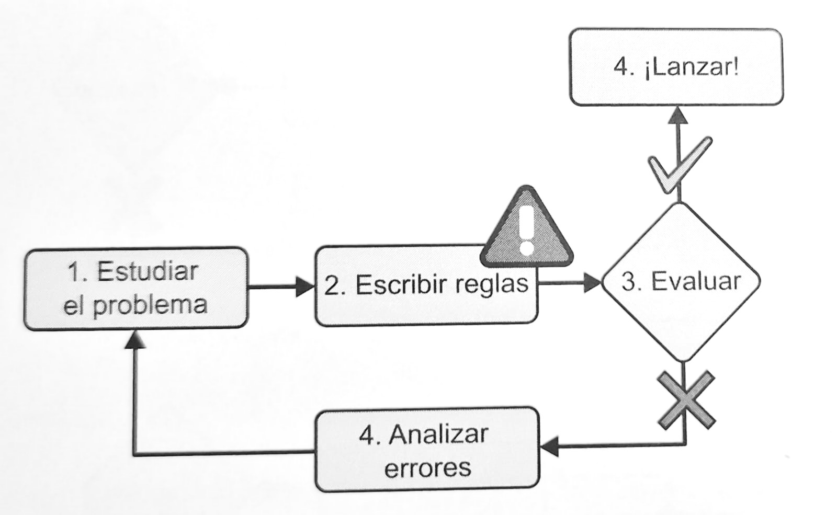
Why use machinelearning
Traditional Spam Filter:
Study the problem: Examine typical spam features. Words or phrases appearing in the subject line, patterns in the sender, in the body of the email, etc.
Write detection algorithm for each identified pattern.
Test the program. If it's OK, launch it; otherwise, go to step 4.
repeat steps 1 and 2 until ready.
Very complex list of rules
Difficult to maintain

Slide 17
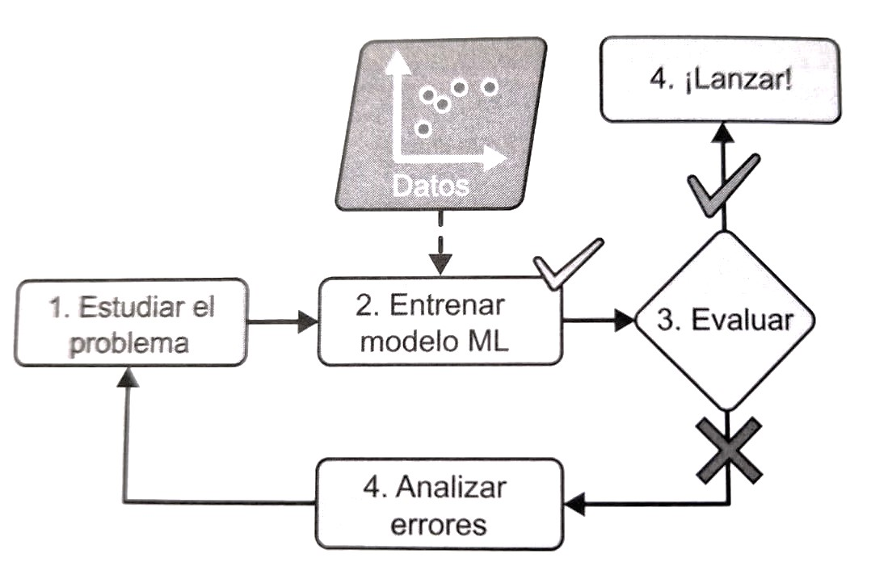
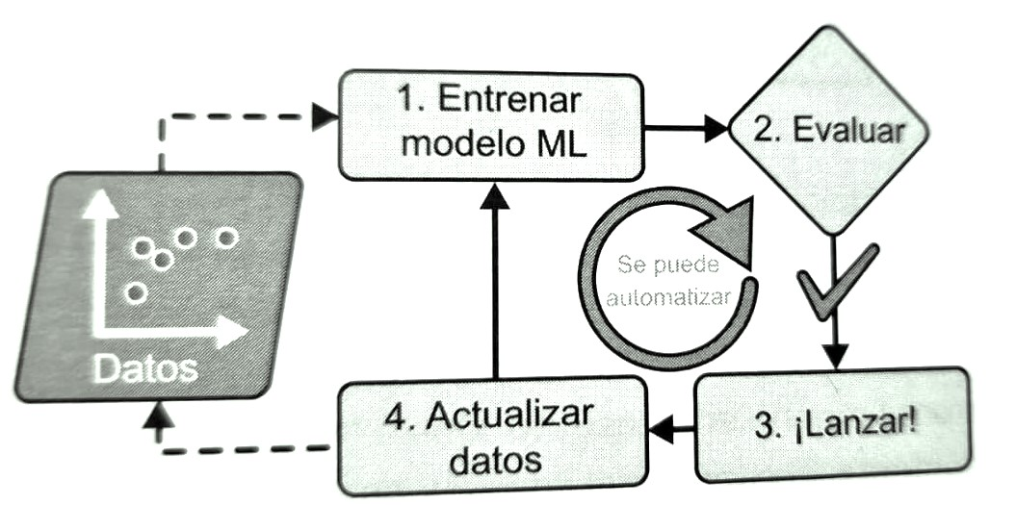
Why use machinelearning
SPAM filter with machinelearning:
Detection of atypically frequent words in spam/jam.
Shorter program, easier to maintain.
More exact.
Learns, adapts to change automatically.
Trained model: reveals word lists and word combinationspredictorsof spam.
Reveals unexpected correlations
Reveals new trends.
Understanding the problem.

Slide 18
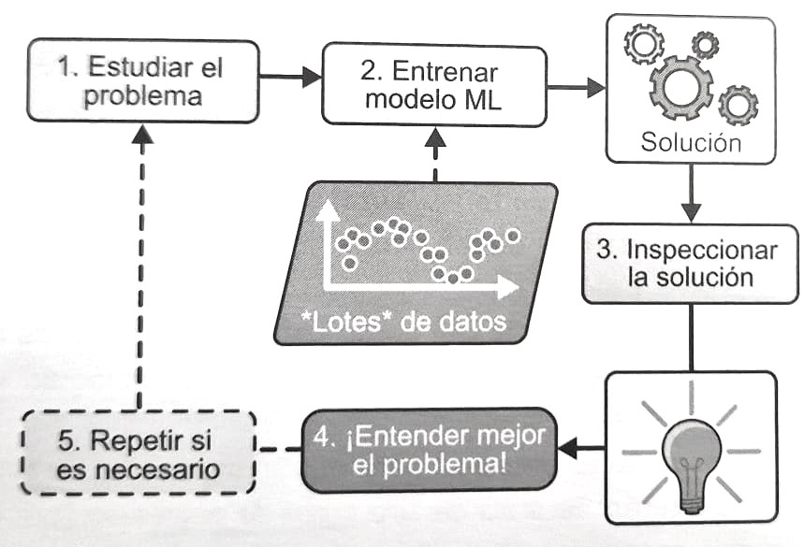
Why use machinelearning
Solving problems that are too complex for traditional approaches.
Solving problems that do not have a known algorithm (speech recognition)
Problems with solutions that require a lot of adjustments.
Changing environments.
Gain an understanding of complex problems and large amounts of data (data mining).

Slide 19
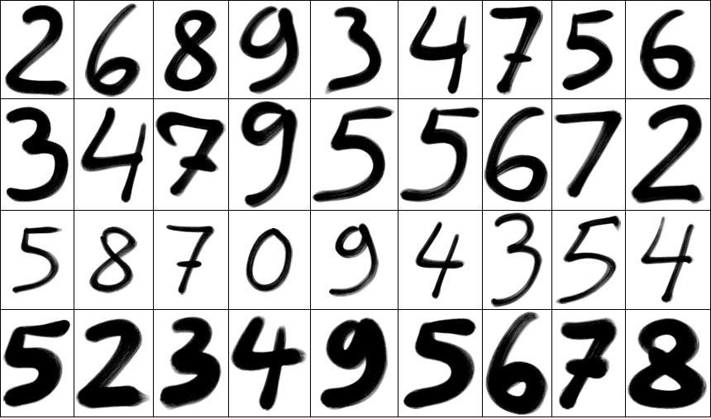
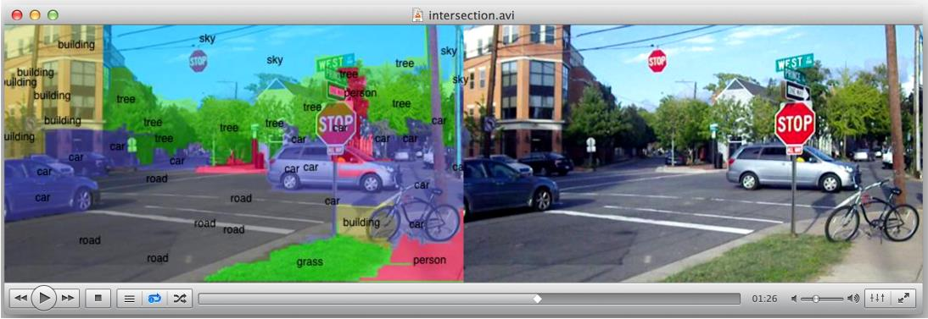
Machine Learning - Examples
Computer vision: from handwritten digit recognition to self-driving cars.

Slide 20
Application examples
Analyze product images in a production line to automatically classify them:image classification. RNC (networksconvolutional), transformers.
Detecting tumors on scans:Semantic image segmentation. Classify each pixel in the image. RNC (networksconvolutional), transformers.
Classify news articles:Natural language processing -> Text classification. RNR (Recurrent Neural Networks), RNC (Recurrent Neural Networks)convolutional), Transformers (best result).
Flagging offensive comments on forums:text classification. RNR, RNC, transformers.
Summarize documents:Natural language processing -> text summarization. RNR, RNC, transformers.
Chatbotor personal assistant:various components of natural language processing (understanding, question answering).
Predict company revenue based on n performance metrics:regression task. Linear regression, regressionpolynomial, SVM(support vector machine),Random Forest…
Application reacts to voice commands:speech recognition, audio sample processing. RNR, RNC, transformers.

Slide 21
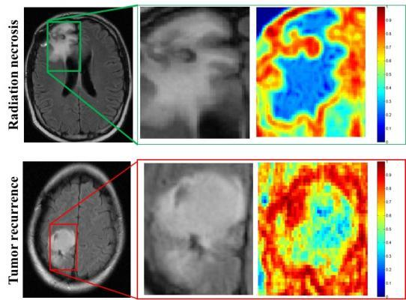
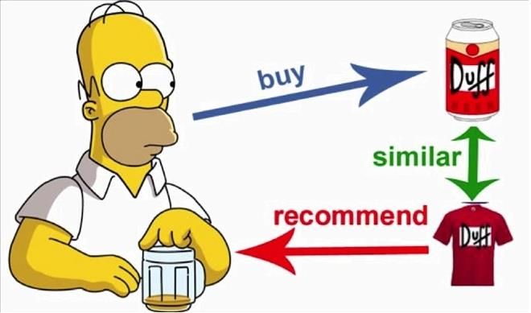
Application examples
Detect credit card fraud:anomaly detection.Isolation forests, Gaussian mixture models and autoencoders.
Segment customers based on their purchases:Clustering. K-means, DBSCAN.
Represent a high-dimensional, complex data set in a clear and detailed diagram:data visualization with reduction ofdimensionality.
Recommend product based on previous purchases:Recommendation system. An artificial neural network (ANN) that is trained on past purchase data and predicts the most likely next purchase.
Create abotsmart for a game:reinforcement learning.

Slide 22
3. Types of ML systems
Supervised learning
Unsupervised learning
Learningsemi-supervised
Learningself-supervised
Reinforcement learning
Batch learning
Online learning
Learningoutofcore
Instance-based learning
Model-based learning

Slide 23
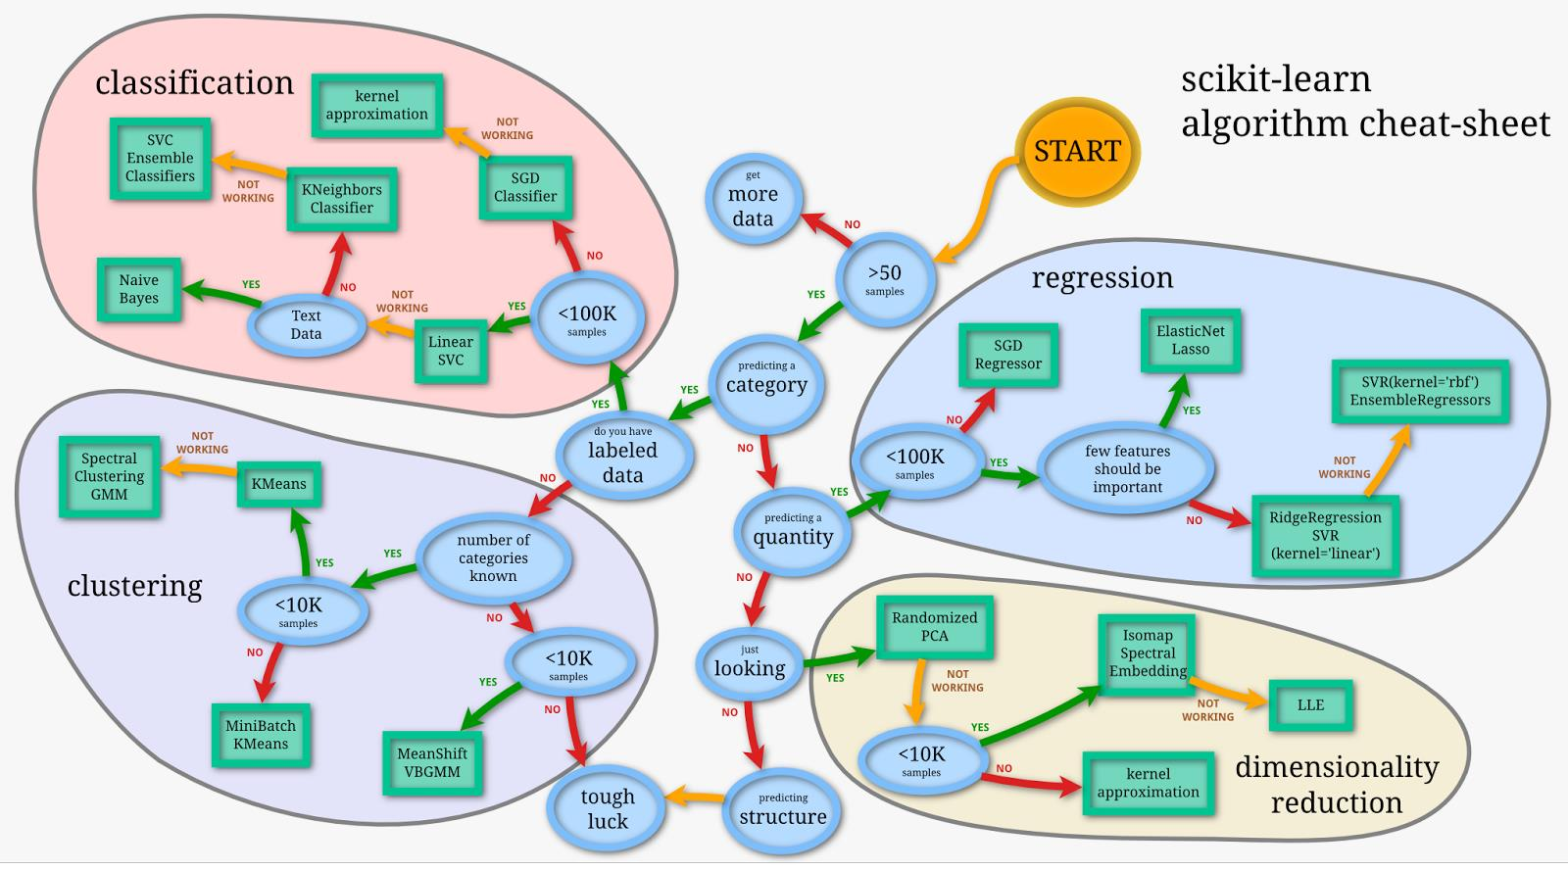
Machine learning - Algorithms

Slide 24
Types of Machine SystemsLearning
Three major categories:They are not mutually exclusive, we can combine them however we want.
Training supervision:How they are supervised during training. Supervised learning, unsupervised learning, learningsemi-supervised, learningself-supervised, reinforcement learning.
Online learning vs. batch learning:They may or may not learn gradually as they go.
Instance-based learning vs. model-based learning:whether they work by simply comparing new data points with known data points or whether they detect patterns in the training data and create a predictive model as scientists do.
“Example: spam filter that learns on the fly using a deep neural network model trained with spam examples andham(provided by humans):Online model-based supervised learning system.”

Slide 25
Training supervision
3.1

Slide 26
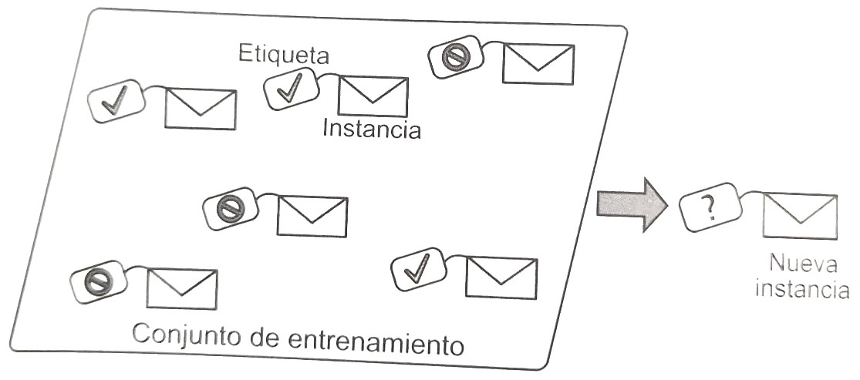
Supervised learning
The training set we include in the algorithm includes the desired solutions: labels.
Classification:
Example 1: spam filter

Slide 27
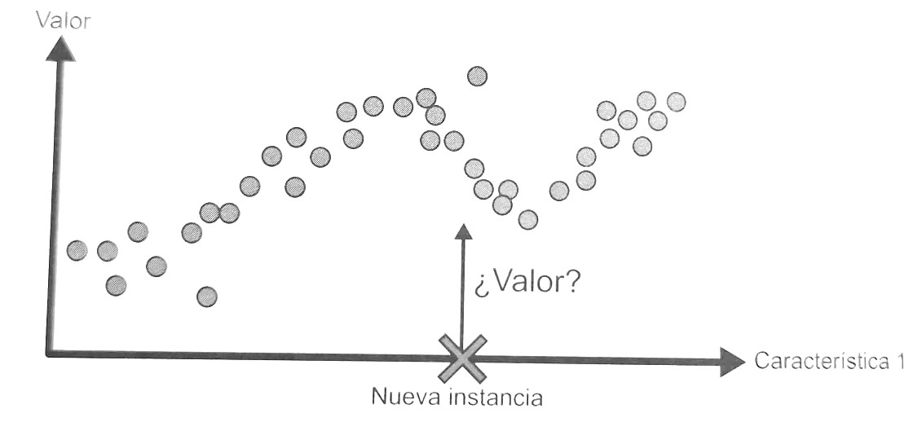
Supervised learning
Regression: Predicting a target numerical value
Predict the price of a car given a set of characteristics (km, make, model, etc.)

Slide 28
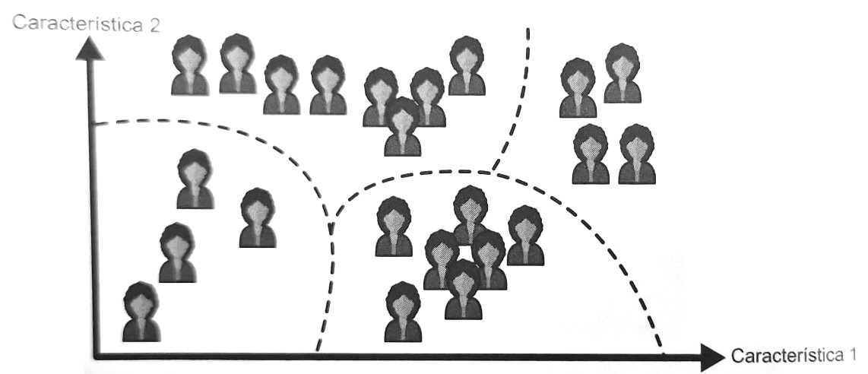
Unsupervised learning
The training data is unlabeled. The system learns without a teacher.
Clustering algorithm:
Blog visitors: detect similar visitors. 2 groups: 40% teenagers who like comics, 20% adults…

Slide 29
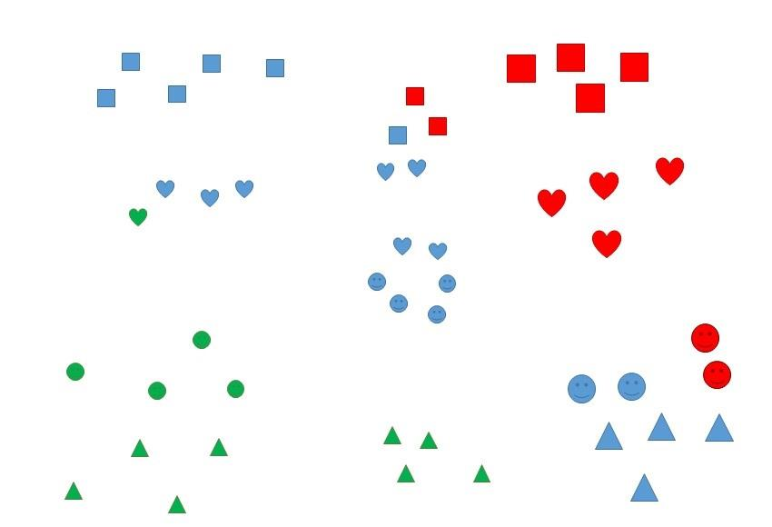
Unsupervised learning- Clustering

Slide 30
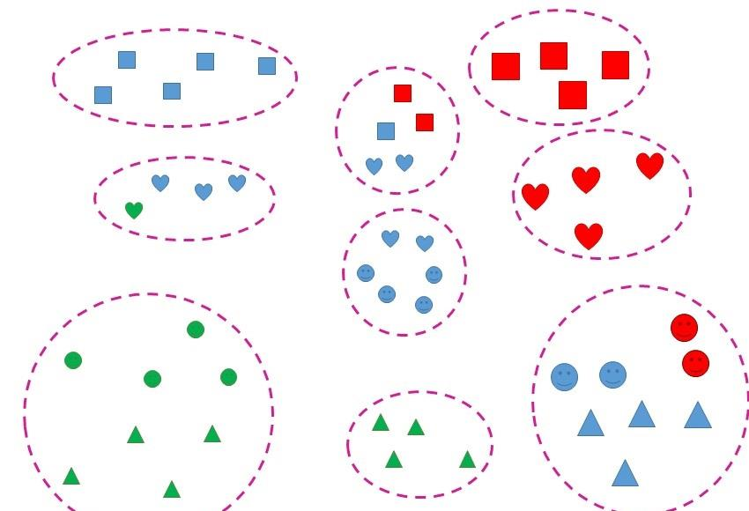
Unsupervised learning- Clustering

Slide 31
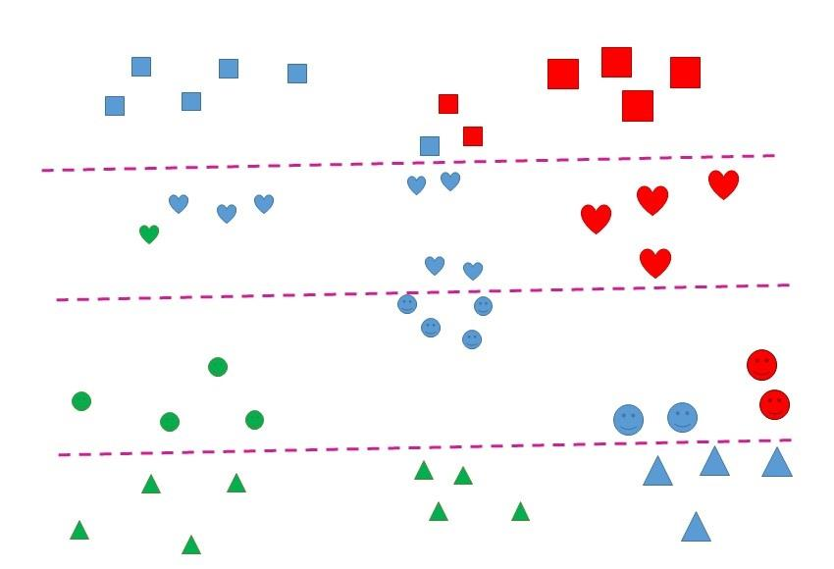
Unsupervised learning- Clustering

Slide 32
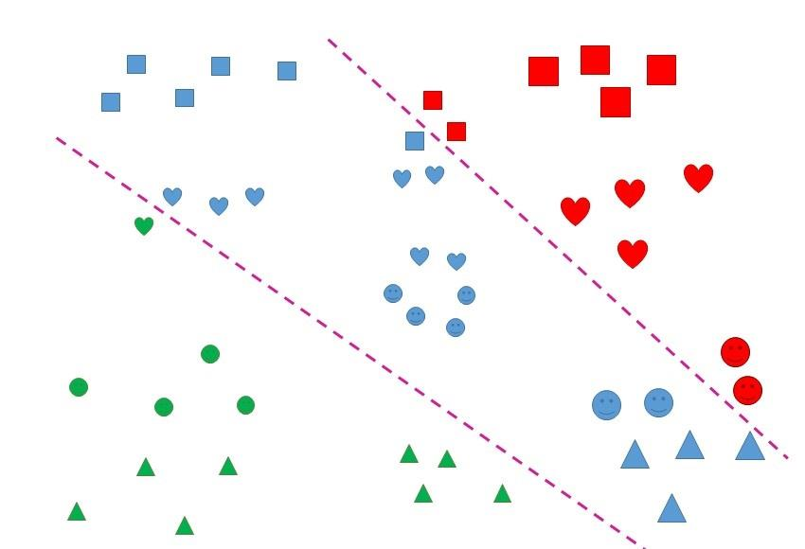
Unsupervised learning- Clustering

Slide 33
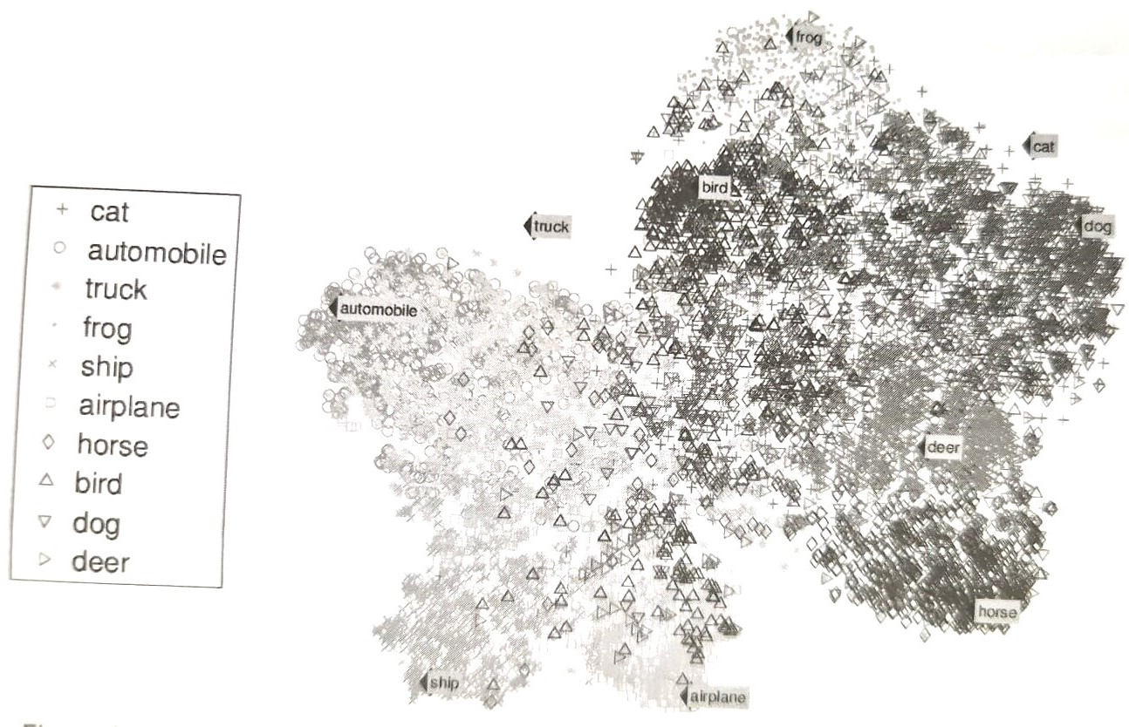
Unsupervised learning
Visualization algorithm:
You enter a lot of complex unlabeled data
Generates 2D, 3D representations
They can be traced easily
Preserve the structure as much as possible
Identify unexpected patterns
Understanding information organization
Example visualization: Animals separated from vehicles. Horse and deer together, birds far away…

Slide 34
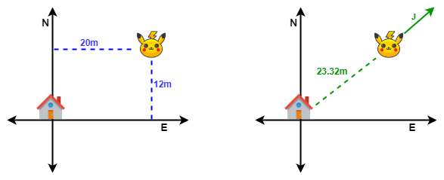
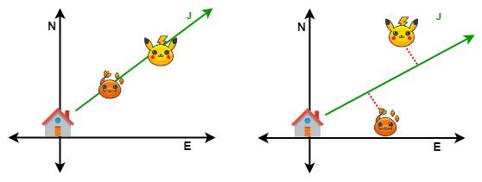
Unsupervised learning: tasks
Reduction of thedimensionality:
Objective: simplify data without losing information.
Merge multiple correlated features into 1.
Example: car km + car age = car deterioration -> feature extraction.

Slide 35
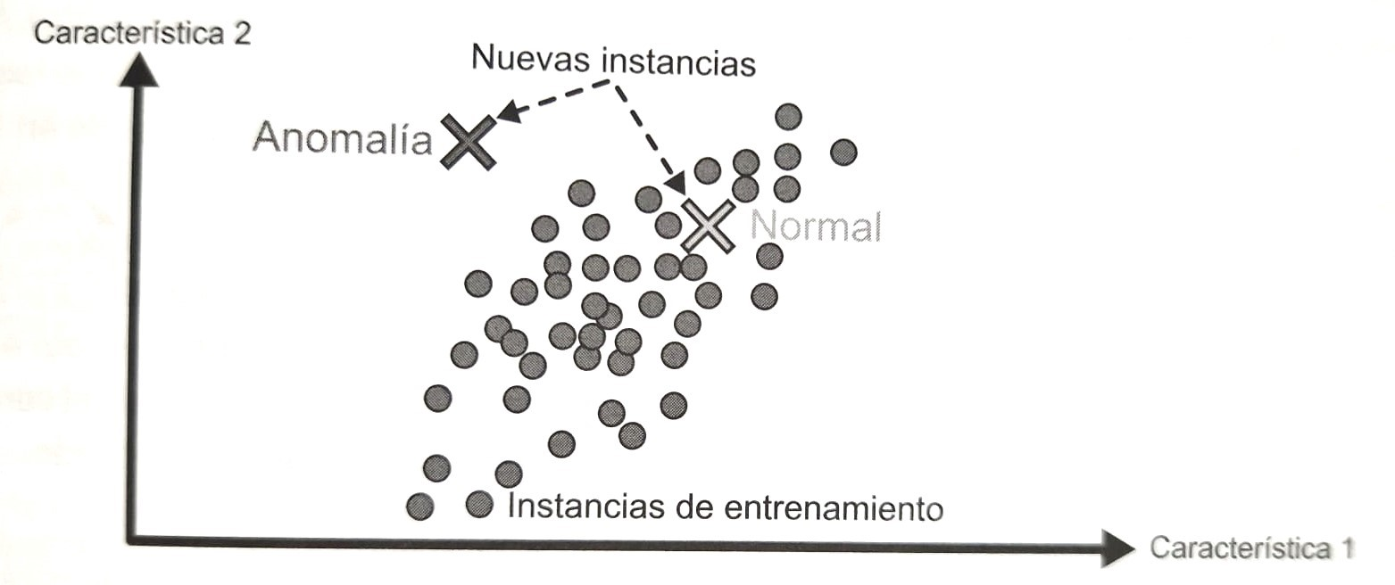
Unsupervised learning: tasks
Anomaly Detection:
Objective: to detect outliers in a data set.
Uses: fraud detection, detection of unusual credit card transactions, detection of manufacturing defects, removal of outliers from data sets.
The system is shown n normal instances during training, it learns to recognize them, and when it sees a new instance it can tell whether it is normal or not.

Slide 36
Unsupervised learning: tasks
New developments detection:
Objective: To detect new instances that appear different from all instances in the training set.
Example: Chihuahua. We have thousands of dog images, and 1% of them are Chihuahuas. The algorithm should detect them as novel. With an anomaly detection algorithm, we could be classified as an anomaly.
Learning association rules:
Explore massive amounts of data and discover interesting relationships between attributes.
Example: supermarket sales

Slide 37
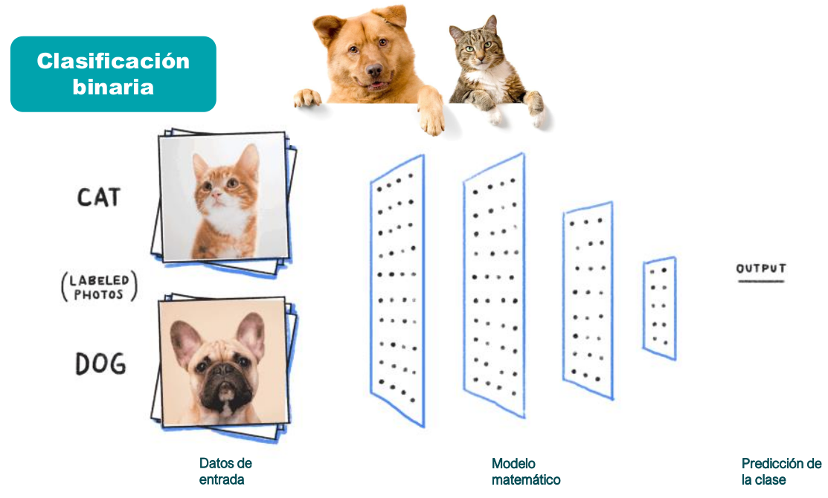
Supervised Learning - Classification

Slide 38
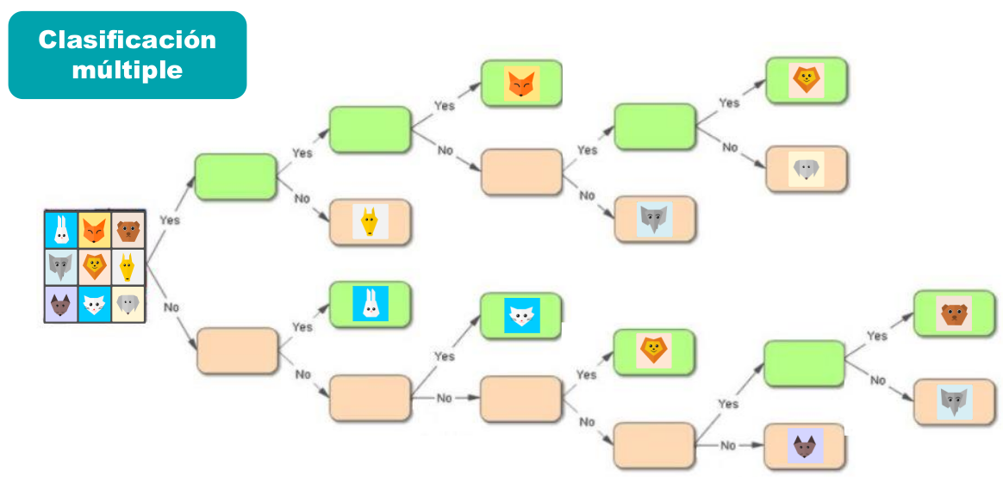
Supervised Learning - Classification

Slide 39

Supervised Learning - Regression
Predicts continuous values ​​(a number).
For example:
Predict sales depending on advertising investment.
Predict the selling price of a house depending on its features.
Predicting a person's age based on their height, build, etc.

Slide 40
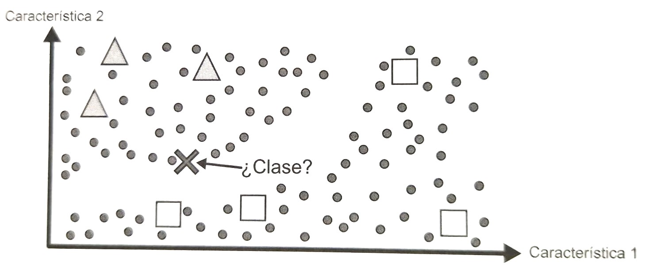
Learningsemi-supervised
Algorithms that deal with data that is partially labeled.
They are a combination of supervised and unsupervised algorithms. A clustering algorithm groups similar instances, and each unlabeled instance takes the most common label from its group.
Labeling requires a lot of time and expense.
Example Google Photos.
We group them into two groups: triangles and squares. We classify the new instance (x) as a triangle.

Slide 41
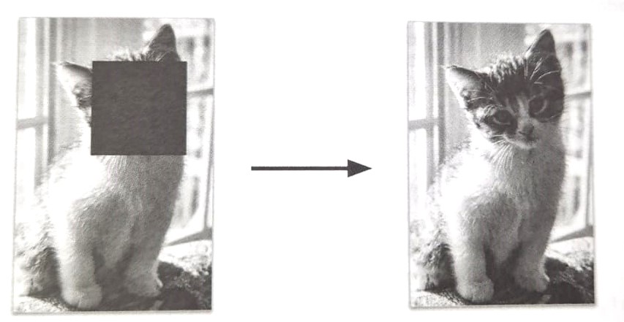
Learningself-supervised
Generates a fully labeled dataset from a completely unlabeled dataset.
Example: Pet classification model
Large image set.
Randomly mask a small portion of the image.
Train the model to recover the original image: Repair images.
Once the model is trained, we fit it to a labeled data set.
We use to classify images.

Slide 42
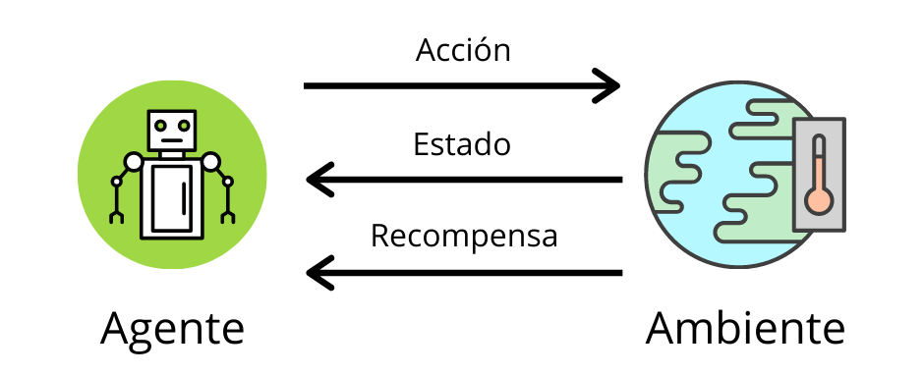
Reinforcement learning
Agent: learning system
You can observe the environment, select and perform actions
Receive positive or negative rewards
Politics: best strategy to get the greatest reward in the shortest time.
Action that an agent must choose when faced with a given situation.
Robots: learning to walk
AlphaGo

Slide 43
Online learning vs. batch learning
3.2

Slide 44
Batch learning
The system needs to learn with all the data available. It can't learn gradually.
It requires a lot of time and a lot of computational resources
It is usually done offline.
The system is trained, released into production, and executed without further learning.
Datadrift:
The world continues to evolve. The model remains unchanged.
The model tends to deteriorate gradually over time (especially in changing environments).
Retrain it regularly to have up-to-date data. Old data + new data.
Examples:
Financial system prediction
Cat and dog classification (cameras, image format, brightness change, etc.)
Disadvantage:
Retraining again: a lot of time and resources
Not acceptable for changing solutions (action prediction) or limited resources (mobile devices)

Slide 45
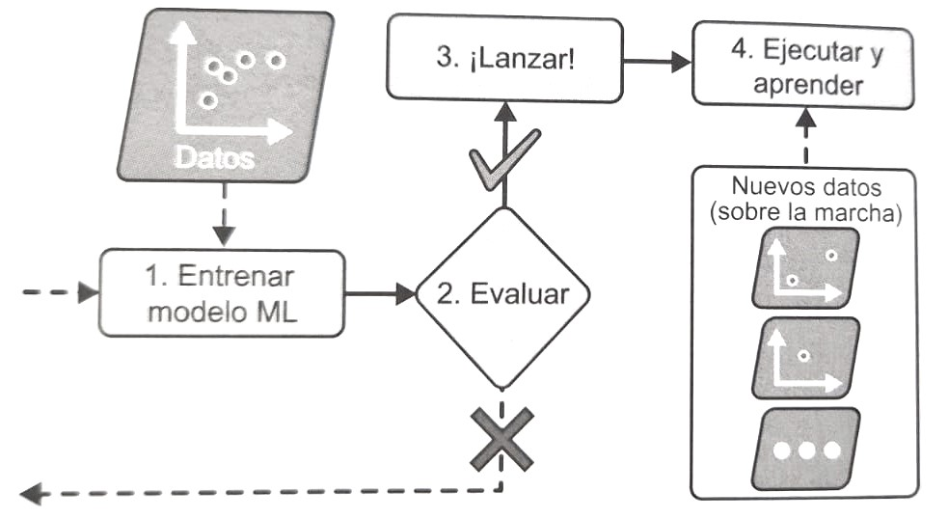
Online learning
The system learns gradually by entering individual data ormini-lotsof data.
Each learning step is fast and cheap.
The system learns from new data on the fly as it arrives.
Systems that need to adapt to change (stock market).
Limited resources (mobile devices).

Slide 46
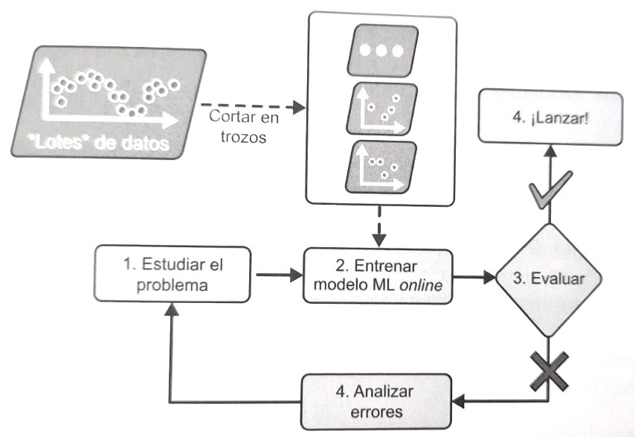
Learningoutofcore
Offline learning.
Huge data sets that do not fit in memory
Divide the data into chunks and run a training step on those chunks and repeat the process.
Learning rate:
High: Adapts quickly to new data. Forgets old data. More sensitive to unrepresentative data.
Low: Learns more slowly. Less sensitive.
Challenge: Bad data causes performance to decline rapidly. Monitor system performance and input data. Disable learning.

Slide 47
Instance-based vs. model-based learning
3.3

Slide 48
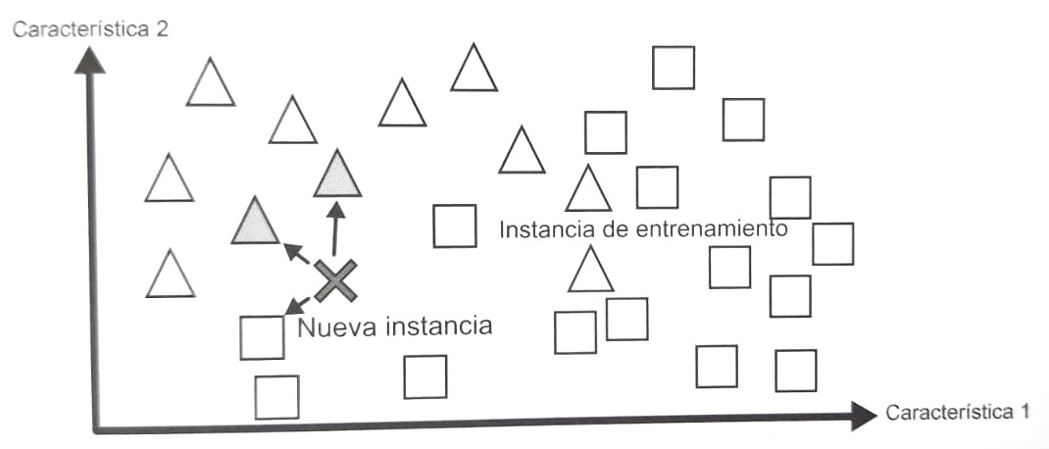
Instance-based learning
The system learns the examples by heart and generalizes to new cases using a similarity measure to compare them with the learned examples.
Notes:
TaskThe important thing about ML is to generalize. Make predictions from examples you haven't seen before.

Slide 49
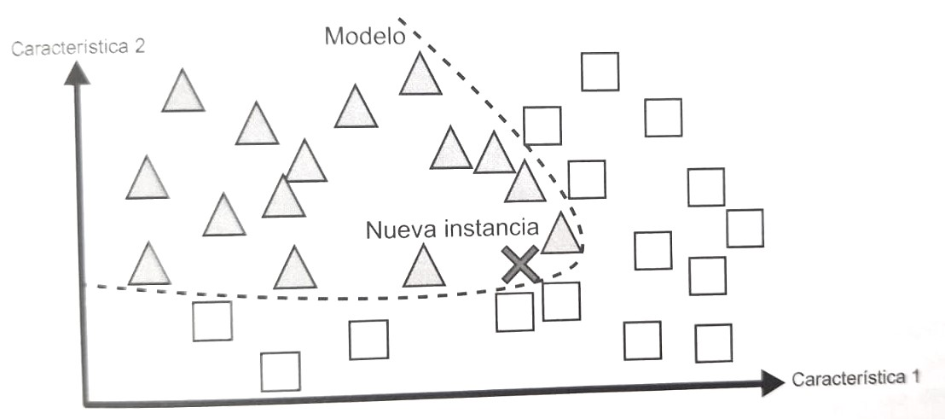
Model-based learning
Given a set of examples, create a model and use it to make predictions.

Slide 50
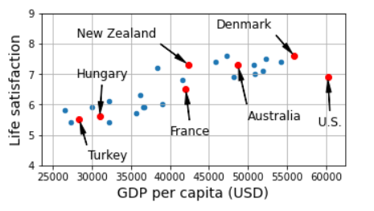
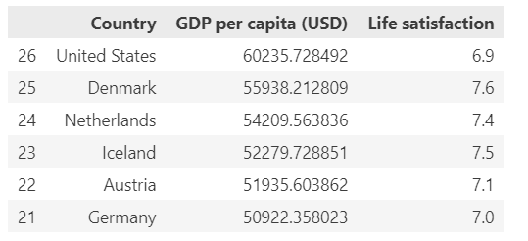
Model-based learning: example
Does money make people happier?
OECD Web + World Bank Web =DataSetlifesat.csv
We analyze:
There seems to be a trend. The data is noisy. There are some random data (US). But overall, satisfaction levels grow linearly as GDP increases.

Slide 51
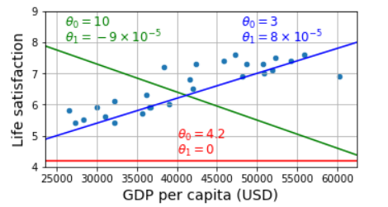
Model-based learning: example
and: dependent variable (satisfaction level)
x: is the independent variable (GDP per capita)
β₀:It is the ordinate at the origin (also known as intercept).
β₁: is the slope of the line, which represents the rate of change ofandwith respect tox.
ϵ: is the error term, which captures the variations not explained by the linear relationship and represents noise or non-systematic variability in the data.
Adjust parameters: define values ​​forβ₀andβ₁so that they have the best performance
Fitness function
Loss function: Minimize the distance between the model predictions and the training examples.
Linear regression algorithm:
We enter the training data
Find the parameters that fit best
Optimal values:β₀= 3.75 andβ₁= 6.78x10-5

Slide 52
Model-based learning: example
Linear Regression Model:
Chile Prediction: We look for its GDP = $37,655 -> 3.75 x 37,566 x 6.78 x 10⁻⁵ = 6.30
import matplotlib.pyplot ace plt
import numpy ace np
import pandas ace P.S
from sklearn.linear_model import Linear Regression
# Read the data
lifesat = P.S.read_csv("lifesat.csv")
X = lifesat[["GDP percapital(USD)"]].values
and = lifesat[["Life satisfaction"]].values
# Visualize the data
lifesat.plot(kind='scatter',grid=True,
x="GDP percapital(USD)",and="Life satisfaction")
plt.axis([23_500,62_500,4,9])
plt.show()
# select a model: linear regression
model = Linear Regression()
# Train the model
model.fit(X,and)
# Make a prediction for Cyprus
X_new =[[37655.2]] # Cyprus' GDP percapitalin 2020
print(model.predict(X_new))# outputs [[6.30165767]]

Slide 53
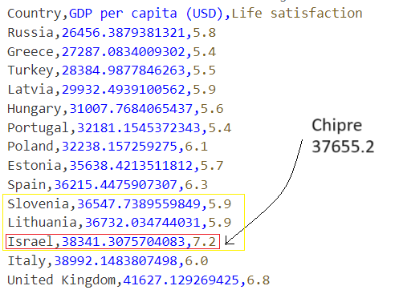
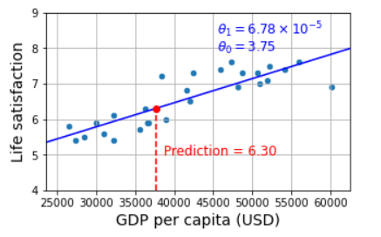
Model-based learning: example
Instance-based learning algorithm:
Israel has the closest GDP to Cyprus ($38,341)
Prediction would have been 7.2
K-nearest neighbors algorithm:
Israel, Lithuania and Slovenia.
Average of the 3: 6.33
# K-nearest neighbors regression model:
from sklearn.neighbors import KNeighborsRegressor
model = KNeighborsRegressor(n_neighbors=3)
# Trainthe model
model.fit(X,and)
#Maketoprediction for Cyprus
print(model.predict(X_new))# outputs [[6.33333333]]

Slide 54
Model-Based Learning: Summary
We study the data.
We select a model.
We train the model with the training data (i.e. the algorithm searches for parameter values ​​that minimize the loss function).
We apply the model to make predictions in new cases, hoping that the model generalizes well.

Slide 55
Main challenges of ML
4.
Insufficient amount of data
Non-representative data
Poor quality data
Irrelevant features
Overfitting (overfitting)
Underadjustment(underfitting)

Slide 56
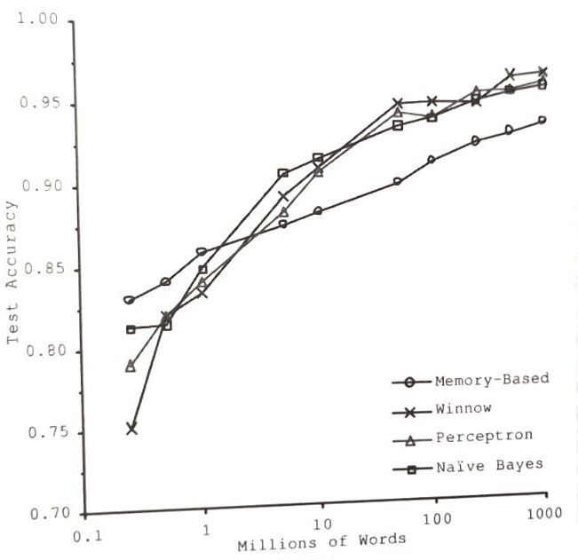
Insufficient amount of training data
Most algorithms require a lot of data to work well.
Simple problems: thousands of examples.
Complex problems: millions of examples.
Natural language disambiguation problem.
StudyMichele Bankoand EricBrill
Almost all of themthealgorithms have similar performance once they are fed with enough data.

Slide 57
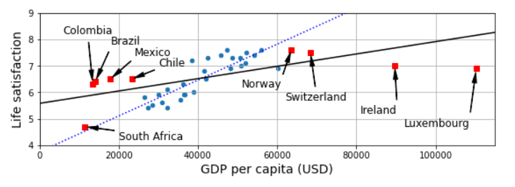
Non-representative training data
It is crucial to use a data set representative of the cases to which we want to generalize.
Both in instance-based and model-based learning.
In the previous case, the data we used to train the model was not representative; the GDP ranged from $23,500 to $62,500. By adding representative data, we see that the richest countries don't seem happier; in fact, they seem a little unhappier. The model doesn't make accurate predictions, especially for the richest and poorest countries.
Notes:
Examples of bias. Electionsfrom the USA 1936Landon/Roosevelt. MagazineLiteraty Digest. 10,000 people. Predicted L(57%) R(43%) reality R(62%).
Funk music inYouTube

Slide 58
Poor quality data
If the data has many errors, outliers, or noise, it will be difficult for the system to detect underlying patterns.
With poor quality data the system is less likely to function well.
It's worth the effort to clean up your data.
Data scientists spend a considerable amount of time cleaning data.
When to clean data:
Instances with outliers: Discard them or try to clean the data.
Instances missing features:Ahem. 50% of customers do not give their age.
Ignore attribute.
Ignore instances
Fill missing values ​​with the mean
Train the model with and without the feature and compare results

Slide 59
Irrelevant features
The system will be able to learn if we have enough relevant features and not too many irrelevant features.
The success of an ML project lies in achieving a good set of features.
Feature Engineering:
Feature selection: Selecting the most useful features from a set.
Feature extraction: combining features to produce a more useful one (feature reduction)dimensionality).
Creating new features by gathering new data.

Slide 60
Antiexample1:Overfittingthe training data
Overfitting:The model performs well on the training data but does not generalize well. This occurs when the model is too complex relative to the amount and noise of the training data.
Complex models (deep neural networks):
They can detect subtle patterns in the data.
Small or very noisy training set.
Detect patterns in the noise itself.
Model has no way of knowing whether a pattern is real or a result of the presence of noise.
Solutions:
Simplify the model: fewer parameters, moving from onepolynomialto a linear one, reduce attributes, restrict the model.
Gather more training data.
Reduce noise: fix errors, remove outliers.
Notes:
Example of a taxi driver who rips us off in a foreign countryand we generalize: all taxi drivers are scammers.

Slide 61
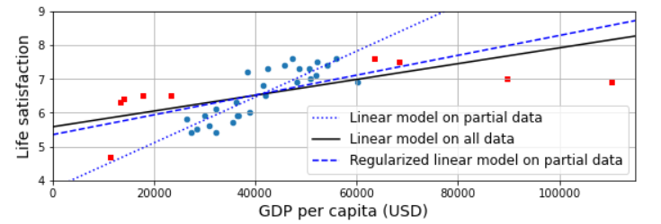
Antiexample1:Overfittingthe training data
Regularization:Restricting a model to make it simpler and reduce the risk of overfitting. Finding the balance between fitting the data perfectly and keeping the model simple enough to generalize well.
Example Quality of life:
The model has 2 parameters,β₀the height andβ₁the slope
β₁= 0 (Algorithm with one degree of freedom):too simple, it would be difficult to fit the data. We could just move the line up and down to fit the data.
Allow the algorithm to modifyβ₁ but we force it to keep it small -> algorithm between 1 and 2 degrees of freedom.
Regularization: Forces the model to maintain a small gradient. It doesn't fit the training data as well, but it generalizes better.
Notes:
Example of a taxi driver who rips us off in a foreign countryand we generalize: all taxi drivers are scammers.

Slide 62
Antiexample1:Overfittingthe training data
Hyperparameter:
It is a parameter of a learning algorithm (not a model).
Controls the amount of regularization to be applied during learning.
It should be established before training. It remains constant throughout.
Very large value:
Nearly flat model: a slope close to 0.
The algorithm does notwill overfitthe training data.
Less likely to find a solution.
Adjusthyperparametersis an important task in creating an ML system.
Notes:
Example of a taxi driver who rips us off in a foreign countryand we generalize: all taxi drivers are scammers.

Slide 63
Antiexample2:Underadjustthe training data
Underadjustment:The opposite of overfitting. The model is too simple to learn thestructureunderlying data.
Example Linear model of life satisfaction:
Prone tounderadjustment.
More complex reality.
Inaccurate predictions even in training.
Solutions:
Select a more powerful model, with more parameters.
Feature engineering: introducing better features to the algorithm.
Reduce restrictions in the model: reducehyperparameterofregularization.

Slide 64
Test and validate
5.
Test and validate
Adjustment ofhyperparameters
Model selection
Data discrepancy
ML Solution
There's no free lunch theorem
MachineLearning Workflow

Slide 65
Test and validate
Once a model has been trained, it must be generalized to new cases.
Evaluate and readjust it.
Split the data into two sets:
Training set 80%
Test set 20%
Generalization error:
Error rate in new cases.
We obtain by evaluating the model on the test set.
Performance of our model on fresh instances.
Low training error + high generalization error = poor modeloverfitting.

Slide 66
Adjustment ofhyperparametersand model selection
Example of tests:
We evaluate a model with a test set
Which model is better? We trained several (linear,polynomial) and compare the results. We select the linear one.
We want to treat overfitting with regularization. How do we select the value for thehyperparameterWe trained 100 models using 100 values ​​for the parameter.
We achieved a generalization error of 5%.
We launched the model into production: 15% errors.
What happened?We have measured generalization many times on the test set and have fitted the model and thehyperparametersto produce the best model for that particular set.
The model is unlikely to perform well with new data.

Slide 67
Adjustment ofhyperparametersand model selection
Validationhold-out:
Validation set/Development set/SetDev:We retain part of the training set to evaluate several candidate models and select the best one.
We train multiple models with varioushyperparametersin the reduced training set.
We select the model with the best performance on the validation set.
We train the best model on the full training set -> final model
We evaluate this final model on the test set to obtain a generalized estimate.
Full training set
Reduced training set
Validation set

Slide 68
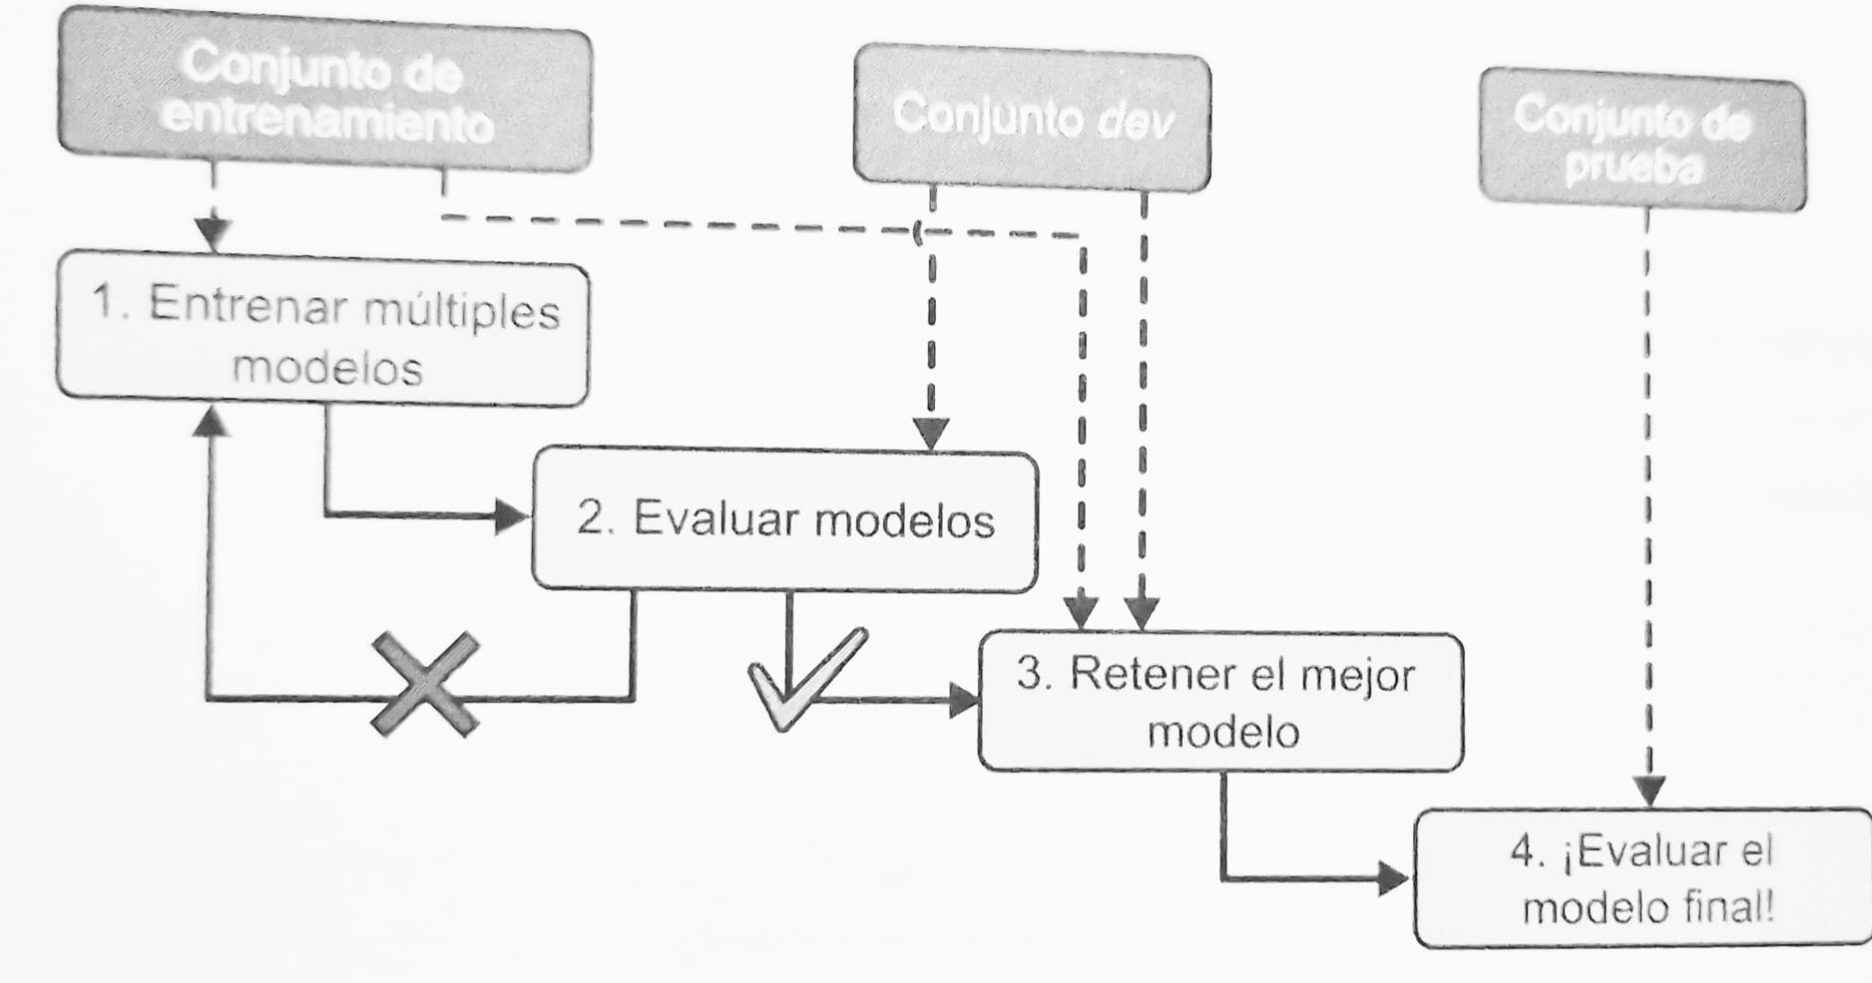
Adjustment ofhyperparametersand model selection
Validationhold-out:

Slide 69
Adjustment ofhyperparametersand model selection
Possible problems:
Validation set too small:Model evaluations are imprecise. You may accidentally select a suboptimal model.
Validation set too large:The reduced training set will be much smaller than the full training set. You are comparing candidate models on a much smaller dataset. It's like selecting thesprinterfaster to run a marathon.
Solution: repeatedly cross-validated:
Using many small validation sets.
Each model is evaluated once per validation set after training on the remaining data. By averaging all model evaluations, we obtain a much more accurate average of its performance.
Disadvantage: training time is multiplied.

Slide 70
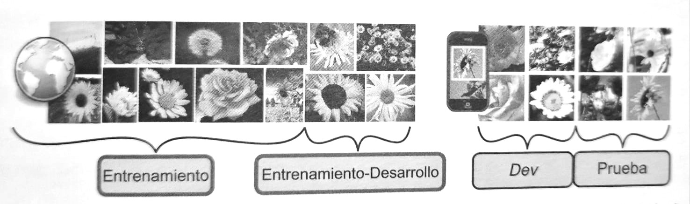
Data discrepancy
The test set and validation set should contain data that is as representative as possible of the data we expect in production.
Example of a mobile application that takes photos of flowers and indicates their species.
Many flower images on the web to train the model.
Many of the images on the web differ from those that the application will classify.
Solution:
Training development set: we retain some images from the web
We train the model on the training set.
We evaluate the overall training development.
Poor performance:
Overfitting: simplifying or regularizing the model
Good performance: evaluate indev. If indevbad ->Preprocessweb images
Evaluate on the test set to see possible performance in production.

Slide 71
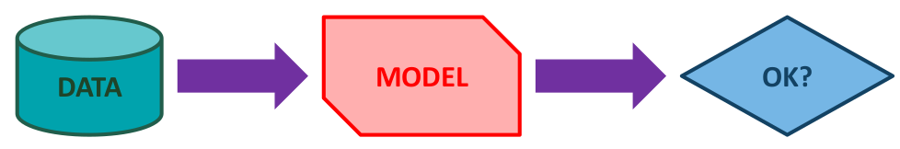
ML Solution
How do we decide if a certain algorithm is agood solutionfor our problem?
How do we compare different algorithms to find out which one is best?best solution?

Slide 72
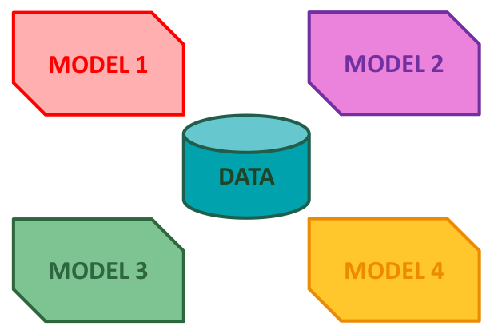
ML Solution

Slide 73
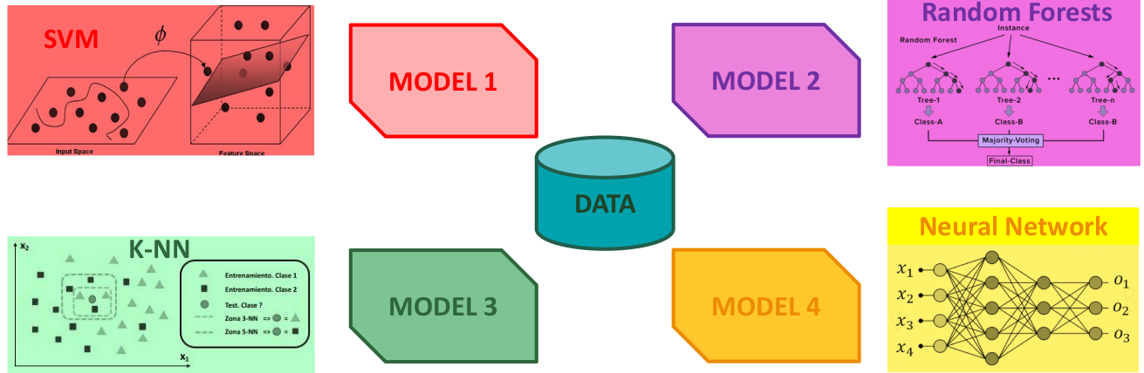
ML Solution
Many different paradigms to choose from, each with their own parameters (settings).
Notes:
SVM → Support Vector Machine
K-NN → K-Nearest-Neighbor

Slide 74
There's no free lunch theorem
A model is a simplified representation of data.
Simplify: discard superfluous details that are unlikely to generate new instances.
When selecting a model type: we are making assumptions about the data.
NFL (No free Lunch): DavidWolpert assumed that if we don't make any assumptions about the data there is no reason to prefer one model over another.
There is no model that is guaranteed a priori to work better.
How do you know which one works best? Try them all.
In practice, reasonable assumptions are made about the data and we evaluate a reasonable number of models.
Simple tasks: linear models with multiple levels of regulation.
More complex tasks: neural networks.

Slide 75

Machine Learning workflow

Slide 76

Machine Learning workflow

Slide 77




#LCAMP_EU
info@lcamp.eu
www.lcamp.eu
@LCAMP_EU
LCAMP Learner Centric Advanced Manufacturing Platform forCoVEs

