Slide 1
CLF-DES-01-EN-MA
PLM management - 3D experience

Slide 2
Content
Create an account
Set up your profile
Educational roles available
Dashboard
Practical apps
Solidworks connector with 3D Experience
3D Experience PLM
How to find things efficiently
Additional educational resources
#LCAMP_EU

Slide 3
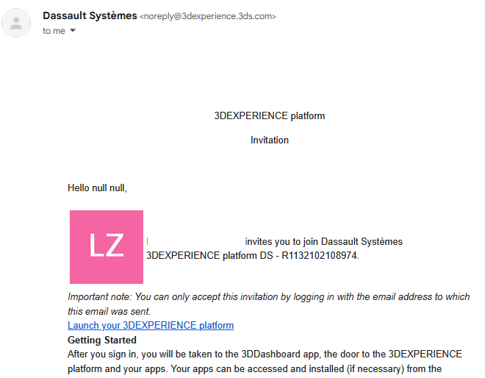
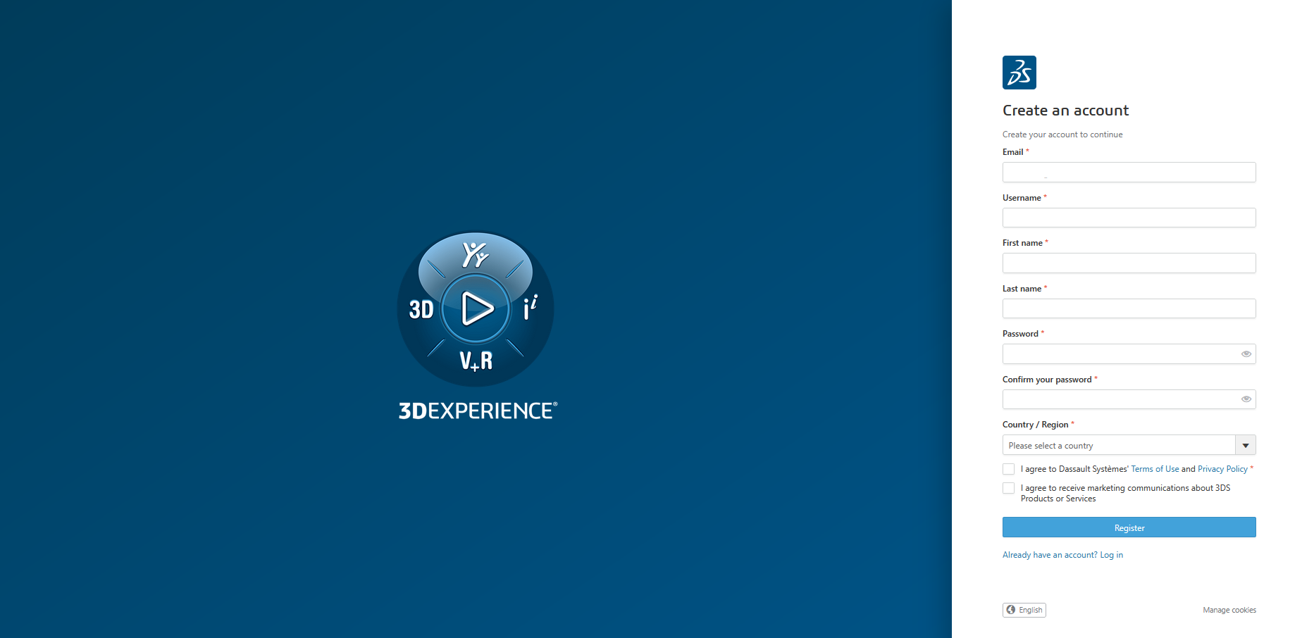
Create an account
The access to the platform is given by an administrator and received by email. Click in the Launch your 3D Experience platform link.
A browser would be opened file the data.
#LCAMP_EU

Slide 4
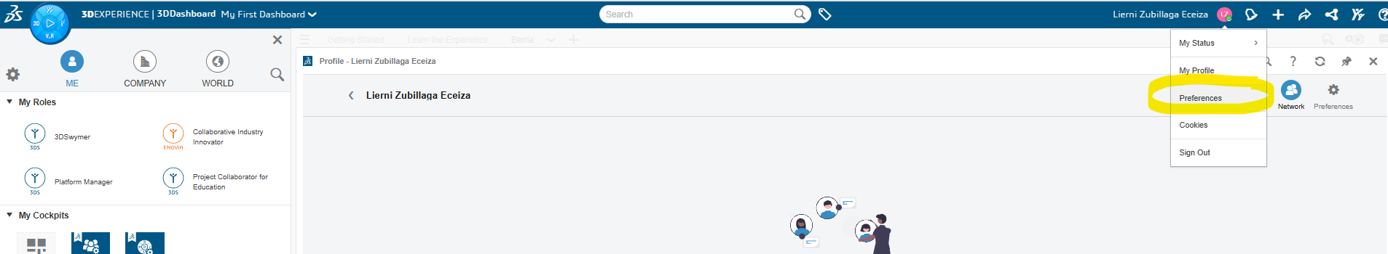
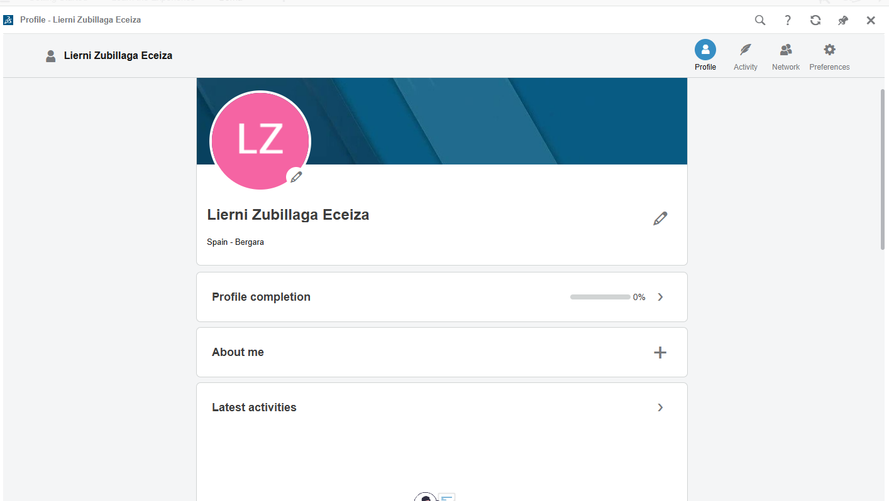
Set up your profile
Personal profile, the share information would be seen by the all platform users.
Privacy settings to determine cookies, passwords, 2 step validation.
Preferences:
  Language
  Mouse configuration
  …
#LCAMP_EU

Slide 5
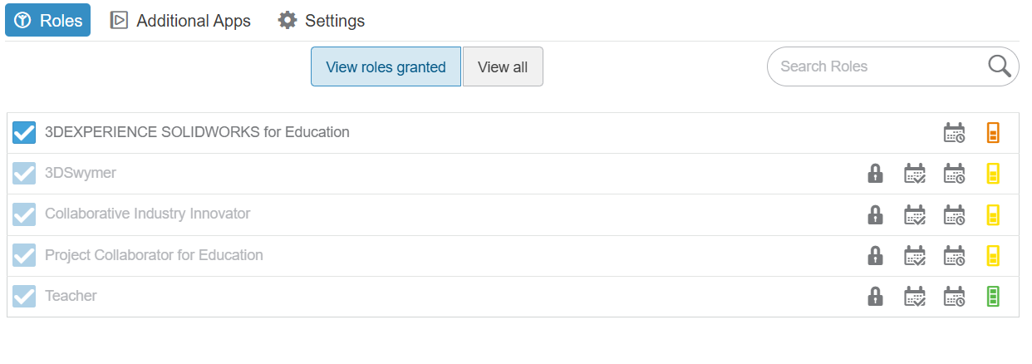
Educational roles available
The platform administrator would give the needed roles to have access to different applications. The once available for an educational platform are:
  3D Experience Solidworks for Education
  3DSwymer
  Collaborative Industry Innovator
  Project Collaborator for Education
  Teacher
#LCAMP_EU

Slide 6
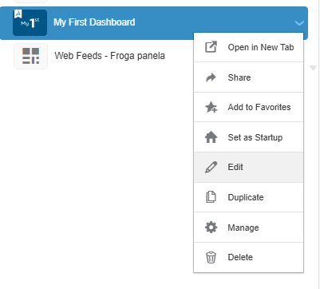
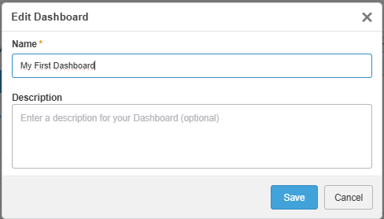
Dashboard
Dashboard: is a way of displaying content and resources in the platform. It is recommended to shortcut the most used apps.
The default dashboard is called “My first dashboard” it can be renamed
#LCAMP_EU

Slide 7
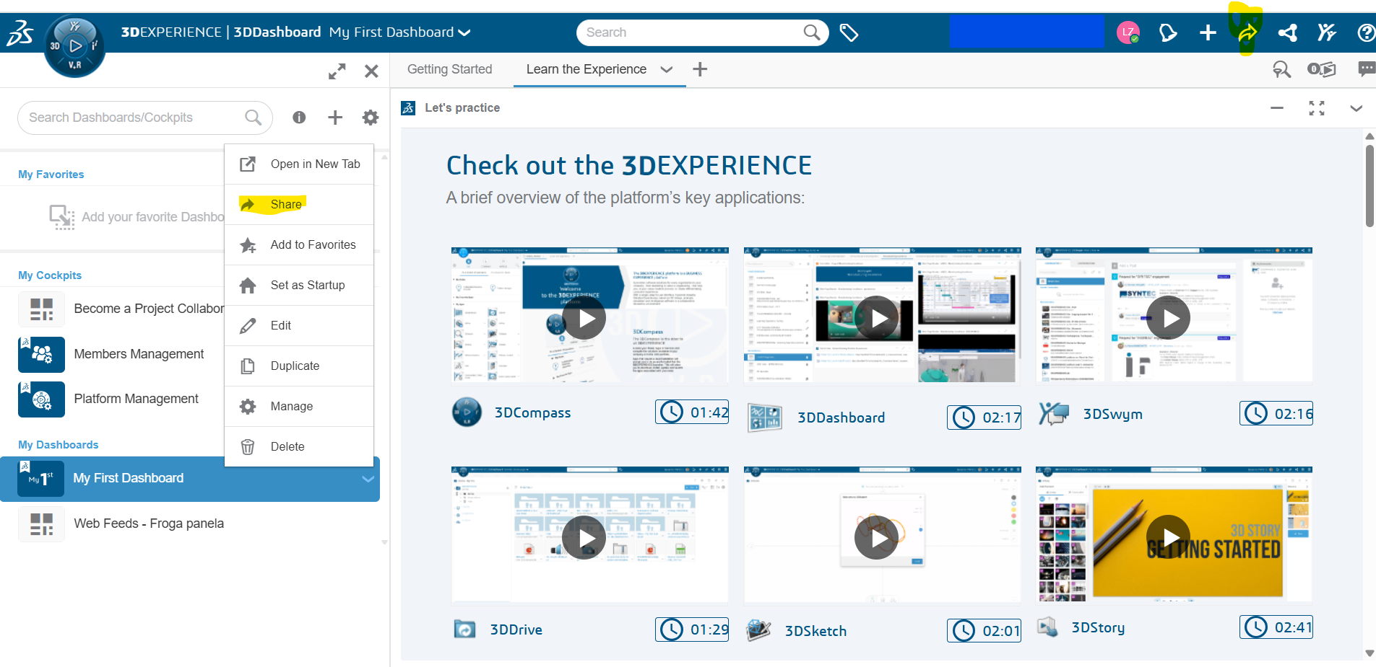
Dashboard
Dashboards can be personalized by the users. Based on their needs and interests.
If desired the personal dashboard can be shared using the following options:
  It can be shared individually or to a users group (if the group has been defined previously).
  Only personal dashboards
  can be edited. The ones that
  had been shared and accepted
  NO.
#LCAMP_EU

Slide 8
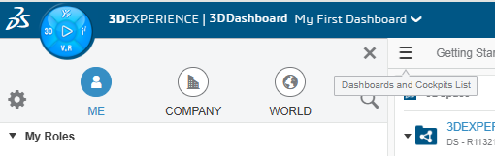
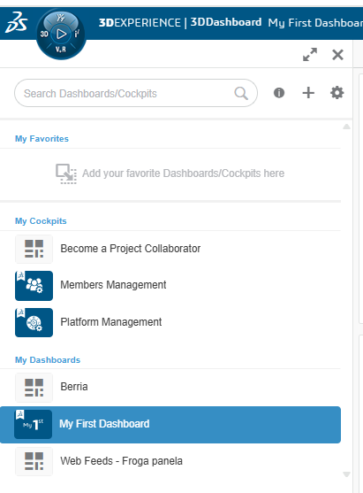
Dashboard
How to access the dashboard from the general compass menu: click on the hamburger menu:
From the dashboard menu you can choose the desired dashboard.
#LCAMP_EU

Slide 9
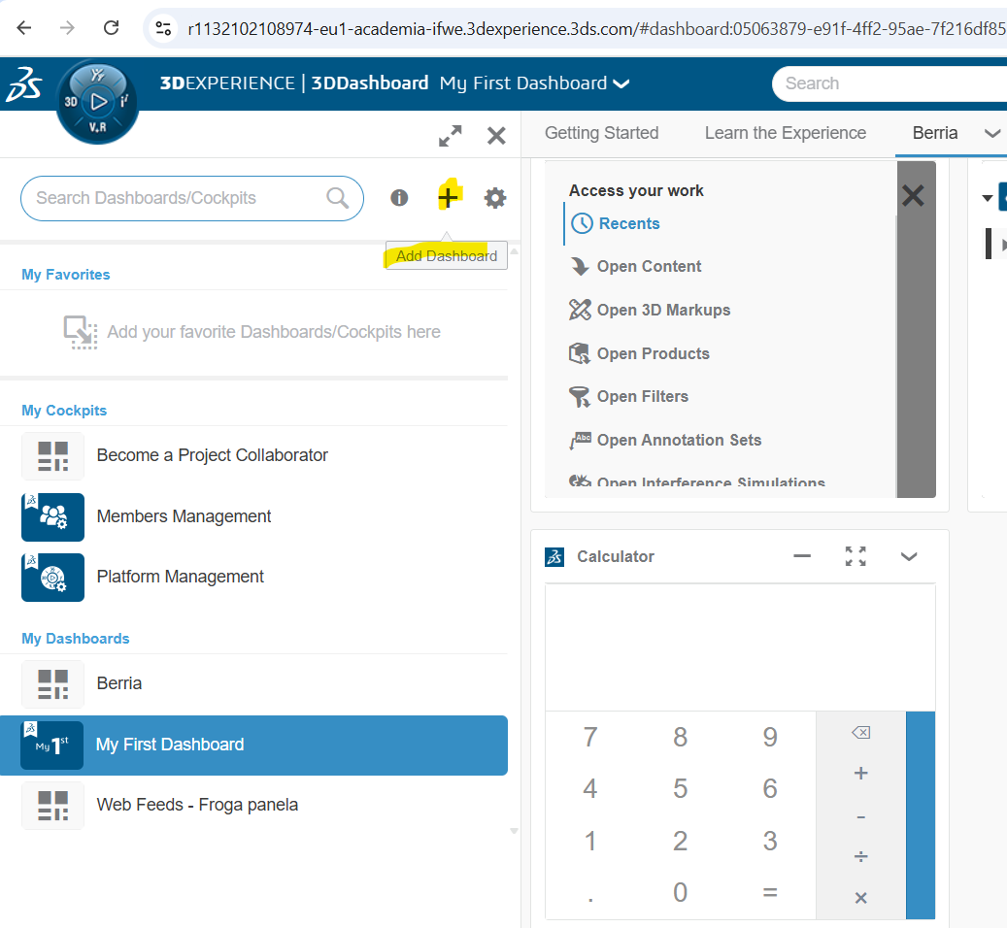

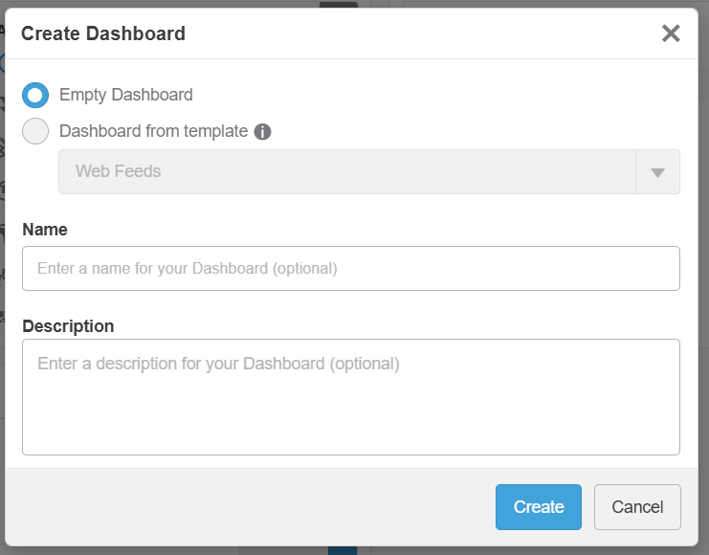
Dashboard
Add a new dashboard
  Option 1 Option2
  Displayed menu to choose dashboard characteristics.
#LCAMP_EU

Slide 10
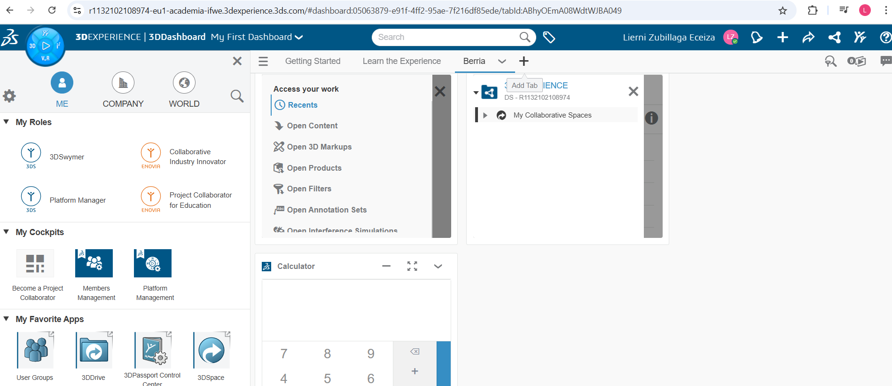
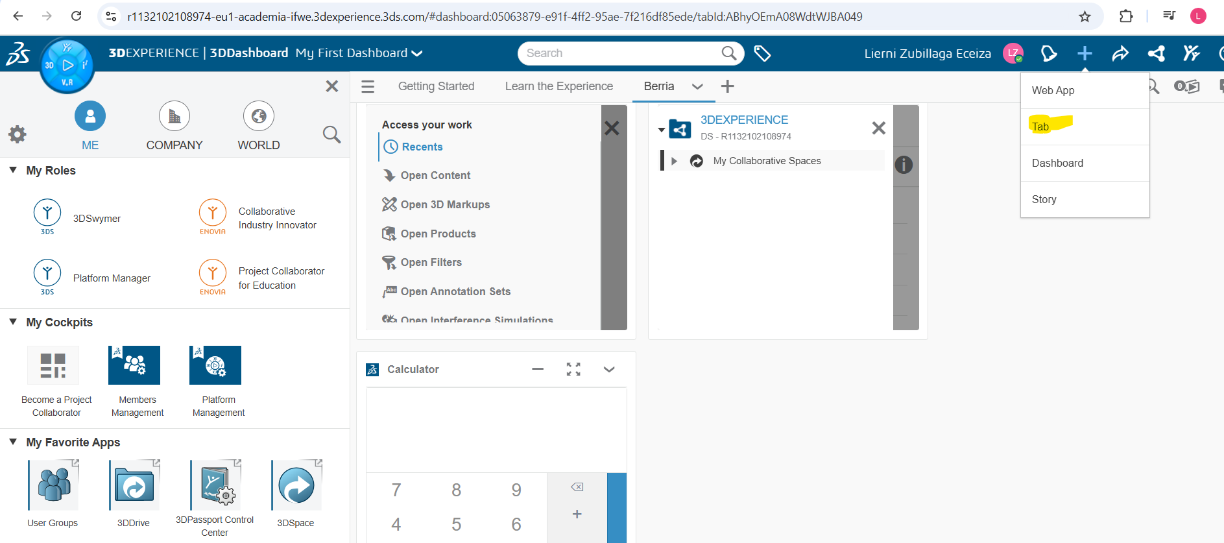
Dashboard
Add a new tab to the dashboard
  Option 1
  Option2
#LCAMP_EU

Slide 11
Dashboard
Add a new tab to the dashboard
  Option 1
  Option2
#LCAMP_EU

Slide 12
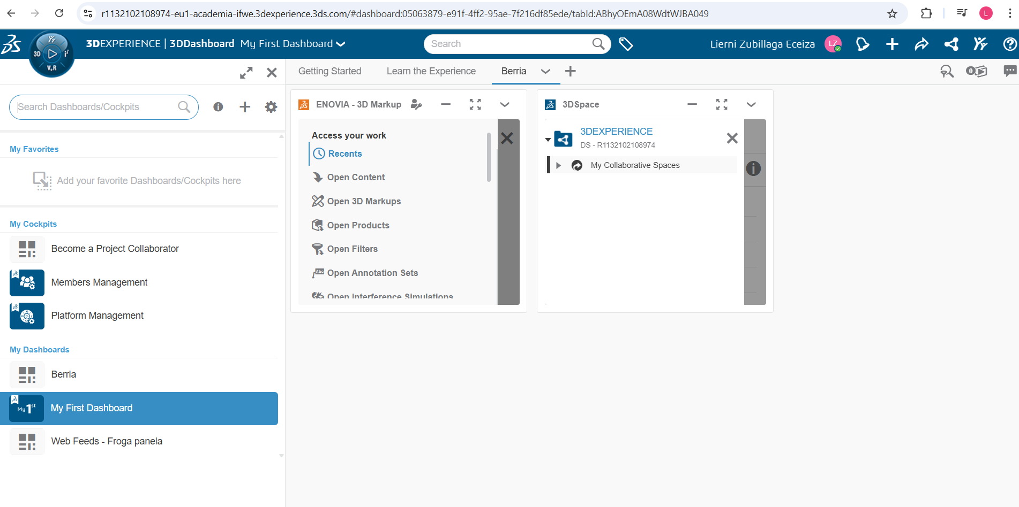
Dashboard
Add a apps to a tab
  In case you are in dashboards home page click on the compass first.
#LCAMP_EU

Slide 13
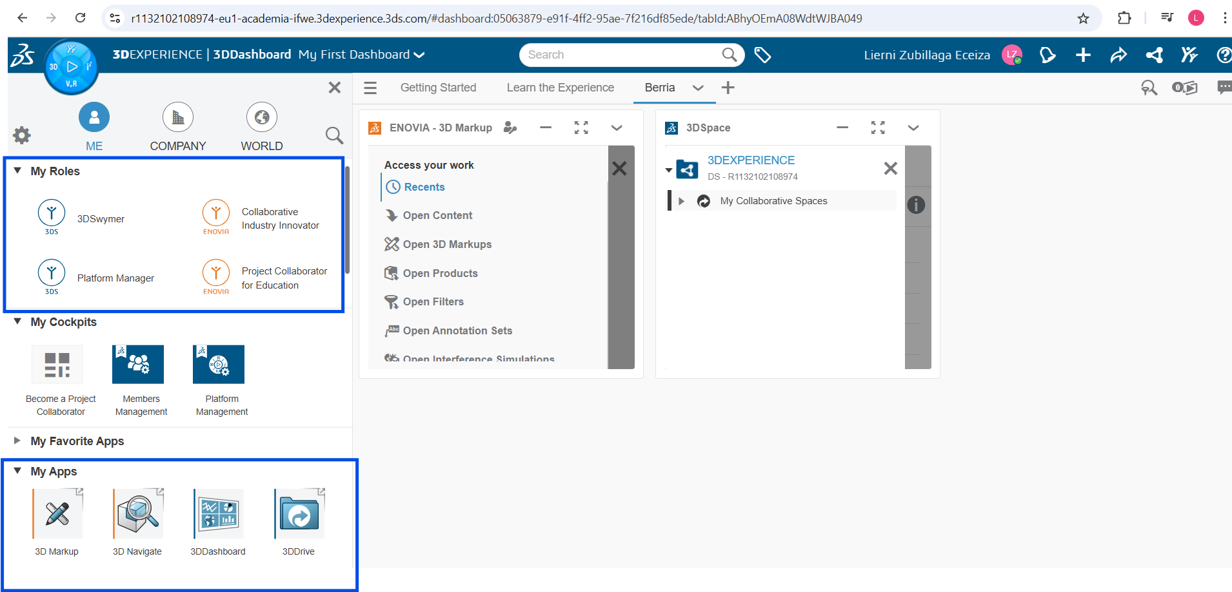
Dashboard
  Then a menu with different roles, apps would be shown.
#LCAMP_EU

Slide 14
Dashboard
  Select role and then the corresponding app.
  Choose the tab and finally click and drag the app to the screen right side.
#LCAMP_EU

Slide 15
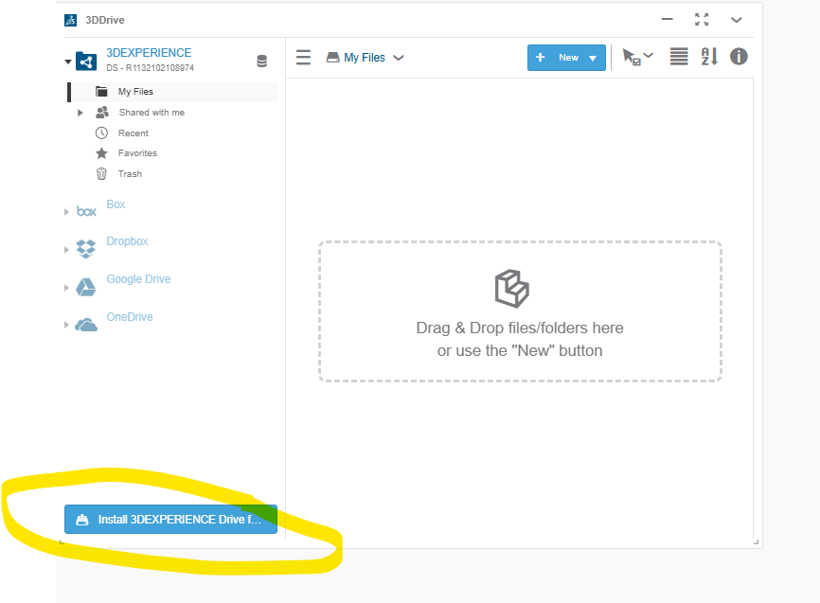
Practical apps
3D Drive
  It is the app to manage the cloud storage: by default the user would have a little space available in 3D Experience.
  This app enables to use other cloud storage providers like: Box, dropbox, Google drive or One drive.
  It is necessary to install in the desktop the app and the link with the cloud method desired. It is not compulsory to install the desktop adding.
  The installation is offered in the 3D Experience location.
  Finally, documents can be added either using the menu or by drag and drop on the area defined area.
  It is very practical for sharing documents.
#LCAMP_EU

Slide 16
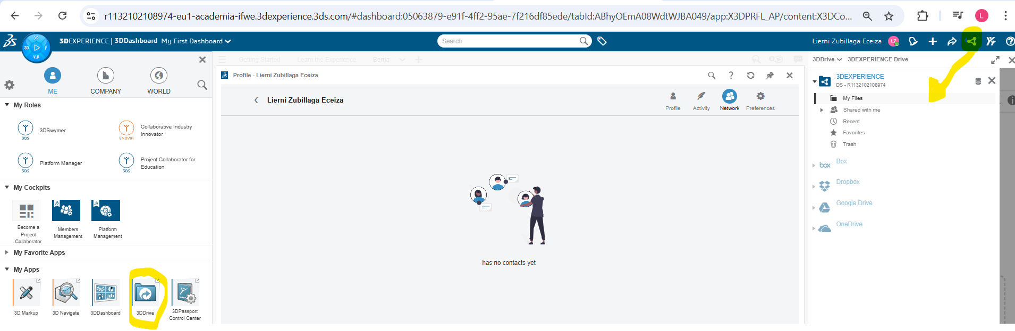
Practical apps
3D Drive
  3D drive it is accessible from both places from the app menu or from the following shortcut.
#LCAMP_EU

Slide 17
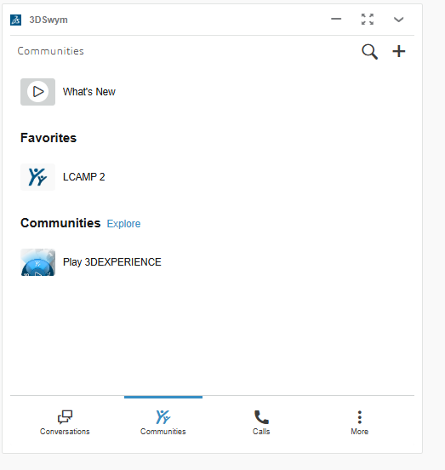
Practical apps
3D Swym
  It used to follow and use communities.
  Communities are groups of users that are linked by a topic. (Project, product…) A user can only be invited to them. A general user cannot open a new community but it They can propose to the administrator.
#LCAMP_EU

Slide 18
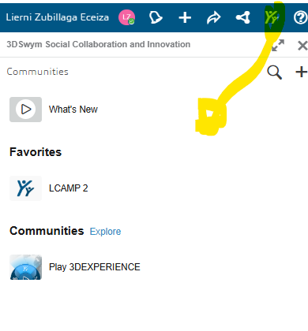
Practical apps
3D Swym
  It is also important for communication it enables to calls, video calls and chats between 3D Experience users.
  It is available from app or from the upper link.
#LCAMP_EU

Slide 19
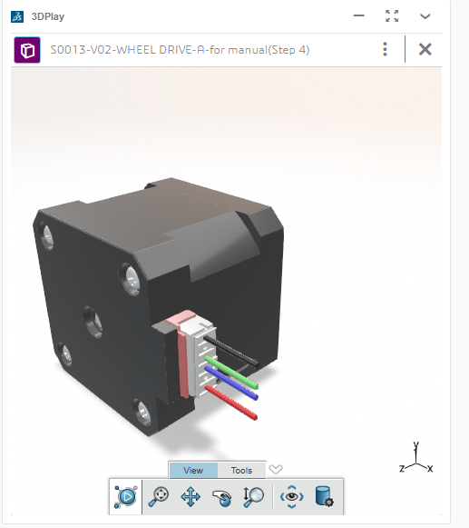
Practical apps
3D Play
  Visualization app only to see or display the model and it is also possible to make annotation.
#LCAMP_EU

Slide 20
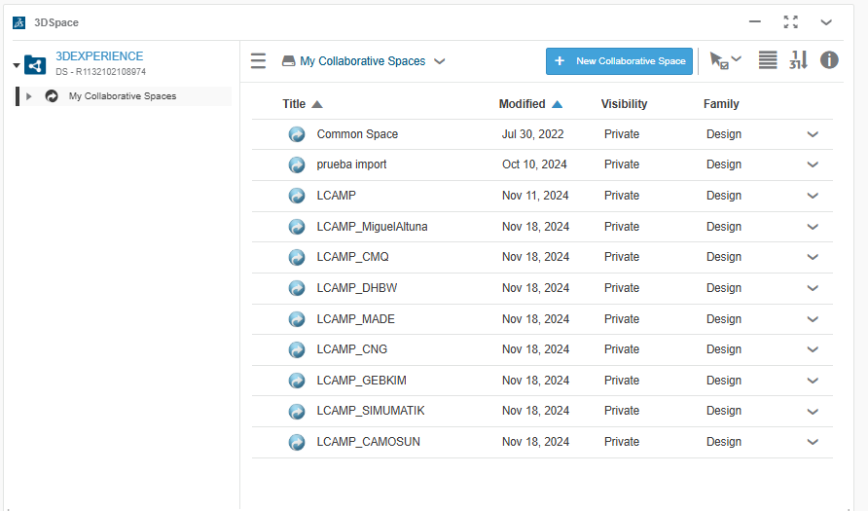
Practical apps
3D Space
  Contains the collaborative spaces of the user.
#LCAMP_EU

Slide 21

Solidworks connector with 3D Experience
The user should have the solidworks on desktop. If not a computer with enough space to install the online version.
In both cases the Solidworks + 3D Experience interface is the same.
#LCAMP_EU

Slide 22
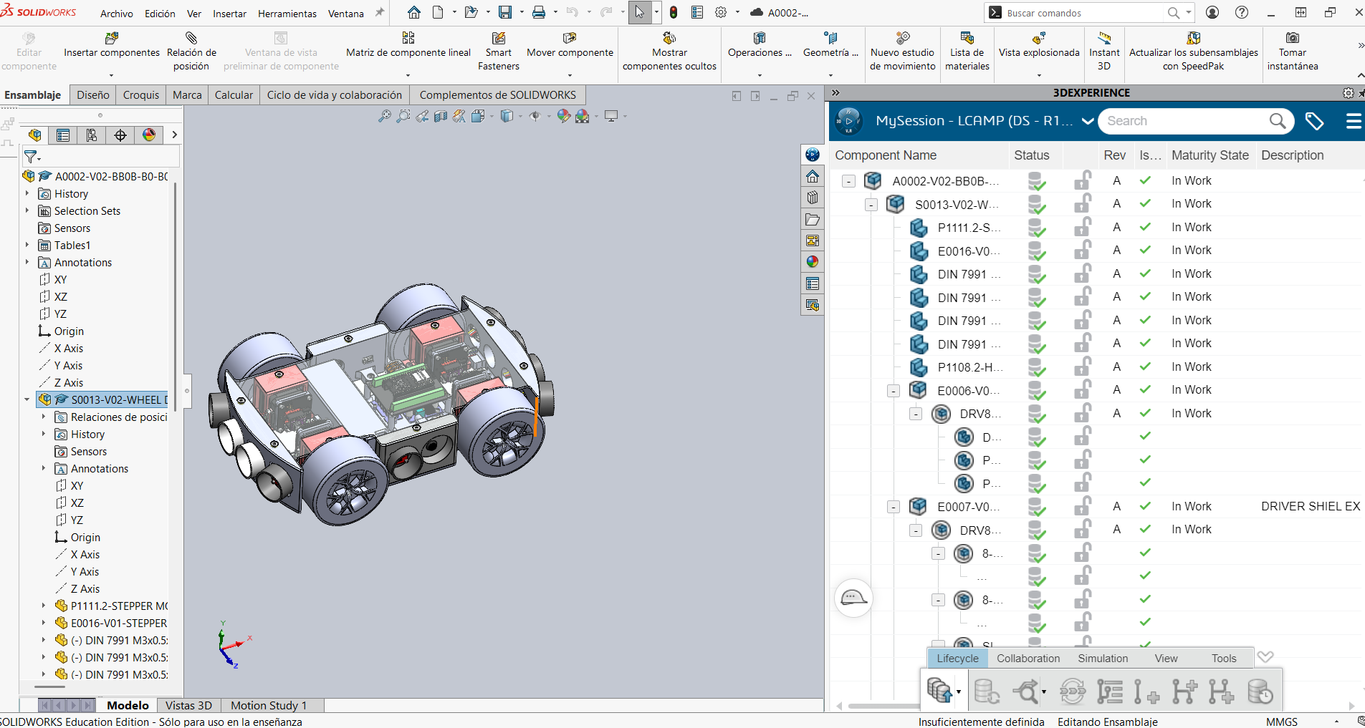
Solidworks connector with 3D Experience
3D experience interface
Note that revision of drawings are done with letters.
#LCAMP_EU

Slide 23
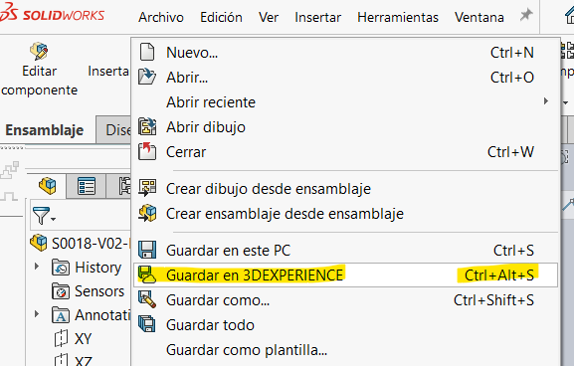
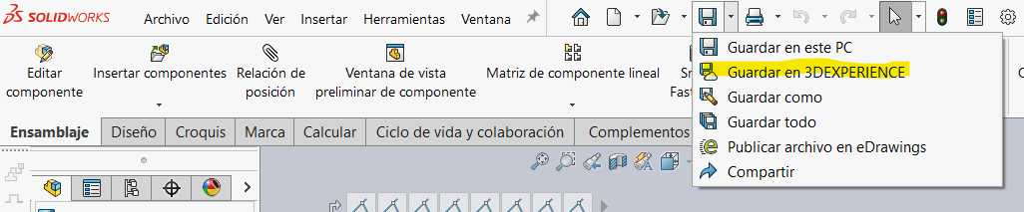
Solidworks connector with 3D Experience
How to save the new part or assembly in 3D from Solidworks.
  Option 1
  Option 2
#LCAMP_EU

Slide 24
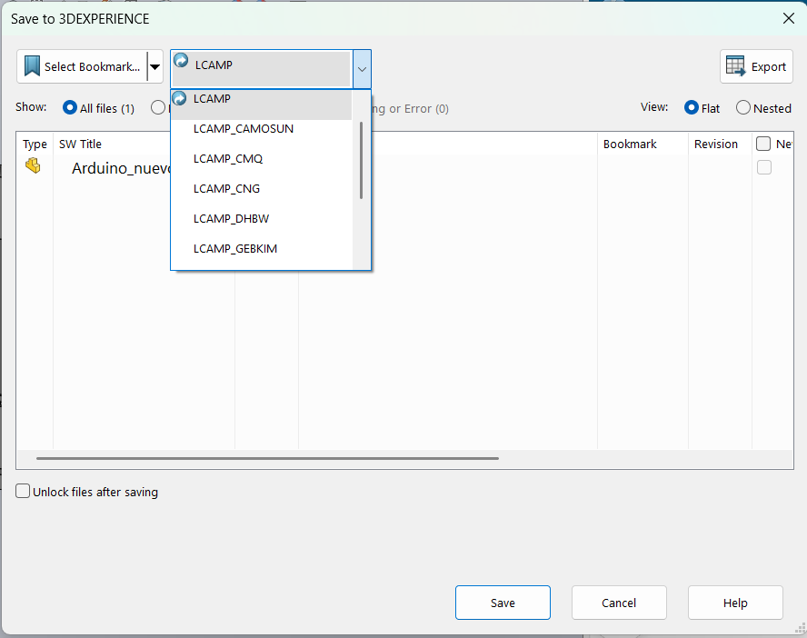
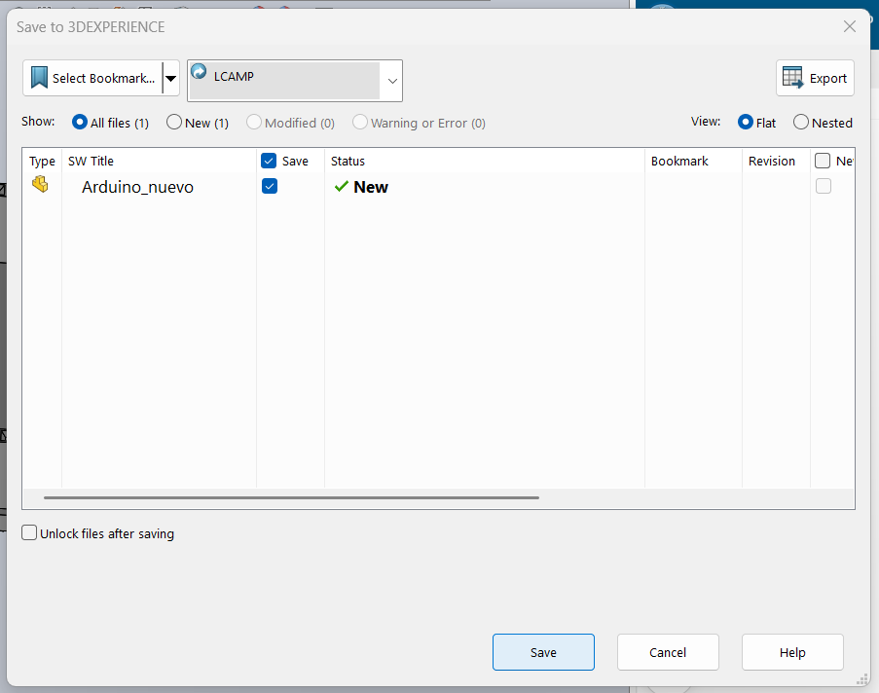
Solidworks connector with 3D Experience
How to save the new part or assembly in 3D from Solidworks.
Then choose collaborative space
#LCAMP_EU

Slide 25
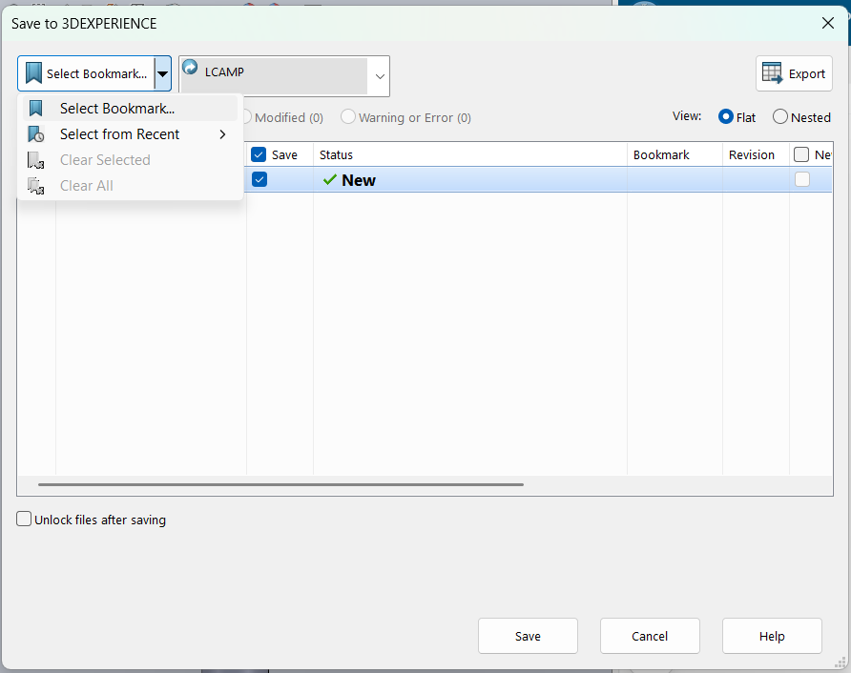
Solidworks connector with 3D Experience
How to save the new part or assembly in 3D from Solidworks.
After choose bookmark and save
#LCAMP_EU

Slide 26
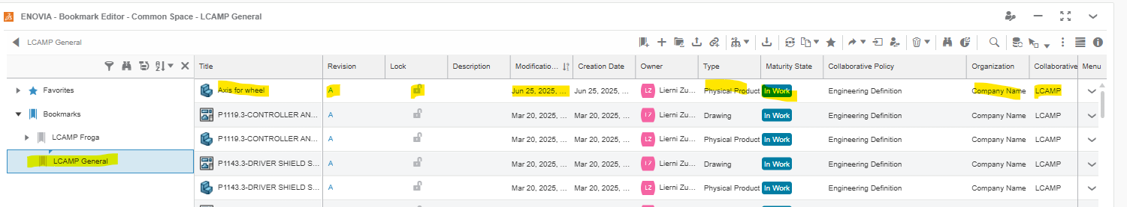
Solidworks connector with 3D Experience
How to save the new part or assembly in 3D from Solidworks.
Then after saving the visualization in 3D experience of the part would be 3D experience bookmark visualization.
#LCAMP_EU

Slide 27
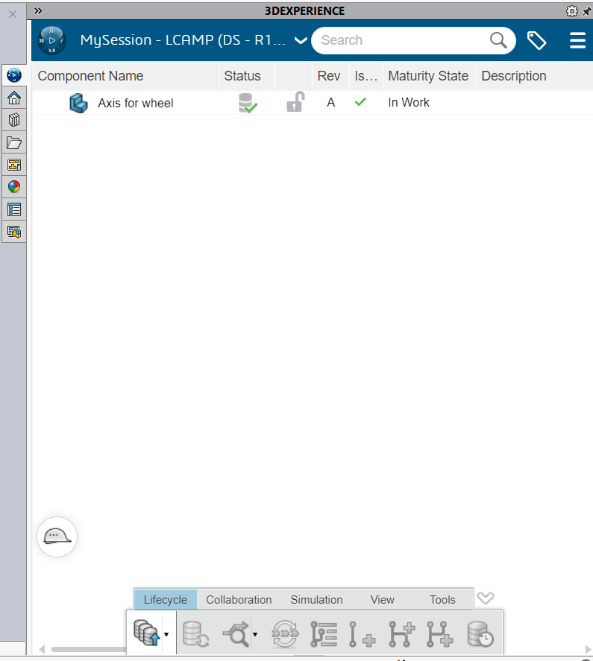
Solidworks connector with 3D Experience
How to save the new part or assembly in 3D from Solidworks.
Then after saving the visualization in 3D experience of the part would be solidworks – 3D visualization.
#LCAMP_EU

Slide 28
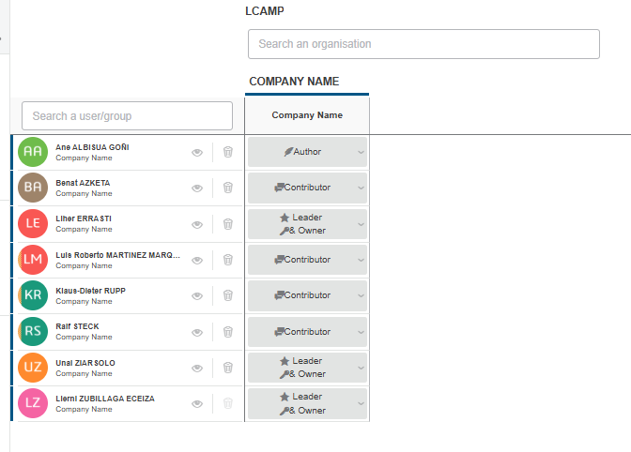
3D Experience PLM
All the tolls of the 3D Experience PLM are named with the ENOVIA Brand.
The collaborative spaces are actived by invitation.
The available activities are defined by roles of the user.
#LCAMP_EU

Slide 29
3D Experience PLM
Depending in the roll type we have being assigned capability for doing different things would be given.
  Leader and owner: see, edit and give other rolls and add user.
  Author: create and publish new docs and read them.
  Collaborator: see and work on the existing documents.
The information is saved in the 3D Space it is like a warehouse where the information is stored. Because of that it is useful to use bookmarks to classify the data in virtual folders (drawing) and document management app too.
#LCAMP_EU

Slide 30
3D Experience PLM
Depending in the roll type we have being assigned capability for doing different things would be given.
  Leader and owner: see, edit and give other rolls and add user.
  Author: create and publish new docs and read them.
  Collaborator: see and work on the existing documents.
The information is saved in the 3D Space it is like a warehouse where the information is stored. Because of that it is useful to use bookmarks to classify the data in virtual folders (drawing) and document management app too.
#LCAMP_EU

Slide 31
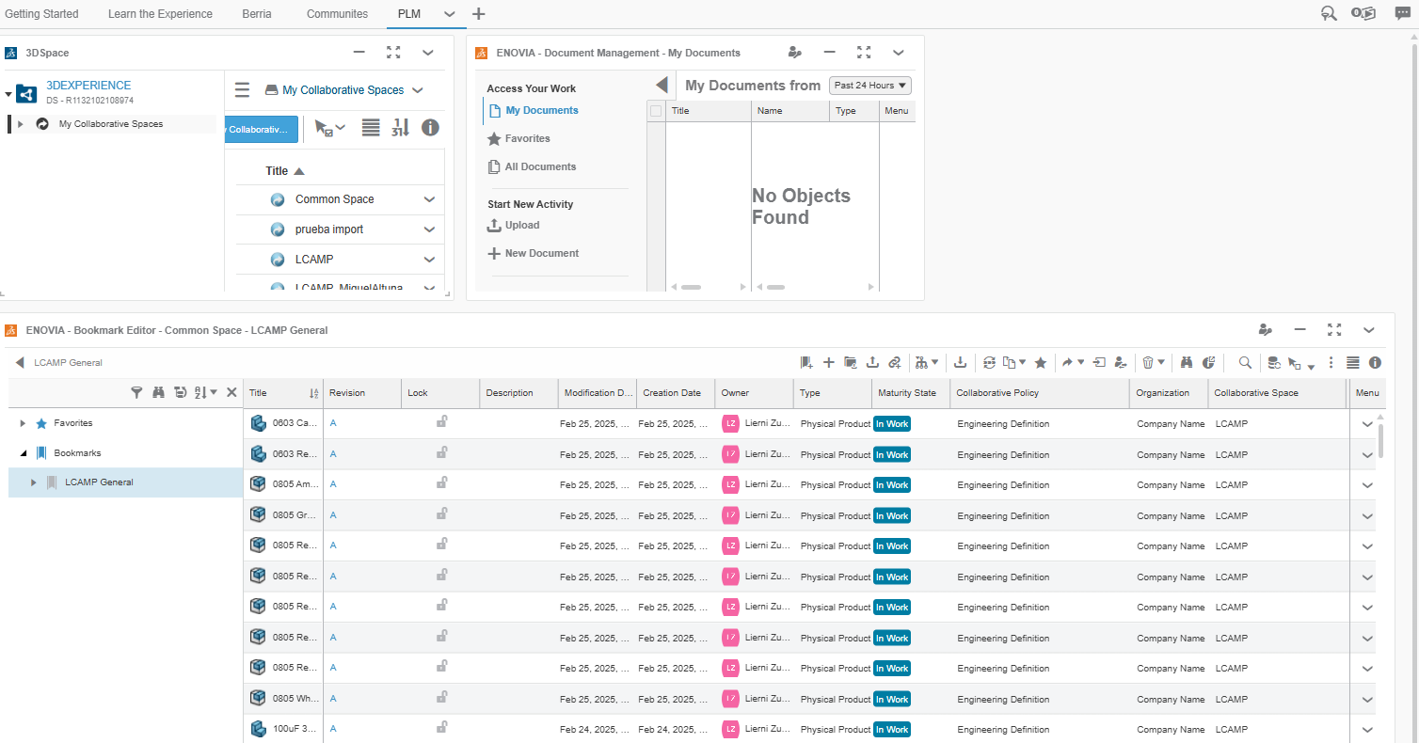
3D Experience PLM
It is highly recommended to prepare a PLM dashboard with the following applications.
  3D Space
  Document management
  Bookmarks
#LCAMP_EU

Slide 32
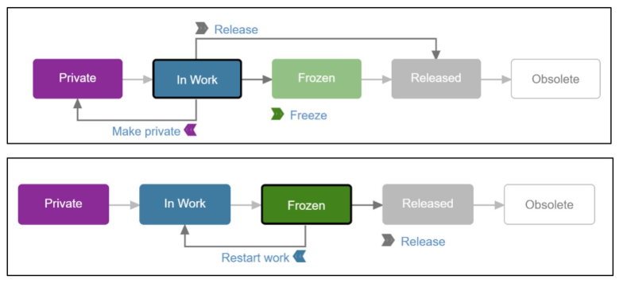
3D Experience PLM
Document management is used for
  Download
  Visualised
  Updated
  Edited
  Added to the library
Document status would be changed according to:
  Part in work process: we can edited without blocking.
  Edited: Must be blocked to be edited and to create a new revision.
  Once realeased the part cannot be edited.
  In case it is necessary a newvrevision would be created.
Note that each configuration of a physical product would form a CAD Family.
#LCAMP_EU

Slide 33
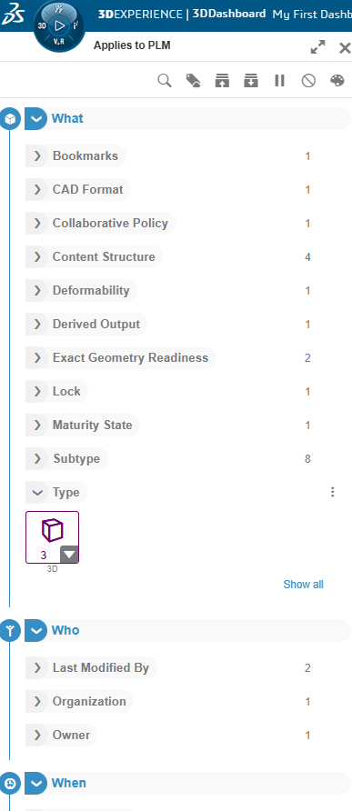
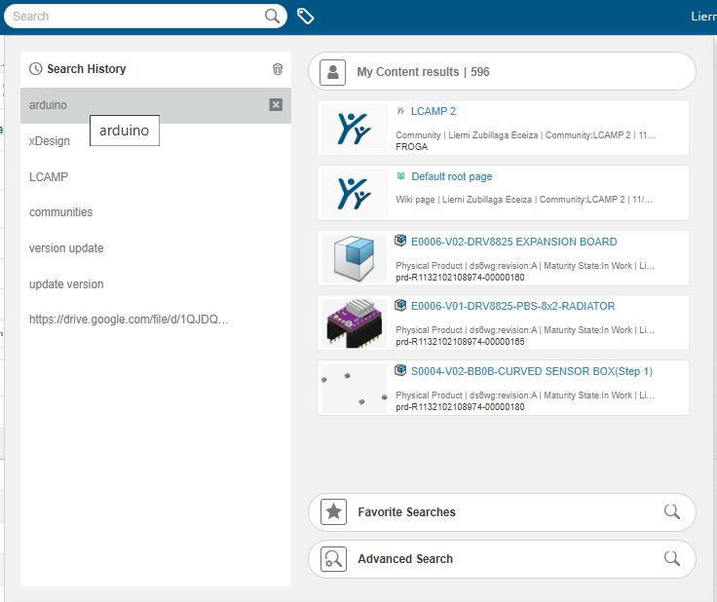
How to find things efficiently
Search menu on the top of the page should be used. If many files are shown use the filter.
Step 1 Search menu Step 2 Filter
#LCAMP_EU

Slide 34
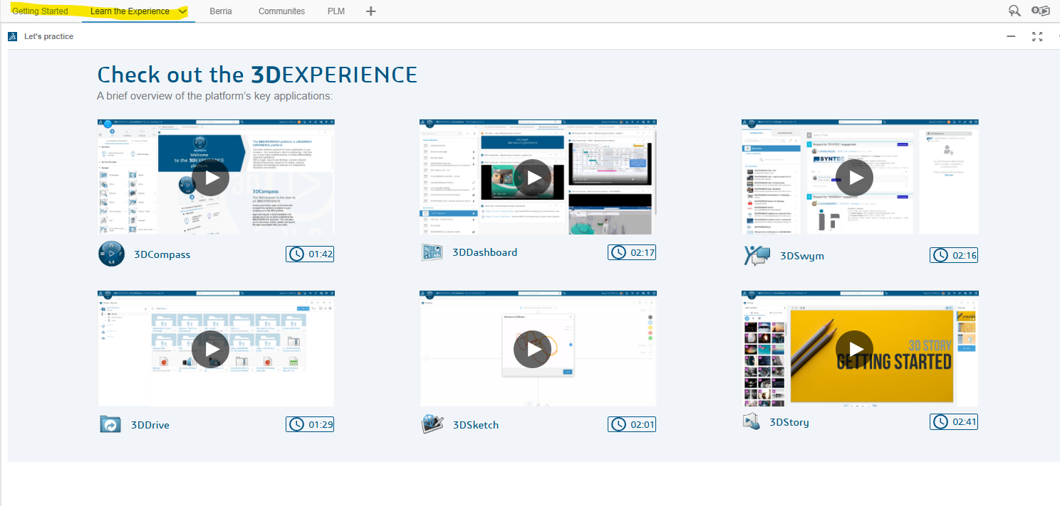
Additional educational resources
In the homepage of the platform default options of online education are available. the links and videos are shown in two tabs. On both tabs of dashboard in Getting started and learn the experience could be found those links.
#LCAMP_EU

Slide 35
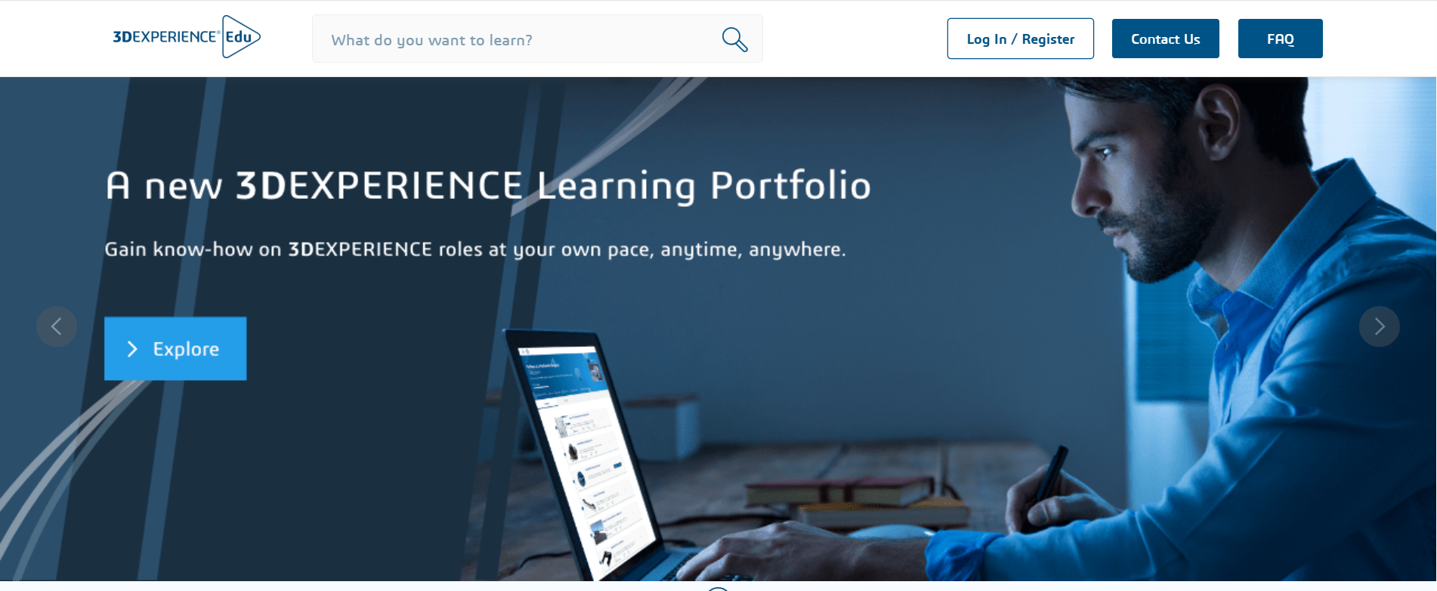
Additional educational resources
Finally a deeper educational web application is available for the 3D Experience users offered by Dassault.
It is necessary to sign up and formations shown would only consider the applications available for the enroled user.
https://eduspace.3ds.com/CompanionManager/public/#/
#LCAMP_EU

Slide 36




#LCAMP_EU
info@lcamp.eu
www.lcamp.eu
@LCAMP_EU
LCAMP
Learner Centric Advanced Manufacturing Platform for CoVEs

