Slide 1

INTRODUCTION OF THE PROGRAMMING OF UR COBOTS

Slide 2
ROBOTS AND COLLABORATIVE ROBOTS (COBOTS)
Cobots
Cobot or collaborative robot is a type of robot, which works together with humans safely doing several in tasks and processes.
Cobots are build to work with humans sharing space and interact effectively.

Slide 3
Cobots
Collaborative robots designed to perform any type of manual and/or repetitive tasks, as well as tasks that may be dangerous for workers, such as the use of heavy clothing or a cutter.​
This is very useful because the possibility of occupational accidents is reduced.

Slide 4
Cobots
They communicate with humans thanks to the establishment of artificial vision, among other things.
It is essential to detect and interact with people, thanks also to the advances of the motion sensors in the devices..
Robot his/her at work interrupt yes , we previously scheduled security as will be included , traditional robot with one will happen of what would be against​

Slide 5
Cobots
https://www.youtube.com/watch?v=KUg6tDGpZfc
https://www.youtube.com/watch?v=XH6MLNL6z-M&ab_channel=SembrandoCiencia

Slide 6
Collaborative Robots in Industry 4.0
Register the first models in the 90s, based on research projects by General Motors.
Humans gave the machine the power to move, and collaborative robots gave control and direction to objects.
In this way, humans could control the power of the robot accompanied by the capabilities of the machine.

Slide 7
Collaborative Robots in Industry 4.0
Today, and with the emergence of technologies such as the Industrial Internet of Things, artificial intelligence, data processing and hyperconnectivity.
Cobots are controlled to work according to human programming without creating greater risks.

Slide 8
Collaborative Robots in Industry 4.0
Humans, instead of being replaced by robots with autonomous parts, introduce cobots.
Collaborative robots enhance capabilities such as precision, information processing, or superforce.
Managing this is one of the goals of Industry 4.0.
https://www.youtube.com/watch?v=5yncaU5jg6s&ab_channel=PodcastIndustria4.0

Slide 9
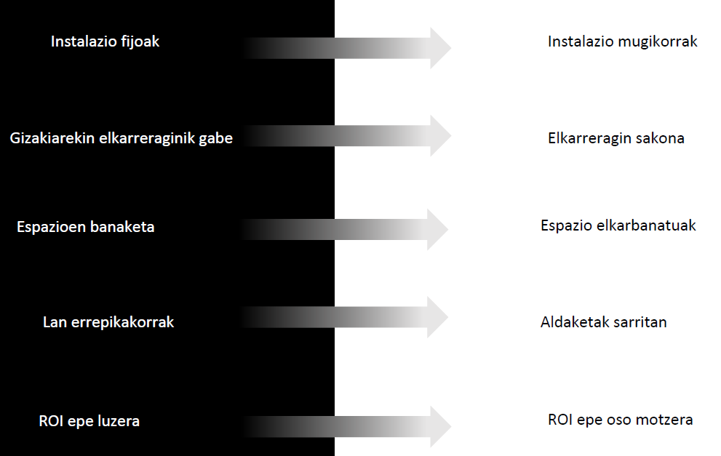
Progress achieved with Collaborative Robots:

Slide 10
Characteristics of a collaborative robot
A Cobot differs from traditional robots or autonomous robots by certain characteristics:
Compact: They usually have small dimensions.
Therefore, they can be used in almost any production process.
Mobile: Against industrial robots.
Cobots are easy to move. They can perform new tasks in different locations of a company.

Slide 11
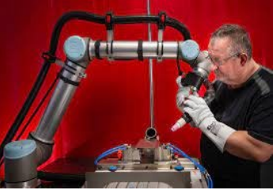
Characteristics of a collaborative robot
Easy installation and programming: With mobile apps and desktop software. Cobots can be operational in a very short time.
Flexible: They can easily learn new operations, which means that they can be used at different stages of a production process. Given all these characteristics, it is important to highlight that kobots are a very important tool for SMEs.

Slide 12
Types of collaborative operations:
According to ISO 10218, four types of collaborative operations are specified. A robot and an operator that can interact with each other by securely sharing the workspace. These are the following:
Controlled security shutdown. A controlled safety shutdown occurs when, when the robot is in motion, it detects the entry of a human being into a predetermined restricted area as the safety area. It should be noted that the robot does not turn off (off state), but remains on (on state), but braked.

Slide 13
Controlled security shutdown
When the operator leaves the safety zone, the robot resumes without external intervention, i.e. performs an automatic restart. It is clear that a plant operating with this type of operation must have security devices for detection (presence sensors...) when the operator is in its vicinity.
This type of collaborative operation can be used if a robot works mostly on its own, but occasionally a human enters its working área, for example, to load or unload material or even for short inspections during the working process. If interactions occur frequently, a lot of time will be wasted.

Slide 14
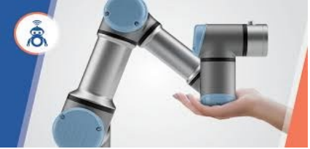
Controlled security shutdown

Slide 15
Separation of speed and distance
In this case, the speed of the robot is reduced depending on the proximity of the person.
Various safety zones around the robot are determined and monitored by means of a sensor (laser, vision...).
When the operator enters one of these areas, the speed of the robot changes to that which is designated for that área, being smaller the closer it is to the robot.

Slide 16
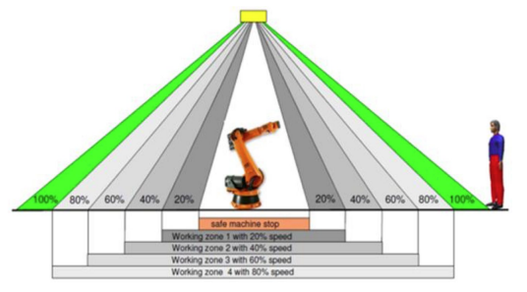
Separation of speed and distance
A controlled stop is made in the área closest to the robot.

Slide 17
Guided by hand
In this type of cooperation operation, the movement of a robot is manually guided by the operator after a controlled safety stop.
Thus, for example, it can be used to quickly "teach" paths in welding applications.
The operator must activate the manual guidance function in order to carry out this operation.

Slide 18
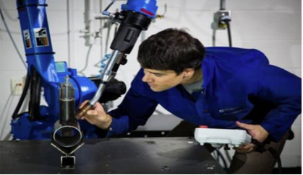
Guided by hand
The robot will resume its normal operation if the operator has left the safety zone and will preferably activate a reset button as an additional check.

Slide 19
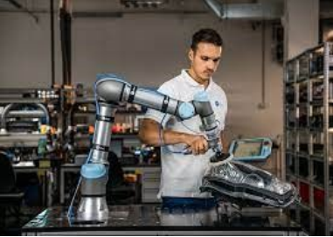
Limitation of Strength and Power
In this type of operation, since the system is inherently safe, even if an operator has direct contact with the robot, the terminals or the load, it will not cause any damage.
Everyone calls them collaborative robots (or Kobots) because they can collaborate with humans without using additional security devices (fencing, panels...)

Slide 20
Elements of security:
The safety elements of the robot can be:
The liabilities are: Physical design with rounded contours (without edges) and no trapping points, minimal openings, soft covers, lightweight materials, reduced maximum speed to generate impacts with low inertia...
The assets are: The force sensor or impact detector must immediately stop the movement if contact with an unexpected external element is detected. Thanks to capacitive sensors that detect the presence, we can anticipate collisions.

Slide 21
Cobots vs Industrial Robots
Collaborative robots may have some similarities with traditional robots.
However, there are more differences and advantages of implementing cobots in companies:
Make a table of the advantages and differences between Robots and Cobots.

Slide 22
Cobots vs Industrial Robots
INDUSTRIAL ROBOTS | COBOTS
They are ideal for large companies with large production processes. | They are designed to maximize the production of any type of company.
It requires an extensive programming process that can take days or weeks of configuration. | It’s easy to program, even for users who haven’t had any engineering experience.
They must be installed in a safe environment and with different protective measures for the worker. | They are designed to work safely together with humans in various processes.

Slide 23
Cobots vs Industrial Robots
INDUSTRIAL ROBOTS | COBOTS
They always perform the same action, since they are usually configured to perform a single process. | Cobots have the ability to program to perform various different tasks, in different places.
Companies have to invest a very large budget in order to obtain this type of machines. It will be several years before the investment is amortized. | Collaborative robots are cheaper and easier to use in the installation and programming process. This also allows for a faster return on investment.

Slide 24
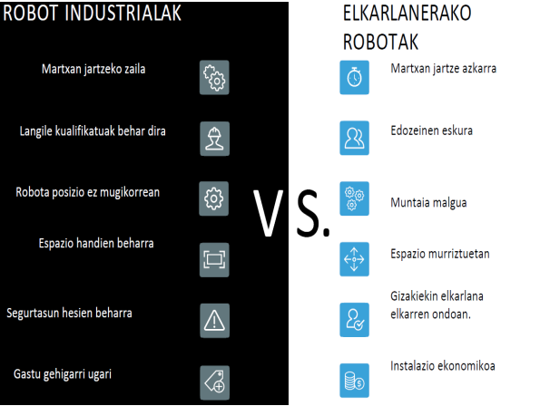
Cobots vs Industrial Robots

Slide 25
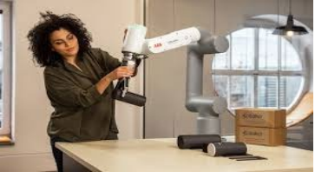
Benefits of Cobots
In addition to the benefits mentioned above, there is a very important one that has to do with the positive impact on employees.
Cobots are also known as people-based robots, as they help facilitate and improve the work they do.
It frees them from unsafe, boring, dirty or repetitive tasks and allows them to focus on more human tasks.

Slide 26
Benefits of Cobots
This also affects the motivation and happiness of the employee, allowing them to have a place for creativity and thought, focused on the search for improvements and solutions for the company.
In addition, Kobots help to meet the maximum targets with minimal costs due to the reduction of errors.

Slide 27
In which industry can a collaborative robot be used?
Since anything can be taught to a Kobot, it can be used in any industry and place.
However, there are some who can get more benefits and are already successfully integrating cobots.
  The food industry
  The Medicine
  Logistics and packaging companies
  The pharmaceutical industry

Slide 28
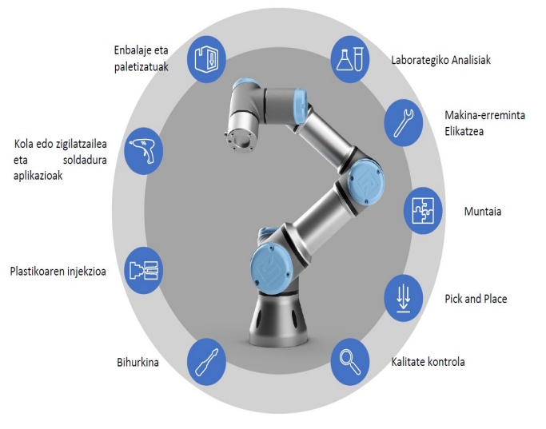
In which industry can a collaborative robot be used?

Slide 29
In which industry can a collaborative robot be used?
Aplicaciones Robotica Colaborativa INDUSTRIA 4.0 ALBACETE (youtube.com)

Slide 30
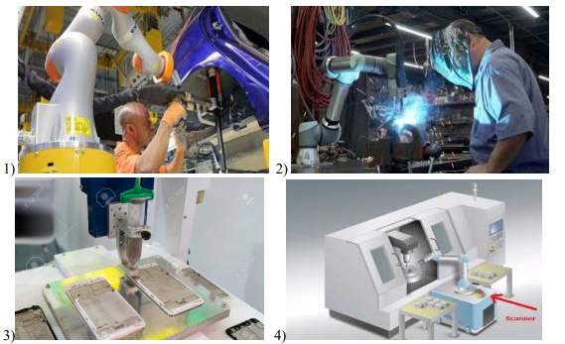
Exercise
Put, to each of Cobot’s photographs what works they are doing and in which industries they are used.

Slide 31
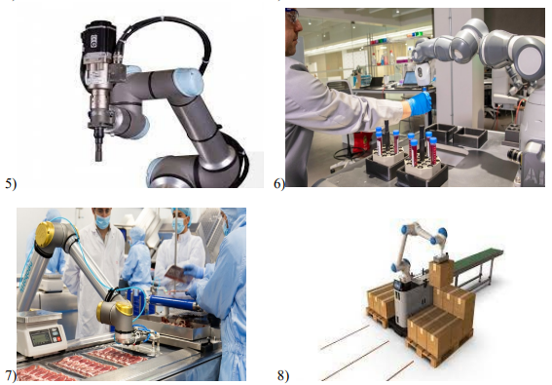
Exercise
Put, to each of Cobot’s photographs what works they are doing and in which industries they are used.

Slide 32
When to include a cobot or collaborative robot in a company?
A relatively high percentage of tasks in an industry when they are repetitive tasks or add little value to the product.
When the process involves a physical or psychological risk to the worker: postural risks, performing the same tasks for a long time...

Slide 33
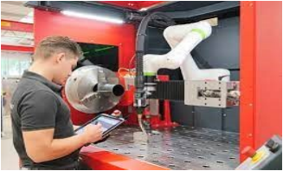
Identify the processes of robotization
The current technology allows to robotize many processes, although it may not be the most appropriate. First, we need to identify which process is convenient or interesting for us to robotize.

Slide 34
Identify the processes of robotization
There may be several reasons why it may be interesting to robotize an application:
It may be advisable for an employee to stop performing an activity.
You can look for a reduction in costs.
In certain embodiments, an improvement may be desired.

Slide 35
Identify the processes of robotization
Activities to delete:
There are several reasons that recommend eliminating the activity of an employee. Traditionally, they are grouped into "3 D": dangerous, dull, dirty –
Because it's dangerous. Very repetitive or high-speed tasks often lead to injuries. Sometimes they can pose a risk to the life of the worker.
Because they are very repetitive, they tend to be boring and unmotivated.
Unpleasant or exhausting during the execution (temperature, confinement...).

Slide 36
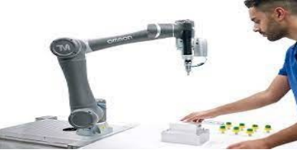
Identify the processes of robotization
2. Reduction of costs:
Competitive pressure constantly drives cost reductions. At the final cost of the product, due to the weight of the wage mass of the labor, this labor can be replaced by robots.
The first activities of robotization, in whole or in part, can be: those that are most intensive for the workers.
It must also be taken into account that an employee can have many waits and therefore not be productive.

Slide 37
Identify the processes of robotization
3. Improvement of performance:
Workers’ performance certainly improves with training and practice, but human beings have limitations (strength, speed, dexterity, vision, ability to concentrate...) that prevent them from reaching any level of performance.
In some cases, the use of machines is essential to achieve:
Improving the quality of finished parts
Greater consistency/homogeneity in the quality of the parts
More speed in the process

Slide 38
Impact on the labour force
In production processes, as a result of the incorporation of more and more robots, workers will be freed from repetitive tasks and can perform tasks of greater value, complexity and professional satisfaction.
In order to maintain jobs, there are other tasks of greater value.
This raises controversy among displaced workers and there are defenders of all positions: those who believe that all workers can be relocated and on the other hand recognize that some low-level profiles are difficult to relocate individually.

Slide 39
Impact on the labour force
In general, and after a while, most of those believe that new jobs will appear.
Some jobs will be lost at first, but when you look at the impact globally, the market will transform dramatically and new jobs will emerge over time.
As always, reality will be the one that gives and takes away the reasons, and since it is giving rapid development, we will not have to wait long.
In any case, with the exception of a cataclysm of global dimensions (nuclear war, impact of a meteorite...), robotization is not an option, but an inevitable consequence of current technological progress.

Slide 40

Impact on the labour force
The inclusion of a robot in a production line generates the following: the initial creation of distrust among employees.
If you want to maintain a good working environment by introducing a robot and achieve success, you need to clearly explain what the benefits are in terms of productivity and highlight the working conditions that improve them.
What do you think of this discussion? Make a list of ideas and discuss them in class.

Slide 41
Impact on the labour force
Cuando la tecnología y el empleo están reñidos: el efecto de los robots en los puestos de trabajo (computerhoy.com)

Slide 42
The choice of the robot
Once the application for robotization has been identified, it is necessary to choose which robot will be integrated. The assessment of whether a particular robot adapts to a process depends mainly on the following characteristics:
The load. The maximum weight that the robot can handle, taking into account the terminal element.
This means that, the terminal element can be very heavy and its payload can be significantly limited. In general, the loads of collaborative robots are small and much smaller than those that a traditional robot can handle.

Slide 43
The choice of the robot
The scope of it. The range is the maximum distance that the terminal element of the robot can reach.
As in the case of charging, collaborative robots are relatively small.
The speed of it. In general, collaborative robots are slow devices.
In any case, the most important thing is not the speed, but whether that speed is sufficient to respect the process times.

Slide 44

The choice of the robot
Ease of programming. Although it is not a specification in itself, it is undoubtedly a feature that must be known before buying a collaborative robot.
Without being mandatory, it is very convenient to know the type of programming of the robot that you want to include in the production line.

Slide 45
The choice of the robot
Other features that can be explored include:
The repeatability. The standard repeatability of collaborative robots is sufficient for most common applications, but if high accuracy is required in any task, this may be a limitation.
The weight. The weight of the robot can be critical when it is placed on the table or glued to another surface or to another machine.
It is also important if the robot moves in the production plant (even if it is mounted on a movable structure).

Slide 46
The choice of the robot
Level of IP protection. The robot must be resistant to water and dust if it is going to be subjected to harsh environmental conditions, the level of IP protection must be taken into account (Ingress Protection, IEC 60529 standard). In some cases an additional protective cover may also be added.
The footprint. What is known as footprint is the space that the robot occupies in operation.
When a robot is to be included in an ongoing process, the available space may be a limit if it is small and cannot be increased.

Slide 47
The choice of the robot
Finally, the characteristics of the terminal element may also be of interest:
The load. The load of the clamp is a parameter independent of the load of the robot.
Open the clamp. Once opened to the maximum, the fingers of the clamp limit the size of the parts that can be grasped.
Ease of integration. The easier it is to install and program the terminal element on a robot, the better..

Slide 48
The choice of the robot
According to a study by MIT, the Massachusetts Institute of Technology, which analyzes what a Kobot is and what its possibilities are, both people and robots increase productivity by up to 85% when they work together than when they work independently.
Agur, robot; kaixo, kobot (berria.eus)

