Slide 1
ARIKETA. DASHBOARD PUBLIKOA

Slide 2
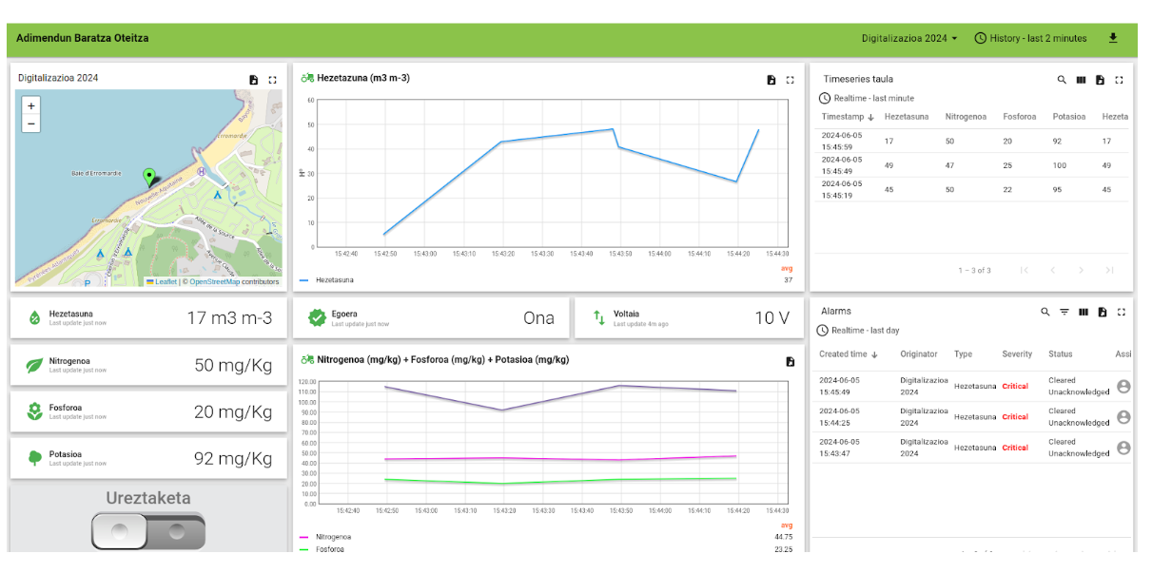
ARIKETA. DASHBOARD PUBLIKOA.
Tknikatik zerbitzatzen dizuegun tailerraren datuak jaso eta Dashboard bat osatu beraiekin.
Ondoren Dashboard honen esteka publikoa sortu eta hemen partekatu.
https://thingsboard.tknika.eus/dashboard/4b3df3a0-217b-11ef-b82d-172c57c297f6?publicId=a89ce020-b3c3-11eb-b06d-016abe8445bb
#LCAMP_EU
Notes:
The alliance will establish an Open Innovation Community to promote applied research and development projects, mainly between Centres of Vocational Excellence and Small and Medium Enterprises. To achieve this cooperation, the role of Vocational Education and Training in Advanced Manufacturing Research and Development activities and its contribution to Regional Smart Specialisation Strategies will be clarified.

Slide 3




#LCAMP_EU
info@lcamp.eu
www.lcamp.eu
@LCAMP_EU
LCAMP
Learner Centric Advanced Manufacturing Platform for CoVEs

