Slide 1
Wiring diagrams

Slide 2
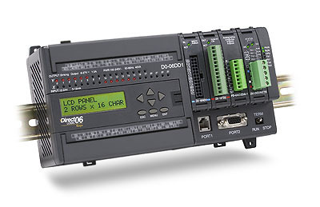
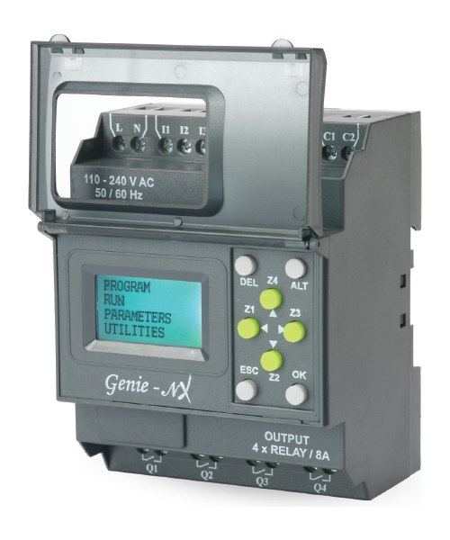
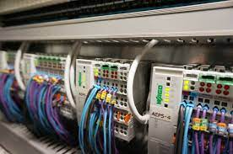
PLC
A PLC is a control unit
Has rows of inputs and outputs
Modern PLCs are more like computers (can perform functions, have built-in timer, clock, date, etc.)

Slide 3
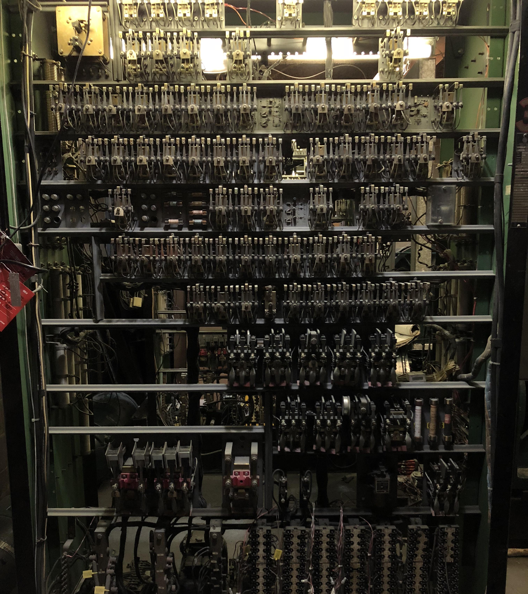
Before
Used to be carried out with relay stations (electrically controlled switches)
If you wanted to change how the relay stations worked, you had to reroute cables
Now, modern relays are often combined with a PLC

Slide 4
Programmable control systems
PLC-program
Input module
Control unit (central unit)
Output Module
Sensors
Controllers

Slide 5
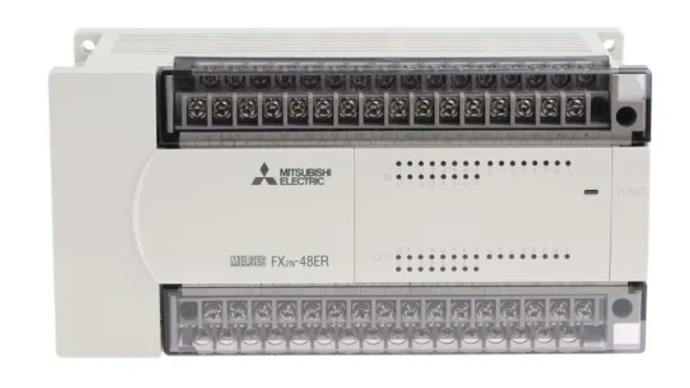
PLC
I (X) – Inputs, Q (Y) – Outputs, M – Memory
Integrated or as components attached to a ladder
Components can be individually programmed

Slide 6
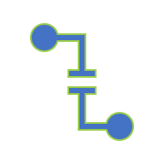
Composite features
Logic gates can be used to break down and formulate how systems should work
By putting the gates together, you get complex functions
Often appears with a flowchart or list
Official Programming Languages – Ladder logic, Function Block Diagram

Slide 7
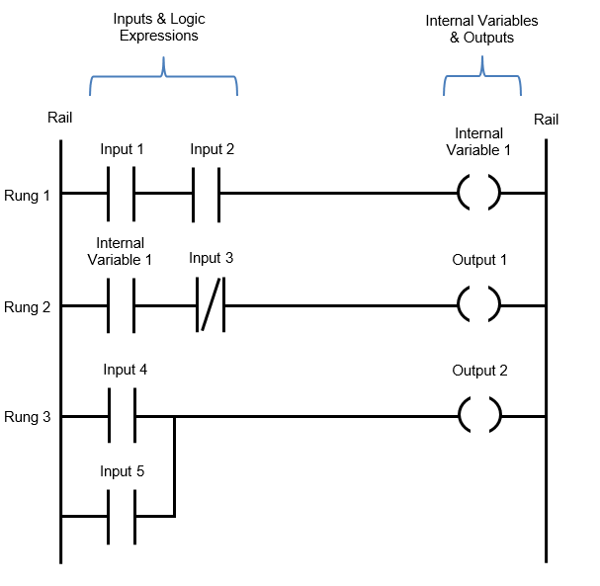
Ladder Logic
A way to write the programs (Most common in the United States)
The diagram looks like a ladder
The rungs are the code
Read from left to right from top to bottom

Slide 8
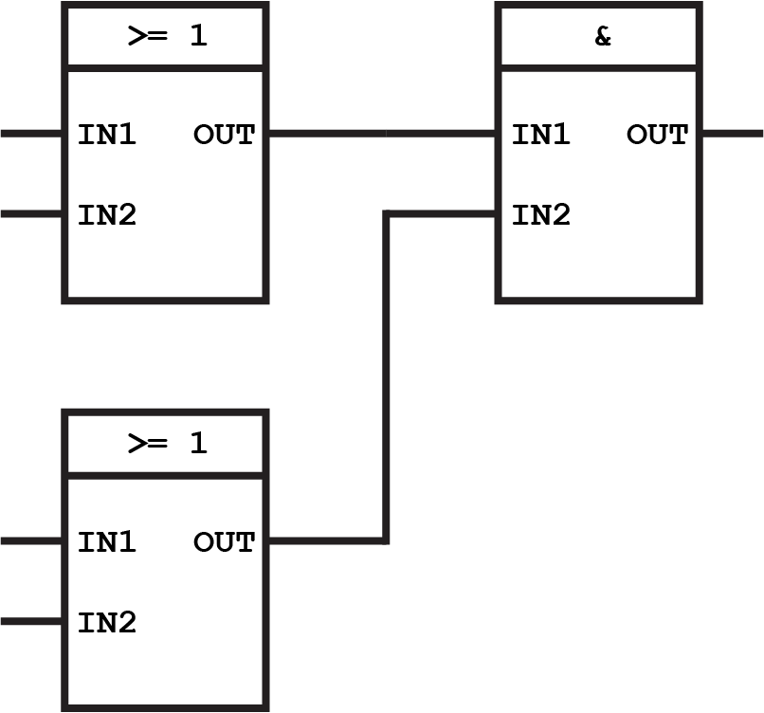
Function Block Diagram
Like a flowchart but features are represented by boxes
At the top of each box, the type of function is indicated
More detailed than ladder logic (most common in Europe)

Slide 9
How a PLC program is designed
Specification – flow charts, descriptions
Design – function tables, control diagrams
Realisation – programming, simulation
Commissioning – installation, software tests

Slide 10




#LCAMP_EU
info@lcamp.eu
www.lcamp.eu
@LCAMP_EU
LCAMP Learner Centric Advanced Manufacturing Platform for CoVEs

