Slide 1
Logic gates

Slide 2
Logic Gates in Mechatronic Systems
To know which signals should give which results, logical gates are used
A logical gate is one or more conditions that determine how input data is processed and what type of data is passed on
Described with symbols, flow diagrams (pseudocode) and drawings

Slide 3
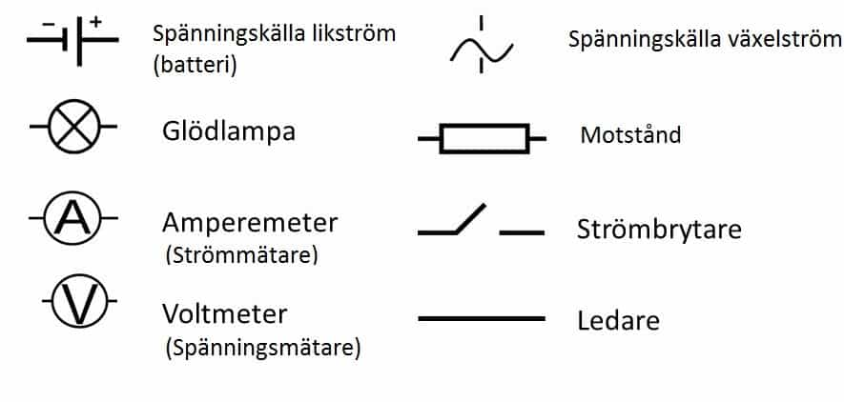
Symbols from Physics
Voltage source alternating current
Battery
resistance
Lamp
Amperemeter
Switch
Voltage meter
Conductor

Slide 4
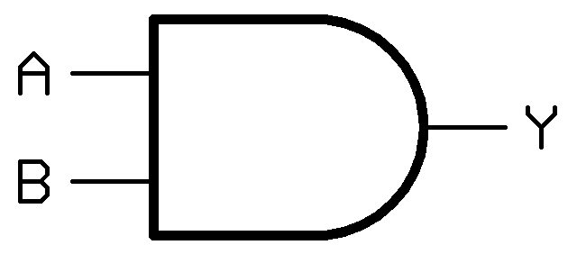
Boolean logic
Input A | Input B | Output
0 | 0 | 0
1 | 0 | 0
0 | 1 | 0
1 | 1 | 1
A logical gate can be set up with a truth table
The table lists all possible combinations of inputs and all possible outcomes
1 means on and 0 means off

Slide 5
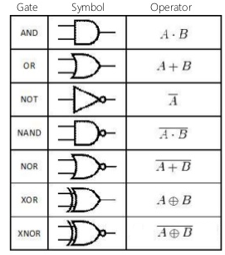
Symbol of conditions
Each condition from a truth table has its own symbol and its own spelling in the algebra
These conditions can be combined to create systems.

Slide 6
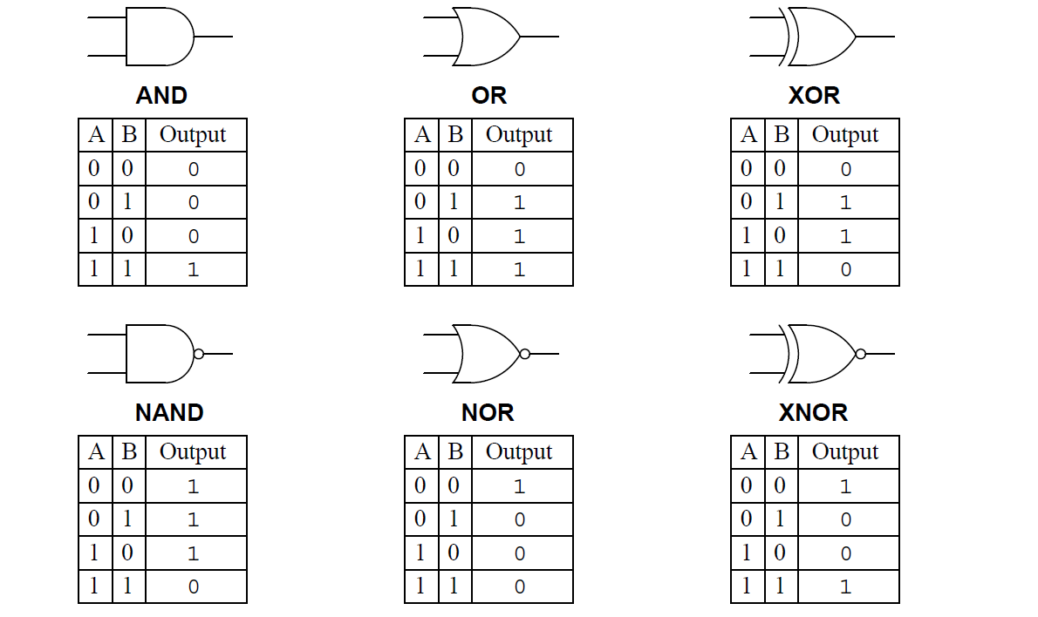

Slide 7

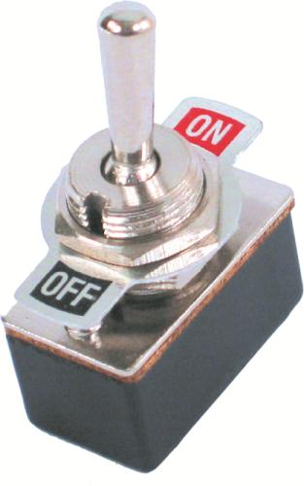


Practical example: AND

Slide 8
Practical example: OR

Slide 9
Practical example: NOR

Slide 10
Scheme of symbols

Slide 11




#LCAMP_EU
info@lcamp.eu
www.lcamp.eu
@LCAMP_EU
LCAMP
Learner Centric Advanced Manufacturing Platform for CoVEs

