Slide 1
Introduction to Stamping and Die Types

Slide 2
Introduction to Stamping and Die Types
Introduction
Metal stamping is a crucial technique in the production of various metal parts. It involves bending, cutting or drawing.
#LCAMP_EU
Notes:
The alliance will establish an Open Innovation Community to promote applied research and development projects, mainly between Centres of Vocational Excellence and Small and Medium Enterprises. To achieve this cooperation, the role of Vocational Education and Training in Advanced Manufacturing Research and Development activities and its contribution to Regional Smart Specialisation Strategies will be clarified.

Slide 3
Introduction to Stamping and Die Types
Stamping Process
Die-cutting is a process whereby a die and a punch are used to cut through materials such as paper, card or metal sheet on a die press. The process allows you to make an identical cut into material numerous times.
#LCAMP_EU
Notes:
The alliance will establish an Open Innovation Community to promote applied research and development projects, mainly between Centres of Vocational Excellence and Small and Medium Enterprises. To achieve this cooperation, the role of Vocational Education and Training in Advanced Manufacturing Research and Development activities and its contribution to Regional Smart Specialisation Strategies will be clarified.

Slide 4
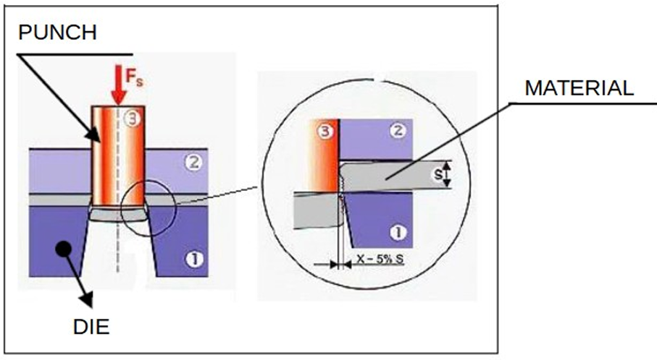
Introduction to Stamping and Die Types
Cutting force
#LCAMP_EU
Notes:
The alliance will establish an Open Innovation Community to promote applied research and development projects, mainly between Centres of Vocational Excellence and Small and Medium Enterprises. To achieve this cooperation, the role of Vocational Education and Training in Advanced Manufacturing Research and Development activities and its contribution to Regional Smart Specialisation Strategies will be clarified.

Slide 5
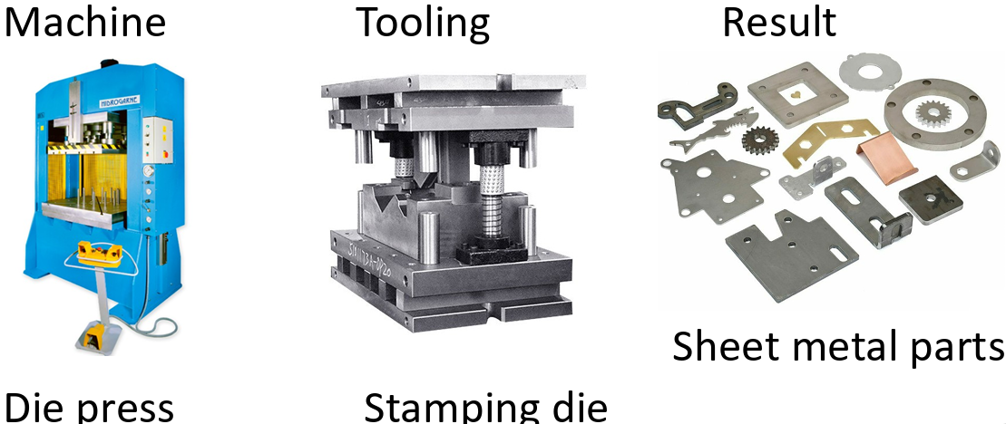
Introduction to Stamping and Die Types
Stamping Process
#LCAMP_EU
Notes:
The alliance will establish an Open Innovation Community to promote applied research and development projects, mainly between Centres of Vocational Excellence and Small and Medium Enterprises. To achieve this cooperation, the role of Vocational Education and Training in Advanced Manufacturing Research and Development activities and its contribution to Regional Smart Specialisation Strategies will be clarified.

Slide 6
Introduction to Stamping and Die Types
Stamping die classification
SIMPLE STROKE DIES:
In each stroke of the press, a single operation is performed, so if the part requires more than one operation, several dies would be needed to be able to complete it completely. These dies have low productivity and are used to manufacture simple parts, such as washers, etc.
COMPOUND DIES:
Compound dies are versatile tools capable of performing multiple operations simultaneously. They are commonly used in the fabrication of complex parts.
#LCAMP_EU
Notes:
The alliance will establish an Open Innovation Community to promote applied research and development projects, mainly between Centres of Vocational Excellence and Small and Medium Enterprises. To achieve this cooperation, the role of Vocational Education and Training in Advanced Manufacturing Research and Development activities and its contribution to Regional Smart Specialisation Strategies will be clarified.

Slide 7
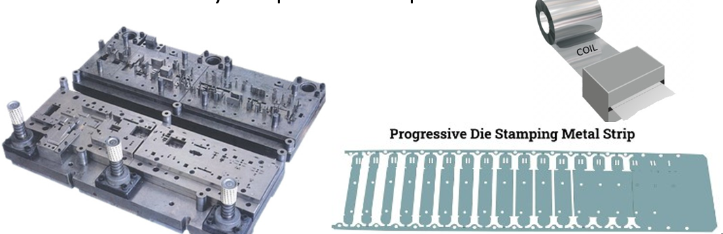
Introduction to Stamping and Die Types
Stamping die classification
PROGRESSIVE DIES:
Progressive dies are a specialized type that allows for multiple operations to be performed in a single pass. This significantly enhances efficiency and production speed.
#LCAMP_EU
Notes:
The alliance will establish an Open Innovation Community to promote applied research and development projects, mainly between Centres of Vocational Excellence and Small and Medium Enterprises. To achieve this cooperation, the role of Vocational Education and Training in Advanced Manufacturing Research and Development activities and its contribution to Regional Smart Specialisation Strategies will be clarified.

Slide 8
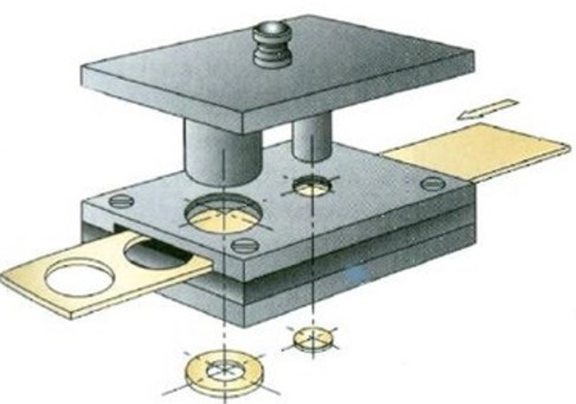
Introduction to Stamping and Die Types
Scrap in Die Stamping Manufacturing
#LCAMP_EU
Notes:
The alliance will establish an Open Innovation Community to promote applied research and development projects, mainly between Centres of Vocational Excellence and Small and Medium Enterprises. To achieve this cooperation, the role of Vocational Education and Training in Advanced Manufacturing Research and Development activities and its contribution to Regional Smart Specialisation Strategies will be clarified.

Slide 9
Introduction to Stamping and Die Types
Stamping die working classification
SIMPLE WORKING DIES: The feed of the sheet is regulated by stops and there is no device to guide the punch in its stroke. These types of dies are rarely used and only for low precision work. https://www.youtube.com/watch?time_continue=1&v=LqQZa1sLtsM
GUIDE EXTRACTOR DIE: The feed is regulated by auxiliary punches and the movement of the punch is guided by means of a plate. Furthermore, the same plate that serves to guide the punches also acts as an extractor plate for the sheet metal, which once punched remains strongly adhered to the punch. https://www.youtube.com/watch?v=MErbB5JlHaQ
GUIDE STEPPER DIE: The feed is also regulated by auxiliary punches and has a plate that serves to guide the punch and to support the sheet while the punching work is carried out. These dies are the ones that guarantee the most precision and are the most used in tool making. https://www.youtube.com/watch?v=O6J4AMKTSpA
#LCAMP_EU
Notes:
The alliance will establish an Open Innovation Community to promote applied research and development projects, mainly between Centres of Vocational Excellence and Small and Medium Enterprises. To achieve this cooperation, the role of Vocational Education and Training in Advanced Manufacturing Research and Development activities and its contribution to Regional Smart Specialisation Strategies will be clarified.

Slide 10
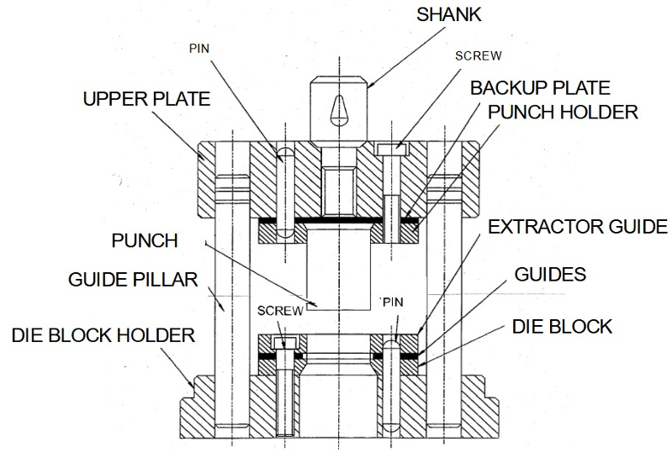
Introduction to Stamping and Die Types
Extractor Guide Die Components
#LCAMP_EU
Notes:
The alliance will establish an Open Innovation Community to promote applied research and development projects, mainly between Centres of Vocational Excellence and Small and Medium Enterprises. To achieve this cooperation, the role of Vocational Education and Training in Advanced Manufacturing Research and Development activities and its contribution to Regional Smart Specialisation Strategies will be clarified.

Slide 11
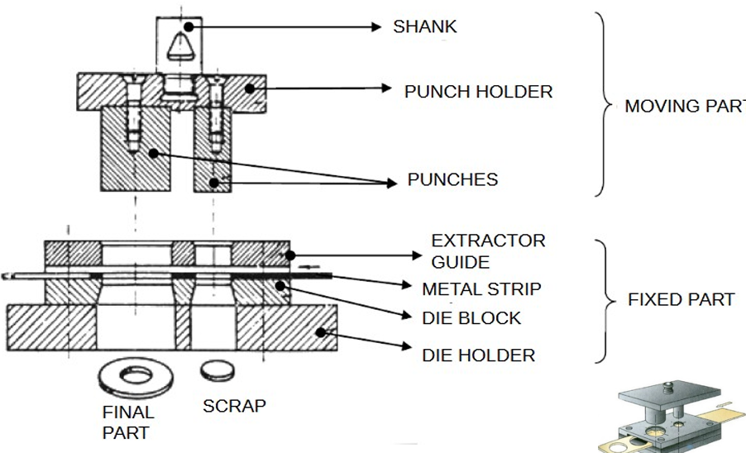
Introduction to Stamping and Die Types
Extractor Guide Die Components
#LCAMP_EU
Notes:
The alliance will establish an Open Innovation Community to promote applied research and development projects, mainly between Centres of Vocational Excellence and Small and Medium Enterprises. To achieve this cooperation, the role of Vocational Education and Training in Advanced Manufacturing Research and Development activities and its contribution to Regional Smart Specialisation Strategies will be clarified.

Slide 12
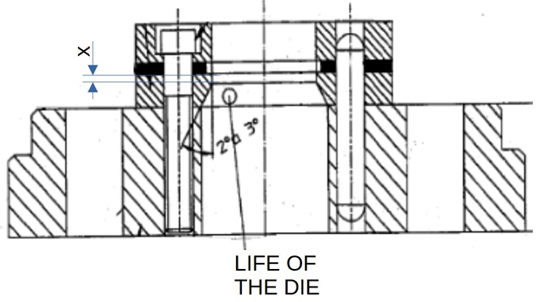
Introduction to Stamping and Die Types
Extractor Guide Die Components
LIFE OF THE DIE:
The die has a straight part of “x” mm, which is called the life of the die, and a conical part to make it easier to evacuate the cut parts and avoid jamming in the die.
When it is observed that the parts come out with a burr, the die must be sharpened on the grinding machine. That is why when the straight part is completely worn out, the life of that die ends.
#LCAMP_EU
Notes:
The alliance will establish an Open Innovation Community to promote applied research and development projects, mainly between Centres of Vocational Excellence and Small and Medium Enterprises. To achieve this cooperation, the role of Vocational Education and Training in Advanced Manufacturing Research and Development activities and its contribution to Regional Smart Specialisation Strategies will be clarified.

Slide 13
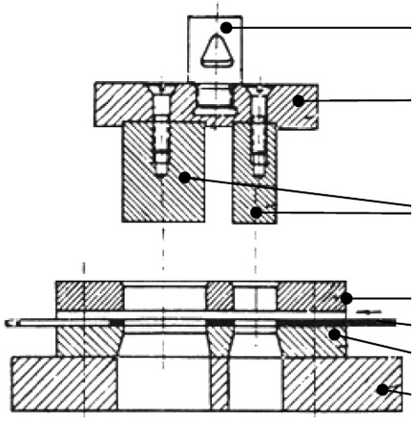
Introduction to Stamping and Die Types
Extractor Guide Die Components
SHANK: To cople the stamping die to the press.
PUNCH HOLDER: To hold punches.
PUNCH: It is the element that produces the shear cutting of the sheet metal when introduced into the hole of the die. Its cross section coincides with the shape of the die.
EXTRACTOR GUIDE PLATE: It has two functions: to guide the punches to the cutting die and to extract the sheet metal trim that remains completely adhered to the punches.
DIE BLOCK: It is with the punches, the element that makes the cut. It takes the total or partial shape of the figure to be obtained.
DIE HOLDER PLATE: It is the base where the die block rests. Its function is to help the die block to withstand the cutting blow and serve as support for the entire stamping die..
#LCAMP_EU
Notes:
The alliance will establish an Open Innovation Community to promote applied research and development projects, mainly between Centres of Vocational Excellence and Small and Medium Enterprises. To achieve this cooperation, the role of Vocational Education and Training in Advanced Manufacturing Research and Development activities and its contribution to Regional Smart Specialisation Strategies will be clarified.

Slide 14




#LCAMP_EU
info@lcamp.eu
www.lcamp.eu
@LCAMP_EU
LCAMP
Learner Centric Advanced Manufacturing Platform for CoVEs

