Slide 1
Sensors

Slide 2
What is a sensor?
A sensor collects, converts, and in some cases distributes signals, stimuli, or data
Our five senses can be thought of as different biological sensors
(Sight, hearing, smell, taste, touch)

Slide 3
What does a sensor consist of?
Simply explained:
Sensors, sensors and signal processors
Analogue and digital signals
Analog – Sine wave – Human voice
Digital – Binary - Data Transfer

Slide 4
What kind of sensors are there
Mechanical
Electrical
Switch
Buttons
Induction
Magnetism
Kapacitans
Temperature
Photo
Movement

Slide 5
PNP and NPN
Important to know, sensors are either PNP or NPN
PNP – The sensor emits a positive voltage
NPN – The sensor emits a negative voltage
Important to take into account when choosing a PLC!

Slide 6
Buttons and Switches
The simplest sensors
Can be combined with logic systems! (E.g. double button to avoid pinching hazards)
Or to sort signals
Wears out over time

Slide 7
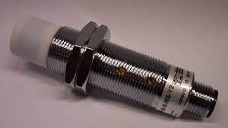
Inductive Sensors
Metal detector
Can detect most metals
Based on electromagnetism and shifts in the magnetic field that arises

Slide 8
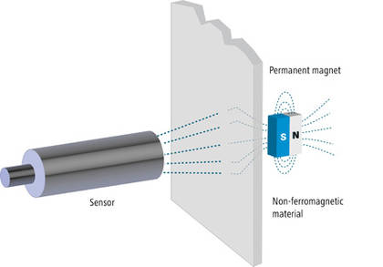
Magnetsensor
Detects magnetism
Works through materials (non-contact)

Slide 9
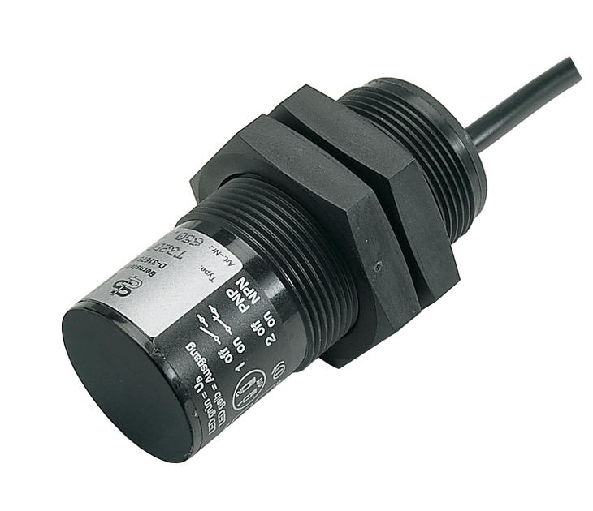
Capacitive sensor
Based on the capacitance of different materials (ability to retain charge)
Can detect materials other than metal
Common in factories (e.g. food)

Slide 10
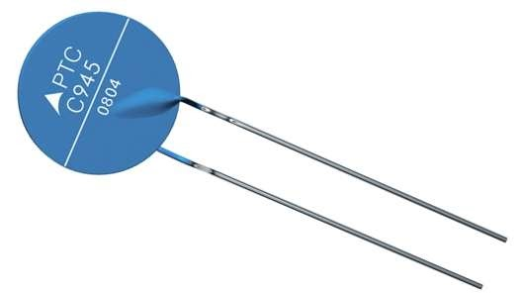
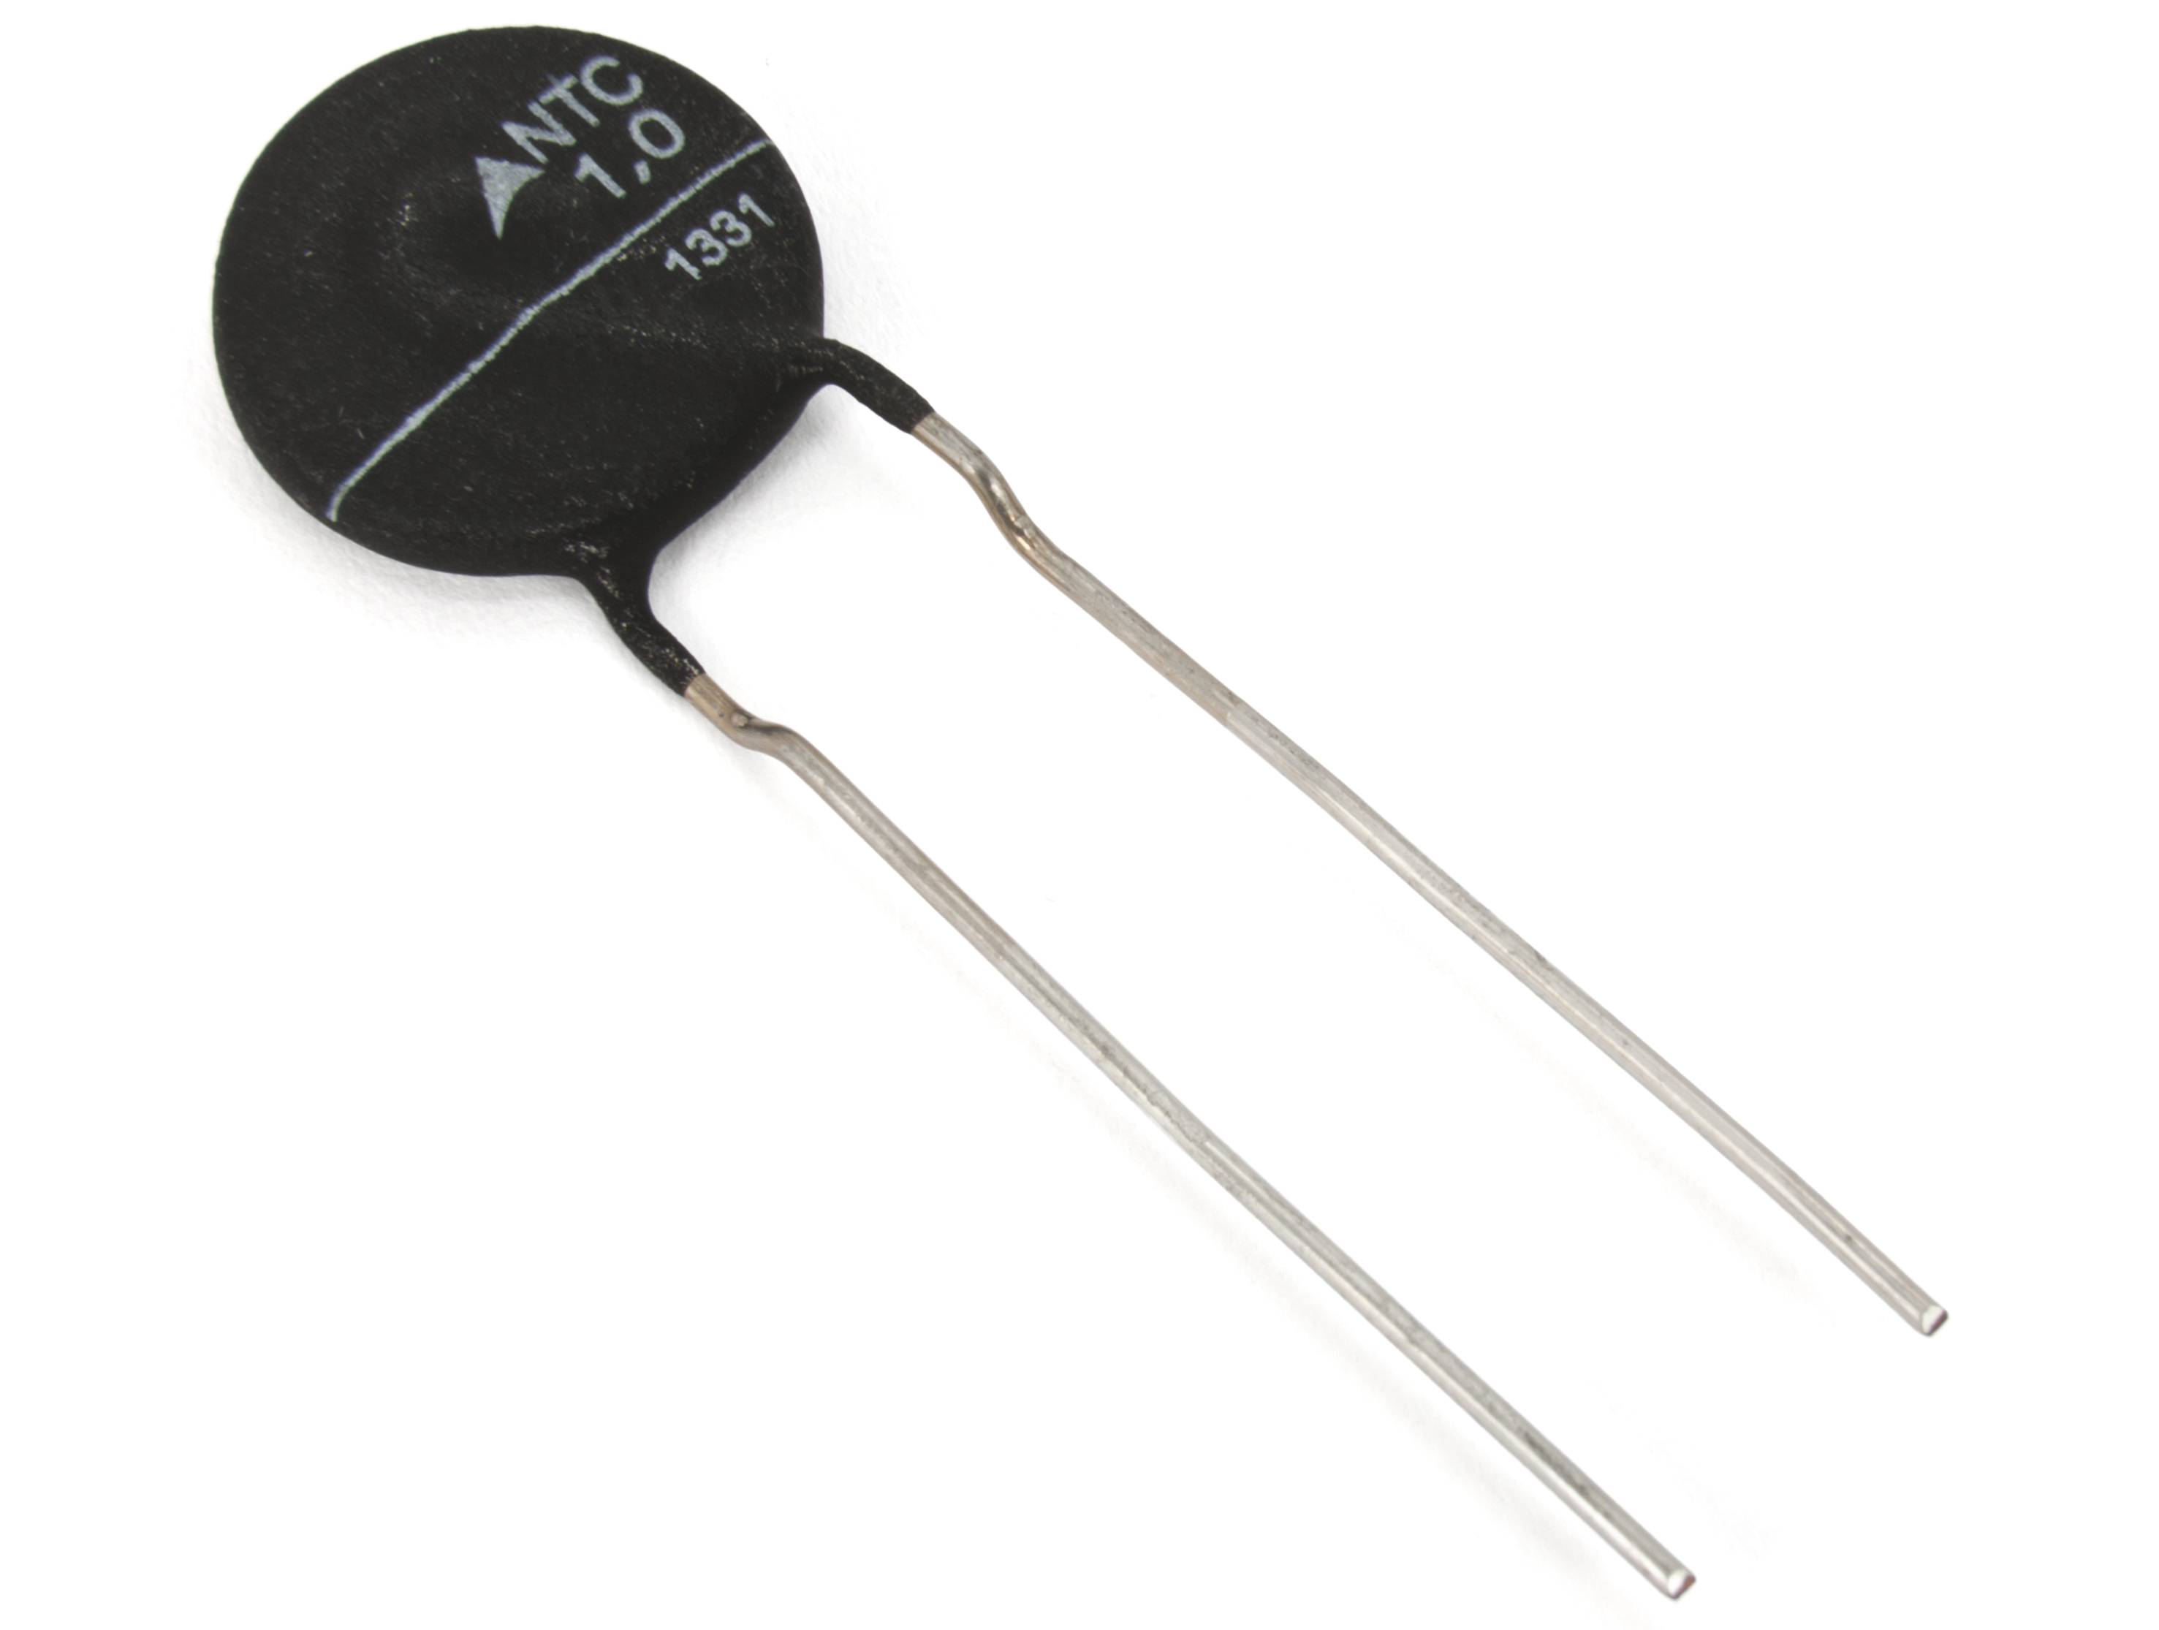
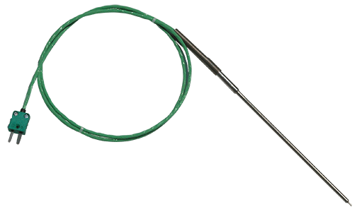
Temperature
Resistance or infrared light
Thermocouple /Thermistor (Electronic Component)/ Thermometers

Slide 11
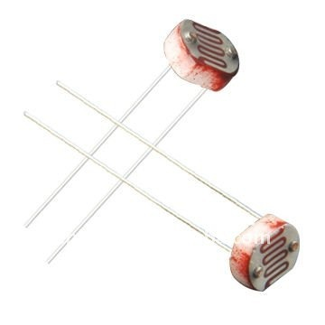
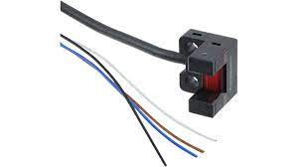
Photo sensor
Sensitive
Combine with motion sensors in e.g. alarms.

Slide 12




#LCAMP_EU
info@lcamp.eu
www.lcamp.eu
@LCAMP_EU
LCAMP Learner Centric Advanced Manufacturing Platform for CoVEs

