Slide 1
ONA AV 35 EDM

Slide 2
ONA AV 35 EDM
MANUAL INDEX
MAIN MENU
2. ALIGNING THE WORKPIECE.
TILT.
MANUAL TILT.
TILT WITH CENTERS
3. WORKPIECE CENTERING
EDGING.
MIDDLE.
CORNER.
INNER CENTERING.
3 POINT CENTERING.
4. SET OFFSET.
#LCAMP_EU
Notes:
The alliance will establish an Open Innovation Community to promote applied research and development projects, mainly between Centres of Vocational Excellence and Small and Medium Enterprises. To achieve this cooperation, the role of Vocational Education and Training in Advanced Manufacturing Research and Development activities and its contribution to Regional Smart Specialisation Strategies will be clarified.

Slide 3

ONA AV 35 EDM
MAIN MENU
In this screen we can see the main menu of the machine
HOME SCREEN
#LCAMP_EU
Notes:
The alliance will establish an Open Innovation Community to promote applied research and development projects, mainly between Centres of Vocational Excellence and Small and Medium Enterprises. To achieve this cooperation, the role of Vocational Education and Training in Advanced Manufacturing Research and Development activities and its contribution to Regional Smart Specialisation Strategies will be clarified.

Slide 4
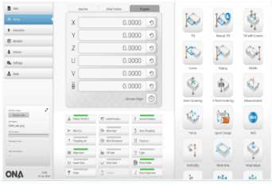
ONA AV 35 EDM
SETUP SCREEN
As you can see in the picture, once we click on SETUP from the main menu we access this screen, where we have all the options related to the preparation of the machine
#LCAMP_EU
Notes:
The alliance will establish an Open Innovation Community to promote applied research and development projects, mainly between Centres of Vocational Excellence and Small and Medium Enterprises. To achieve this cooperation, the role of Vocational Education and Training in Advanced Manufacturing Research and Development activities and its contribution to Regional Smart Specialisation Strategies will be clarified.

Slide 5
ONA AV 35 EDM
ALIGNING THE WORKPIECE
As in any machine, one of the first operations is to align the workpiece with the axes of the machine.
This operation can be done through the traditional system, that is, using a dial gauge. But this machine gives us the possibility to do it automatically with the function “TILT”
#LCAMP_EU
Notes:
The alliance will establish an Open Innovation Community to promote applied research and development projects, mainly between Centres of Vocational Excellence and Small and Medium Enterprises. To achieve this cooperation, the role of Vocational Education and Training in Advanced Manufacturing Research and Development activities and its contribution to Regional Smart Specialisation Strategies will be clarified.

Slide 6
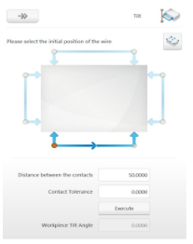
ONA AV 35 EDM
TILT
Once you press the TILT icon, you will see the menu in the image. Here you can choose the axis in which you want to make the contacts, the distance between them and their direction.
Once the operation is executed, we will be able to align the machine coordinate system with the alignment angle of the part with respect to the machine axes.
You can see how to use it here
#LCAMP_EU
Notes:
The alliance will establish an Open Innovation Community to promote applied research and development projects, mainly between Centres of Vocational Excellence and Small and Medium Enterprises. To achieve this cooperation, the role of Vocational Education and Training in Advanced Manufacturing Research and Development activities and its contribution to Regional Smart Specialisation Strategies will be clarified.

Slide 7
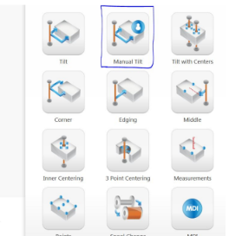
ONA AV 35 EDM
MANUAL TILT
If you want to align the workpiece semi automatically, because the part Is not an interrupted line, another option is using the MANUAL TILT operation function that we will access from the icon of the main menu marked in the image
#LCAMP_EU
Notes:
The alliance will establish an Open Innovation Community to promote applied research and development projects, mainly between Centres of Vocational Excellence and Small and Medium Enterprises. To achieve this cooperation, the role of Vocational Education and Training in Advanced Manufacturing Research and Development activities and its contribution to Regional Smart Specialisation Strategies will be clarified.

Slide 8
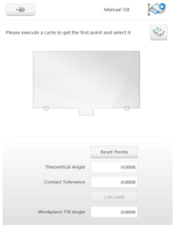
ONA AV 35 EDM
MANUAL TILT
Once you have accessed the MANUAL TILT operation menu, you will see the menu in the image.
Before entering in this option you must ma you can choose the first point, after we have done the contact with CONTACT command. Then, after moving the machine manually to the second position and doing contact with the same CONTACT command, we’ll choose the second point.
Between these two points the CNC will generate a line that will be used to align the machine coordinate system with the alignment angle of the part with respect to the machine axes.
You can see how to use it here
#LCAMP_EU
Notes:
The alliance will establish an Open Innovation Community to promote applied research and development projects, mainly between Centres of Vocational Excellence and Small and Medium Enterprises. To achieve this cooperation, the role of Vocational Education and Training in Advanced Manufacturing Research and Development activities and its contribution to Regional Smart Specialisation Strategies will be clarified.

Slide 9
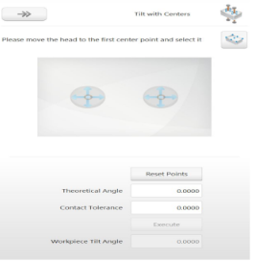
ONA AV 35 EDM
TILT WITH CENTERS
Once you have accessed the TILT WITH CENTERS operation menu that you can see in the image, you can choose the first hole. Then, you move the machine manually to the second hole, with the help of the wire jet.
The CNC of the machine will execute one cycle to create a line between the centers of chosen holes after centering the wire in each of them.
This line will be used to align the machine coordinate system with the alignment angle of the part with respect to the machine axes.
You can see how to use it here
#LCAMP_EU
Notes:
The alliance will establish an Open Innovation Community to promote applied research and development projects, mainly between Centres of Vocational Excellence and Small and Medium Enterprises. To achieve this cooperation, the role of Vocational Education and Training in Advanced Manufacturing Research and Development activities and its contribution to Regional Smart Specialisation Strategies will be clarified.

Slide 10
ONA AV 35 EDM
CENTERING
Centering of a part is the operation of adjusting the coordinate system of the machine to the coordinate system of the part to be machined.
In other words, setting a zero coordinate for our machining, which is within the machine coordinate system.
This centering will have three types of coordinates:
Machine coordinates referred to machine zero.
Initial coordinates referred to previous part zero.
Part zero coordinates referred to our work plane
#LCAMP_EU
Notes:
The alliance will establish an Open Innovation Community to promote applied research and development projects, mainly between Centres of Vocational Excellence and Small and Medium Enterprises. To achieve this cooperation, the role of Vocational Education and Training in Advanced Manufacturing Research and Development activities and its contribution to Regional Smart Specialisation Strategies will be clarified.

Slide 11
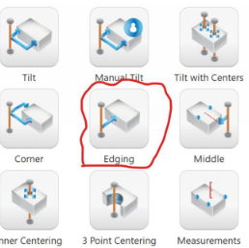
ONA AV 35 EDM
EDGING
This function allows us to locate a point on the
workpiece.
It is useful when combined with other functions such
as middle to locate the 0 point of the coordinate system, as we will see in the next slide
#LCAMP_EU
Notes:
The alliance will establish an Open Innovation Community to promote applied research and development projects, mainly between Centres of Vocational Excellence and Small and Medium Enterprises. To achieve this cooperation, the role of Vocational Education and Training in Advanced Manufacturing Research and Development activities and its contribution to Regional Smart Specialisation Strategies will be clarified.

Slide 12
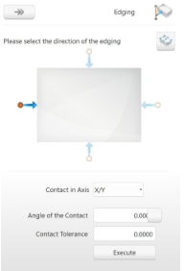
ONA AV 35 EDM
EDGING
As we can see, in the menu of this function we can
choose the direction or the angle in which we want to
make the contact and automatically execute.
#LCAMP_EU
Notes:
The alliance will establish an Open Innovation Community to promote applied research and development projects, mainly between Centres of Vocational Excellence and Small and Medium Enterprises. To achieve this cooperation, the role of Vocational Education and Training in Advanced Manufacturing Research and Development activities and its contribution to Regional Smart Specialisation Strategies will be clarified.

Slide 13
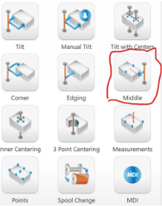
ONA AV 35 EDM
MIDDLE
When we want to centre the part between two
contacts we have to combine EDGING with
MIDDLE.
To do this, first, locate the two points on the piece and then with MIDDLE locate the midpoint between them on the axis we want.
#LCAMP_EU
Notes:
The alliance will establish an Open Innovation Community to promote applied research and development projects, mainly between Centres of Vocational Excellence and Small and Medium Enterprises. To achieve this cooperation, the role of Vocational Education and Training in Advanced Manufacturing Research and Development activities and its contribution to Regional Smart Specialisation Strategies will be clarified.

Slide 14
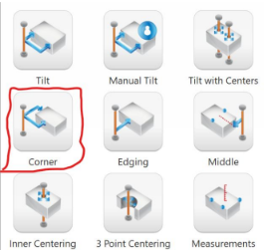
ONA AV 35 EDM
CENTERING WITH CORNER
This is the menu of the function that we can
execute, after we have have chosen two points with the EDGING function.
You can see how to use it here
#LCAMP_EU
Notes:
The alliance will establish an Open Innovation Community to promote applied research and development projects, mainly between Centres of Vocational Excellence and Small and Medium Enterprises. To achieve this cooperation, the role of Vocational Education and Training in Advanced Manufacturing Research and Development activities and its contribution to Regional Smart Specialisation Strategies will be clarified.

Slide 15
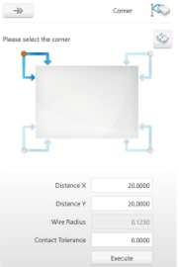
ONA AV 35 EDM
CENTERING WITH CORNER
As we can see in the picture we can choose the corner what we want and the CNC system will automatically make the cycle within some conditions (Distance X, Distance Y, contact tolerance)
You can see how to use it here
#LCAMP_EU
Notes:
The alliance will establish an Open Innovation Community to promote applied research and development projects, mainly between Centres of Vocational Excellence and Small and Medium Enterprises. To achieve this cooperation, the role of Vocational Education and Training in Advanced Manufacturing Research and Development activities and its contribution to Regional Smart Specialisation Strategies will be clarified.

Slide 16
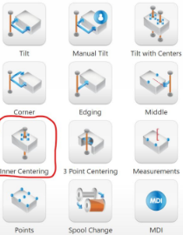
ONA AV 35 EDM
INNER CENTERING
We will use this function when the point of
reference is the centre of a hole.
#LCAMP_EU
Notes:
The alliance will establish an Open Innovation Community to promote applied research and development projects, mainly between Centres of Vocational Excellence and Small and Medium Enterprises. To achieve this cooperation, the role of Vocational Education and Training in Advanced Manufacturing Research and Development activities and its contribution to Regional Smart Specialisation Strategies will be clarified.

Slide 17
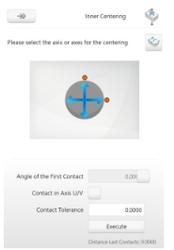
ONA AV 35 EDM
INNER CENTERING
Before we use this function we have to thread the wire into the hole.
Then, as we can see in the picture, we only have to select the axis with which we want to start centering.
#LCAMP_EU
Notes:
The alliance will establish an Open Innovation Community to promote applied research and development projects, mainly between Centres of Vocational Excellence and Small and Medium Enterprises. To achieve this cooperation, the role of Vocational Education and Training in Advanced Manufacturing Research and Development activities and its contribution to Regional Smart Specialisation Strategies will be clarified.

Slide 18
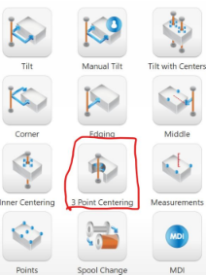
ONA AV 35 EDM
3 POINT CENTERING
We can use this function when we have an arc or part of a round hole
#LCAMP_EU
Notes:
The alliance will establish an Open Innovation Community to promote applied research and development projects, mainly between Centres of Vocational Excellence and Small and Medium Enterprises. To achieve this cooperation, the role of Vocational Education and Training in Advanced Manufacturing Research and Development activities and its contribution to Regional Smart Specialisation Strategies will be clarified.

Slide 19
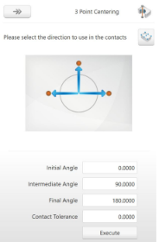
ONA AV 35 EDM
3 POINT CENTERING
As we can see in the picture we can choose the three contact angle before carrying out the execution.
#LCAMP_EU
Notes:
The alliance will establish an Open Innovation Community to promote applied research and development projects, mainly between Centres of Vocational Excellence and Small and Medium Enterprises. To achieve this cooperation, the role of Vocational Education and Training in Advanced Manufacturing Research and Development activities and its contribution to Regional Smart Specialisation Strategies will be clarified.

Slide 20
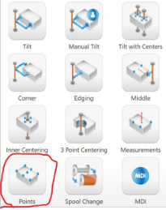
ONA AV 35 EDM
SET OFFSET
This function is used to set offset points (new part coordinate system) and crossing points.
#LCAMP_EU
Notes:
The alliance will establish an Open Innovation Community to promote applied research and development projects, mainly between Centres of Vocational Excellence and Small and Medium Enterprises. To achieve this cooperation, the role of Vocational Education and Training in Advanced Manufacturing Research and Development activities and its contribution to Regional Smart Specialisation Strategies will be clarified.

Slide 21
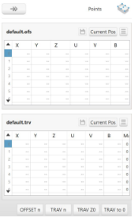
ONA AV 35 EDM
SET OFFSET
In the upper table of the image we can establish floating zeros in the specified machine coordinates.
The lower table of the image contains axis coordinate points to traverse said points, either referred to machine or program coordinates.
#LCAMP_EU
Notes:
The alliance will establish an Open Innovation Community to promote applied research and development projects, mainly between Centres of Vocational Excellence and Small and Medium Enterprises. To achieve this cooperation, the role of Vocational Education and Training in Advanced Manufacturing Research and Development activities and its contribution to Regional Smart Specialisation Strategies will be clarified.

Slide 22




#LCAMP_EU
info@lcamp.eu
www.lcamp.eu
@LCAMP_EU
LCAMP Learner Centric Advanced Manufacturing Platform for CoVEs

