Slide 1
Controllers

Slide 2
Different types of control devices
Controllers
Tires
Electronics
Mechanics
Hydraulics

Slide 3
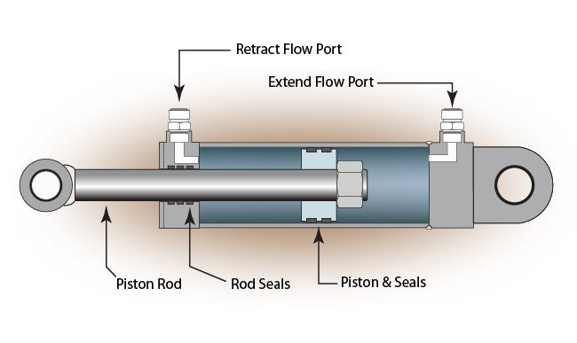
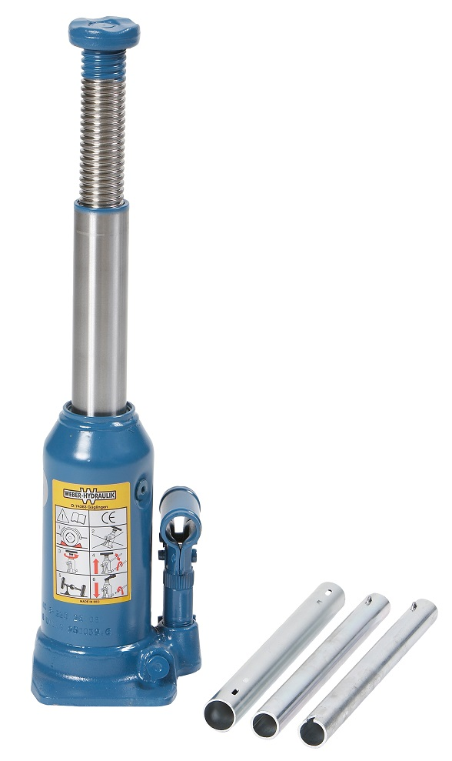
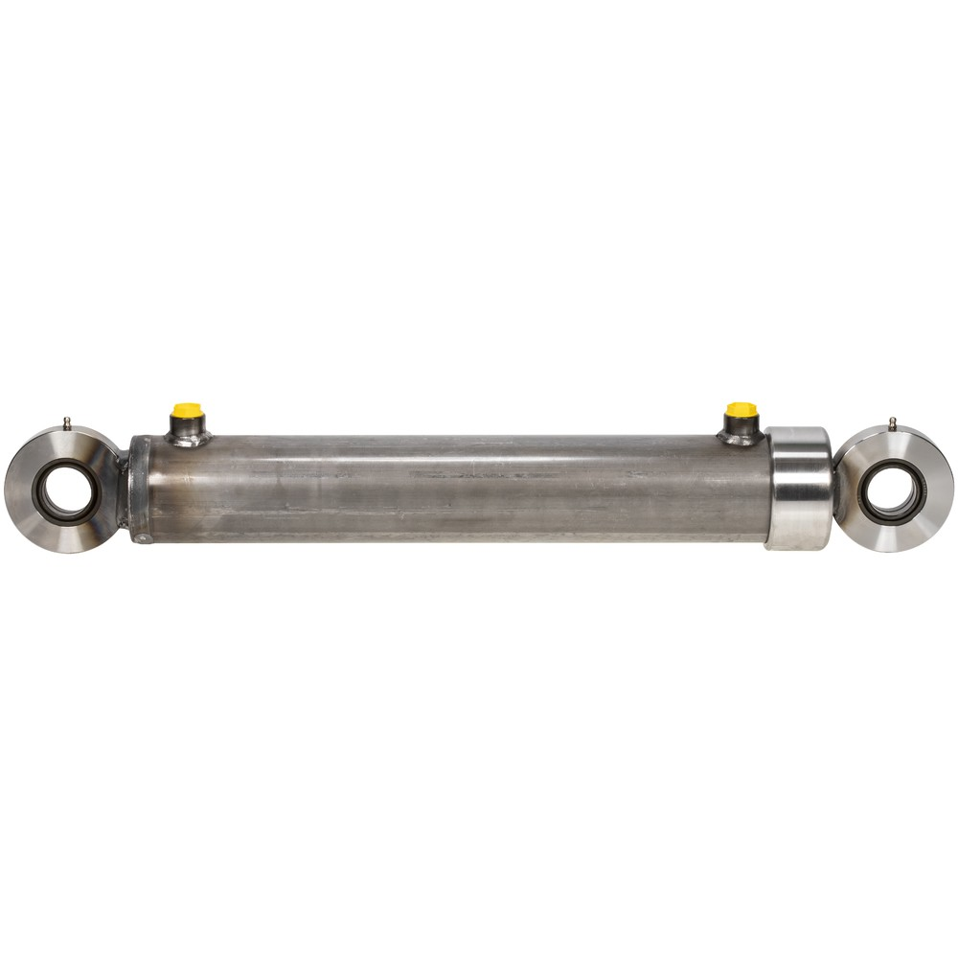
Hydraulic Controllers
Hydraulic jack / Hydraulic piston
Often combined with a pump
A fluid (usually hydraulic oil) transmits power

Slide 4
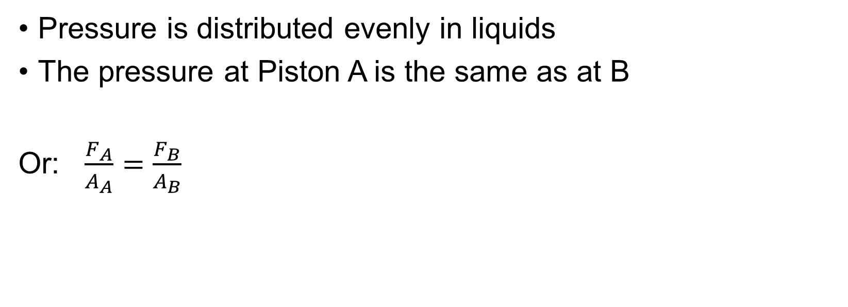
Hydraulic jack
Pressure is distributed evenly in liquids
The pressure at Piston A is the same as at B
Or: $\frac{F_{A}}{A_{A}}=\frac{F_{B}}{A_{B}}$
A
B

Slide 5
Hydraulics
Benefits
Cons
Simple construction
Almost no moving parts
Spark proof
Uniform load
Leakage short-circuits the system
The oil can be toxic/dangerous
Gaskets and bearings

Slide 6
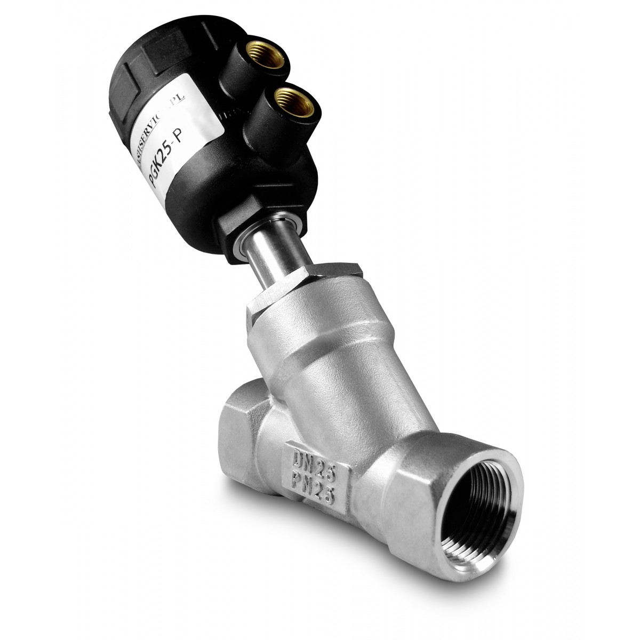
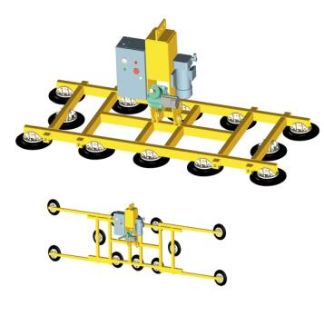
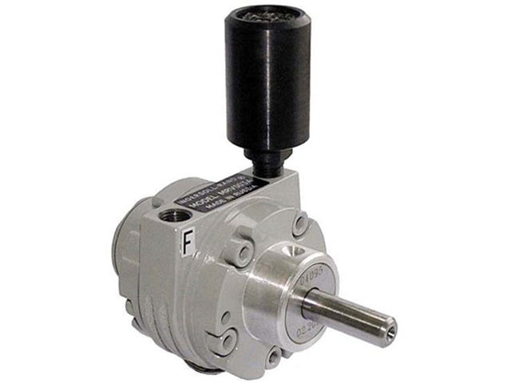
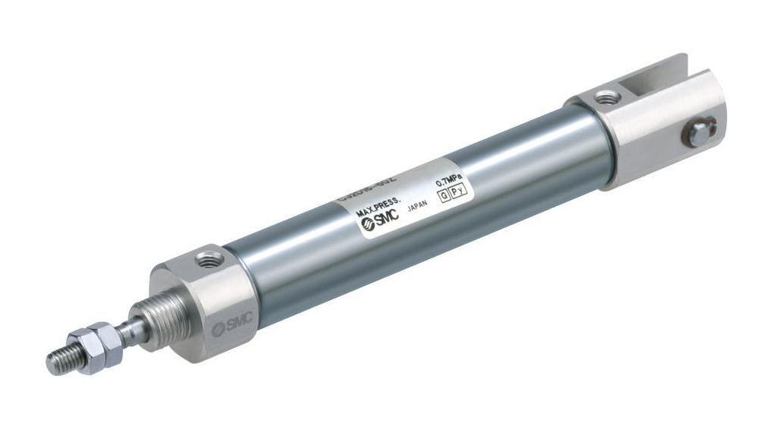
Pneumatic Controllers
Two-way and one-way (stroke)
Functionally identical to hydraulic systems
Compressed air instead of liquid

Slide 7
Tires
Benefits
Cons
Air is harmless and easily accessible
Air is not affected by piping
Easy to adjust/set up precisely
Leaks are difficult to detect
Compressors
Condensation
Loudly

Slide 8
Air pressure
Measured in Pascals but most common is Bar (Air pressure = 1 Bar)
PSI – Pounds per Square Inch
If the air is compressed to, for example, 100 in a pressure vessel, it contains 100 times its volume in air.

Slide 9
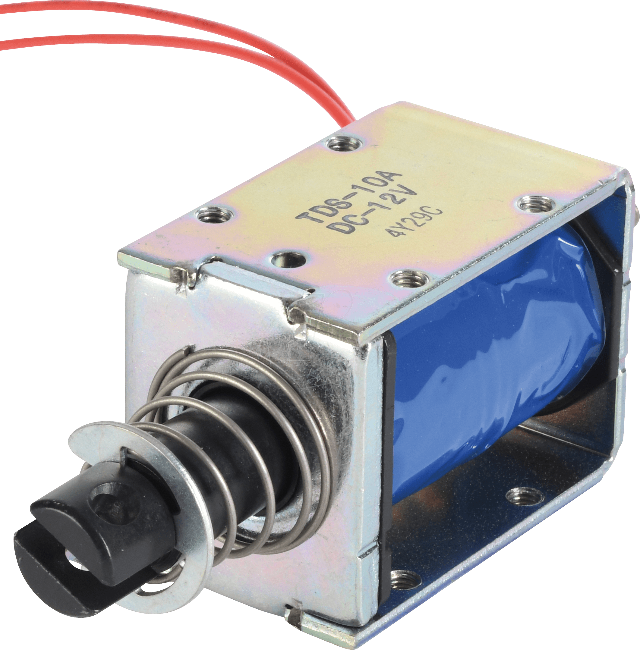
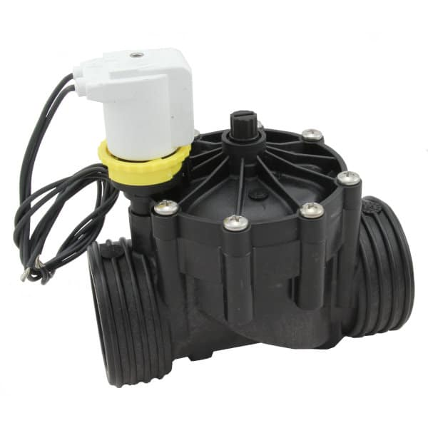
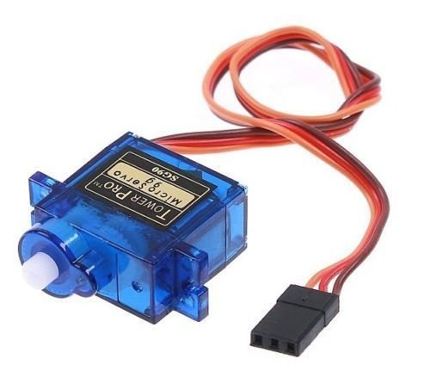
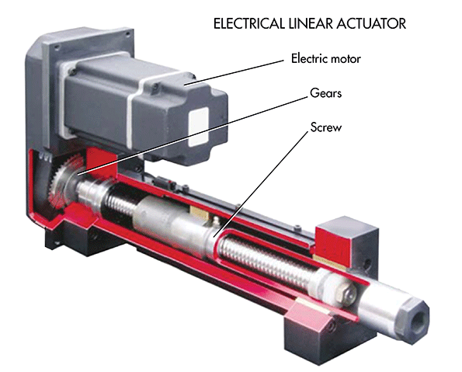
Electronic Control Units
Solenoids, electric motors, solenoid valves

Slide 10
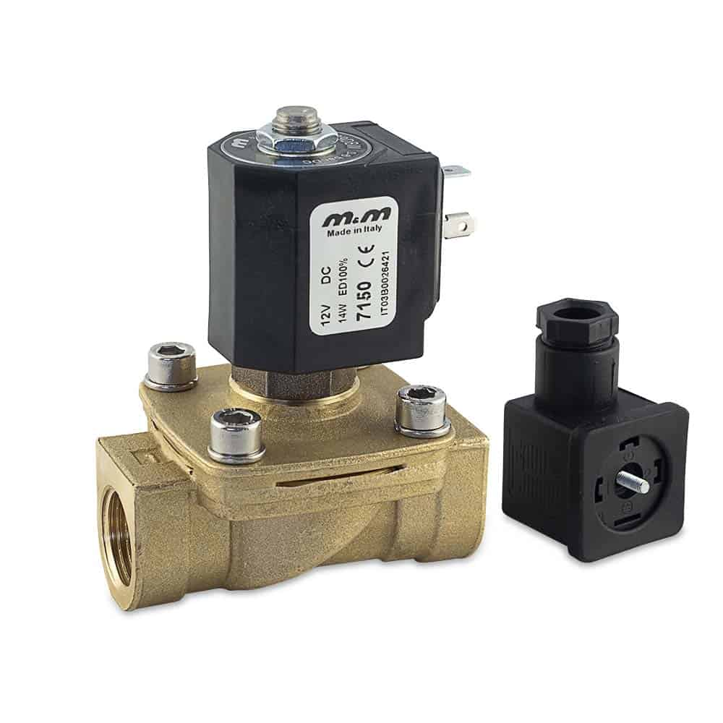
Elektromagneter - Solenoid
A solenoid is a type of electromagnet (coil + iron core)
When current is passed through it, the iron core is repelled
Often used as a type of switch
What does the Solenoid do in a Passenger Car?

Slide 11
Electronic systems
Benefits
Cons
Integrable
Programmable (highly accurate)
Costly
Requires power

Slide 12
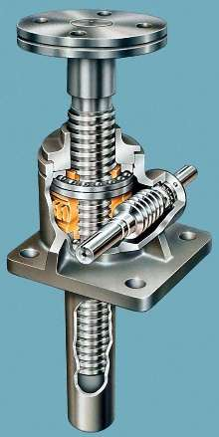
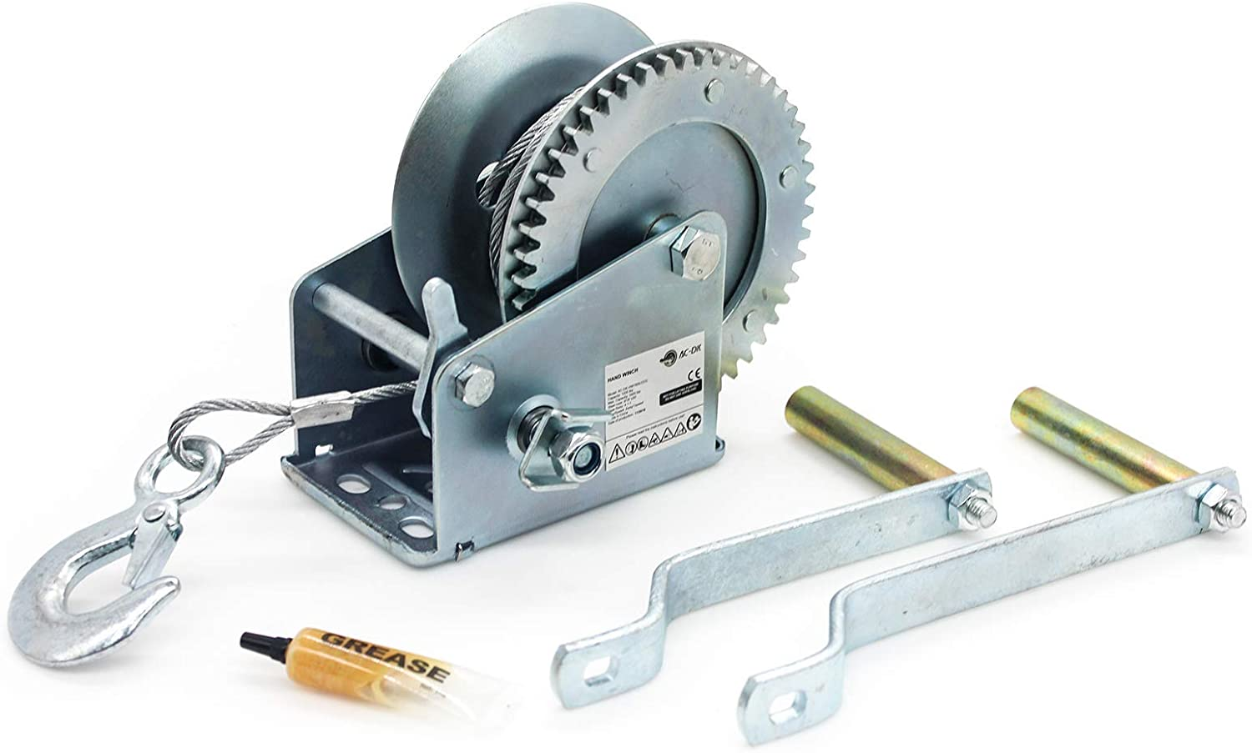
Mechanical control units
The simple machines
Conversion between linear and rotary motion
Specific parts for specific purposes

Slide 13
Mekaniska System
Benefits
Cons
Proven technology
Durable
Easy to maintain
Costly
Difficult to adapt
Friction
Sparks

Slide 14




#LCAMP_EU
info@lcamp.eu
www.lcamp.eu
@LCAMP_EU
LCAMP Learner Centric Advanced Manufacturing Platform for CoVEs

