Slide 1
Mechatronics

Slide 2
Mechatronics 1 according to the Swedish National Agency for Education
E | E | E
The pupil plans and builds in consultation with the supervisor one or more mechatronic systems that bring together mechanical structure, electrical engineering and control technology. In the work, the student uses drawings and manuals with a certain degree of certainty and cooperates with others with a certain degree of safety. The student makes a simple documentation of his or her work. | With examples from both industry and everyday life, the student describes briefly how a simple mechatronic system is structured. With the help of mathematical and physical concepts, the pupil describes general physical principles in various mechatronic applications. | When the student consults with a supervisor, he or she assesses with some certainty his or her own abilities and the requirements of the situation.

Slide 3
Systems thinking
Input
System
Output
"A system is a number of components, which work together for a common goal" - Wikipedia, the free encyclopedia
Components of a system can be different in importance
A system can be clearly limited or loose

Slide 4
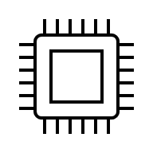


What is mechatronics?
And also:
Automatic Control
Computer Engineering
Signal processing
Electronics
Mechanics
Control technology

Slide 5
A simple mechatronic system
Sensor
Electronic or mechanical
Controller
Tolkar indata
Controllers
Do the work itself
Tires
Hydraulics
Mechanics
Electronics
PLC – Programmable Logic Controller
Dator system
Pressure, sound, light, temperature
Consists of:

Slide 6

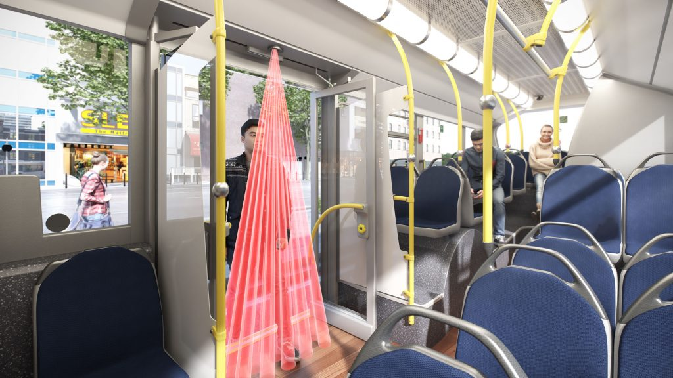
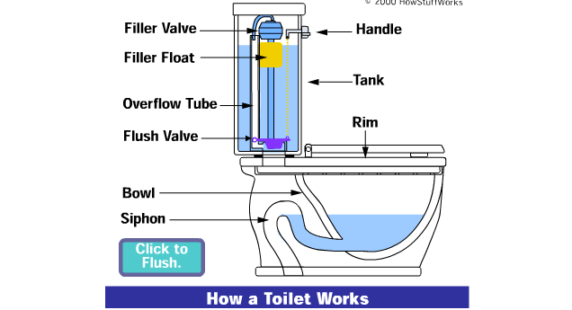
What are the mechatronic systems?
Which systems do you find in your everyday life?
Sensor – Controller – Actuator
Examples: Kettle, Water closet, Bus door, Revolving door in the mall

Slide 7
Challenges with mechatronic systems
What types of sensors are needed? Buttons? Meter? How accurate do they need to be?
Two electrical systems, controllers usually run on 12-24 volts DC voltage, motors and the like often run on 230-380 volts AC voltage.
How should signals from the system be interpreted?

Slide 8




#LCAMP_EU
info@lcamp.eu
www.lcamp.eu
@LCAMP_EU
LCAMP
Learner Centric Advanced Manufacturing Platform for CoVEs

